Slide 1






SCHOOL SAFETY AND SECURITY COORDINATOR TRAINING

Slide 2

TODAY’S TRAINING AGENDA
Part I: Overview, Frameworks,
& Health Related Topics
8:00 - 9:05 am​
Welcome and Purpose Setting​
Intro to Case Study​
Intro to Universal Supports​
Leadership & Appropriate Staffing
9:05 - 9:15 am (Break)​
9:15 - 10:15 am​
Trauma Informed​ Approaches
Behavioral Health Awareness​
10:15 - 10:25 am (Break)​
10:25 - 11:30 am​
Bullying and Suicide Awareness
Substance Use Awareness​
11:30 - 12:30 Lunch
Part II: Physical Safety
& Emergency Preparedness
12:30 - 12:45 pm ​
Welcome Back and Purpose Setting
12:45 - 1:45 pm​
Situational Awareness
Physical Security/Assessments​
1:45 - 1:55 pm (Break)
1:55 - 2:55 pm​
Emergency Prep
Coordination with Law Enforcement​
2:55 - 3:05 pm (Break)​
3:05 - 4:00 pm ​
Emergency Procedures
Wrap up

Slide 3

PRELIMINARIES
ADMINISTRATION
Alarms, Exits, Restrooms
Cell Phones
Lunch
SESSION EXPECTATIONS
Courteous, safe environment
Questions are encouraged
Collaborative
End of session evaluations (Feedback for iterative improvement)

Slide 4

PRELIMINARIES
Training Website:
https://pak12ssstp.org/training/
Notes:
Direct participants to the website for access to all training materials to be outlined on next page.
https://www.pccd.pa.gov/schoolsafety/Pages/default.aspx

Slide 5


PARTICIPANT TOOLS
Participant Manual:
  Print/Webpage
  Appendix I: Pre-work Checklist
  Appendix II: Legal
  Appendix III: Resources
  Appendix IV: Case Study
Notes:
What you are bringing – YOUR expertise and your policies/procedures/documentation
Show Webpage with Slide Deck and Resources
For participants who brought printed manuals, point out how manual is laid out with appendixes at back

Slide 6
REASON AND SCOPE FOR SSSC TRAINING
In 2018, Article XIII-B (School Safety and Security) of the Pennsylvania Public School Code of 1949 created the School Safety and Security Committee (SSSC) within the Pennsylvania Commission of Crime and Delinquency (PCCD). The SSSC was tasked with developing the criteria that schools use to perform school safety and security assessments, measure school safety and security preparedness, and administering grants.
Later amendments to Article XIII-B, including Act 18 of 2019, Act 67 of 2019, Act 30 of 2020, and Act 55 of 2022 created additional responsibilities for the SSSC. Some of these responsibilities include:
The development of a model trauma-informed approach plan.
The development of model trainings for threat assessment teams.
The development of training requirements for school resource officers (SROs), school police officers (SPOs) and school security guards.
The development of school safety and security training standards for school employees and School Safety and Security Coordinators.
Notes:
NOTE: In this training we will use the term SCHOOLS to mean "SCHOOL ENTITITES"
Review legislation that formed School Safety and Security Committee (SSSC) and its responsibilities
Link to training standards for today

Slide 7

School Safety and Security Coordinator Duties
Per Section 1309-B of the PA Public School Code of 1949, coordinators are required to oversee all school police officers, school resource officers, school security guards and policies and procedures in the school entity and report directly to the chief school administrator.
In addition, coordinators have the following specific duties:
Review the school's policies / procedures relative to school safety and security and compliance with Federal and State laws
Coordinate training /resources for students and school staff in matters relating to situational awareness, trauma-informed approaches, behavioral health awareness, suicide and bullying awareness, substance abuse awareness and emergency procedures and training drills, including fire, natural disaster, active shooter, hostage situation and bomb threat.
Coordinate school safety and security assessments, as necessary.
Serve as the school liaison with the committee, the department, law enforcement and other organizations on matters of school safety and security.
Make a report no later than June 30, 2019, and each June 30 thereafter, to the school's board of directors on the school's current safety and security practices.
Coordinate a tour of the school's buildings and grounds biennially or when a building is first occupied or reconfigured with the law enforcement agencies and first responders that are primarily responsible for protecting and securing the school.
Pursuant to Article XIII-E (Threat Assessment) of the PA Public School Code, individuals appointed to serve as School Safety and Security Coordinators must also be a member of their school entity's established Threat Assessment Team(s).
Notes:
You are the first responder, supporter, leader who can help address violence, suicide, bullying, physical security, and emergency response.
Intervene early. Intervene often.
Review the school's policies / procedures relative to school safety and security and compliance with Federal and State laws
Coordinate training /resources for students and school staff in matters relating to situational awareness, trauma-informed approaches, behavioral health awareness, suicide and bullying awareness, substance abuse awareness and emergency procedures and training drills, including fire, natural disaster, active shooter, hostage situation and bomb threat.
Coordinate school safety and security assessments, as necessary.
Serve as the school liaison with the committee, the department, law enforcement and other organizations on matters of school safety and security.
Make a report no later than June 30, 2019, and each June 30 thereafter, to the school's board of directors on the school's current safety and security practices.
Coordinate a tour of the school's buildings and grounds biennially or when a building is first occupied or reconfigured with the law enforcement agencies and first responders that are primarily responsible for protecting and securing the school.

Slide 8
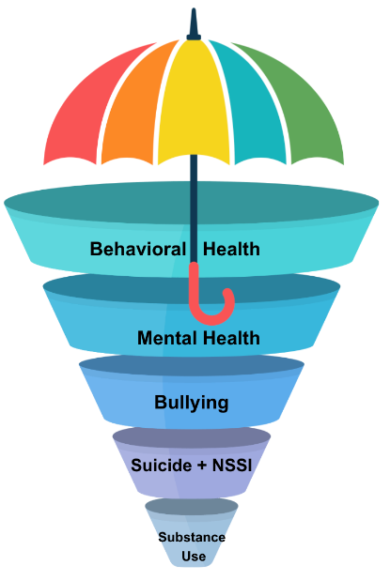
TRAUMA-INFORMED UMBRELLA
Everything done in schools emanates from a trauma informed approach to academics, behavior and climate. It is the umbrella that supports and protects everyone in the school community
Behavioral health
Mental health
  Bullying
Suicide
Substance use
Notes:
Review legislation that formed School Safety and Security Committee (SSSC) and its responsibilities
Link to training standards for today
Everything done in schools emanates from a trauma informed approach to academics, behavior and climate. It is the umbrella that supports and protects everyone in the school community
Behavioral health generally refers to mental health and substance use disorders, life stressors and crises, and stress-related physical symptoms. Behavioral health care refers to the prevention, diagnosis and treatment of those conditions.
Mental health includes emotional, psychological and social well-being. It includes thoughts, feelings, actions and helps determine how we handle stress, relate to others and make choices. Those who experience mental health challenges may show changes in thinking, mood and behavior.
Bullying is unwanted, aggressive behavior among school aged children that involves a real or perceived power imbalance. The behavior is repeated, or has the potential to be repeated, over time.
Suicide may feel like a scary topic and can be terrifying to think that you or a loved one may be considering it. Follow the below steps to assist in helping yourself or a friend or loved one. Call or text 988 (or chat at 988lifeline.org/chat)
Substance use includes the use of illegal drugs and the inappropriate use of legal substances, such as alcohol and tobacco with some physical, behavioral and or social consequences.

Slide 9




INTRODUCTION TO
CASE BASED LEARNING: ALEX

Slide 10

CASE STUDY: MEET ALEX
CHAPTER 1 + 2

Slide 11

ALEX CHAPTER 1: INTRODUCTION
Consider key developmental periods in Alex’s life.
Alex’s story is organized below by the following chapters:
Prenatal through 1-2 Years Old: Intergenerational Trauma
2. 2-3 Years Old: Early Childhood Trauma
3. K- 2nd Grade: Academic, Emotional, & Social Challenges
4. 5-6th Grade: Emerging Behavioral & Academic Challenges
5. 8-9th Grade: Intensifying of Mental Health Challenges
6. 11-12th Grade: Increased Substance Use
Notes:
Narration / Script for Trainer: (PLEASE READ THIS OUT LOUD BEFORE REVIEWING THIS SLIDE)
Examining Alex’s developmental history through a biopsychosocial holistic lens, we can see how his early-life adversity shaped the trajectory of mental health challenges, experiences in school, and later substance misuse.
A biopsychosocial lens refers to an integrative approach to understanding children and families. It is just a way of saying that we are taking into account the biological factors, psychological processes, and social influences when interpreting a person’s behaviors and needs.
This holistic perspective acknowledges that a child’s development and behavior are influenced by the interaction of a combination of things and not just one thing in isolation. Examining Alex’s developmental history through a biopsychosocial holistic lens, we can see how his early-life adversity shaped the trajectory of mental health challenges, experiences in school, and later substance misuse.
A biopsychosocial lens refers to an integrative approach to understanding children and families. It is just a way of saying that we are taking into account the biological factors, psychological processes, and social influences when interpreting a person’s behaviors and needs.
This holistic perspective acknowledges that a child’s development and behavior are influenced by the interaction of a combination of things and not just one thing in isolation.
Narration / Script for Trainer: life, has presented with ADHD, depression, anxiety, and substance use. His story starts much earlier than that though, and today we will use his story to learn more about the topics for todays training.

Slide 12
ALEX CHAPTER 1: INTERGENERATIONAL TRAUMA
(PRENATAL THROUGH YEAR 1-2)
Learn more about Alex's mom, Jackie:
Sexual abuse age 7
Early bouts of depression and anxiety
Cannabis use initiation age 13
Involvement with heroin, drug dealing age 18; pregnancy with Alex
Poverty, job, food and housing insecurity as well as struggling to care for Alex led to relapse
Convicted of possession with intent to deliver opiates; subsequent incarceration
Grandmother awarded custody of Alex
"Unfit mother" or survivor?
Notes:
Narration / Script for Trainer: (PLEASE READ THIS OUT LOUD BEFORE REVIEWING THIS SLIDE) Before delving into Alex's own journey, it's critical to understand Jackie's story, Alex's mother, as it provides vital context to the environment in which Alex was born.
The layers of Alex's trauma exposure find their roots not only in individual circumstances but also in a broader narrative that spans generations.
Alex’s mom, Jackie, reported a year-long period of sexual abuse by a neighbor when she was seven years old. She struggled with bouts of depression and anxiety but did not link these mental health issues to her own trauma that she experienced.
She never told anyone until she entered behavioral health treatment a year ago.
She admitted to trying different drugs at the age of 13 but found using cannabis before and after school helped her “calm down” and get through the day.
At eighteen, Jackie graduated high school and also became pregnant with Alex. Around the same time, Jackie became heavily involved with her dealer, who introduced her to heroin.
When she found out she was pregnant, she stopped using with the help of a treatment center specializing in the care of pregnant women.
The stressors related to finding housing, money for food, and clothing to care for Alex caused her to relapse shortly after she gave birth, and she began dealing again in order to provide for Alex and herself.
Alex was one year old when Jackie was arrested for possession with intent to deliver heroin and prescription drugs that were not prescribed for her. The District Attorney offered a plea deal to her dependent on Jackie naming the larger network of dealers, but she refused. She was then sentenced to two years in the county jail, where she concurrently received drug treatment. At this time, Jackie’s mother (Alex’s Grandmother) was awarded custody of Alex.
Alex's mom struggled with her own intergenerational trauma and accessed treatment and support to cope with her issues. Her steadfast support of Alex throughout his own behavioral health challenges was a major source of strength for him throughout his life.
Jackie faced considerable adversity throughout her own childhood. A potent combination of trauma, poverty, and chronic adversity impacted her journey. What complicated her situation further was the frequent judgment and punitive treatment that she received from multiple systems she encountered, including the health care, educational, and judicial systems.
Jackie's history of intergenerational trauma, combined with periods of drug use, was seldom seen through a trauma-informed lens of empathy or understanding. Instead, it was met with judgment. Within the educational system, she was hastily labeled a "bad student" who was prone to trouble.
These perceptions and stigmatizations followed her into adulthood, with many viewing her as an unfit mother, primarily due to her struggles with substance use. The healthcare system (from its policies and practices to the sideways glance from a nurse who checked her into the rehab program for pregnant women) also treated Jackie like she was not worthy, or less-than. Not surprisingly, the stigmatization impacted her own self-concept, and at times, she began to think of herself through this negative lens.
Unfortunately, the systems that could have offered Jackie support, understanding, and empathy often took a punitive approach, heavily focused on punishment rather than restoration or healing. These punitive responses, rather than addressing the root causes of Jackie's challenges, further traumatized her. Such approaches did little to instill hope or inspire change; instead, they compounded Jackie's pain and further solidified her belief that institutional systems were inherently untrustworthy.
For Jackie the world seemed like a place where mistakes were not lessons to learn from but were damning verdicts on her character. This environment of constant judgment and lack of restorative support inevitably impacted the early nurturing environment she could provide for Alex, setting the stage for the challenges he would later face. With this, the cycle of intergenerational trauma and adversity continued.

Slide 13
ALEX CHAPTER 2: EARLY CHILDHOOD TRAUMA
(2-3 YEARS OLD)
Alex's key developmental challenges related to trauma
Tumultuous early life with housing and food insecurity; mother battled behavioral and mental health challenges.
Early separation from primary caregiver (living with extended family) leading to disrupted attachment and increased anxiety.
Teachers in Head Start Preschool observe Alex as:
  Fussy
  Clinging
  Difficulty with pick-up/drop-off
  Trouble with self-soothing and receiving comfort
Challenging behaviors observed in pre-school setting.
Notes:
Note for speaker: (PLEASE READ THIS OUT LOUD BEFORE REVIEWING THIS SLIDE) Alex’s mother, Jackie, had an available, present, and engaged family system that readily supported her in times of need. Despite this, he didn't know extended family well and this was stressful
Alex's early life was notably tumultuous, characterized by housing and food insecurity and his mother’s intermittent employment and incarceration. Alex's mother, while dedicated, battled her mental health challenges (such as depression and chronic stress related to living in circumstances where she struggled to provide for herself and her child.)
Alex experienced separation from his primary caregiver (during his mother's brief but impactful incarceration), living temporarily with relatives. Alex did not know his extended family very well, so the move to that home was stressful for him. Jackie’s faith community was also a strength for her and Alex. Jackie relied heavily on her mother and aunts as role models and resources for her physical and emotional needs. Although not always able to meet their needs for food and housing, Jackie often thought of their support and messages of hope, and sought them out when feeling overwhelmed, which comforted her.
Upon her incarceration, Alex’s move away from his mom into the home of his extended family resulted in a foundation of instability and insecurity.
During this time, Alex attended a local Head Start preschool, where he enjoyed learning about his colors and numbers. Developmentally, Alex was often described as "fussy" and exhibited behaviors that could be described as attachment-related challenges (difficulty at drop off and pick up at school), clinging to caregivers (grandmother and teacher at times), alternatively seeking physical comfort and resisting it when it was offered, suggesting possible anxiety rooting from those early disruptions in attachment and stable living conditions. t preschool, where he enjoyed learning about his colors and numbers. Developmentally, Alex was often described as "fussy" and exhibited behaviors that could be described as attachment-related challenges (difficulty at drop off and pick up at school), clinging to caregivers (grandmother and teacher at times), alternatively seeking physical comfort and resisting it when it was offered, suggesting possible anxiety rooting from those early disruptions in attachment and stable living conditions.

Slide 14
ALEX CHAPTER 2: HEAD START CLASSROOM
(2-3 YEARS OLD )
The following educational issues can be linked to trauma exposure. Alex’s teachers at Head Start preschool were frustrated by his behaviors, which included:
Throwing toys and destroying things in the classroom.
Fighting with peers.
Frequent meltdown's, inattention, distractibility viewed as willful.
Frequently sent to office for discipline; questioned expulsion.
Judgements about poor parenting causing Alex's behavior issues.
What to Do?
PD in trauma informed approaches over 3-5 years
Recognition that punitive measures were not only ineffective but potentially harmful for children exposed to trauma.
Focus on understanding the root causes
Root causes:
What is the unmet need and/or lagging skill?
Notes:
Note for speaker: (PLEASE READ THIS OUT LOUD BEFORE REVIEWING THIS SLIDE) Some of Alex’s teachers at Head Start were frustrated and annoyed by his behaviors. They didn’t seem to understand why he was so clingy or needy, or that his behaviors were driven by underlying, trauma driven anxiety.
At times, his anxiety was evidenced by behaviors like throwing toys and destroying things in the classroom. At these times, in particular, at least one of his teachers struggled. Her perspective was that Alex needed to be punished and put in a separate area for time-outs. This teacher said, “If his mom actually disciplined him, he wouldn't be such a brat!” She advocated with the director of the Head Start program that Alex be expelled from the preschool. Or, at the very least, his mother should be brought in for a serious “talking to” about how difficult her child was.
Fortunately, the lead teacher in the Head Start classroom and the preschool director had training in trauma-informed approaches, and they were already working towards training the entire staff on these approaches. This shift proved invaluable for Alex’s development and well-being.
The lead teacher and program director recognized that punitive measures like time-outs or the threat of expulsion were not only ineffective but potentially harmful for children exposed to trauma. Instead, by understanding the root causes of Alex's behaviors and using a compassionate, trauma-sensitive lens, the teacher provided Alex with an environment where he felt understood and safe, laying a foundation for more positive interactions and learning experiences.
Because of this approach, his daycare and early school experiences became increasingly positive and supportive

Slide 15

ALEX CHAPTER 2: THE IMPACT
(2-3 YEARS OLD)
Behaviors that Alex's educators observed above the surface:
Clinginess
Difficulty engaging in peer activities
Trouble managing feelings
Reported difficulty sleeping, nightmares
Tantrums, crying
Property destruction when angry
What's going on beneath the surface?
Attachment disruption leads to increased anxiety
Repeated episodes of loss sow seeds of distrust in caregivers
Perception of change in routine or other loss is threatening and activates stress response
Difficulties with social interactions with peers may stem from experience that relationships are transitory and potentially painful
Notes:
Speaker notes: (PLEASE READ THIS OUT LOUD BEFORE REVIEWING THIS SLIDE) Alex's teachers saw the tip of the iceberg: behaviors that were disruptive to his learning, and the learning of others. Punitive, exclusionary and shaming discipline wont fix the behaviors and possibly will make them worse. A trauma sensitive lens provides educators with an opportunity to see whats beneath the surface, and come up with ways to meet Alex's unmet needs (food, safety, connection) and/or lagging skills (emotional regulation, asking for and accepting support, self-soothing).
Alex’s earliest memories were interspersed with moments of chaos and fleeting stability, reflecting a turbulent home environment. This was characterized by food and housing insecurity, with frequent extended family members also in and out of grandmother's home on a regular basis. His grandmother cared for Alex deeply but also had many others who relied on her. At times, this resulted in inconsistent (physical and emotional) availability. At this age, when most infants and toddlers find solace in the predictable patterns of emotional availability, nourishment, and safety from their caregivers, Alex’s world was anything but predictable. Here are some of the ways that Alex was impacted by that early trauma (please see the full case study in your appendix for additional information about each of these)
Attachment Disruption: Attachment theory underscores how important a secure bond between a child and caregiver is, especially during early development. This is a key factor in shaping the child’s perception of the world as a safe or threatening place. For Alex, the caregiver-child bond was tenuously formed and repeatedly disrupted due to several factors:
Inconsistent Availability: Alex’s mother, albeit loving, was inconsistently available both emotionally and physically due to her struggles with mental illness, drug use, and subsequent incarceration. This inconsistency contributed to an insecure attachment, as Alex learned that the availability of the caregiver was unpredictable.
Parental Mental Illness and Addiction: Witnessing the mother’s struggles with behavioral health and observing or being indirectly involved in her crises likely contributed to Alex’s feelings of anxiety. Children naturally perceive their parents as providers of safety, but when roles inadvertently and subtly begin to shift, even momentarily, the child may develop anxious tendencies.
Separation: Periodic separation from the mother, the primary caregiver, during times of incarceration or crises meant Alex experienced repeated episodes of loss. These separations disrupted the formation of a consistent and secure attachment, embedding a belief that associated attachment figures with pain and instability.
Behavioral Manifestation: In these formative years, Alex's behaviors and emotional expressions mirrored the internal and external chaos in the following ways:
Clinginess: Alex displayed clinginess and separation anxiety when interacting with consistent adults, like his grandmother, reflecting an anxious attachment style. The clinging was a manifestation of fear of repeated abandonment or sudden loss, and thus, any semblance of separation, even momentarily, was perceived as threatening.
Difficulty in Social Interactions: During play, Alex did not participate but preferred to observe peers playing, reluctant to engage fully. This social hesitancy may have stemmed from an intrinsic belief, shaped by early experiences, that relationships and connections are transitory and potentially painful.
Emotional Dysregulation: Alex exhibited difficulty in managing emotions, with frequent crying, tantrums, or withdrawing behaviors when needs were not immediately met. This was not merely a reflection of toddler frustration but possibly a reflection of the emotional chaos and unmet needs experienced within his environment.
Sleep Disturbances: Nightmares, night waking, or resistance to bedtime were also prevalent, as nighttime may have been associated with the unpredictability and fear of not having needs met.

Slide 16
PARTICIPANT REFLECTION
What are some of the protective factors that you notice in Alex’s life?
What do you notice may be the early stressors that Alex is experiencing?

Slide 17

UNIVERSAL SUPPORTS AND STRATEGIES

Slide 18
UNIVERSAL STRATEGIES AND SUPPORTS
SSSCs are called to be leaders and partners (administration, school employees, students, and families) to:
Cultivate a positive, connected school environment
Support wellness of students and staff
Focus on each student having a positive relationship with a caring school adult
Strengthen student protective factors
BIG IDEA: Students who have a strong connection with one person (non-family member) have higher levels of positive support, engage in less risky behavior, and have increased levels of overall well-being.
Notes:
School Safety and Security Coordinators in partnership with administration, school employees, students, and families can be leaders in creating safe and supportive school environments that strengthen the conditions for greater student and staff wellness. Universal strategies for creating safe and supportive environments and greater wellness include having positive relationships with caring adults, strengthening student protective factors, and cultivating a positive, connected school climate.
Having positive relationships with caring adults in schools is an important factor in a child’s life. According to the Search Institute, students who have a strong connection with at least one non-family member have higher levels of positive support, engage in less risky behavior, and have increased levels of overall well-being. They are also more likely to be engaged in school and more motivated to succeed academically.
What are the critical components of a positive relationship with a school adult that help students thrive? The Search Institute, a leading center of research and practice on positive youth development and the advancement of equity see this as adults…
…showing they care.
…challenging young people to be their best selves while providing ongoing support.
…sharing power and showing respect…. and
…expanding young people’s sense of possibilities and opportunities.
As the School Safety and Security Coordinator, you are an integral part of the team who can ensure that each student has a positive caring relationship with at least one adult at school. Positive, connected relationships may make it more likely that students will notify an adult when they or their friends are struggling; and once notified, you can connect them with the appropriate support at school and in the community - in this way, you become a protective factor that can safeguard student mental health and wellness.

Slide 19
UNIVERSAL STRATEGIES AND SUPPORTS
  Protective factors support wellness and reduce both the likelihood of mental and behavioral health concerns as well as the intensity and progression of diagnosed mental health disorders.
Positive, connected relationships
Opportunities for pro-social involvement such as clubs and sports
Connection to school and the ability to contribute
Positive peer relationships
Social skills development
Supporting emotional regulation of adults and students
Good decision-making skills
Planning and goal setting skills
Schools, families and communities work together to strengthen these.
Center for Disease Control, 2022; Communities that Care Model, 2023; Pennsylvania Youth Survey, 2021.
Notes:
Before we move on to look at established mechanisms for intervention and support for students with identified concerns, it’s worth reflecting on the factors that are most likely to reduce the likelihood of, in particular, mental and behavioral health concerns, but also the intensity or progression of mental health disorders. These are termed protective factors. According to the CDC, (2022) the following protective factors may provide some insulation for children from social and emotional harms.
Examples of individual characteristics that may serve as protective factors for students:
positive self-worth
social and emotional skills, such as self-management, compassion for others, effective communication, resolving conflict and expressing gratitude
Positive, connected relationships
good decision-making skills
self-control
planning and goal setting skills
Likewise, the Communities that Care model (CTC, 2023), a five-phase process that seeks to promote healthy youth development and reduce problem behaviors, provides a framework to increase protective factors through daily interactions with children and adolescents. The protective factors listed below may buffer youth with high levels of risk factors from developing health and social problems.
CTC protective factors:
opportunities for pro-social involvement in the community
positive parent and family involvement
feeling connected to school and able to contribute to the school community
positive peer relationships
social skills
the ability to regulate emotions
Similarly, the Pennsylvania Youth Survey (PAYS, 2021) findings suggest that there are several protective factors associated with mental health and wellbeing. Chief among these are positive, connected relationships. Sixty percent of recent PAYS respondents reported positive family attachments as the most important contributing factor to their wellbeing. While this is not something school personnel can necessarily influence in any substantive sense, it is important to know that positive bonds within families are protective. Ultimately, this means that we can identify a possible risk factor for mental and behavioral health challenges where these family relationships do not exist or are breaking down.
Opportunities for prosocial involvement, such as participation in clubs, sports, and other activities, were also reported as important protective factors. This highlights how a school’s approach to fostering positive student engagement in the school community can act as a powerful support for mental and behavioral health and wellbeing. Finally, interactions with prosocial peers was identified as an important protective factor.
When a child has been identified as in need of support due to a behavioral health concern, schools can use any combination of the programmatic interventions discussed in the next sections to surround the child with support in a scaffolded manner to facilitate their growth and recovery.

Slide 20
UNIVERSAL STRATEGIES AND SUPPORTS
  BIG IDEA: When children feel safe at school, they are more likely to develop trust in the teachers and staff who support them, when they trust in their teachers and other staff, they are more likely to act in a cooperative manner.
  Positive, connected School Climate:
Combats bullying and harassment
Creates conditions for students to feel safe and to trust school adults
Increases engagement and cooperativeness
Notes:
When schools focus on cultivating a positive, connected climate where adults address concerning behaviors, they can insulate children from harm. Schools can work to intentionally combat bullying and harassment by attending to school culture and climate. School leaders can work to establish a school-wide culture of inclusion and respect that is welcoming to all students.
When children feel safe at school, they are more likely to develop trust in their caregivers, when they trust in their caregivers, they are more likely to act in a cooperative manner. Children who feel safe and trust adults at school may also be more likely to report mental health concerns, bullying behaviors, and other behaviors of concern. All members of the school community can contribute to the development of a positive school culture.
● School leaders can provide professional development to all staff identifying behaviors of concern and teach them ways to intervene and refer… when relevant… to the appropriate staff member when they witness concerning behaviors. They can also survey students about when and where concerning behaviors such as bullying and harassment are happening at school. Leaders can then create supervision schedules that ensure hot spots where bullying and harassment occur are being consistently monitored by adults. School leaders can also ensure that all stakeholders know how to report concerning behavior and to whom to report it. This information can be distributed as a part of the school’s bullying prevention program, which can be a component of the schoolwide positive behavioral support systems sometimes known as PBIS in alignment with the school’s Student Assistance Program … referred to as SAP.
● Teachers can develop, teach and reinforce expectations for respectful classroom behavior. They can provide intentional, responsive supervision by not leaving their class unattended, addressing bullying behavior when they witness it, and being a role model for respectful treatment of others. Teachers can refer students to the appropriate staff member and their Student Assistance Program when they have concern about student mental health, wellbeing, and/or safety.
● School Staff can be intentional and vigilant in their monitoring of student behaviors in common areas where bullying and harassment are more likely to occur such as hallways, the cafeteria, buses, and other non-classroom settings. The visible presence of adults is a powerful deterrent to bullying and other negative behaviors. Staff can refer students to the appropriate point of contact and their Student Assistance Program when they have concern about student mental health, wellbeing, and/or safety.
● Parents and Guardians can establish a consistent routine of checking in with their child about how things are going at school, both academically and socially. When parents make conversations about social interactions, online and in person, a routine part of conversations with their children - without overreacting or going into lecture mode – they position themselves as a source of help and support should the need arise. Parents can also lean into their role as educational partners by contacting the school if they become aware of behaviors of concern (DHHS, 2017).
● Students are often witnesses to bullying and harassment that happens in person or online. They are also likely to be the person a student in distress will reach out to for support. Students can help to improve school climate and make school feel safer for everyone by being good bystanders when they witness bullying and other behaviors of concern. It is important for students to understand their bystander role and report bullying or other concerning behavior to a school official or trusted adult as well as through their schools Safe2Say and Student assistance Program referral process.

Slide 21
OVERVIEW OF THE STRATEGIES AND SUPPORTS FOR INTERVENTIONS
The Pennsylvania Student Assistance Program (SAP) is a systematic team process focused on identifying and addressing barriers to a student's learning
Multi-tiered Systems of Support (MTSS) and Positive Behavioral Interventions and Supports (PBIS)
Notes:
SAP is designed to address any barrier a student may be experiencing (e.g., academic, behavioral, physical, etc.).
SAP is also structured to assist in identifying and addressing potential concerns related to alcohol, tobacco, other drugs, and mental health issues which pose a barrier to a student’s success.
SAP does not provide treatment, diagnosis, or referrals to treatment.
SAP teams mobilize school resources to remove barriers to learning while identifying potential resources within the building.
Where the challenge is beyond the scope of the school, the SAP team (with support from SAP liaisons (where applicable) from community mental health and/or drug and alcohol agencies) assists parents and guardians and the student with information so that they may access appropriate services in the community.
Multi-tiered Systems of Support (MTSS) can help in determining the specific mix and intensity of strategies appropriate to the level of concern presented by a student.
Positive Behavioral Interventions and Supports (PBIS) is one example of MTSS that emphasizes social emotional and behavioral skills.

Slide 22

INTERVENING AND SUPPORTING STUDENTS
  Opportunities for Connection
  When a child shares sensitive information:
Stay calm
Acknowledge that you hear them and care about their well-being
Let them know they can receive help and support
Tell them you will share their concern with other supportive adults in the school
What do you do if children share that someone is hurting them, they are thinking of hurting or killing themselves or others, or that they are struggling with substance use?
Follow Mandated Reporting Laws (Act 126)
Concerns can be reported to:
A school counselor, school social worker, or school psychologist
An administrator
A supervisor
Notes:
What opportunities do we have to identify a student who is struggling and who should we report our concerns to?
Throughout a child’s day, whether during the school day or after-school activities, we have numerous opportunities to engage with children and observe their behaviors. As we develop trusting relationships with children, they may share their problems or feelings with us. This is a sign that the child feels safe and connected to us. Children might share that someone is hurting them, that they are thinking of hurting themselves or others, or that they are struggling with substance use. Each of these disclosures represents a serious concern that must be reported to the proper adult or agency including mandated reporting procedures when relevant. When a child shares a serious concern or mental health issue, it is important to stay calm. Acknowledge that you hear them, care about their well-being, and will help them to find the support they need. Do this is a non-judgmental manner that validates the student’s feelings or thoughts they are sharing. Thank the child for sharing their concern and let them know that you will share their concern with other supportive adults at school so that they can receive the help and support they need. Regardless of the role you have in schools, identifying and reporting behaviors of concern in the students in your school should be a top priority. It is essential that you know with whom to share any child’s behavior that is concerning to you.
Schools have processes to refer students to school-based teams to follow through on reported concerns; always follow the law and the policies and procedures set up by your school entity when reporting concerns. School employees should understand that the concerns they have are valid, no matter if, when examined in more detail, it is determined that the student does not need any specific help. All school employees can use the Safe2Say Something Program to report concerns; however, concerns regarding the Keep Kids Safe guidelines must be made in compliance with that law, and the policies and procedures set up by your school entity.
Note: if a child reports anything that falls under the mandated reporting requirements (see Act 126 for more information), be certain to follow the Keep Kids Safe guidelines and the policies and procedures set up by your school entity related to substance abuse and other policy violations/concerns.
Regardless of your school’s structure, the following is a list of people you can report concerns to:
A school counselor, school social worker or school psychologist.
A school nurse.
An administrator.
Your supervisor.
Note: if a child reports anything that falls under the mandated reporting requirements (see Act 126 for more information), be certain to follow the Keep Kids Safe guidelines and the policies and procedures set up by your school entity related to substance abuse and other policy violations/concerns.
Once reported, the aforementioned is shared with one or more of these people, they will coordinate to determine which intervention and support systems embedded in the school would best address the concerns you report.
The below strategies can be used to intervene and support students experiencing a myriad of behavioral health and developmental concerns. We will be returning to these strategies for intervention and support throughout the next two hours.

Slide 23

METHODS FOR INTERVENTION AND SUPPORT
FOR STUDENTS WITH IDENTIFIED CONCERNS
Student Assistance Program (SAP) is:
Mandated by state law
All schools are required to have SAP services available for any student in grades K-12.
The SAP process includes four phases:
Referral
Data collection
Action planning
Follow-up
SAP Team Members
Notes:
The Pennsylvania Student Assistance Program – more usually known as SAP is a systematic team process focused on identifying and addressing barriers to a student’s learning. SAP is designed to address any barrier a student may be experiencing (e.g., academic, behavioral, physical, etc.). However, by design, it is also structured to assist in identifying and addressing potential concerns related to alcohol, tobacco, other drugs, and mental health issues which pose a barrier to a student’s success. SAP does not provide treatment, diagnosis, or referrals to treatment. SAP teams mobilize school resources to remove barriers to learning while identifying potential resources within the building. Where the challenge is beyond the scope of the school, the SAP team (with support from SAP liaisons (where applicable) from community mental health and/or drug and alcohol agencies) assists parents and guardians and the student with information so that they may access appropriate services in the community.
SAP is Code-mandated Section 1547 of the School Code and 22 Pa. Code 12.42, and all school entities are required to have SAP services available for any student in grades K through 12.
Note that, in line with the Protection of Pupil Rights Amendment students’ and parents’ rights are required to be recognized and respected, and parents or guardian active consent is required for SAP. SAP is voluntary for students and parents.
The SAP process includes four phases: referral, data collection, action planning, and follow-up. Based on data gathered through the SAP process, a structured action plan may be developed with recommended strategies to address student needs via in-school and/or community-based supports and services. If the data gathered by the SAP team indicates a possible underlying mental health or drug and alcohol concern, a SAP liaison may screen or assess that student to obtain additional recommendations. They may also make a recommendation for interventions, including:
School-Based Academic Supports which range from general academic support that most students can access, such as tutoring, to more specific targeted interventions such as special education services.
School-Based Counseling Interventions, including one-to-one counseling with school counselors, psychologists or school social workers, or crisis interventions
Community-Based Supports, including recommendations for outpatient or inpatient psychiatric referral following suicide screening conducted by a school employee.
SAP Team Members
The multidisciplinary SAP team is comprised of school and community agency personnel. School personnel include teachers, administrators, counselors, social workers, and nurses who receive specialized training to work cohesively with , families, and school staff.
Specialized SAP Team roles include:
The SAP Coordinator - provides organization, leadership and facilitation of SAP team in each building ensuring the process operates with fidelity to the PA Model.
The Case manager - actualizes and monitors the action plan, acting as the key point of contact for the student, family, and school staff. The case manager monitors and supports students to achieve goals of action plan.
The Community based SAP Liaison - provides consultation, screening and when necessary, linkage to community resources that best meet the student’s needs. Not every entity that has a SAP team may have a community based liaison.
The Administrator actively participates in SAP team meetings, supports the team with time and resources for ongoing professional development and maintenance of the process. In addition to consequences, administrators promote SAP as the mechanism for assisting students who may have violated a school policy.
While SAP support is tailored to meet the needs of individual students, schools may consider how to integrate or align SAP with other team-based initiatives, such as Multi-Tiered Systems of Support (MTSS) and Positive Behavioral Interventions and Supports (PBIS).

Slide 24
INTERVENING AND SUPPORTING STUDENTS
Pennsylvania’s Multi-Tiered Systems of Support (MTSS) is
Standards-aligned
Framework for enhancing academic, behavioral and social-emotional outcomes for all students.
Multi-Tiered Systems of Support MTSS must be implemented with:
Attention to equity
With a trauma-informed lens
Increasingly intensive interventions
Notes:
MTSS can help in determining the specific mix and intensity of strategies appropriate to the level of concern presented by a student.
“Pennsylvania’s MTSS is a standards-aligned, comprehensive school improvement FRAMEWORK for enhancing academic, behavioral and social-emotional outcomes for ALL students.”
Pennsylvania Training and Technical Assistance Network (PATTAN), Multi-Tiered Systems of Support
https://www.pattan.net/Multi-Tiered-System-of-Support/MULTI-TIERED-SYSTEM-OF-SUPPORTS
To be most effective, MTSS must be implemented with attention to equity and through a trauma informed lens. In its application to students of concern for behavioral and mental health issues, MTSS can be used to develop universal, targeted, as well as individualized interventions proportional to the level of concern established through data collection and review. These are components of the wider program efforts to build and maintain safe, secure, and positive school environments.
MTSS is a tiered approach, with increasingly intensive interventions applied to the smaller number of students presenting the most concern.

Slide 25
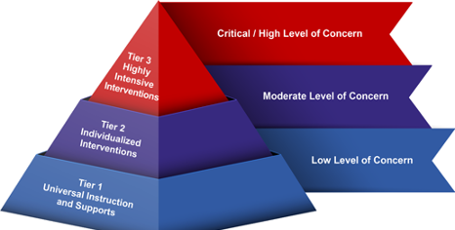
Pennsylvania’s Multi-Tiered Systems of Support (MTSS)

Slide 26
TIER 1:
INTERVENING AND SUPPORTING STUDENTS
Tier 1 of MTSS includes universal interventions provided to all students in the school population.
At Tier 1, interventions are focused on:
Connection and relationships that all students receive
Teaching Practices that all students receive
Schoolwide Programs to Support School Climate
Notes:
Tier 1 of MTSS comprises universal interventions provided to all students in the school population, recognizing the fact that healthy behaviors and school climate are closely linked.
At Tier one, the focus is on prevention and the development of skills. Universal practices and support are delivered through whole school opportunities for development of academic, social emotional, and behavioral skills. Activities can include development of common expectations and language, curriculum delivered in classroom lessons, and through school – wide initiatives.
At Tier 1, interventions are focused on:
Connection: Helping students to feel a sense of belonging at school and have a positive, healthy connection to an adult. The objective is to enable students to feel safe at school, free from bullying and harassment and supported by warm, positive relationships between staff and students, which promote a culture of respect and trust.
Teaching Practices: Positive classroom management strategies are used, and clearly stated behavioral expectations are communicated. Teachers use instructional methods that reflect the diversity of cultures present in the classroom, and the learning environment is organized, consistent and respectful.
Schoolwide Programs to Support Climate: The school employs data systems to identify early warning signs of poor behavioral outcomes in students and provide immediate intervention, and, among different strategies, will have programs to prevent bullying, and, generally, to teach Social Emotional Learning … typically referred to as SEL or character building, content with all students. These lessons can be centrally important to supporting a positive, prosocial school community that is so important in minimizing risk for negative behavioral and mental health outcomes, and might involve activities or narratives such as:
Promoting healthy coping strategies such as talking with a trusted adult, engaging in physical activity, and breathing exercises.
Teaching students to identify emotions.
Reminding students to engage in problem solving when they feel emotionally overwhelmed.
Helping children to make a list of supportive adults who are available to them as sources of support, which might include parents, guardians, and other caregivers, teachers, counselors, other school staff, coaches, faith leaders, or extended family members.
Exercises – games and activities – that help to build self-confidence and healthy self-esteem.

Slide 27
At Tier 2, targeted interventions address a specific, identified population of students in need of additional services on top of Tier 1 approaches.
Tier 2 examples could include:
Small group counseling
Intervention Team
Additional Tier 2 Interventions:
Daily check in /check out
Use of behavior contracts to monitor daily behaviors and celebrate even small successes in behavioral change.
Restorative practices
The assignment of a mentor
TIER 2:
INTERVENING AND SUPPORTING STUDENTS
Notes:
At Tier 2, we will see targeted interventions, provided to address a specific, identified population of students in need of additional services layered on top of Tier 1 approaches; typically, around 10% to 15% of the total school population might, at any one time, be receiving Tier 2 interventions. Examples of targeted interventions that may be provided in Tier 2 include:
Small group counseling: Group counseling can be provided by the school counselor, school social worker, school psychologist or other school-based mental health professional . Counseling groups tend to be short term, psychoeducational in nature, and focused on skill building or targeted themes to address specific concerns (grief being an example). All student participants are screened for group membership. Parental permission is obtained prior to students participating in small group counseling or any activity that is beyond what is delivered to the general student population within the regular classroom setting. Counseling groups can provide targeted support to help children to develop coping, self-regulation or peer relationship skills.
Intervention Specialists’ Team, also known as, Intervention Team: This team establishes supportive practices for students identified as needing Tier 2 support. Members of the team make sure students have access to interventions, oversee implementation, and monitor progress to evaluate how successfully the student’s needs have been addressed. Because the team is focused on the single student, they are well-placed to build rapport, decrease isolation, problem solve legitimate grievances, provide feedback and mentoring, and monitor reactions to interventions and events that might trigger negative behaviors or episodes where an individual’s mental health disorder presents acutely.
Other Tier 2 interventions: At Tier 2, in addition to what we have discussed here, there are a very wide range of other interventions schools might consider, including:
Daily check in /check out with students in need of support.
Use of behavior contracts to monitor daily behaviors and celebrate even small successes in behavioral change.
Restorative practices including restorative circles – an approach to building and restoring relationships through sharing views in an open, facilitated forum where perceptions and attitudes can be positively re-set.
The assignment of a mentor who can establish a positive, connected relationship with the student in need of services.
May want to differentiate here between psycho-educational group programs on themes/topics vs. therapeutic group counseling
Maybe think about these as short-term skill building rather than counseling as counseling typically occurs more in Tier 3.

Slide 28
  At Tier 3, individual-intensive support is provided to a small number of students.
School-based special education services
Positive Behavior Support Plan
Safety Plan
Ongoing in school counseling
Consideration of change in educational placement
Referral to community supports
Wrap-around approach reflecting multi-agency involvement may be required at Tier 3. These services may include:
Referral for mental health assessment.
Assessment for short-term placement
Wrap-around services for student and family members.
TIER 3:
INTERVENING AND SUPPORTING STUDENTS
Notes:
At Tier 3, individual-intensive support is provided to a small number of students – perhaps only 3 to 5% of the school population – who are in need of ongoing, multi-component interventions. Owing to the specialized nature of intervention at Tier 3, the information provided in this training is kept at a high level only for general awareness as the responsibility for assessment of need and referral or implementation will rest with specifically trained student-specific teams comprised of professionals – both internal staff and external service providers as well as other individuals from the community. Some examples of these highly intensive, individualized interventions and supports are:
School-based special education services, including small group classroom instruction.
Development of a detailed Positive Behavior Support Plan – based on the results of a Functional Behavior Assessment, or FBA
Increased supervision and monitoring where appropriate, such as when a student poses a risk to self or others and remains in school. (Safety Plan)
Ongoing counseling which may be provided by the school psychologist, school social worker or school counselor.
Consideration of change in educational placement or referral to alternative education placement.
Referral to community supports, including behavioral healthcare providers.
Wrap-around approach reflecting multi-agency involvement may be required at Tier 3. These services may include:
Referral for mental health assessment.
Assessment for short-term placement at a behavioral healthcare facility.
Wrap-around services for the student and their family members.
Most school personnel do not need to understand all of the components of the continuum of care for mental health services. However, it is important for everyone to understand that services range from least intensive to most intensive. Outpatient services (which may be delivered in school or community settings) are considered least intensive, followed by services like Intensive Behavioral Health Services (IBHS), family-based mental health services delivered in the home, to hospitalization, including partial hospitalization and inpatient treatment. The specific service array and availability may vary across the Commonwealth.

Slide 29
CRISIS SITUATIONS THAT WARRANT
AN IMMEDIATE RESPONSE
BIG IDEA: There are specific situations which warrant immediate referral
Thoughts or behaviors to harm self
Thoughts or behaviors to harm others
School Re-entry Plans
Should be collaboratively created
Helps students feel safe and supported when they return to school
Notes:
There are specific situations which warrant immediate referral to a designated team or individual within the school for further screening/assessment and follow-up. These include:
Thoughts or behaviors to harm self (e.g. Suicide Screening and Referral), these topics will be covered in the suicide and bullying awareness module.
Thoughts or behaviors to harm others (e.g. Threat Assessment ; for more information on Threat assessment, see Pennsylvania K-12 Threat Assessment Technical Assistance and Training Network)
School Re-entry Plans
If students are placed outside of the school for academic or behavioral health services, a school re-entry plan should be collaboratively created with the school-based team, the child’s family, and the child’s community behavioral health provider, and any other community agencies that may be involved. (e.g. Child Welfare, Juvenile Justice).
The aim of these plans is to help students feel safe and supported when they return to school from a psychiatric hospitalization, treatment program, or alternative school placement. These plans, developed in collaboration between caregivers, the student and the school, will list actions to be taken by the school, caregiver, or student; will assign actions to a named individual, typically, a case manager responsible for implementation and oversight, and set in place mechanisms to ensure monitoring of the plan by the case manager who will engage in ongoing communication with the student, caregivers, school staff and any outside providers.
As School Safety and Security Coordinator, it is important that you be familiar with the different teams and individuals in your school entity who can provide student supports, as well as the community-based providers that collaborate with your school entity, so that you can assist in facilitating communication and mobilizing the appropriate teams and staff to assist when needed.

Slide 30

LEADERSHIP AND APPROPRIATE STAFFING

Slide 31
LEADERSHIP AND APPROPRIATE STAFFING
Name of Relevant Sections: | Section 1309-B “School Safety and Security Coordinator | Section 1310-B of Public School Code “School Safety and Security Training” | Sections 1301-C – 1315-C “Article XIII-C - School Security”
Applies to (Relevant to): | School Safety and Security Coordinators (SSSC or coordinator) and School Administrators. It is the chief school administrator (i.e. superintendent in public school or career / technical school, executive director of IU, or CEO of charter school) who appoints the SSSC. | This section applies to school employees and the school safety and security coordinator and/or administrator who oversees training of employees. | This Article applies to the same chief school administrator (responsible for managing school safety) and provides important guidelines, powers and duties for school security personnel (i.e. school police officer, school resource officers, school security guards, etc.).
Purpose (What it does): | This section outlines the requirements for appointing a SSSC within a school entity and describes the duties that the SSSC is legally responsible for. | This section mandates training on school safety and security for employees of school entities. It aims to ensure that school employees are well-equipped and regularly trained in various aspects of school safety and security, adapting to the specific needs and circumstances of their school entity. | This section provides key definitions for the various terms related to school safety and security personnel. This section is integral in setting the framework for understanding roles and responsibilities of school security personnel within Pennsylvania's educational institutions.
Permits (or Requires): | Requires that the SSSC oversees school police officers, resource officers, security guards, and safety policies, reporting directly to the chief school administrator. Also requires that SSSC review safety policies, coordinate training for safety and emergency procedures, oversee security assessments, liaise with various agencies on safety matters, report annually to the school board, and coordinate tours of the school for law enforcement and first responders. Also notes their training requirements. | School entities must provide two hours of training annually for their employees on a range of subjects based on the needs of the school entity. The topics include: situational awareness, trauma-informed approaches, behavioral health, suicide and bullying awareness, and substance use awareness. School entities must provide one hour of training annually specifically on emergency training drills (e.g., for fire, natural disasters, active shooters, hostage situations, and bomb threats) and the identification of student behaviors indicating potential threats are required annually. | It provides multiple definitions, but some of the most salient of these are: School Police Officer: School Resource Officer: School Security Guard:
Notes:
Overview https://www.pccd.pa.gov/schoolsafety/Pages/default.aspx
As the appointed School Safety and Security Coordinator (SSSC) for your School Entity, you have been entrusted with some of the most important aspects of school leadership. The responsibilities associated with your role as a SSSC range widely and include knowing and understanding the laws which govern all aspects of School Safety and Security; understanding key aspects of child and adolescent mental health, behavioral health, and trauma-informed practices; creating best practice, developmentally appropriate safety drills; and providing the leadership skills and knowledge necessary to ensure appropriate emergency operations planning is created, maintained, and used when necessary.
What Makes this Important to Me?
All your job responsibilities as your school entity’s School Safety and Security Coordinator are framed and upheld by relevant Pennsylvania and Federal Laws and Regulations. Additionally, your school entity’s policies and procedures provide an additional framework for your work.
The following laws and regulations reviewed here are the most significant for your role. You should have a high-level understanding of these laws and regulations to ensure that your school entity is in compliance with them.
PUBLIC SCHOOL CODE OF 1949. Act 14 of 1949 (or the Public School Code of 1949) is the over-arching statute governing the public school system in Pennsylvania. It also includes certain provisions that are applicable to private and parochial schools. The following list includes sections of the Public School Code that influence the work of school safety and security and are relevant for this training.
This section of the PA School Code is perhaps the most important section for School Safety and Security Coordinators. It outlines the requirements for appointing a School Safety and Security Coordinator within a school entity and the specific duties of a Coordinator. Key points include:
Appointment: The chief school administrator must appoint a school administrator as the coordinator by August 31, 2018.
Deadline and Vacancies: Appointments must be made within 30 days after the section’s effective date or within 30 days of a vacancy.
Notification: Schools must submit the coordinator's name and contact information to the state’s School Safety and Security Committee within 30 days of the appointment.
General Duties: The coordinator shall oversee school police officers, school resource officers, security guards, and safety and security policies, reporting directly to the chief school administrator.
Specific Duties: The coordinator shall:
Review safety and security policies for the school entity and ensure that they comply with state and federal laws;
Coordinate training and resources for students and staff in matters relating to situational awareness, trauma-informed approaches, behavioral health awareness, suicide and bullying awareness, substance abuse awareness and emergency procedures and training drills, including fire, natural disaster, active shooter, hostage situation and bomb threat;
Oversee security assessments;
Serve as a liaison with the School Safety and Security Committee, the Department of Education and law enforcement and other organizations on matters of school safety and security;
Report annually (by June 30th of each year) to the school board regarding the school entity’s current safety and security practices and strategies to improve safety, and submit a copy of the report to the School Safety and Security Committee; and
Coordinate tours of school buildings and grounds with law enforcement and first responders. This is required biennially or when a building is newly built or reconfigured.
In addition to these major laws , the SSSC is responsible for understanding all other laws and regulations covered in the Laws appendix document.
School Police Officer: A law enforcement officer employed by a school (or appointed) responsible for maintaining order and security in schools. See 1306-C for additional clarity on power and duties.
School Resource Officer: A law enforcement officer stationed in a school based on an agreement between the school and a law enforcement agency.
School Security Guard: An individual, employed or contracted, who provides routine safety and security duties in a school without certain powers granted under section

Slide 32

LEADERSHIP
Per Section 1309-B of the PA Public School Code of 1949, coordinators are required to oversee all school police officers, school resource officers, school security guards and policies and procedures in the school entity and report directly to the chief school administrator.
Notes:
Section 1309-B of the Public School Code provides legal duties related to your role as the School Safety and Security Coordinator. We will revisit this law many times throughout this training. For purposes of leadership, one of your legal duties includes the drafting and delivery of a report made to your school entity’s board of directors by June 30 of each year. This report must include the school entity’s current safety and security practices and the identification of strategies to improve school safety and security. This report is protected from the “right to know” law and must be presented during the school entity’s board meeting during an executive session, which means the meeting is not open to the public. This is so sensitive security information is not made public. Your board of directors (or Joint Operating Committee or Board of Trustees) may direct you to include certain elements in this annual board report through an adopted board policy. Some of the subjects that the board of directors will often request might include:
Threat assessment team information.
Reports of completed emergency preparedness, fire, bus evacuation and school security drills.
Information on required school safety and security training and resources provided to students and staff.
Safe2Say Something aggregate data.
Behavioral health and school climate information, including aggregate data from surveys.
Updates regarding the Memorandum of Understanding with local law enforcement agencies.
Updates to laws, regulations and/or policies related to school safety and security.
Information on tours, inspections and/or School Safety and Security Assessments that have been completed.
Information on grants or funding applied for and/or received in support of school safety and security efforts.
Note: A SRO is not a direct employee of the school entity, but they should have an understanding of the school entity’s policies and procedures, Emergency Preparedness Plan. If there is a question, direct them to district leadership, their police department or the school solicitor.

Slide 33

LEADERSHIP
IMPORTANT PRACTICES:
Working with key stakeholders to establish policy and procedures:
Who are the key stakeholders?
Why is having a broad range of stakeholders important?
Establishing and maintaining clear goals when planning:
Alignment of goals
Setting clear goals
Notes:
Importance of working with key stakeholders to establish policy and procedures for school safety and security.
With the previous covered laws and regulations providing a foundational framing for the work required of all Pennsylvania school entities, your role as the School Safety and Security Coordinator is to work with key stakeholders to establish relevant school safety and security policies and procedures for your school entity. At a minimum, key stakeholders should include: your school entity’s legal counsel, your school board (or Joint Operating Committee or Board of Trustees), representatives from your school entity’s administrative team, an expert in Special Education, all school employee groups, students, community members, relevant first responders and law enforcement, and local mental health and behavioral health community providers. This multi-disciplinary team of key stakeholders will provide numerous perspectives which will ensure that the policies and procedures developed for your school entity cover all stakeholders.
Policies are overarching governance documents that are adopted or revised by your school board at a public meeting, demonstrate compliance and provide direction, and apply to your entire school community. Procedures, or administrative regulations or guidelines, are documents designed to implement the high-level policies with step-by-step processes and details; they are typically approved by the chief school administrator and serve as directives to staff and students. This is important to note when it comes to school safety and security because policies will always be public-facing documents and should address information like the requirement for all doors to be locked after the start of the school day, with one designated entrance. Procedures, administrative regulations or guidelines are more detailed—they may be provided publicly sometimes, but other times they will be retained securely, such as when they detail the process for using a panic button or initiating a lock down.
Importance of establishing and maintaining clear goals when planning.
As you work to create, implement, and engage in constant review and improvement of all of your school entity’s school safety and security planning, it is essential for you to develop clear, realistic goals and strategic planning with your key stakeholders. These goals and plans should align with the other essential goals and plans laid out in your school entity’s comprehensive planning process. School safety and security planning should not be expected to outline in detail every aspect of your strategy, but it does need to set clear goals. When you are reviewing your goals, ask yourself:
Is this goal a means to an end, or an end in itself?
If it is a means to an end, is that the most important end?
Is this the best means to that end?
Are your goals measurable, accountable and have a defined timeframe?

Slide 34
LEADERSHIP
Role of communication when planning:
  Ensure school staff are aware of the most current theories and practices regarding school safety.
  Ensure that discussion of school safety theories, practices and policies are a regular aspect of the school’s culture.
Notes:
The role of communication when planning
One of the most essential elements for ensuring that all stakeholders involved with upholding the school safety and security policies and procedures can do so is to clearly communicate the training requirements and the school entity’s plans for addressing training based on the strengths and needs of school staff. Effective means for communication is going to vary from school entity to school entity and need not be standardized. SSSCs are encouraged to develop communication around existing school safety and security employee training requirements and carry out those requirements based on the needs of your school entity. This information can be stored in a place that best works for your school entity. Some examples are an intranet page, a page on your learning management system, a Teams channel, a Slack channel, etc.
As the SSSC, how do you know if your school employees are aware and informed of important information that you are communicating to them? Here are six tips to ensure that your staff are feeling well informed:
Overcommunicate! Because different people have different communication styles, share information in as many ways as possible, and don’t forget to share the “why.”
Check for understanding on both sides. “What I heard was …” “What can I clarify?”
Quick documentation can do wonders for communication. Get it in writing!
True communication is always a conversation. Employees should have an avenue to provide feedback and get their concerns addressed.
Set aside time to decide how to communicate as well as what you communicate. A well-considered message can make a huge difference.
Make a habit of formalizing what you plan on sharing.
Does your school entity have discussions about school safety theories, practices, and policies as a regular aspect of the school’s culture. The SSSC should have a plan in place for reviewing and updating how school employees access information regarding school safety and security to reflect current best practices.
The following free resources can assist you with the development and implementation of the SSTCP:
Center for Safe Schools
Readiness and Emergency Management for Schools
Cybersecurity & Infrastructure Security Agency
PA Commission on Crime and Delinquency – School Safety and Security resources
SchoolSafety.gov
U.S. Secret Service National Threat Assessment Center Publications and Toolkits
Safe2SayPa.org
We will revisit some of these resources in greater detail later in the training program.

Slide 35
LEADERSHIP
Monitoring the effectiveness of school practices and their impact on school culture/environments:
  Engagement with key stakeholders
Modeling appropriate behaviors including strict adherence to school safety policies and procedures:
  Model what you want to see
  Oversight of School Security Personnel:
    Know the associated laws and regulations
Notes:
Monitoring effectiveness of school practices and their impact on school culture & environment.
Developing and updating plans to monitor the effectiveness of your school safety practices provides you with ongoing opportunities to ensure that all stakeholders are familiar with and can uphold these practices. As the SSSC, you should engage with key stakeholders to ensure the following:
SSSC will have an understanding of the cadence & systems to collect, analyze, and review data which monitors and focuses on the improvement of school culture/environment. It is important to note that the responsibility of creating and monitoring these systems is typically delegated to building administrators.
The following free resources from the Pennsylvania Department of Education can assist you with the development of systems to monitor the effectiveness of your school safety practices and their impact on school culture and environment:
National Center on Safe Supportive Learning Environments
National School Climate Center
WestEd
Alliance for the Study of School Climate
Importance of modeling appropriate behaviors including strict adherence to school safety policies and procedures.
As the School Safety and Security Coordinator, it is imperative that you model best-practice and appropriate behaviors regarding school safety and security policies and procedures. Think about what you would want to see school employees doing when modeling these behaviors. Are you following all procedures properly? Are you allowing visitors into your building without vetting them and providing them with proper visitor’s identification? Are you propping doors open when you are going in and out of the building? Are you reporting issues with the building such as a malfunctioning camera, broken window, blind spots due to unkept vegetation or signage, etc.?
It is also a great idea for you to provide praise for those that you witness doing these actions. It helps employees to understand that these actions are taken seriously and are important. Modeling this behavior is not limited to school safety drills and emergency responses. It also includes understanding child and adolescent mental health and behavioral health evidence-based practices and how to use those practices to create school safety policies and procedures that are responsive to the diverse needs of the students served in schools. As the school safety and security coordinator, you should have a general understanding of these topics, but you are not required to be the expert. You should know who the experts are on these topics in your school entity and be able to direct school personnel to the correct person to assist them. The PCCD Policy and Training Assessment Criteria downloadable document is a good document for you to use as a reference point. We will look at this document in greater detail later in the training program.
Oversight of School Security Personnel
As the School Safety and Security Coordinator, you are responsible for oversight of all school security employees. This requires a specific understanding and knowledge about the laws and regulations which govern this oversight. The following laws, requirements, and training resources provide the framework for this oversight:
Section 1309-B - Section 1309-B of the Public School Code says under subsection b “General duties. --The school safety and security coordinator shall oversee all school police officers, school resource officers, school security guards and policies and procedures in the school entity and report directly to the chief school administrator.”
Article XIII-C - Sections 1301-C – 1315-C of the Public School Code focuses on the legal requirements for school security personnel including the legal processes associated with hiring various personnel, required training, and powers and duties of school security personnel.
PA Requirements for Training
PDE Training Information
44 Pa. C.S. 7301 et seq. - relates to law enforcement background investigations and employment information, including the rules for hiring and firing, in addition to background checks and child abuse certifications required for all school employees and contracted personnel
You can also view this reference document from the Bucks County Intermediate Unit that includes all state mandates for 2023 – 2024
In addition, you must become familiar with your own school entity’s policies and procedures related to the oversight of school security personnel, including policies addressing personnel who are employed and those who are contracted.
Here is a list of policy topics that most public school entities have in place, which the School Safety and Security Coordinator should be aware of:
Weapons
Terroristic threats
Students convicted/adjudicated of sexual assault
Special education and discipline of students with disabilities
Counseling, student services and Student Assistance Program
Student discipline and suspension/expulsion
Controlled substances/paraphernalia
Building security and safety
School visitors
Searches
Emergency preparedness and response
Relations with law enforcement agencies
School safety and security personnel
Threat assessment
Child abuse
Trauma-informed approach
Nondiscrimination/Harassment, Hazing, Bullying and Dating Violence
Suicide Awareness, Prevention and Response
CPR
Naloxone
Breach of computerized personal information
Employee hiring, conduct and contracted services
It is important for the School Safety and Security Coordinator to be familiar with these policies and procedures and how they are interrelated.
Trainers should familiarize themselves with these links.

Slide 36
APPROPRIATE STAFFING
Ensuring Appropriate School Safety & Security Training for Staff
These are the mandatory trainings required for various school employees that address some aspect school safety and security:
Child abuse recognition and reporting
Act 18 of 2019 - Threat assessment team training
Trauma-informed approach for certificated staff and board of directors
Act 71 of 2014 - Suicide awareness and prevention for educators in grades 6-12
CPR/AED – at least 1 certified staff member in each school
Positive behavior support and de-escalation for staff working with students with disabilities - must invite local law enforcement
Act 67 of 2019 - Training requirements for school security personnel
Act 55 of 2022 training for Coordinators
Act 55 of 2022 training for all School Employees
Notes:
Pennsylvania Acts 55 of 2022, 67 of 2019, and 18 of 2019 outline the mandated requirements for school safety and security training for school entity staff. As the School Safety and Security Coordinator, you are responsible for all aspects of ensuring that the mandates outlined in these Acts are implemented. In order to ensure these mandates are implemented, you must maintain your knowledge of the current Acts and any subsequent updates to them. It is also important to be aware of other mandated employee training that is related to school safety and security:
Child abuse recognition and reporting (24 P.S. 12-1205.6)
Act 18 of 2019 - Threat assessment team training (24 P.S. 13-1302-E)
Trauma-informed approach for certificated staff and board of directors (24 P.S. 3-328 and 12-1205.7)
Act 71 of 2014 - Suicide awareness and prevention for educators in grades 6-12 (24 P.S. 15-1526)
CPR/AED – at least 1 certified staff member in each school (24 P.S. 14-1424)
Positive behavior support and de-escalation for staff working with students with disabilities - must invite local law enforcement (22 Pa Code 10.23, 14.133)
Act 67 of 2019 - Training requirements for school security personnel (24 P.S. 13-1305-C, 13-1313-C, 13-1314-C)
Act 55 of 2022 training for Coordinators (24 P.S. 13-1316-B)
Act 55 of 2022 training for all School Employees (24 P.S. 13-1310-B)
Additionally, you must establish and update processes for tracking compliance for new hires and existing staff. It is important to have these processes in place to ensure that your employees get the proper training, but also use the information from the training. There are ways to track employee training both quantitatively and qualitatively. One way that you can track who has taken a training is through a spreadsheet. Spreadsheets can be automated to compile employee compliance either through real time tracking, i.e. an online module that generates information directly into the spread sheet or manually, i.e. where someone takes demographic information from a sign-in sheet and inputs the data.
If your school entity has a Learning Management system or other online compliance system, training details such as registration, certification, completion and tracking can be done through that system. It’s not only important to know that your employees have been compliant in taking required training, but also for you to understand how that training impacts their work. Offering employees a chance to provide feedback is a helpful way to gauge the effectiveness of the training and to identify areas for improvement. Additionally, having employees take an assessment can help you to see if there is a pattern of strengths or weaknesses in your training program. It is also important to regularly review your training to measure your progress.

Slide 37
APPROPRIATE STAFFING
  Interviewing and Hiring Practices:
  Working with school administration to establish interviewing and hiring practices that assess an individual’s ability to interact well with and build appropriate relationships with children
  Identify and review:
  Communications channels
  Induction
  Onboarding
  Reviewing Safety and Security Training
Notes:
In your role as the School Safety and Security Coordinator, part of your responsibilities include working with your school entity’s administration to establish interviewing and hiring practices which include the following:
Creation of practices in interviewing and hiring school security personnel and employees or contractors providing school safety and security services that assess an individual’s ability to interact well with and build appropriate relationships with children.
Your role with on-boarding new staff and ensuring familiarity with building security and school safety and security policies and procedures.
Assurance that substitute teachers and contracted personnel have a familiarity with building security and school safety and security policies and procedures.
The above bullets will require intentional collaboration opportunities with administrative staff (both central office and school-based) and your school entity’s human resources department.
As part of your responsibilities in this area of interviewing and hiring practices, you should identify and plan for reviewing and updating the following:
Employee communication channels related to school safety and security.
Policies and procedures related to employee-student positive relationships.
Your School Entity’s Induction Plan, Professional Education Plan, onboarding processes and yearly review of safety and security training during opening Professional Development or summer academies.
Understanding these induction and onboarding programs and processes is a good start. Not all SSSCs in the state of Pennsylvania have the same background in safety and security so, if being your school entity’s School Safety and Security Coordinator is a new or unfamiliar role for you, how do you know if you have these in place? At a minimum, you should investigate to see what practices that your school entity and/or individual schools have in place to ensure that new hires, contracted personnel and substitutes receive proper training on school safety and security topics, as well as the process for record keeping and following up on their understanding of the information that they need to know. Your suggestions to your make your school entity’s hiring and training practices more inclusive of school safety and security practices may make all the difference in an emergency.

Slide 38
APPROPRIATE STAFFING
Focus on Students:
Provide youth at a school with developmentally appropriate exposure to emergency/security personnel
Student age, grade, specific learning, and emotional needs must all be taken into consideration when planning programs and activities.
Notes:
Providing Students with Developmentally Appropriate Exposure to Emergency/Security Personnel
In your role as the School Safety and Security Coordinator, you are responsible for collaborating with appropriate school employees such as Counselors, Psychologists, Social Workers, SAP Team, and Administrators to ensure that students receive developmentally appropriate exposure to emergency and security personnel. Student age, grade, specific learning, and emotional needs must all be taken into consideration when planning programs and activities.
As you collaborate with the school employees who have specialized knowledge about developmentally appropriate exposure to emergency and security personnel, you can refer to the following resources which can provide opportunities and frameworks for this exposure:
PDE K-12 learning standards which embed opportunities for exposure
Additional Resources/Opportunities for Exposure:
Safe2Say Notifications and Resources
Opening Day Assemblies
Health Curriculums
Drills
Fire Safety Week
Partnerships for lunch/reading buddies/mentorships
We will talk about several of these topics more in-depth throughout the training.

Slide 39

CASE STUDY: ALEX
CHAPTER 3
Notes:
Speaker Notes: (PLEASE READ THIS OUT LOUD BEFORE REVIEWING THIS SLIDE) Let’s transition back to Alex and see how we can learn more from him and his story.

Slide 40

ALEX CHAPTER 3: ACADEMIC, EMOTIONAL, AND SOCIAL CHALLENGES
(KINDERGARTEN - GRADE 2)
The following areas are linked to trauma exposure
Academic Signs:
Trouble with reading, language development, vocabulary
Difficulties with organization, attention, memory
Daydreaming
Frequent absenteeism
Appears sad, tired, worried, withdrawn
What to do?
Refer to MTSS & School Counselor
Tier 1 & 2 Academic Supports
Psychoeducational Evaluation & IEP (school psychologist)
Coping Plan
Notes:
Speaker Notes: (PLEASE READ THIS OUT LOUD BEFORE REVIEWING THIS SLIDE) As Alex’s story continued and he entered the next chapter of his educational trajectory, his teachers noted that he exhibited signs of internalizing behaviors: appearing socially withdrawn, rarely initiating play with peers, and often appearing sad, tired, or worried. This kind of anxiety and emotional dysregulation is not uncommon for children exposed to early adversity. Alex’s academic performance was average but was often overshadowed by frequent school absences due to instability in the home environment.
Cognitive signs associated with Trauma: (read narrative)
Alex’s teacher expressed concern that he would “daydream” often and just stare out the window. She knew he had trouble with reading, focusing, and remembering key concepts. Growing up in poverty, with exposure to toxic stress, can create challenges for children in the areas of language development, vocabulary, executive functioning, and memory.
referred Alex to the Multi-Tiered Systems of Support (MTSS) Team.

Slide 41
ALEX CHAPTER 3: ACADEMIC, EMOTIONAL, AND SOCIAL CHALLENGES
(KINDERGARTEN – GRADE 2)
Fight – Flight – Freeze Reactions Are Automatic & Unconscious
Difficulty with unstructured time, transitions, fire drills:
Run and Hide (Flight)
Cry and Kick (Fight)
Disengage/Shut Down
  Appearing Inattentive (Freeze)
What to Do?
Recognize that these brain states help the brain decrease, end or escape threat and return to peaceful state
Teach Alex about the brain and increase feeling recognition
Educate school staff
  View behaviors as adaptations to toxic stress
  Develop universal focused attention practices for all students
These reactions are automatic and unconscious.
Notes:
Speaker Notes: (PLEASE READ THIS OUT LOUD BEFORE REVIEWING THIS SLIDE) The fight-flight-freeze reactions are brain states that are self-protective adaptations to events or circumstances threatening physical and emotional safety. It's not uncommon for students to have difficulty perceiving danger in the environment, and sometimes, the brain reacts to a stressor as if the original traumatic event was happening again (even though there is no actual threat). We sometimes refer to these as activators. Activators are often tied to sensations like sight, smell, sound, taste, touch, and uncertainty. In a school setting, these “activators” could be any number of things and will vary by child.
His teacher observed that Alex had trouble with fire drills and unstructured time, and transitions. His response was often to run and hide (flight), disengage (freeze), or cry (fight) inconsolably for about 20 minutes before de-escalating.
These events activate a fight-flight-freeze reaction and are automatic and largely unconscious. The fight-flight-freeze response helps the brain decrease, end, or escape a threat and return to a peaceful state.
The interventions led by the MTSS team were helpful! Alex loved learning about his brain and why he had trouble paying attention. He also found it beneficial to learn more about how his big feelings sometimes got in the way of learning. His teacher worked with him to identify times and circumstances when he demonstrated these “flight reactions” so that they could implement breathing and other calming strategies in the moment.
Sometimes, Alex had difficulty expressing what was happening and seemed unplugged or spaced out, which was a typical freeze response. Because the teachers at his school had received some training and education on trauma, Alex’s teachers learned to see this as an adaptation to toxic stress outside of school. They grew in their ability to re-engage him through movement or by having the entire class do other focused attention practices like breathing.

Slide 42
ALEX CHAPTER 3: ACADEMIC, EMOTIONAL, AND SOCIAL CHALLENGES
(KINDERGARTEN – GRADE 2)
The following areas are linked to trauma exposure:
Peer Relationship:
Trouble engaging in group activities
Difficulty reading social cues
Issues with regulating emotions in interpersonal conflict
Bullying Related to Social Struggles:
Becoming an easy target due to excessive emotional reactions
Internal reactions to bullying increases withdrawal, avoidance and declining self-esteem
Attempts to fit and avoid confrontation in by acquiescing to peer demands
What to Do?
Implement school policy; provide social skill development at Tier 1 & 2
Struggles which may be related to early attachment disruption.
Notes:
Speaker Notes: (PLEASE READ THIS OUT LOUD BEFORE REVIEWING THIS SLIDE) By the time Alex entered Kindergarten, the foundational cracks of early attachment disruption had already played a role in the development of some mistrust and emotional dysregulation. This is likely, in part, why social relationships remained difficult for him. With its inherent demands for social interaction and adaptability, the school environment posed significant challenges for Alex. Due to some of these challenges, Alex also participated in a social skills group. This intervention was helpful; he became less isolated and learned concrete social skills. He found this enjoyable, although peer relationships generally were still somewhat complex for him.
Peer Relationship Struggles: Navigating the intricate world of early peer relationships was difficult for Alex:
Trust Issues: Alex’s early attachment disruptions resulted in mistrust towards establishing new relationships. In the classroom, this materialized as hesitancy to join group activities or reluctance to participate in peer-led games.
Difficulty Reading Social Cues: Having not been exposed to a consistent array of social and emotional cues during early development, Alex struggled to accurately interpret the intentions and emotions of peers. Misreading neutral gestures as hostile or overlooking cues signaling positive intentions led to missed connections.
Emotional Dysregulation in Social Contexts: Stemming from early experiences, Alex displayed difficulty in regulating emotions, particularly in interpersonal conflicts. A small disagreement over a shared toy or a playground game might evoke an outsized emotional reaction from Alex, further distancing peers.
Bullying: Children with social vulnerabilities, like Alex, can unfortunately become easy targets for bullying:
Becoming a Target: Alex’s emotional reactions, combined with social hesitancy, made Alex an easy target for some peers. The overt emotional responses, whether it was crying or anger, provided bullies with the desired reaction, often reinforcing the cycle of bullying.
Reactions to Bullying: Faced with consistent peer aggression, Alex’s self-esteem plummeted. When feeling isolated, Alex either withdrew, spending recess periods close to familiar adults, or avoided school altogether through complaints of physical ailments, further contributing to his absenteeism.
Attempts to Fit In: Desiring connection, Alex sometimes exhibited appeasement behaviors, acquiescing to peer demands or partaking in behaviors against personal wishes, just to feel a fleeting moment of acceptance or to avoid confrontation. This can sometimes be considered a “fawning” behavior, as described in the fight-flight- freeze-fawn responses to trauma.

Slide 43
ALEX CHAPTER 3: CHALLENGES IN MUSIC CLASS
(KINDERGARTEN – GRADE 2)
Teacher Uses "Three Strikes Rule" to Punish Alex:
Helping or Hurting?
The following areas are linked to trauma exposure:
What the Teacher Perceives' as 'Willful'
Covers his ears with loud 'noise'
Refuses to answer questions
Runs out of class
What to Do?
Reframe Discipline to Consequences that Teach
Implement universal trauma-informed education for all staff
Establish predictable routines
Music teacher focuses on relationship building
Music-specific self-regulation activities in music with appropriate acknowledgement of positive behaviors
Collaborative problem solving – choice voice and empowerment
Notes:
Recognizing the ineffectiveness and potential harm of these punitive tactics, Alex's lead teacher and the Principal—both trained in trauma-informed practices—intervened with alternative strategies. They implemented trauma-informed approach that focused on building relationships, fostering a sense of safety and trust, and providing training to ensure all teachers understood the underlying causes of his behaviors.
In consultation with the music teacher, who was open to learning and adding to her toolbox, they tried the following:
Predictable routines in music class give Alex a sense of structure and security.
Self-regulation activities to help him manage his emotional responses, such as deep breathing exercises or quiet time, or even noise canceling headphones if the auditory stimuli became overwhelming for him.
Positive reinforcements to acknowledge and reward his desired behaviors rather than predominantly focusing on the negative consequences associated with undesired behavior.
Collaborative problem-solving, engaging with Alex to identify issues and develop strategies he felt ownership over, helping him feel respected and heard.
By prioritizing prevention through connection, these trauma-informed interventions were designed not to control Alex but to empower him, providing a supportive framework that enabled him to learn and thrive despite his challenges.

Slide 44
PARTICIPANT REFLECTION
Describe Alex's academic challenges.
What struggles did he have with peer relationships?
What made Alex a target for bullying?
How did his experiences with toxic stress influence these challenges?

Slide 45




BREAK: 10 MINUTES

Slide 46

TRAUMA INFORMED APPROACHES

Slide 47

INTRODUCTION: TRAUMA-INFORMED APPROACHES
  BIG IDEA: Trauma impacts everything, and we need to understand it to help students.
A trauma-informed perspective serves as the umbrella, mindset, and culture for our work in schools.
Toxic stress impacts brains and bodies.
Notes:
A trauma-informed perspective serves as the umbrella, mindset, and culture for our work in schools. School Safety and Security Coordinators (SSSC), along with administrators, school staff, students, and families, are champions in creating safe and supportive school environments that promote a positive climate for learning and growth among students and staff.
As an SSSC, your leadership depends on a working knowledge of trauma and toxic stress and how it impacts the brains and bodies of our youth. School personnel embrace a trauma-informed approach as a protective umbrella whose values infuse how we view academics, behavior, and school climate.

Slide 48

CASE STUDY: ALEX CHAPTER 4 + 5
Notes:
Speaker Notes: (PLEASE READ THIS OUT LOUD BEFORE PROCEEDING TO THE NEXT SLIDE) Let’s transition back to Alex and see how we can learn more from him and his story.
As Alex continued to progress in school, he demonstrated difficulty forming and maintaining friendships, likely stemming from difficulties trusting others and an inability to manage emotions effectively. Multiple interventions had been used and had been successful in the earlier grades, but the demands of middle school peer relationships were overwhelming for him. As the peer dynamics of middle school became increasingly fluid and subtle, Alex’s peer relationships continued to suffer. He began to chew his fingernails to the quick in an attempt to manage feelings of anxiety and distress. His teachers and school staff also began to see Alex becoming more aggressive with peers and occasionally defiant toward authority figures. These “fight” reactions were part of his mal-adaptative reactions to previous and current toxic stressors. Lack of stability and chaos in his living environment (a variety of people in and out of the home for varying lengths of time; his mother's own difficulty in being consistently emotionally available) further complicated Alex’s academic and social development.

Slide 49

ALEX CHAPTER 4: EMERGING BEHAVIORAL ISSUES AND ACADEMIC CHALLENGES​
(5 – 6TH GRADES)
Middle school increases academic demands and Alex is struggling with these things:
Problem solving
Fluid reasoning
Integration of concepts
Working memory
Teachers observe Alex's attentional challenges:
Absent minded and forgetful
Inattentive
Disorganized
Falling behind peers in classes makes Alex feel overwhelmed and discouraged.
Notes:
Speaker Notes: (PLEASE READ THIS OUT LOUD BEFORE REVIEWING THIS SLIDE) The fight-flight-freeze reactions are brain states that are self-protective adaptations to events or circumstances threatening physical and emotional safety. It's not uncommon for students to have difficulty perceiving danger in the environment, and sometimes, the brain reacts to a stressor as if the original traumatic event was happening again (even though there is no actual threat). We sometimes refer to these as activators. Activators are often tied to sensations like sight, smell, sound, taste, touch, and uncertainty. In a school setting, these “activators” could be any number of things and will vary by child.
His teacher observed that Alex had trouble with fire drills and unstructured time, and transitions. His response was often to run and hide (flight), disengage (freeze), or cry (fight) inconsolably for about 20 minutes before de-escalating.
These events activate a fight-flight-freeze reaction and are automatic and largely unconscious. The fight-flight-freeze response helps the brain decrease, end, or escape a threat and return to a peaceful state.
The interventions led by the SAP team were helpful! Alex loved learning about his brain and why he had trouble paying attention. He also found it beneficial to learn more about how his big feelings sometimes got in the way of learning. His teacher worked with him to identify times and circumstances when he demonstrated these “flight reactions” so that they could implement breathing and other calming strategies in the moment.
Sometimes, Alex had difficulty expressing what was happening and seemed unplugged or spaced out, which was a typical freeze response. Because the teachers at his school had received some training and education on trauma, Alex’s teachers learned to see this as an adaptation to toxic stress outside of school. They grew in their ability to re-engage him through movement or by having the entire class do other focused attention practices like breathing.

Slide 50
ALEX CHAPTER 4: EMERGING BEHAVIORAL ISSUES AND ACADEMIC CHALLENGES​
(5 – 6TH GRADES)
Alex experiences memory challenges
Short term memory gaps – forgets directions as soon as given, viewed as carelessness
Long term memory gaps – unable to retain and retrieve previously taught concepts
Alex experiences concentration difficulties
Constant mental chatter – self-doubt, flashbacks, social anxiety
Easily distracted, flight, freeze response
Alex also has trouble with task initiation and persistence leading to incomplete work.
Notes:
Speaker Notes: (PLEASE READ THIS OUT LOUD BEFORE REVIEWING THIS SLIDE) The fight-flight-freeze reactions are brain states that are self-protective adaptations to events or circumstances threatening physical and emotional safety. It's not uncommon for students to have difficulty perceiving danger in the environment, and sometimes, the brain reacts to a stressor as if the original traumatic event was happening again (even though there is no actual threat). We sometimes refer to these as activators. Activators are often tied to sensations like sight, smell, sound, taste, touch, and uncertainty. In a school setting, these “activators” could be any number of things and will vary by child.
His teacher observed that Alex had trouble with fire drills and unstructured time, and transitions. His response was often to run and hide (flight), disengage (freeze), or cry (fight) inconsolably for about 20 minutes before de-escalating.
These events activate a fight-flight-freeze reaction and are automatic and largely unconscious. The fight-flight-freeze response helps the brain decrease, end, or escape a threat and return to a peaceful state.
The interventions led by the SAP team were helpful! Alex loved learning about his brain and why he had trouble paying attention. He also found it beneficial to learn more about how his big feelings sometimes got in the way of learning. His teacher worked with him to identify times and circumstances when he demonstrated these “flight reactions” so that they could implement breathing and other calming strategies in the moment.
Sometimes, Alex had difficulty expressing what was happening and seemed unplugged or spaced out, which was a typical freeze response. Because the teachers at his school had received some training and education on trauma, Alex’s teachers learned to see this as an adaptation to toxic stress outside of school. They grew in their ability to re-engage him through movement or by having the entire class do other focused attention practices like breathing.

Slide 51
Participant
Reflection
How does this awareness of Alex’s memory, concentration, and problem-solving difficulties link to early childhood trauma?
How does connecting these issues to early and ongoing toxic stressors help educators better support him?

Slide 52
LAWS FOR ALL MENTAL HEALTH TOPICS
FERPA IDEA HIPAA
Overarching Law or Statute: | The Family Educational Rights and Privacy Act (FERPA) (20 U.S.C. § 1232g; 34 CFR Part 99) is a Federal law that protects the privacy of student education records. The law applies to all schools that receive funds under an applicable program of the U.S. Department of Education. | The Individuals with Disabilities Education Act (IDEA) is a federal law that ensures students with disabilities are provided with Free Appropriate Public Education (FAPE) through specially designed instruction and related services tailored to their individual needs. | The Health Insurance Portability and Accountability Act of 1996 (HIPAA) is a federal law that requires the creation of national standards to protect sensitive patient health information from being disclosed without the patient’s consent or knowledge.
Name of Relevant Sections: | § 20 U.S.C. 1232g (FERPA) and 34 CFR Part 99 | § 20 U.S.C. 1400 et seq. (IDEA) and 34 CFR Part 300 | § Health Insurance Portability and Accountability Act of 1996 (HIPAA)
Applies to (Relevant to) | Part 99 of FERPA regulations applies to educational agencies or institutions receiving federal funds (i.e. programs administered by the U.S. Secretary of Education) including those providing educational services or instruction to students, and those authorized to control educational institutions (i.e. public schools). | Part 300 of IDEA regulations establishes the framework for states to provide appropriate educational services to children with disabilities, ensuring their rights and the involvement of their parents/guardians in their education. | “In most cases, the HIPAA Privacy Rule does not apply to an elementary or secondary school because the school either: (1) is not a HIPAA covered entity or (2) is a HIPAA covered entity but maintains health information only on students in records that are by definition “education records” under FERPA and, therefore, is not subject to the HIPAA Privacy Rule.” Schools and staff should be aware that HIPAA privacy rules do apply to community partners who provide behavioral health services and support to students.

Slide 53
LAWS FOR ALL MENTAL HEALTH TOPICS (CONTINUE)
FERPA IDEA HIPAA
Purpose (What it does): | It sets out regulations for the protection of privacy of parents/guardians and students in educational settings. | The main objectives of IDEA and its regulations are to ensure that all children with disabilities receive a free appropriate public education (FAPE) suited to their unique needs, to protect the rights of these children and their parents/guardians, to assist states and localities in educating children with disabilities, and to assess the effectiveness of these educational efforts. | Limits the disclosure of protected health information.
Permits (or Requires): | Essentially, it requires us to balance maintaining privacy and parent/guardian or student control over educational records, while also providing exceptions for things such as safety emergencies or educational needs. Particularly relevant to this training is that it allows for the disclosure of information from educational records in health and safety emergencies and provides parameters for acquiring parental consent when records need to be shared with partners who are providing behavioral health and other support services to students. | Essentially, it requires that children with disabilities are entitled to a Free and Appropriate Public Education through provision of specially designed instruction and related services. It also provides parameters for sharing of records and information in an emergency and with parental consent when records need to be shared with partners who are providing educational or support services. | Most relevant to this training, is the potential intersection of FERPA and HIPAA. This is most relevant for “educational records” and information that may be shared about a student (for example, with community-based providers).

Slide 54
DEFINING TRAUMA AND TYPES OF TRAUMA
  BIG IDEA: Trauma can look different, to different people
There are many different types of traumatic events that humans may experience.
In their document “Empowerment Through a Common
Language”, the PA Department of Education described
various terms that are used to describe exposure to events that may or may not be perceived as traumatic:
Community violence
Family trauma
Grief and Loss
Human-caused disasters
  Source: https://www.education.pa.gov/Documents/K-12/Safe%20Schools/MentalHealth/Empowerment%20Through%20Common%20Langauge%20in%20PA.pdf
Notes:
There are many different types of traumatic events that humans may experience. In their document “Empowerment Through a Common Language”, the Pennsylvania Department of Education described various terms that are used to describe exposure to events that may or may not be perceived as traumatic:
Community violence: Robberies, shootings, assault, gang-related violence, hate crimes, and group trauma affecting a particular community
Family trauma: Abuse, neglect, experiencing or witnessing domestic violence, death,
incarceration of family members, family substance abuse, family mental health needs,
family medical needs, divorce/separation
Grief and Loss: The death of a loved one, classmate/teacher, or someone the child
knows, including pets
Human-caused disasters: Accidents, wars, environmental disasters, acts of terrorism
https://www.education.pa.gov/Documents/K-12/Safe%20Schools/MentalHealth/Empowerment%20Through%20Common%20Langauge%20in%20PA.pdf

Slide 55

TYPES OF TRAUMATIC EVENTS CONTINUED
BIG IDEA: Trauma can look different to different people
Medical trauma
Natural disasters
Poverty
Refugee and Immigrant trauma
School violence
Toxic stress
Notes:
Medical trauma: Pain, injury and serious illness, invasive medical procedures or
treatments, acute or chronic illnesses such as cancer
Natural disasters: Hurricanes, fires, floods, pandemics, tornado
Poverty: Lack of resources, support networks, or mobility, financial stressors;
homelessness
Refugee and Immigrant trauma: Exposure to war, political violence, torture, forced
displacement, migration and acculturation stressors, fears of deportation
School violence: Threats, fights, school shootings, bullying, violent loss of a student or staff member
Toxic stress: is a one time or chronic adversity that is experienced WITHOUT the context of a supportive relationship.
"Toxic stress is stress that is prolonged, severe, or chronic, can cause significant problems with health and development. (Franke, 2014). Such stress, that itself creates additional challenges for a person’s functioning, is toxic stress (Harvard University Center for the Developing Child, n.d.). Typically, one of the key differences between toxic and tolerable stress is the presence (or absence) of supportive, protective interpersonal relationships

Slide 56

TRAUMA AND TYPES OF TRAUMA:
HOW PREVALENT IS IT?
BIG IDEA: More people have experienced trauma than you might think.
By age 17, two out of three children have experienced a traumatic event or toxic stressor that has influenced their development³
1 in 7 children have experienced child abuse and/or neglect
1 in 5 high school students reported being bullied
Each day, about 14 youths die from homicide
The COVID-19 pandemic created major collective trauma events with significant impact noted among vulnerable groups
The Pennsylvania Youth Survey, conducted in 2021, revealed that 1 out of every 5 (18.6%) of 6th, 8th, 10^{th,} and 12th graders who participated in the study reported seriously considering suicide.
³Perfect, M. M., Turley, M. R., Carlson, J. S., Yohanna, J., & Saint Gilles, M. P. (2016). School-Related Outcomes of Traumatic Event Exposure and Traumatic Stress Symptoms in Students: A Systematic Review of Research from 1990 to 2015. School Mental Health, 8(1), 7-43. https://doi.org/10.1007/s12310-016-9175-2
Notes:
How Prevalent is Trauma?
Research suggests that by age 17, two out of three children have experienced a traumatic event or toxic stressor that has influenced their development.
At least 1 in 7 children have experienced child abuse and/or neglect in the past year, and this is likely an underestimate.
In 2019, 1,840 children died of abuse and neglect in the United States.
Each day, more than 1,000 youths are treated in emergency departments for physical assault-related injuries.
In 2019, about 1 in 5 high school students reported being bullied on school property in the last year.
About 8% of high school students had been in a physical fight on school property one or more times during the 12 months before the survey.
Each day, about 14 youths die from homicide, and more than 1,300 are treated in emergency departments for violence-related injuries.
The COVID-19 pandemic, its isolation, and disruptions were major collective trauma events with increased mental health problems among youth, with a more significant impact noted among vulnerable groups, such as those with pre-existing mental health problems, those with physical disabilities, racial and ethnic minorities, and sexual minorities
The Pennsylvania Youth Survey, conducted in 2021, revealed that 1 out of every 5 (18.6%) of 6th, 8th, 10th, and 12th graders who participated in the study reported seriously considering suicide
.
Nearly 1 out of 3 students (31%) felt so sad for two weeks or more that they stopped doing their usual activities.

Slide 57
WHY IS UNDERSTANDING TRAUMA IMPORTANT?
FOUR KEY REASONS
BIG IDEA: Knowing about trauma helps us better understand
students and what they need to succeed
Supportive Learning Environment School Climate
Awareness and Recognition
Empathy and Sensitivity
Academic and Social Success is impacted by trauma
Notes:
Learning about the impact of trauma on students and adults is important for SSSCs for four key reasons:
Supportive Learning Environment School Climate: Knowledge of trauma helps all school staff create a positive and engaging learning environment. By understanding trauma's impact, school personnel can implement policies and practices that promote a culture of safety, inclusivity, and understanding. This can help reduce re-traumatization, minimize stigmatization, and create an environment where all students and adults feel valued, supported, and empowered.
Awareness and Recognition: Understanding the impact of trauma helps school personnel recognize and identify signs and symptoms that may indicate a student or adult has experienced trauma. Remember, keep focused on what a person needs. Sometimes, people think knowing the specific details of any person's trauma history leads to greater understanding and solution-building. However, that’s not the case. Focusing on the needs of the individual is one of the most critical skills school personnel can develop. While we don’t need to know the specific details of a person's trauma history, understanding how trauma impacts people is very helpful. This awareness allows for early intervention and appropriate support, reducing the risk of misinterpreting trauma-related behaviors or reactions as personal shortcomings leading to traditional disciplinary procedures.
Empathy and Sensitivity: Knowledge about trauma and implementation of trauma-informed approaches equips school personnel with empathy and sensitivity when interacting with students and adults who have experienced trauma. The underlying reasons behind certain behaviors or difficulties can greatly help school personnel foster compassionate relationships and supportive environments. By responding with empathy and building skills, educators and staff can help create a safe and trusting space for individuals impacted by trauma.
Academic and Social Success: Trauma can significantly impact students' academic performance, social interactions, and well-being. School personnel can implement multi-tiered systems of support that heavily emphasize preventive approaches. For those needing more targeted or individual-intensive interventions, this framework provides and supports students' educational and social-emotional needs. These may include providing appropriate accommodations, implementing trauma-sensitive classroom practices, fostering positive relationships, and offering targeted support services. Such efforts can enhance students' academic success, engagement, and healthy development.

Slide 58
ADVERSE CHILDHOOD EXPERIENCES (ACEs)
BIG IDEA: ACEs are potentially traumatic events that happen during childhood and can have lasting adverse effects on a person.
ACEs do not define an individual's destiny, and with appropriate support, resilience, and protective factors, individuals can build resilience to overcome adversity and achieve positive outcomes
Notes:
Introduction to ACES
Adverse Childhood Experiences (ACEs) are potentially traumatic events that occur during childhood and have the potential to have lasting adverse effects on the individual's cognitive functioning and physical, social, emotional, mental or spiritual well-being. The concept of ACEs originated from a study conducted by the Centers for Disease Control and Prevention (CDC) and Kaiser Permanente, which identified ten specific categories of adverse experiences. This study began the conversation and studies around ACEs but it is important to recognize that there are additional adverse experiences that can impact youth. While a comprehensive list of adverse events are beyond the scope of this training, the goal for this training is a recognition that adversity impacts physical and mental health outcomes.
ACEs impact cognitive functioning and physical, social, emotional, mental or spiritual well-being. The more ACEs someone has, the higher their risk for various physical and mental health problems that may cause both early disease and death.
The accumulation of ACEs has been associated with a higher risk of various physical and mental health problems, including chronic illnesses, mental health disorders, substance abuse, poor educational outcomes, and social difficulties. However, it is important to note that ACEs do not define an individual's destiny, and with appropriate support, resilience, and protective factors, individuals can build resilience to overcome adversity and achieve positive outcomes.

Slide 59
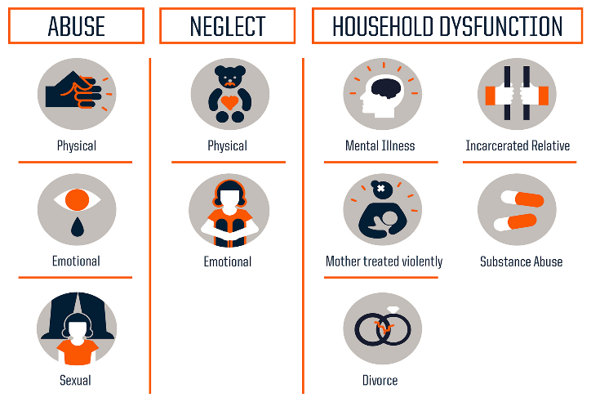


TEN CATEGORIES OF ADVERSE CHILDHOOD EXPERIENCES
Understanding ACES with Dr Nadine Burke Harris
Notes:
The QR code links you to an excellent video with Dr Nadine Burke Harris who gives a seven-minute overview of the ACES study and its impact on childhood development, early disease development, disability and early death. She also gives us great hope that ACES do not define us. That’s the miracle of neuroplasticity in the brain. Brains can change for better or worse. ACES heal in the context of nurturing relationships
Adverse Childhood Experiences (ACEs) are potentially traumatic events that occur during childhood and have the potential to negatively impact a person's physical, emotional, social, mental and spiritual well-being.

Slide 60
UNDERSTANDING BEHAVIOR: WHEN TO BE CONCERNED
BIG IDEA: Pay attention when things change.
Childhood and adolescence are critical periods for growth.
A change in a young person's behavior should alert adults and increase our awareness. It is our job to notice and respond.
Pay attention to:
Frequency
Duration
Intensity
Impact
Notes:
As we saw with Alex, childhood and adolescence are critical periods for growth. During this time, the foundation is laid for neural pathways that help create healthy attachment, language, cognition, emotional regulation, social skills, and many other important skills. When there is a change in a young person's behavior, this tells us that this is something we should pay attention to. Essentially, any deviation or CHANGE increases our awareness. These changes are not inherently “good or bad.” Instead, they are simply things that we should attend to and notice. And as grown-ups in young people's lives who regularly interact with youth, we must pay attention to changes in behavioral patterns. It is our job to notice and respond.
A change in a young person's behavior should alert adults and increase or awareness. It is our job to notice and respond. Pay attention to:
Frequency refers to how often a child exhibits a particular behavior; regular instances might indicate an embedded behavioral pattern needing further intervention.
Duration, or the length of each occurrence, is equally significant, as prolonged episodes may suggest deeper issues affecting the child’s emotional or cognitive state.
Intensity reflects the severity or forcefulness of the behavior.
Impact helps to determine the immediate effect on the child and those around them. A noticeable increase in any of these dimensions signals a need for additional attention and possibly professional support. Keeping in mind developmental stages and age-appropriate behavior is an important area of focus for assessing impact. Using frequency, duration, intensity, and impact helps adults monitor behavior, identify potential problems, and proactively tailor strategies to help children manage their behavior, promoting their social and emotional well-being.

Slide 61
UNDERSTANDING BEHAVIOR & EARLY WARNING SIGNS
BIG IDEA: Early warning signs, or "red flags," for emotional distress are indicators that can lead to mental health challenges.
Mood
Academic performance
Appetite, weight loss/gain
Sleep, too much/not enough
Social connection - isolation, withdrawal
Health - somatic complaints
Activities - loss of interest in activities they once found pleasurable
As an SSSC, if you notice early warning signs or have concerns about a young person's mental health, reach out to your colleagues in the school who are directly involved in supporting mental health. Refer to the Student Assistant Program (SAP) Team.
Notes:
Early warning signs, or "red flags," for emotional distress are indicators that can lead to mental health challenges. While these signs may vary depending on the individual, here are some common early warning signs to watch out for:
Changes in mood
such as increased irritability, frequent or prolonged sadness, sudden or uncontrollable anger, emotional outbursts
Social withdrawal or isolating themselves from friends and family
Changes in academic performance, such as lack of motivation, increased absenteeism, sudden compulsion for perfectionism, or sudden changes in grades
Changes in appetite or unexplained weight loss or gain
Changes in sleep patterns, such as sleeping too much or too little
Frequent headaches or stomach aches, or physical injuries
Loss of interest in activities they once found pleasurable, like hobbies, sports, or extracurriculars devoid of replacing those activities with new ones of interest.
It's important to note that these signs should not be viewed in isolation but considered within the context of the young person's overall well-being.
As an SSSC, If you notice early warning signs or have concerns about a young person's mental health, reach out to your colleagues in the school who are directly involved in supporting mental health. Refer to the Student Assistant Program (SAP). When in doubt about how to refer, consult a school psychologist, school social worker, school counselor, or principal. It's also important to be mindful of Mandatory Reporting requirements. Pennsylvania’s Child Protective Services Law establishes requirements for adults considered mandated reporters, including SSSCs who have direct contact with children, to report suspected child abuse if they have reasonable cause to suspect that a child is a victim of abuse. It is, unfortunately, possible that when considering the signs of trauma, an individual may have reasonable cause to believe that a child may be a victim of child abuse that has not been reported. SSSC’s should follow the requirements of the law and establish policies and procedures for reporting, as well as providing support to students.

Slide 62
TRAUMA REACTIONS: FIGHT-FLIGHT-FREEZE
  BIG IDEA: Using trauma-sensitive responses means we must understand how the brain’s stress response system works.
The fight-flight-freeze reactions are brain states that are self-protective responses to events that may threaten safety.
The brain may react to a stressor as if the original traumatic event were happening again.
These are called activators, because they activate one of the following:
Fight
Flight
Freeze
Notes:
School personnel may never have a clear answer as to whether or not a student has experienced trauma. Yet, it is essential to apply trauma-sensitive responses in our interactions with all students as a Tier 1 practice. Our response must be grounded in understanding how the brain’s stress response system works. Dr. Nadine Burke Harris, states that the stress response system evolved to help humans fight off a bear (fight) or run away from the bear (flight), or other predators and dangers. If the danger was overpowering, they also might have “frozen,” a survival tactic that's similar to when animals play dead, or even a “fawning” response (which many consider a type of freeze response), where a student may engage in people-pleasing behaviors.
The fight-flight-freeze reactions are brain states that are self-protective adaptations to events or circumstances threatening physical and emotional safety. It's not uncommon for students who have experienced trauma or toxic stress to have difficulty perceiving danger in the environment, and sometimes, the brain reacts to a stressor as if the original traumatic event were happening again. We sometimes refer to these as activators. These events activate a fight-flight-freeze reaction and are automatic and largely unconscious. The fight-flight-freeze response aims to decrease, end, or escape a perceived threat and return to a peaceful state.
The “fight” or “flight” reaction prepares the body for a physical response.
The “fight” reaction may emerge as aggression, fighting, arguing, defiance, disrespect, screaming, and yelling. However, school personnel also see meltdowns, tantrums, and hyperactivity in students. While “fight” presents as something externalizing, “flight” is more internalizing. A student in a “flight” response may avoid people, places, and things they perceived as overwhelmingly stressful. Students can be very suspicious and slow to trust and feel safe with adults, other children, or even life in school.
Flight can present as daydreaming, hiding, withdrawal, wandering, or running away. Frequent visits to the nurse for pain and recurrent infections can also be rooted in trauma reactions.
Remember that the “freeze” response is one of the deepest survival reactions in the brain. Freeze is a state where running away or fighting and emoting are not perceived as safe or viable responses. What we are seeing during a “freeze” response is a state of hypoarousal or shutting down. Educators sometimes get angry when a student refuses to answer a question or “spaces out”, but what may be happening is that that child’s “thinking” brain has shut down. After these events, young people will sometimes talk about feeling numb or being unable to move. Many times, youth report feeling a sense of shame or embarrassment when receiving special help and/or refusing to ask for help so as not to call attention to their difficulties, and this can all be related to the freeze response.
Perry, B & Winfrey, O. (2021) What happened to you?:conversations on truama, resliience and healing. Flation Books.

Slide 63
VIEWING BEHAVIOR THROUGH TRAUMA LENSES
BIG IDEA: Use your knowledge of trauma to interpret behavior.
Have you ever heard a student described as:
Lazy
Defiant
Withdrawn
Disorganized
Zoned-out
Instead, ask what are the child's:
Unmet needs
Lagging skills
A trauma-informed approach urges school staff to view challenging behavior as a complex tapestry of responses influenced by various factors that help the youth address their own unmet needs. ​
Notes:
Speaker may ask for two or three responses to the question: "Given your review of the drivers of behavior, give an unmet need or lagging skill that might be beneath LAZY
Then, Disrespectful, then Withdrawn
Have you ever thought that a student is “lazy,” “defiant,” “withdrawn,” “disorganized,” or “zoned-out?” ALL behaviors serve a purpose (function). These reactions are sometimes learned ways of adapting to traumatic circumstances.
While this overly active stress response helps a child survive, it can make it hard for them to focus while in school, make friends, and trust adults. For example, children who experience trauma are often misdiagnosed with ADHD because they have trouble sitting still and concentrating.
Underneath the label of “lazy” may be a student struggling with unmet needs for food, sleep or connection. They too may be overwhelmed by the volume of work and their lagging skills for organization, memory and concentration.
Viewing a student characterized as “defiant” or “disrespectful” through trauma lenses may reveal a student who has an unmet need for safety and acquiring a sense of belonging through relationships and self-esteem. They may lack skills in self-regulating their feelings such as anger as well as be unable to filter and communicate their needs effectively.
A trauma-informed approach urges school staff to view challenging behavior as a complex tapestry of responses influenced by various factors that help the youth of concern address their unmet needs

Slide 64
TRAUMA REACTIONS: WHAT IS UNDERNEATH THAT BEHAVIOR
  BIG IDEA: To understand and support children, we must dive beneath the surface and explore the root causes of their behavior.
All behavior is a form of communication
Challenging behaviors are a way for the child to express their feelings, needs, and experiences
“What’s Happened to This Child?”
(instead of "What is wrong with this child?")
Notes:
To understand and support the children we work with in school systems, we must dive beneath the surface and explore the root causes affecting their behavior. By seeking to understand and address the underlying factors, we can foster a more empathetic and effective approach to helping children heal and thrive.
When faced with challenging behaviors in the school setting, it can be easy to personalize the behaviors and feel as if they are directed at the adults. This can lead to a discipline and blaming, rather than open the opportunity for understanding the underlying factors. By solely focusing on the tip of the iceberg, we risk overlooking the child's unmet needs and the impact of trauma they may be experiencing. Instead, we must remind ourselves that all behavior is a form of communication. Challenging behaviors are a way for the child to express their feelings, needs, and experiences when they lack the words, understanding and skills to do so in a more socially desirable manner. By taking the time to understand the hidden layers beneath the surface, we can approach the child's struggles with empathy and compassion, opening the door to providing appropriate support and interventions that can truly make a difference in their lives. Blaming the child or their family only perpetuates misunderstanding, while diving deeper into the underlying reasons allows us to respond with understanding and genuine care. This type of approach positions us to stop asking the question “what’s wrong with you?” to asking, “what happened to you?” In the words of Sandra Bloom , this is a time to ask the question: What’s happened to this child?

Slide 65



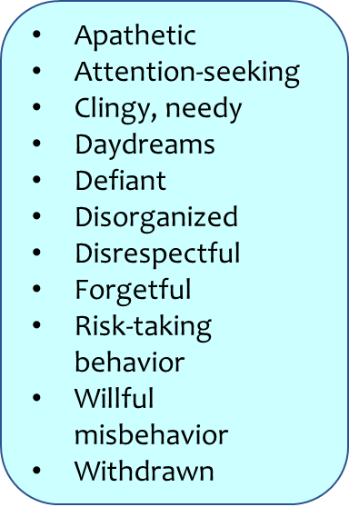
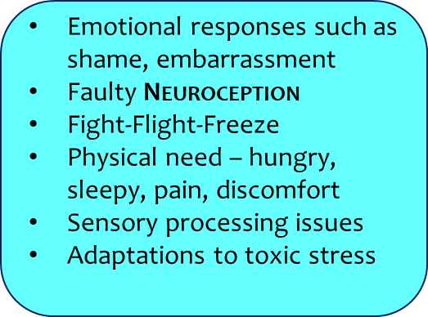
CHALLENGING BEHAVIORS: THE TIP OF THE ICEBERG
  BIG IDEA: We need to look at what is going on under the surface.
Notes:
As a result of our own stress, implicit biases, beliefs and experiences, we often describe behavior based on what we observe. The student is “defiant” or behaving “willfully.” It's important to recognize that what we perceive on the surface may not be what is driving the behavior. This helps us respond in more helpful ways to what we see.
Neuroception as the brain’s ability to detect danger. It’s how we distinguish whether situations or people are safe or threatening. Porges believes that faulty neuroception is at the root of many psychiatric disorders, including ODD. For many vulnerable children, neuroception is biased towards detecting danger when there is no real danger. Faulty neuroception shifts the child involuntarily into a defensive position, resulting in a variety of challenging behaviors. This can result from a host of causes (but not limited to) constitutional; genetic or brain wiring differences; biomedical issues; environmental stress; or sensory processing challenges, which cause a child to perceive ordinary sensations as threatening. Currently, our most vulnerable oppositional and defiant children are generally managed with plans that work on eliminating unwanted behaviors, rewarding desired behaviors, or withholding treasured objects or experiences (such as screen time) as consequences to those behaviors. These techniques are often ineffective because they are based on a faulty premise: that the child has intentional control over those behaviors. If faulty neuroception is to blame, however, behaviors will be a reflection of an immediate, “fight or flight” response and not purposeful misbehavior. In such cases, punishment can potentially cause more distress, triggering additional feelings of threat rather than safety.
The iceberg analogy provides a powerful way to understand children's behaviors, particularly in the context of trauma and challenging behaviors. The tip of the iceberg, which is visible above the water, represents the outward expressions of a child's actions that may be perceived as challenging. However, just like with an iceberg, this is only a small fraction of the whole picture. Beneath the waterline, hidden from plain sight, lie the underlying reasons for these behaviors. Trauma, can significantly influence a child's actions, and these deeper root causes and needs can often go unnoticed.
When faced with challenging behaviors in the school setting, it can be easy to personalize the behaviors. This can lead to a discipline and blaming, rather than understanding the underlying factors. By solely focusing on the tip of the iceberg, we risk overlooking the child's unmet needs and the impact of trauma they may be experiencing. Instead, we must remind ourselves that all behavior is a form of communication.
Challenging behaviors are a way for the child to express their feelings, needs, and experiences when they lack the words, understanding and skills to do so in a more socially desirable manner. By taking the time to understand the hidden layers beneath the surface, we can approach the child's struggles with empathy and compassion, opening the door to providing appropriate support and interventions that can truly make a difference in their lives.
Again, we ask: “What’s Happened to This Child?”

Slide 66




REGULATION AND RELATIONSHIPS: UNDERSTANDING THE BRAIN & EMOTIONAL REGULATION
  BIG IDEA: Help students REGULATE first
Dr. Bruce Perry helps educators recognize how stimuli enter the brain and are processed
Perry’s Neurosequential Model reveals that the brain develops from the bottom up:
REGULATE FIRST
RELATE NEXT
REASON LAST
Notes:
Having a basic understanding of how the brain works can help understand trauma's signs and symptoms in young people. Trauma can profoundly impact the brain's development and functioning, leading to various emotional and behavioral responses. By knowing how trauma affects the brain, caregivers and educators can respond with greater empathy and patience, tailoring support and interventions to promote healing and resilience in those who have experienced trauma.
Dr. Bruce Perry, a pioneer in the understanding of and treatment of children and youth who experienced severe trauma, helps educators recognize how stimuli enter the brain and are processed. Perry’s Neurosequential Model states that the brain develops from the bottom up.
By recognizing the way the brain works, adults are better equipped to interact with children who may have experienced trauma. Remember that until adults help children regulate (which often involves first becoming regulated themselves) and letting young people know they are cared about through relationships, we can’t begin to problem-solve or reason with them. The top two regulation strategies we can use are breathing and moving the body through gentle stretching.

Slide 67


UNDERSTANDING THE BRAIN & EMOTIONAL REGULATION
  BIG IDEA: Trauma can profoundly impact the brain's development and functioning, leading to various emotional and behavioral responses.
A basic understanding of how the brain works can help us understand trauma's signs and symptoms in young people.
Allison Sampson Jackson Video
Notes:
Allison Sampson Jackson (video in QR) gives language for working with students and describing the “upstairs” and “downstairs” brain. This is critically important for teaching emotional regulation. Not just for students, but for staff too! First, we as adults need to self-regulate. Then, we can work with young people to support them in co-regulation, which in turn, helps them learn to self-regulate. Once students learn to self-regulate, it makes the educator’s job so much easier.
A basic understanding of how the brain works can help us understand trauma's signs and symptoms in young people.
With this knowledge, caregivers and educators can respond with greater empathy and patience, tailoring support and interventions to promote healing and resilience in those who have experienced trauma.
Adults are then better equipped to interact with children who may have experienced trauma are cared about through relationships, we can’t begin to problem-solve or reason with them.

Slide 68

OVERVIEW OF SCHOOL & COMMUNITY SUPPORTS
  BIG IDEA: Knowing about school and community supports, and being able to connect young people to those supports, allows us to better support students.
Activity: In small groups, discuss the following two questions.
(5 minutes)
What policies/ procedures has your school entity implemented to create trauma-informed approaches?
What school and community resources can you provide to students, families, staff, and community members who may be struggling with the effects of trauma and toxic stress?
Notes:
As an SSSC, it's essential to be aware of … and be able to discuss reliable resources to support those in the school community who struggle with the effects of trauma and toxic stress.
This can be an independent activity if there are time considerations

Slide 69
TRAUMA INFORMED RESPONSES TO BEHAVIOR
  BIG IDEA: Trauma-informed behavior support systems work at multiple levels to promote positive behavior and intervene early when challenging conduct emerges.
Trauma-informed behavior support systems recognize the relationships between trauma exposure, student behavior, and staff responses. This approach teaches expectations which help to minimize the likelihood of behavior problems.
Examples of evidence-based prevention initiatives within the MTSS/PBIS framework:
Restorative practices
K-12 Substance Use Prevention Programs
  Blueprint Programs: Positive Youth Development
  Office of Juvenile Justice and Delinquency Prevention
  SAMHSA's National Registry of Evidence-based Programs / Programs
  SAMHSA's Evidence-Based Practices Resource Center
Notes:
Trauma-informed discipline systems recognize the relationships between trauma exposure, student behavior, and staff responses. This approach teaches expectations which help to minimize the likelihood of behavior problems. When challenging behaviors emerge, schools provide reasonable naturally occurring consequences to teach and re-teach pro-social behavior, while looking beneath the behavior, offering interventions that address unmet needs and lagging skills.
Consequences teach; shaming and exclusionary discipline sanctions can retraumatize students. While there are always circumstances where the infraction warrants referral to alternative education placement or even filing charges, a trauma-informed discipline system works to prevent these issues as much as possible.
The selection of these programs should be based on multiple data sources that give information not just about individual students, but also at the system level. Needs and priorities should be identified using a data-driven approach. All policies and programs must be tailored to the unique needs and resources of the local school entity. For more information, consult the PCCD Model Trauma-Informed Approach Plan: Guidelines for School Entities.
Early intervention with learning barriers is crucial to a safe and supportive school climate. The Pennsylvania Student Assistance Program provides a framework for addressing the behaviors that may stem from underlying trauma or other behavioral health issues. The SAP team then engages with parents and guardians, obtains consent, and may recommend a behavioral health screening or assessment with an agency SAP liaison that supports the school community. If the student meets criteria and would benefit from mental health treatment, the liaison works closely with the parent or guardian, providing linkages to the best resources.
When discussing discipline policies, it’s important to address zero-tolerance. Zero tolerance policies are not conceptually aligned with trauma-informed approaches by responding to all circumstances in the same way, without regard for underlying causality or the effect of systems on behavior. The American Psychological Association (APA) Zero Tolerance Task Force conducted a thorough review of the literature and concluded that “zero tolerance has not been shown to improve school climate or school safety … has not proven an effective means of improving student behavior, [and] … zero tolerance policies as applied appear to run counter to our best knowledge of child development.
Discipline policies and staff development need to consider cultural sensitivity as a core value of trauma-informed approaches. The U.S. Commission on Civil Rights 2019 report found students with disabilities are approximately twice as likely to be suspended. Students of color are suspended and expelled more than their white peers, including for the same offenses. Those punishments are harsher and longer. Schools must consistently review data for this disproportionality and take steps, such as evidence-based prevention, early intervention, and consistent staff development to reduce or eliminate these discrepancies.

Slide 70
WRAPPING-UP TRAUMA INFORMED CARE
  BIG IDEA: A "trauma-informed approach" emphasizes understanding and responding to the effects of trauma
Given that trauma and persistent stress are prevalent, a
trauma-informed approach can help alleviate its impact and pave the way for
healing and hope.
Remember that you are part of a supportive community. You are not alone. Ensure you're familiar with and adhere to the policies and procedures in place at your school when expressing concerns about a student.
Every single staff member that interacts with students in a school community plays an important role in fostering a school culture that feels safe and supportive for all​
Notes:
Given that trauma and persistent stress are prevalent, a trauma-informed approach can help alleviate its impact and pave the way for healing and hope.
Remember that you are part of a supportive community. You are not alone. If you're worried about a student, please reach out to your SAP team.
School psychologists, school counselors, and/or social worker are resources as well. They are here specifically to assist students grappling with trauma's effects. Ensure you're familiar with and adhere to the policies and procedures in place at your school when expressing concerns about a student. Now that you have completed this module:
Take a moment to identify which staff or teams in your school are designated to assess and provide support to students who may be struggling.
Identify the process you would use to contact them if you have a concern about a student

Slide 71

BEHAVIORAL HEALTH AWARENESS

Slide 72
BEHAVIORAL HEALTH AWARENESS
WHAT IS BEHAVIORAL HEALTH?
  Promotion
  Support
Notes:
The Substance Abuse and Mental Health Services Administration define the term “behavioral health” as the promotion of mental health, resilience and wellbeing; the treatment of mental and substance use disorders; and the support of those who experience, or are in recovery from these conditions, along with their families and communities.

Slide 73
MENTAL HEALTH DISORDERS AND MENTAL AND BEHAVIORAL HEALTH
BIG IDEA: A mental health disorder is characterized by serious changes in how we think, feel, and act
Cognition – how we think
Emotions– how we feel or
Behavior – how we act…
Notes:
It is important to understand the distinction between mental and behavioral health and mental health disorders, and here we summarize the aspects of these topics relevant to you as School Safety and Security Coordinator.
What is a mental health disorder and how does it relate to mental and behavioral health?
A mental health disorder is characterized by a clinically significant disturbance in an individual’s:
Cognition – how we think;
Emotions– how we feel; or
Behavior – how we act…
… and is associated with distress or impairment in important areas of functioning.
A mental health disorder is distinct from developmentally normal, brief episodes of feeling sad, lonely, or overwhelmed. A mental health disorder involves serious changes in how we think, feel, and act.
The term mental health disorder covers a broad range of conditions, including Anxiety Disorders, Depressive Disorders, Behavioral Disorders, and Neurodevelopmental Disorders including disorders of intellectual development, Autism Spectrum Disorder, and Attention Deficit Hyperactivity Disorder.
Mental health disorders can have profound impacts on a child’s day-to-day functioning at school, home, and in the community.
Mental health disorders are diagnosed by a licensed, trained professional based on set criteria. It is also important to understand the course of disorders can differ significantly. Disorders can present as short or ongoing and long term. Some individuals may experience a mental health condition for a period of time and with treatment, and the development of effective coping strategies, their symptoms may abate and not occur again in the future. It is also possible for some mental illnesses, such as depression, to manifest for the first time in adolescence, remit with treatment, and then re-emerge later in life; some individuals may experience lifelong mental health symptoms and will need to develop strategies to address those issues throughout their lives.

Slide 74
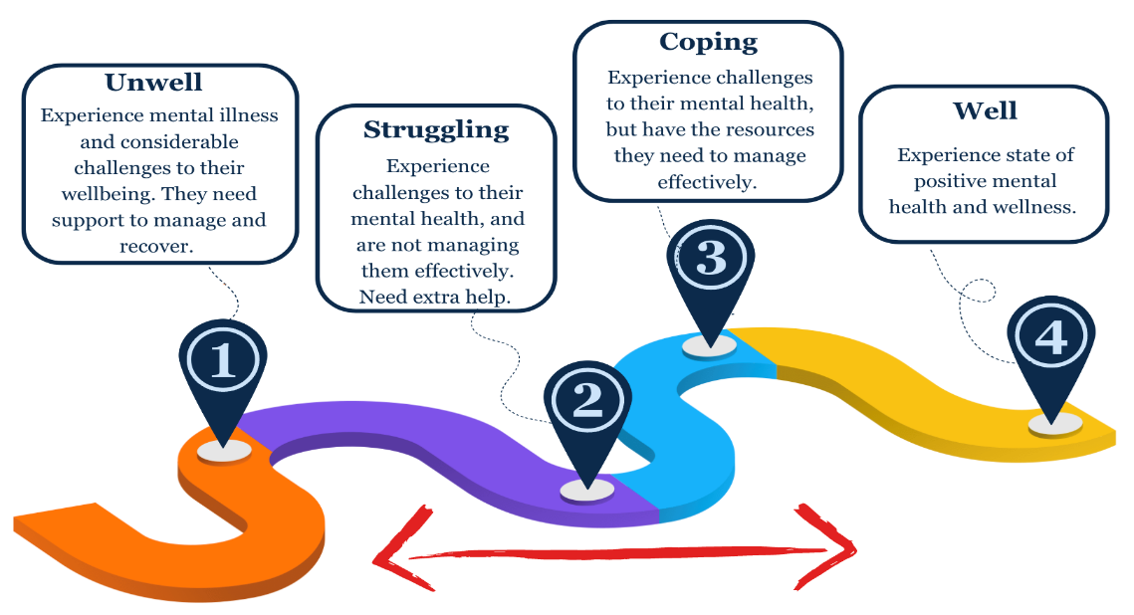
MENTAL HEALTH – A CONTINUUM
Adapted from The National Children’s Mental Health and Wellbeing Strategy (Australian Government, 2021)
Notes:
Mental and behavioral health, distinct from mental health disorders, should be thought of as a continuum we all navigate. Being mentally healthy does not mean feeling happy all the time. It also does not mean the absence of strong feelings of sadness, anger, or anxiety, when those emotions are appropriate.
Consider this Mental Health Continuum model. It is common that, over time, a child may be located at different points on the continuum, moving from well, to coping, to struggling or, equally, in the other direction. Occasionally, some children may become unwell at times throughout their development. In other words, mental health and well-being is a lifelong, fluid process that requires the same attention as physical health.
It is normal to have an emotional response to situations that arise in our lives. Being mentally healthy involves having a full spectrum of feelings and emotions, and being able to identify and manage feelings effectively. We can encourage children to be mentally healthy by helping them to establish positive, connected relationships and to develop habits such as restful, restorative sleep, exercise and good nutrition, all of which promote mental and physical well-being.
By framing our thinking around mental health and mental health disorders in this way, we can provide support to our students as they navigate typical life experiences. We can also address their feelings when they are experiencing mental health concerns and mental health disorders.
BIG IDEA: Mental and behavioral health, distinct from mental health disorders, should be thought of as a continuum we all navigate. Mental health and well-being are a lifelong, fluid process that require the same attention as physical health. Adapted from The National Children’s Mental Health and Wellbeing Strategy (Australian Government, 2021)

Slide 75
PREVALENCE OF CHILD AND ADOLESCENT
MENTAL HEALTH DISORDERS
According to the Center for Disease Control (CDC, 2023), the most common mental health disorders in children aged 3-17 are:
ADHD 9.8%
Anxiety 9.4%
Behavior problems 9.8%
Depression 4.4%
Rates of diagnosis are increasing, and many students suffer from more than one mental health condition.
Notes:
Having established some of the basic definitions and scope of mental health, we’ll now turn to thinking about what signs and symptoms a student may experience when they are struggling with their mental health.
In spite of the enduring stigma associated with mental health conditions, they are statistically common. Longitudinal data from the Centers for Disease Control reveal that approximately 20% of students have a diagnosable mental health disorder, the rates of diagnosis are increasing, and many students suffer from more than one mental health condition. For instance, about three in four children diagnosed with depression have a comorbid diagnosis of anxiety. This means that if 20% of children have a diagnosable mental health disorder, in a classroom with 25 students, five students may be experiencing a mental health disorder It is useful to understand the prevalence of mental health disorders so that we are alert to signs and symptoms of concern.
The most commonly diagnosed mental health disorders in children aged 3-17 are:
ADHD 9.8%
Anxiety 9.4%
Behavior problems 8.9%
Depression 4.4%

Slide 76
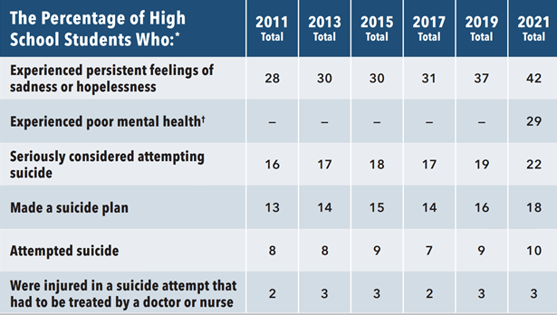
PREVALENCE OF CHILD AND ADOLESCENT
MENTAL HEALTH DISORDERS
Mental health trends among youth aged 12-17 in the United States (PA disaggregated) conducted from 2011-2021 indicate the following (CDC, 2023).
Notes:
When we consider these statistics within a typical classroom, we get a clearer picture of the number of students who may be struggling with their mental health or have a diagnosed mental health disorder at any given time.
Surveys investigating mental health trends among youth aged 12-17 in the United States conducted from 2011-2021, reveal a troublesome story about teen mental health. In short, youth have been reporting worsening symptoms of depression, mental health concerns, and thoughts and acts of suicide since 2011; nine years before the COVID pandemic. This trend continues today.
Since 1989, every two years the Pennsylvania Youth Survey, known as the PAYS (Narrator note: pronounce “PAYS”) has been administered to 6th, 8th, 10th, and 12th grade students from Pennsylvania school entities who volunteer to participate in the survey. This survey collects self-reported information on mental health and youth attitudes and behaviors towards alcohol, tobacco, and other drug use and other problem behaviors, including what our youth think and believe about anti‐social behaviors, and their school environment.
On the most recent PAYS Narrator note: pronounce “PAYS” students in grades 6, 8, 10, and 12 told us this about their mental health:
40.1% of all students indicated that they had felt depressed or sad most days in the past 12 months
27.9% of all students indicated that they sometimes thought life is not worth it
38.6% of all students indicated that “at times I think I am no good at all”
26.2% indicated that they felt that they were a failure
17.6% of students indicated harming themselves (i.e., “cutting, scraping, burning as a way to relieve difficult feelings, or to communicate emotions that may be difficult to express verbally”) at least one time in the past year.

Slide 77
HOW DO MENTAL HEALTH CONCERNS SHOW UP IN SCHOOL?
BIG IDEA: Depending on a child’s age, cognitive, social, emotional, and physical abilities, signs of mental health distress can manifest in schools in many ways:
Academically
Avoiding specific tasks or avoiding specific classes
Truancy
Poor grades, declining from a previous level
Missing assignments
Difficulty with group work
Displaying signs of “perfectionism” that interfere with a student’s ability to complete work
Notes:
The information provided in this section is meant to provide an overview of potential indicators of concern. It is important to keep in mind that children grow and develop differently and at their own pace. Some indicators may be developmentally normal, but still a cause for concern for children, teens, and the adults in their lives.
Depending on a child’s age, cognitive, social, emotional, and physical abilities, signs of mental health distress can manifest in a school setting in some of the following ways:
Academically
Avoiding specific tasks or avoiding specific classes.
Truancy.
Poor grades, declining from a previous level.
Missing assignments.
Difficulty with group work.
Displaying signs of “perfectionism” that interfere with a student’s ability to complete work.

Slide 78
HOW DO MENTAL HEALTH CONCERNS SHOW UP IN SCHOOL?
Socially
Little to no interaction with other students or staff.
Isolating during times of typical opportunities for engagement (i.e. lunch, recess)
Quitting clubs or teams they once enjoyed.
Refusing to join clubs or teams or engage in other age-appropriate activities
“Hanging out” with people who are using drugs, alcohol, or tobacco.
Emotionally
Increased irritability.
Intense, uncontrolled anger.
Verbally threatening others.
Talking, writing, drawing, or acting out, about feelings of distress.
Shutting down.
Sharing thoughts of harming self or others.
Poor self-esteem or self-image.
Notes:
Socially
Little to no interaction with other students or staff.
Isolating during times of typical opportunities for engagement such as lunch, recess, study halls, assemblies, or field trips.
Quitting clubs or teams they once enjoyed.
Refusing to join clubs or teams or engage in other age-appropriate social settings and events.
“Hanging out” with people who are using drugs, alcohol, or tobacco.
Emotionally
Increased irritability.
Intense, uncontrolled anger.
Verbally threatening others.
Talking, writing, drawing, or acting out, about feelings of distress.
Shutting down.
Sharing thoughts of harming self or others.
Poor self-esteem or self-image.

Slide 79
HOW DO MENTAL HEALTH CONCERNS SHOW UP IN SCHOOL?
Behaviorally
Physical aggression, including fighting, hitting walls, kicking chairs or desks.
Argumentative, or otherwise confrontational.
Sleeping in class.
Asking to go to the nurse’s office often.
Complaining of stomach aches or headaches.
Eating little or no food during lunch, including avoiding the lunchroom.
Wearing clothing not appropriate to the climate, which could be an indication of self-harming behavior such as cutting.
Asking to go to the restroom more than typical.
Notes:
Physical aggression, including fighting, hitting walls, kicking chairs or desks.
Argumentative, or otherwise confrontational.
Sleeping in class.
Asking to go to the nurse’s office often.
Complaining of stomach aches or headaches.
Eating little or no food during lunch, including avoiding the lunchroom.
Wearing clothing not appropriate to the climate, which could be an indication of self-harming behavior such as cutting.
Asking to go to the restroom more than typical.
It is important to note that experiencing one or more of these signs or symptoms does not necessarily mean a person has a mental health disorder. Children and adolescents may experience or present some of these behaviors or characteristics from time to time as a part of developmentally normal social and emotional growth. However, these symptoms may indicate the need for further evaluation or support from the child’s school-based team.
All school employees, including, but not limited to school safety and security coordinators, office staff, teachers, coaches, custodial and maintenance staff, school counselors, bus drivers, school psychologists, school social workers, and administrators are members of a child’s “team” and should share concerns about a student to appropriate school-based staff. To provide as much information as possible, consider the following:
Frequency: How often does the behavior happen?
Duration: how long has this gone on for?
Intensity: How much does this interfere with their ability to function, and engage in normal life activities?
Child and adolescent symptoms of mental health concerns and mental illness can manifest in many ways. Where a child is already identified with a mental health concern or disorder, concern may increase where there are observed changes to a student’s baseline behaviors – how that individual typically engages with the world, thinks and feels. Determining baseline behavior is most often successful within the context of a child-centered team, as perspective from different viewpoints is most likely to identify shifts in thoughts, feelings and actions. Team members might include the student’s teachers, counselor, school nurse, administrator, school mental health professional, and a parent or guardian. Any time that significant behavioral changes that interfere with a child’s ability to access the curriculum, participate in prosocial relationships, or activities are noted, the child’s team should explore possible explanations for the change in behavior.
While signs and symptoms of mental health concerns can vary depending on the specific condition, there are some common indicators that may suggest that a student needs help and support. The information provided below is not exhaustive and should not be viewed as a checklist, but these behaviors may serve as indicators that a child is in need of support or services.
Persistent sadness, hopelessness, or a general feeling of emptiness.
Intense or excessive worry, anxiety, or fear.
Rapid or extreme changes in mood, such as frequent mood swings.
Social withdrawal and a loss of interest or pleasure in activities once enjoyed.
Difficulty concentrating, making decisions, or experiencing memory problems.
Changes in appetite or weight, either significant increase or decrease.
Sleep disturbances, such as insomnia or excessive sleeping.
Fatigue or loss of energy, feeling constantly tired or lacking motivation.
Irritability, agitation, or restlessness.
Physical symptoms without an apparent medical cause, such as headaches or stomach aches.
Increased use of alcohol or drugs or engaging in other risky behaviors.
Suicidal thoughts, self-harm, or expressing a desire to die.
Thoughts or behaviors involving hurting others.

Slide 80

CASE STUDY ACTIVITY
Using the Alex case study, work in groups to:
Identify current system processes in place to assist Alex at their school entity.
Review the referral process for Alex specific to their school entity, including Child Find practices for students who may have a disability.
Identify school and community programs and resources that are available to support Alex (e.g., which school staff are trained to address concerns and how referrals to community resources are made).
22 Pa. Code § 14.12 Child Find
Notes:
Use or modify based upon time
Using a scenario of the case study related to behavioral/mental health the School Safety and Security Coordinators will work in table groups to:
Identify current system processes in place to assist Alex (case study student) at their school entity.
Review the referral process for Alex specific to their school entity, including Child Find practices for students who may have a disability.
Identify school and community programs and resources that are available to support Alex (e.g., which school staff are trained to address concerns and how referrals to community resources are made).
SCCCs will be able to deepen their learning by sharing what they each have available in their school entities and by debriefing in the room with the instructors.

Slide 81




BREAK: 10 MINUTES

Slide 82

BULLYING AND SUICIDE AWARENESS

Slide 83
ALEX CHAPTER 5: INTENSIFYING OF MENTAL HEALTH CHALLENGES
(8-9TH GRADES)
BIG IDEA: Adolescent development may precipitate
more serious mental health challenges
Intensifying episodes of depression and anxiety
Ongoing difficulties with concentration and memory with accommodations and specially designed instruction through his IEP
Emerging self-injurious behavior – severe nail-biting with visits to school nurse to manage infection
Relationship between self-injury and suicide, the nurse asked Alex if he ever thought about suicide. He told her he thinks about it frequently
The nurse activated the in-school suicide screening protocol with the school counselor who recommended safety plan, in-school academic and behavioral supports through SAP and other community resources
Admits to school counselor that he uses alcohol and cannabis to quiet anxiety that drove his thoughts of dying
SAP Liaison provided full screening and linked Alex with school-based mental health treatment
Despite Alex’s challenges, the trauma-informed educational practices helped him Alex's early work with educators helped him develop a love for basketball and theatre that he continued with throughout the adolescent challenges that emerged. The basketball coach and theatre moderator supported him throughout his high school career
Notes:
Recognizing the ineffectiveness and potential harm of these punitive tactics, Alex's lead teacher and the Principal—both trained in trauma-informed practices—intervened with alternative strategies. They implemented trauma-informed approach that focused on building relationships, fostering a sense of safety and trust, and providing training to ensure all teachers understood the underlying causes of his behaviors.
In consultation with the music teacher, who was open to learning and adding to her toolbox, they tried the following:
Predictable routines in music class give Alex a sense of structure and security.
Self-regulation activities to help him manage his emotional responses, such as deep breathing exercises or quiet time, or even noise canceling headphones if the auditory stimuli became overwhelming for him.
Positive reinforcements to acknowledge and reward his desired behaviors rather than predominantly focusing on the negative consequences associated with undesired behavior.
Collaborative problem-solving, engaging with Alex to identify issues and develop strategies he felt ownership over, helping him feel respected and heard.
By prioritizing prevention through connection, these trauma-informed interventions were designed not to control Alex but to empower him, providing a supportive framework that enabled him to learn and thrive despite his challenges.

Slide 84
PARTICIPANT REFLECTION
What do your school suicide procedures instruct educators to do when a student talks about dying or witnesses self-injury?
Who in your building conducts suicide risk screens and/or assessments?
Notes:
What were the contributors to Alex’s substance use? What does your school suicide policy instruct educators to do when a student talks about dying? Is your staff aware that although some students use self-injury behaviors as a coping mechanism and these don’t necessarily indicate a warning sign for suicide, self-injury can be a warning sign for suicide ideation. Are your staff aware of who is trained to do suicide risk assessments?

Slide 85
BULLYING AND SUICIDE
AWARENESS
BIG IDEA: Provide SSSC's with knowledge and understanding of suicide and bullying and the systems of support available in Pennsylvania to enable stakeholders to identify students who:
may be at risk for suicide
and/or may be displaying signs that they are engaging in, or the recipient of bullying
Notes:
Welcome to this module/section on suicide and bullying awareness. The objective of this training is to provide School Safety and Security Coordinators with important knowledge and understanding of suicide and bullying and the systems of support available in Pennsylvania to enable stakeholders to identify students who 1) may be at risk for suicide and 2) may be displaying signs that they are engaging in, or the recipient of bullying.

Slide 86

WHAT IS BULLYING?
  Bullying is: An intentional electronic, written, verbal or physical act, or a series of acts
Bullying can be:
Physical
Verbal
Relational
Cyberbullying
Notes:
Bullying is:
An intentional electronic, written, verbal or physical act, or a series of acts:
(1) directed at another student or students;
(2) which occurs in a school setting; (however, a school entity shall not be prohibited from defining bullying in such a way as to encompass acts that occur outside a school setting if those acts meet the requirements contained in subsection (e)(1), (3) and (4))
(3) that is severe, persistent or pervasive; and
(4) that has the effect of doing any of the following:
(i) substantially interfering with a
student's education;
(ii) creating a threatening
environment; or
(iii) substantially disrupting the
orderly operation of the school
Note: "school setting" shall mean in the school, on school grounds, in school vehicles, at any time in transit to and from school or at any activity sponsored, supervised or sanctioned by the school.
Bullying can take many forms and can occur in many school settings. Bullying can be:
physical - hitting, pushing, spitting, etc.
Verbal - name calling, slurs and other hurtful and/or offensive comments.
Relational - spreading rumors, purposely excluding others, ganging up on one person, etc., is another kind of bullying behavior.
Bullying that takes place using technology - phones, computers, social media, etc., is called cyberbullying.

Slide 87

WHAT IS CYBERBULLYING?
Cyberbullying is bullying that takes place over digital devices. It can:
Occur through text messages, apps, in social media, or online gaming
Include sending, posting, or sharing negative, false, or harmful content about someone else
Include sharing personal or private information about someone else causing embarrassment or humiliation
Notes:
Cyberbullying is bullying that takes place over digital devices like cell phones, computers, and tablets. It can occur through text messages, apps, or online in social media, forums, or gaming where people can view, participate in, or share content. Cyberbullying includes sending, posting, or sharing negative, false, or harmful content (words, pictures, memes, etc.) about someone else. It can include sharing personal or private information about someone else causing embarrassment or humiliation. Bullying, including cyberbullying, is unlawful, or criminal behavior. In Pennsylvania, public school code stipulates that each school entity adopt a policy or amend existing policy relating to bullying and incorporate the policy into the school entity's code of student conduct. The school bully prevention policy delineates disciplinary consequences for bullying and may provide for prevention, intervention, and education programs aimed at the prevention of bullying.
The most common places where cyberbullying occurs is on social media sites such as Snapchat, Tik Tok, Instagram, etc., it also occurs in text messaging via cell phone and messaging apps on mobile or tablet devices, in instant messaging and/or direct messaging in online forums, chat rooms, and message boards, such as Reddit. Online gaming communities can be particular hotbeds of cyber bullying behaviors, especially among boys. When someone is not doing well in the game, other players may call them names, curse them, or exclude them from game play. Because of the anonymous nature of online games - such as the use of avatars and screen names - these behaviors can quickly escalate into bullying.
While cyberbullying generally occurs outside school hours, it can significantly impact school functioning and can translate to in-person behavior related to what has been posted or shared. ￼
Bullying, including cyberbullying, has been linked to many negative outcomes for children and teens. It can cause physical injury, social problems, and emotional distress. Cyberbullying has also been linked to low self-esteem, depression, anxiety, academic difficulty, self-injurious behavior, and suicidal thoughts and attempts. Research indicates that ongoing bullying may cause or worsen feelings of isolation, exclusion, and despair. The experience of bullying can also worsen feelings of depression and anxiety, which can contribute to suicidal thoughts and actions. That said, the majority of youth who are bullied do not become suicidal.
DHHS, 2021b
DHHS, 2021b
CDC, 2021
Cyberbullying Research Center, 2021
DHHS, 2021b
CDC, 2021
Cyberbullying Research Center, 2021
DHHS, 2021a

Slide 88
LGBTQIA+ STUDENTS
Members of the LGBTQIA+ community are more likely to experience bullying both in person and online
40% of students who identify as LGBTQIA+ reported experiencing bullying
The Trevor Project’s 2021 National Survey on LGBTQ Youth Mental Health found that bullying of LGBTQIA+ youth remains a major area of concern
Bullying has been found to be a risk factor for youth suicide and LGBTQIA+ youth experience bullying at higher rates than their heterosexual or cisgender peers
Notes:
Members of the LGBTQIA+ community are more likely to experience bullying both in person and online. In 2021, forty percent (40%) of students who identify as LGBTQIA+ reported experiencing bullying in the past year as compared to 22% of heterosexual students.
The Trevor Project’s 2021 National Survey on LGBTQ Youth Mental Health found that bullying of LGBTQIA+ youth remains a major area of concern, with rates of electronic bullying exceeding in-person bullying for this population. Middle school students, students who are transgender or nonbinary, and Native or Indigenous students reported the highest level of concern regarding bullying behaviors online and at school.
Since bullying has been found to be a risk factor for youth suicide and LGBTQIA+ youth experience bullying at higher rates than their straight or cisgender peers, we must work to both identify bullying behaviors directed at these groups, and support and protect these vulnerable students.
When school leaders and staff work to intentionally create environments that are affirming, caring, accepting, and supportive of all students, they can directly impact the well-being of marginalized students and cultivate a school culture of safety and respect.
A focus on a positive, affirming school culture can protect students and may save children’s lives. The Trevor Project 2023 National Survey on the Mental Health of LGBTQ Young People found that about half of transgender and nonbinary participants found their school to be gender-affirming and participants who did reported lower rates of suicide attempts. CDC, 2021
Trevor Project, 2021
Koyanagi et al., 2019
Webb et al., 2021
Trevor Project, 2021
Trevor Project, 2023

Slide 89

BULLYING = POWER IMBALANCE
The power imbalance may be physical, social, or developmental.
Bullying tends to persist over time, but a single event of violence, discrimination or harassment can qualify as bullying behavior.
The purpose of bullying behavior is to hurt the target of the bullying, physically or psychologically.
Notes:
Not all mean behavior is bullying. True bullying behavior typically involves a power imbalance between the bully and victim. The power imbalance may be physical, social, or developmental. Bullying tends to persist over time, with repeated events of the bullying behavior taking place. That said, a single event of violence, discrimination or harassment can qualify as bullying behavior. The purpose of bullying behavior is to hurt the target of the bullying, physically or psychologically. This is part of the reason that a lot of bullying behavior happens again and again, leaving the victim feeling scared and powerless. While bullying behavior can be harmful to children’s physical and/or mental health, it is important to differentiate bullying from other kinds of developmentally appropriate, yet unkind, behaviors. We will examine some of these behaviors below.
Rudeness is discourteous or impolite behavior, e.g., cutting in line. The intent of rudeness may not be to hurt another person; people engaging in rude behavior are often not giving any consideration to other people.
Meanness involves doing something to hurt someone maybe one or two times. Meanness tends to be an in-the-moment expression of angry feelings on the part of the aggressor.
Conflict is a disagreement or argument between two or more children who may or may not be friends. Conflict is a normal part of child and adolescent development. Learning to successfully resolve conflicts with others is an essential life skill.
It is important for school staff to appropriately label bullying behavior and to respectfully correct children and adults who misuse the term. When everything is labeled bullying, it can take away the focus from actual bullying when it occurs. When adults trivialize bullying behaviors or accept bullying as a normal part of growing up, children are harmed.

Slide 90

IMPACT OF BULLYING ON STUDENT MENTAL HEALTH
Children with diagnosed mental health condition:
more likely to be bullied
experience negative effects of bullying behavior
Children who bully others, and who have also been bullied themselves, are at the greatest risk
negative mental and physical health consequences
increased risk for aggression, serious mental health concerns, and suicide ideation and attempts.
Children who bully others, are bullied, or both bully and are bullied:
more likely to think about or attempt suicide than those who are not involved in bullying
Notes:
The negative mental health effects of bullying can include symptoms of depression and anxiety, low self-esteem, self-harming behavior, alcohol and drug use, aggressive behaviors, involvement in violence, crime, and other anti-social actions. Bullying can lead to mental health issues for any child, but children who already have a diagnosed mental health condition are both more likely to be bullied, and to experience the negative effects of bullying behavior. Cyberbullying has also been linked to symptoms of poor mental health. When compared to peers who have not experienced cyberbullying, children who experience cyberbullying report higher levels of depression, more thoughts of suicide, greater emotional distress, anger and acting out behaviors.
Bullying can affect everyone involved in it —those who are bullied, those who bully, and those who see bullying take place. The Centers for Disease Control identify bullying as a form of youth violence and an Adverse Childhood Experience (ACE). Adverse Childhood Experiences are potentially traumatic experiences that occur in childhood. ACEs are linked to health problems throughout childhood and adulthood, mental health issues, and substance use problems in adolescence and adulthood. Without intervention, ACEs can potentially impact the long-term education, job opportunities, and earning potential of children who experience them.
Bullying is a common, widespread problem for children in the United States.
Some youth experience bullying more than others.
Members of the LGBTQIA+ community are more likely to experience bullying than their straight or cisgender peers.
In 2021, about 30% of female high school students reported experiencing bullying at school or online, compared to about 19% of male students.
Bullying is a common student conduct problem for schools
bullying reports are made most frequently in middle schools (28%) high schools (16%), combined schools (12%), and primary schools (9%)
cyberbullying reports peak in middle schools (33%) followed by high schools (30%), combined schools (20%), and primary schools (5%)
Since 1989, every two years the Pennsylvania Youth Survey, known as the PAYS (Narrator note: pronounce “PAYS”) has been administered to 6th, 8th, 10th, and 12th grade students from Pennsylvania school entities who volunteer to participate in the survey. This survey collects self-reported information on mental health and youth attitudes and behaviors towards alcohol, tobacco, and other drug use and other problem behaviors, including what our youth think and believe about anti‐social behaviors, and their school environment. The Chart below provides a snapshot of PAYS data related to bullying and internet safety that was collected from 2017-2021.
DHHS, 2018
CDC, 2021
CDC, 2023
CDC, 2023
CDC, 2021

Slide 91


IMPACT OF BULLYING ON STUDENT MENTAL HEALTH
Notes:
Bullying has a negative impact on all youth involved - those who are bullied, those who bully, and bystanders to the bullying behavior. The chart below highlights some of the negative effects of bullying that can be experienced by each participant in bullying behavior.
Children who bully others, who have also been bullied themselves, are at the greatest risk for negative mental and physical health consequences of bullying. These children may experience a negative perception of themselves and others and are at risk for mental health concerns. These children may lack social skills, exhibit negative behavior and/or conduct, and may experience rejection by their peer group. Children who have bullied others and have also been bullied themselves have been found to be at increased risk for aggression, serious mental health concerns , and suicide ideation and attempts DHHS, 2018

Slide 92
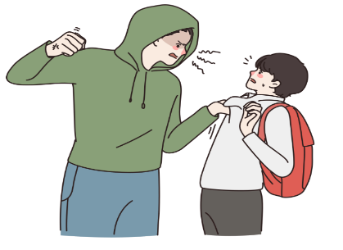
WARNING SIGNS A STUDENT
MAY BE BULLYING OTHERS
  Engagement in physical or verbal fights
Quick to anger
Lack of empathy
Hostile/defiant attitude
Blame others/deny behaviors
Engage in risky behaviors
Be highly competitive and/or focused on status/popularity
Referring to others negatively, mean ways, name calling
Need to be in charge and/or have power and control over others
Notes:
There are warning signs when a child is involved in bullying behavior, either as the perpetrator or the target of the bullying. It is important for adults to pay attention to children’s behavior because behavior is a messenger that communicates a need. Children may not use words to ask for help when they are affected by bullying, but their behavior may communicate that something is wrong. Many educators dismiss complaints of bullying behavior, which puts both the target of the bullying as well as the perpetrator at risk. It is important for all adults in a child or teens life to listen and respond to concerns related to bullying. Per Pennsylvania statute bullying behavior should be reported in accordance with school policy. The behaviors listed in the next sections may indicate that a child is in need of intervention and/or adult support.
Children who are bullying others may:
Engage in physical or verbal fights
Refer to others negatively, or in mean ways (e.g., name calling, put downs)
Need to be in charge and/or have power and control over others
Be quick to anger
Lack empathy
Have a hostile/defiant attitude
Blame others/deny behaviors
Engage in risky behaviors
Be highly competitive and/or overly concerned with status/popularity

Slide 93
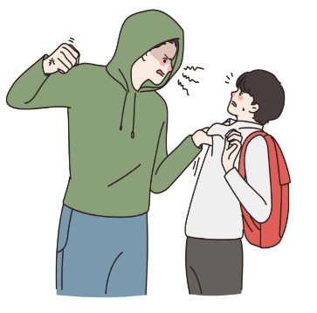
WARNING SIGNS A STUDENT
MAY BE GETTING BULLIED (THE TARGET)
  Unexplained injuries
  Lost or destroyed clothing, books, electronics
  Frequent headaches, stomach aches, feeling sick, faking illness
  Changes in eating habits
  Difficulty sleeping, nightmares
  Changes in/loss of interest in schoolwork
  School avoidance/refusal
  Self-destructive behaviors
    Running away from home
    Self-harm
    Talking about suicide
  Change in friends, avoids social situations
  Feelings of hopelessness, helplessness, decreased self-esteem
Notes:
It is helpful to pay attention to any behavioral changes that are taking place in children. Again, behavior is a messenger that communicates a need. Children who are experiencing bullying may need adult support and intervention to navigate the situation. It is most helpful when adults listen and pay attention to what children are saying both with their words and their behaviors. The behaviors listed in the next section may indicate that a child is the target of bullying behavior.
Animator’s note: Please create a graphic or chart with the list below
Children who are the target of bullying may have:
Unexplained injuries
Lost or destroyed clothing, books, electronics, etc.
Frequent headaches or stomach aches, feeling sick or faking illness
Changes in eating habits
Difficulty sleeping; nightmares
Changes in grades, loss of interest in schoolwork
School avoidance/refusal behaviors
Changes in friend groups; avoidance of social situations
Feelings of helplessness, hopelessness or decreased self-esteem
Self-destructive behaviors such as running away from home, harming themselves, or talking about suicide.
If you suspect that a child is being bullied, it is okay to ask them about your concern. When a child shares that they are being bullied by another child, try to stay calm and resist the urge to give advice. Children have to navigate the social waters of school, and it is often true that adults do not fully understand all of the dynamics at play in a bullying situation. Instead of giving advice, let the child know that you are sorry that they are being bullied and that you will be there to help and support them. Tell the child that you hear them, care about their well-being, and will help them to find the help they need. Thank the child for sharing their concern and let them know that you will share their concern with other supportive adults at school so that they can receive the help and support they need. Identifying and reporting bullying behavior should be a top priority; as School Safety and Security Coordinator, you should be familiar with the reporting mechanisms and resources in place to address bullying behavior in your school buildings.
DHHS, 2021c

Slide 94
HOW BULLYING TIES INTO THE THREAT ASSESSMENT PROCESS.
  THREAT ASSESSMENT PROCESS
Bullying can also move individuals further down the pathway to violence. A positive school climate helps keep all students and staff safe at school
Preventing targeted violence relies primarily on developing positive school climates that are built on foundations of safety, respect, trust, and social and emotional support
Schools can build safe, positive school climates by supporting diversity, open communication, conflict resolution, and addressing issues like bullying and harassment
Notes:
As we have learned throughout this section, bullying can put perpetrators, bystanders, and victims at risk for physical and mental health concerns. As it relates to Threat Assessment, bullying can also move individuals further down the pathway for violence. That said, there are many things schools can do to improve climate, which can help to keep all children safe at school.
Create and Promote a Safe, Positive School Climate
Preventing targeted violence relies primarily on developing positive school climates that are built on
foundations of safety, respect, trust, and social and emotional support. Schools can build safe, positive
school climates by supporting diversity, open communication, conflict resolution, and addressing issues
like bullying and harassment.
Schools should encourage teachers and staff to build positive, healthy, and trusting
relationships with students and their families, and should work to break down “codes of
silence” by helping students feel empowered to share concerns with trusted adults.
Maintaining professional standards and boundaries with students is foundational to these
efforts, and to ensure that relationships are healthy and developmentally appropriate. Determine what policy and training resources are available to your staff for addressing this area.
Helping students feel more connected to their classmates and school community can foster a
positive school climate. This can include identifying clubs or teams at school students can join
or encouraging students to develop their own group. Determine where students find this information and the process for students to get involved in your school buildings so that you can serve as a resource to students, staff and families.
Frameworks like school-wide Positive Behavior Interventions and Supports (PBIS) can promote
safe, supportive school climates by actively teaching students what appropriate behavior looks
like in a variety of settings, and by focusing on encouraging good behavior. Determine if your schools use PBIS or other models to promote positive school climate and learn about how those models are implemented.
Taken from PCCD Threat Assessment Manual

Slide 95
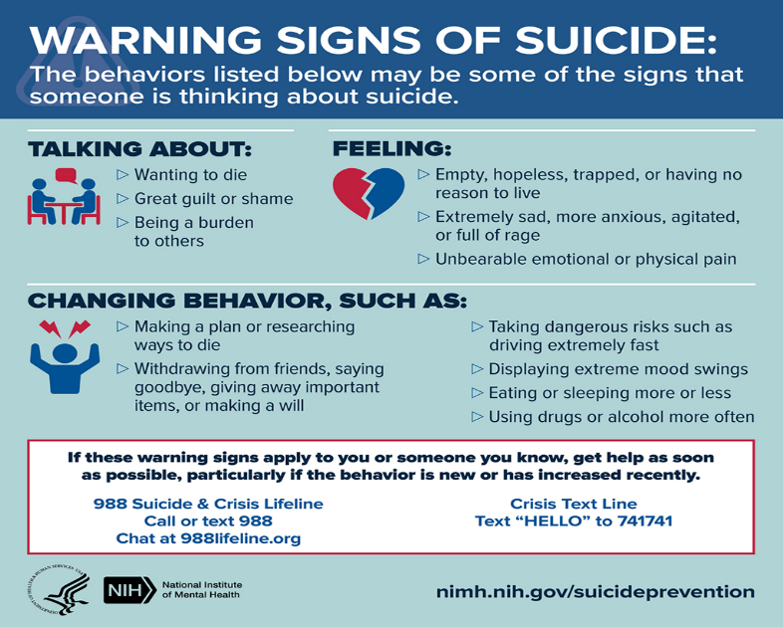
SUICIDE AWARENESS
Notes:
Suicide in school-aged children is a devastating topic to understand and address. As School Safety and Security Coordinators and school employees serve as gatekeepers for nearly all children in our communities, addressing suicide is one of our greatest responsibilities. Whether the topic of this training is new to you or a refresher, one of the most crucial understandings for you to take away from the training is that you can serve as the adult who saves a child’s life. By establishing trusting, supportive, caring relationships with each child you encounter in your schools, you can become the adult they turn to when they are considering something as grave as ending their own life.

Slide 96
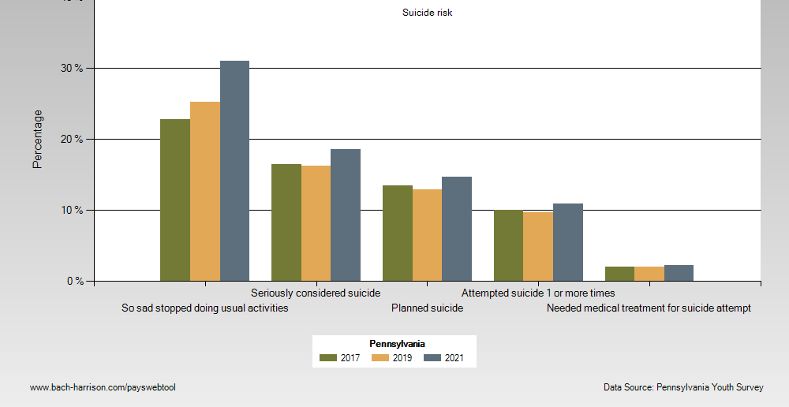
Notes:
National and State Statistics
The statistics related to child and adolescent suicide serve as a stark call-to-action in our schools and communities. On the most recent Pennsylvania Youth Survey (PAYS,2021) Narrator note: pronounce “PAYS” students in grades 6, 8, 10, and 12 told us this about their mental health:
40.1% of all students indicated that they had felt depressed or sad most days in the past 12 months
27.9% of all students indicated that they sometimes thought life is not worth it
38.6% of all students indicated that “at times I think I am no good at all”
26.2% indicated that they felt that they were a failure
17.6% of students indicated harming themselves (i.e., “cutting, scraping, burning as a way to relieve difficult feelings, or to communicate emotions that may be difficult to express verbally”) at least one time in the past year.
The table below presents a snapshot of data collected from the PAYS between 2017-2021.

Slide 97
IDENTIFYING STUDENTS AT RISK OF SUICIDE
BIG IDEA: Section 1526 of the PA Public School Code, known as Act 71, Youth Suicide Awareness & Prevention, provides for school entities to incorporate curriculum related to youth suicide awareness and prevention polices.
  State law (22 Pa. Code 12.12), requires that information received from a student may be shared with the student’s parent/guardian or other appropriate authority when the health, welfare or safety of the student or others is clearly in jeopardy.
  .
  Students may demonstrate suicide risk in a number of ways
Notes:
At every school level, qualified school staff can talk with students about warning signs of depression and suicide, risk factors and how get help for themselves or a friend. Schools can partner with other professionals to deliver these lessons to all school-based stakeholders, including students, employees, families, and community members. Specifically, Section 1526 of the PA Public School Code, which is Act 71, Youth Suicide Awareness & Prevention, specifically provides for school entities to incorporate curriculum on this topic into their instructional programs pursuant to their youth suicide awareness and prevention polices.
While it is important to respect student confidentiality in many situations, as is required by state law (22 Pa. Code 12.12), information received from a student may be shared with the student’s parent/guardian or other appropriate authority when the health, welfare or safety of the student or others is clearly in jeopardy. When it comes to suicide prevention, the well-being of the student is the priority.
Within the school setting, students may demonstrate that they are at risk for suicide in a number of ways, they may also exhibit specific warning signs that they are in danger of suicide. They may draw pictures, journal or write about thoughts regarding suicide. They may express these thoughts or plans about suicide to peers. They may exhibit behavioral changes. They may also directly tell us. Though suicide is complex and rarely is caused by a single event or circumstance, it is critical to understand both the risk factors which increase the likelihood of risk for suicide, and warning signs, which are evidence-based indicators that someone may be in danger of suicide immediately or in the near future.

Slide 98
SUICIDE IN SCHOOL-AGED CHILDREN AND ADOLESCENTS
BIG IDEA: Connection matters!
Establishing trusting, supportive, caring relationships with each child you encounter in your schools, can create the relationship that saves a child’s life
Suicide is:
eighth leading cause of death in children ages 5–11
second leading cause of death in children ages 10-14
third leading cause of death for ages 15-24
  Centers for Disease Control (CDC, 2023)
Notes:
According to the Centers for Disease Control, suicide is now:
the eighth leading cause of death in children age 5–11.
the second leading cause of death for children ages 10-14
the third leading cause of death for ages 15-24.
“Though rare in children under the age of 10, suicide risk factors and signs should be of the utmost concern and not discounted or dismissed for our elementary-aged students. “
As we covered in the Behavioral Health Awareness Section (including visual graphs and charts), surveys of United States youth aged 12-17 from 2011-2021, which tracked mental health trends, reveal a troublesome story about their mental health. In short, youth have been reporting worsening symptoms of depression, mental health issues, and thoughts and acts of suicide since 2011, which is 9 years before the COVID pandemic. This trend continues today.
As we covered in the Behavioral Health Awareness Section (including visual graphs and charts), surveys of United States youth aged 12-17 from 2011-2021, which tracked mental health trends, reveal a troublesome story about their mental health. In short, youth have been reporting worsening symptoms of depression, mental health issues, and thoughts and acts of suicide since 2011, which is 9 years before the COVID pandemic. This trend continues today.

Slide 99
INDIVIDUAL RISK FACTORS
Personal factors may contribute to risk:
Previous suicide attempt
History of depression and other mental illnesses
Serious illness such as chronic pain
Criminal/legal problems
Job/financial problems or loss
Impulsive or aggressive tendencies
Substance use
Presence of adverse childhood experiences
Sense of hopelessness
Violence victimization and/or perpetration
BIG IDEA: It is critical to understand risk factors which increase the likelihood of risk for suicide, and warning signs, which are evidence-based indicators that someone may be in danger of suicide now or in the near future.
Notes:
These personal factors contribute to risk:
Previous suicide attempt
History of depression and other mental illnesses
Serious illness such as chronic pain
Criminal/legal problems
Job/financial problems or loss
Impulsive or aggressive tendencies
Substance use
Presence of adverse childhood experiences
Sense of hopelessness
Violence victimization and/or perpetration

Slide 100

RELATIONSHIP RISK FACTORS
These harmful experiences within relationships contribute to risk:
Bullying
Family/loved one’s history of suicide
Loss of relationships
High conflict or violent relationships
Social isolation
Notes:
Relationship Risk Factors
These harmful or hurtful experiences within relationships contribute to risk:
Bullying
Family/loved one’s history of suicide
Loss of relationships
High conflict or violent relationships
Social isolation

Slide 101

COMMUNITY & SOCIETAL RISK FACTORS
Community Risk Factors
Lack of access to healthcare
Suicide cluster in the community
Stress of acculturation
Community violence
Historical trauma
Discrimination
Societal & Cultural Risk Factors
Stigma associated with help-seeking and mental illness
Easy access to lethal means of suicide among people at risk
Unsafe media portrayals of suicide
Notes:
Community Risk Factors
These challenging issues within a person’s community contribute to risk:
Lack of access to healthcare
Suicide cluster in the community
Stress of acculturation
Community violence
Historical trauma
Discrimination
Societal Risk Factors
These cultural and environmental factors within the larger society contribute to risk:
Stigma associated with help-seeking and mental illness
Easy access to lethal means of suicide among people at risk
Unsafe media portrayals of suicide
It is equally important to understand that there are many protective factors that reduce or eliminate the risk of suicide.

Slide 102

INDIVIDUAL & RELATIONAL PROTECTIVE FACTORS
BIG IDEA: There are specific things that can help!
Individual Protective Factors
Effective coping and problem-solving skills
Reasons for living (for example, family, friends, pets, ability to identify reason for living, etc.)
Strong sense of cultural identity
Relationship Protective Factors
Support from parents, friends, and family
Feeling connected to others; trusted adults at school can meet this need
Notes:
It is equally important to understand that there are many protective factors that reduce or eliminate the risk of suicide. Many of the following protective factors compiled by the Center for Disease Control can be addressed within the school setting:
These personal factors protect against suicide risk:
Effective coping and problem-solving skills
Reasons for living (for example, family, friends, pets, ability to identify reason for living, etc.)
Strong sense of cultural identity
Relationship Protective Factors
These healthy relationship experiences protect against suicide risk:
Support from parents, friends, and family
Feeling connected to others; trusted adults at school can meet this need

Slide 103

COMMUNITY & SOCIETAL PROTECTIVE FACTORS
Community Protective Factors
Feeling connected to school, community, and other social institutions
Availability of safe and adequate housing and nutrition, and consistent and high quality physical and behavioral healthcare
Societal Protective Factors
Reduced access to lethal means of suicide among people at risk
Cultural, religious, or moral objections to suicide
Notes:
Community Protective Factors
These supportive community experiences protect against suicide risk:
Feeling connected to school, community, and other social institutions
Availability of safe and adequate housing and nutrition, and consistent and high quality physical and behavioral healthcare
Societal Protective Factors:
These cultural and environmental factors within the larger society protect against suicide risk:
Reduced access to lethal means of suicide among people at risk
Cultural, religious, or moral objections to suicide

Slide 104
HOW TO RESPOND TO A STUDENT WHO
MAY BE AT RISK OF SUICIDE
  BIG IDEA: Do not dismiss or minimize the seriousness of the information you get about a student who is at risk for suicide
Call 911 if the risk for suicide is imminent or completed
Follow established district policies/procedures/protocols regarding suicidal students
Listen. Affirm and support their need for help. Thank the child for talking with you
Immediately contact the appropriate school-based mental health professional (such as the school counselor, school psychologist or school social worker), the school nurse, an administrator, or your direct supervisor, as defined in your suicide prevention policy.
Do not leave the child alone, ensure a trusted adult remains with the child while you speak with a member of your school entity’s crisis team, a school-based behavioral health professional, the appropriate administrator, or your direct supervisor
If you learn about this information outside of school hours:
  In the case of imminent risk: Call 911
  Follow your school's policies, procedures, and protocols
  Report your concern to Safe2Say Something
SUICIDE IS PREVENTABLE: Asking a child if they are thinking about suicide does not increase their risk.
Notes:
Asking a child if they are thinking about suicide does not increase their risk, in fact, it can remove fear about talking about their suicidal thoughts.
It is critical not to dismiss or minimize the seriousness of concerns you have or the information you receive about a student who is at risk for suicide or is exhibiting warning signs of suicide.
Should a student express or demonstrate warning signs for suicide to you, or to a student’s peer or other non-school employee who reports it to you:
Call 911 if the risk for suicide is imminent or the student has engaged in an act of suicide
Follow established district policies/procedures/protocols regarding suicidal students
Listen
Affirm and support their need for help
Thank the child for talking with you
Immediately contact the appropriate school-based mental health professional (such as the school counselor, school psychologist or school social worker), the school nurse, an administrator, or your direct supervisor, as defined in your suicide prevention policy.
Do not leave the child alone, ensure a trusted adult remains with the child while you speak with a member of your school entity’s crisis team, a school-based behavioral health professional, the appropriate administrator, or your direct supervisor
If you learn about this information outside of school hours:
In the case of imminent risk: Call 911
Follow your school entity’s policies, procedures, and protocols
Report your concern to Safe2Say Something
It is the responsibility of all school entities to have a protocol for making a crisis referral for a suicide screening during school hours. As the School Safety and Security Coordinator, you should be able to identify this process, your school policies and procedures related to suicide prevention and response, and also be able to refer other staff to these resources. If you are concerned that a student is demonstrating thoughts or behaviors that indicate a warning sign for suicide, you should immediately follow your established protocols to report this to a school-based behavioral health professional, crisis team, the appropriate administrator, or call 911 if the danger is imminent.

Slide 105

SMALL GROUP ACTIVITY
FOR BULLYING AND SUICIDE
  Discuss the policies and procedures around bullying and suicide prevention that are currently being used at your school.
  What is working well?
  What can be improved?
  Is there anyone else who should be around the table when these policies and procedures are being reviewed?
Notes:
Have the table groups read from the Scenario and identify experiences in Alex’s life that include first Bullying and second, risk of suicide. Then instruct each School Safety and Security Coordinator to do the following and consider how their school entity’s policies, procedures, and resources might be used to support Alex.
Bullying
Identify your school bullying policy
What are your school entity's protocols for reporting bullying?
If you witness a child being bullied or a child engaging in bullying behavior, how do you refer them for support and intervention? To whom are they referred?
What school and community programs and resources are available to support students who are being bullied or who are engaging in bullying behavior? (including which school staff are trained and how referrals to community programs are made).
Suicide
What are your school entity’s policies and procedures related to suicide awareness, prevention and postvention?
What is the referral process for a student at risk of suicide or demonstrating warning signs for suicide?
What school and community programs and resources are available to support students who are suicidal or at risk of suicide? (including which school staff are trained and how referrals to community programs are made).

Slide 106

SUBSTANCE USE AWARENESS

Slide 107

SUBSTANCE USE AWARENESS
BIG IDEA: Adolescent substance use is a major problem that often creates barriers to learning and threads to other underlying mental health issues
  “The majority of adults who meet the criteria for having a substance use disorder started using substances during their teen and young adult years”
  ‘Substance use’ is a term used to include alcohol, tobacco and other drugs
It is essential that schools offer not only consequences but also interventions that provide access to treatment
Addiction is a chronic but treatable medical condition
Using person-centered language, reduces the harmful stigma and negativity around substance use disorders
  US Department of Health and Human Services (HHS), Office of the Surgeon General Facing Addiction in America: The Surgeon General’s Report on Alcohol, Drugs, and Health. Washington, DC: HHS, November 2016.
Notes:
School Safety and Security Coordinators (SSSC) create a safe and caring school environment by planning and implementing programs that reduce school violence and engage students, staff, families and community members in behaviors and activities that promote academic growth and facilitate character development. As an SSSC, your leadership depends on a working knowledge of substance use and how it impacts the brains and bodies of our youth.
The term ‘Substance use’ is a term broadly used to include alcohol, tobacco and other drugs. Adolescent substance use is a major problem that often creates barriers to learning and threads to other underlying mental health issues.
Substance use disorders may have their roots in adolescence when the brain is undergoing enormous change. Exposure to alcohol and drugs during this period of crucial neurological development may alter the natural course of brain development. Earlier age of onset of use is significantly associated with the risk of developing a substance use disorder later in life.
Punitive approaches alone don't stop teens from using substances. It is essential that schools take a balanced approach that offers not only consequences but also interventions that provide access to treatment, as warranted. SSSC’s advocate for controlled substances policies that promote both consequences and options for assistance.
“The majority of adults who meet the criteria for having a substance use disorder started using substances during their teen and young adult years.”
U.S. Department of Health and Human Services (HHS), Office of the Surgeon General Facing Addiction in America: The Surgeon General’s Report on Alcohol, Drugs, and Health. Washington, DC: HHS, November 2016.
Addiction is a chronic but treatable medical condition. Often unintentionally, many people still talk about addiction in ways that are stigmatizing—meaning they use words that can portray someone with a substance use disorder (SUD), you, dee in a shameful or negative way and may prevent them from seeking treatment. With simple changes in communication using person-centered language, we can reduce the harmful stigma and negativity around substance use disorders.
SSSC leadership depends on a working knowledge of substance use and its impact on the brains and bodies of our youth. The term ‘Substance use’ is a term broadly used to include alcohol, tobacco and other drugs. Exposure to alcohol and drugs during crucial neurological development may alter the natural course of brain development. Earlier age of onset of use is significantly associated with the risk of developing a substance use disorder later in life.
It is essential that schools take a balanced approach that offers not only consequences but also interventions that provide access to treatment, as warranted.
Addiction is a chronic but treatable medical condition. Often unintentionally, many people still talk about addiction in ways that are stigmatizing—meaning they use words that can portray someone with a substance use disorder (SUD in a shameful or negative way and may prevent them from seeking treatment. With simple changes in communication using person-centered language, we can reduce the harmful stigma and negativity around substance use disorders.

Slide 108

SUBSTANCE USE AWARENESS
  BIG IDEA: The legal issues that impact schools’ responses to substance use overlap with other laws in all other areas.
Substance Use Awareness
42 Pa. C.S. §8337 and §8337.1 (Civil immunity of school officers/ employees related to emergency care)
24 P.S. §13-1302.1-A (Model memorandum of understanding between schools and local police depts)
24 P.S. §15-1547 (Mandatory drug and alcohol use prevention and intervention programming)
35 P.S. §807.1 et seq.(Schools enforce rules that prohibit the use of steroids)
22 Pa. Code §10.21, §10.22, §10.23, §10.25 (Response and handling of a student with a disability)
22 Pa. Code §12.16, §12.42 (Student rights and student services)
20 U.S.C. 1232g (FERPA) (Family Educational and Privacy Rights)
34 CFR Part 99 (FERPA related, parents / students right to inspect and review educational records)
20 U.S.C. §7114 (Use of state funds)
20 U.S.C. §7118 - (Activities to support safe and healthy students)
Health Insurance Portability and Accountability Act of 1996 (HIPAA)
24 P.S. §15-1547 (PDE Basic Education Circular (BEC) that provides for Student Assistance)
Notes:
PAY SPECIAL ATTENTION TO the first three highlighted laws that underpin the role of the school in recognizing and responding to substance use issues in schools. When questions surface direct participants to their solicitors.

Slide 109

SUBSTANCE USE AWARENESS
  SMALL GROUP ACTIVITY
Directions: In small groups, discuss the following questions. Be prepared to share with the large group.
Review the data on the next slide. How does this data help you determine ATOD prevention and intervention needs?
As a coordinator, how can you advocate for using the PAYS or other tools that will assist your school entity in collecting and assessing overall data trends related to substance use in schools?
Notes:
Pick this one or the other

Slide 110

PENNSYLVANIA YOUTH SURVEY
SELECTED RESULTS FROM 2021
Overall, lifetime use of alcohol and use of alcohol in the last thirty days decreased among Pennsylvania youth surveyed from 2019 to 2021.
Pennsylvania youth reported higher rates of lifetime alcohol use (35%) and 30-day past use (28%) than those reported nationally 28% and 22% respectively.
PA students reported using less marijuana than in 2019, although 17% of HS Seniors reported use in the past 30 days.
Nicotine was the most common substance youth reported vaping
PA students reported 30-day e-cigarette use at the same rates as the national average (both about 17%).
Notes:
As an SSSC you will be part of the data review, planning and programming process for promoting mental health and preventing substance use disorders among students in your schools. One important source of data using student voice is the Pennsylvania Youth Survey (PAYS), that demonstrates the risk and protective factors unique to your school community. In the following activity, participants will review the PAYS and Monitoring the Future data and discuss how these data inform Alcohol, Tobacco and Other Drugs (ATOD) prevention and intervention programming.
Pennsylvania Youth Survey 2021 Selected Results
Overall, lifetime use of alcohol and use of alcohol in the last thirty days decreased among Pennsylvania youth surveyed from 2019 to 2021.
Pennsylvania youth reported higher rates of lifetime alcohol use (35%) and 30-day past use (28%) than those reported nationally 28% and 22% respectively.
PA students reported using less marijuana than in 2019, although 17% of HS Seniors reported use in the past 30 days.
Nicotine was the most common substance youth reported vaping
PA students reported 30-day e-cigarette use at the same rates as the national average (both about 17%).
Over 38% OF 12th graders who vaped in the past year said they vaped marijuana or hash oil.
Among 12th graders who report vaping in the past year, the percent who report vaping marijuana has increased each year since 2015.
Among 6th graders (21.3%)who reported vaping in the past year, the majority report not knowing what substance they vaped
12th Grade lifetime pain reliever use continued to decrease however this remained higher in PA (3.3%) than the national average of 2.3%
https://www.pccd.pa.gov/Juvenile-Justice/Documents/2021%20PAYS/PAYS-Highlight-Report-2021-V6.pdf

Slide 111
SUBSTANCE USE AWARENESS:
MONITORING THE FUTURE STUDY
BIG IDEA: Increased use of prescription painkillers and opiates, including heroin, has contributed to an increase in adolescent overdose deaths.
Deaths due to drug overdose among adolescents nearly doubled from 2019 to 2020 ​
The most significant increases in these deaths were among adolescent males as well as Black and Hispanic teens
The Monitoring of the Future Study emphasizes the increased use of prescription painkillers and look-alike street drugs is a major issue for schools and communities
Notes:
The Monitoring of the Future Study emphasizes the increased use of prescription painkillers and look-alike street drugs remains a significant issue for schools and communities. In Alex’s case study, we see Alex’s mom, Jackie, incarcerated for possession of heroin and prescription drugs.
One significant consideration for SSSC’s is the increase in overdose deaths among teens. Deaths due to drug overdose among adolescents nearly doubled from 2019 (282 deaths) to 2020 (546 deaths). In the same period, the most significant increases in these deaths were among adolescent males (deaths more than doubled), as well as Black (deaths more than tripled) and Hispanic (deaths more than doubled) adolescents.
https://monitoringthefuture.org/wp-content/uploads/2022/12/mtf2022.pdf
Panchal, N. Rudowitz, R. and Cox, C. (2022). Recent Trends in Mental Health and Substance Use Concerns Among Adolescents. https://www.kff.org/coronavirus-covid-19/issue-brief/recent-trends-in-mental-health-and-substance-use-concerns-among-adolescents/

Slide 112

RISK FACTORS INCLUDE
  Early, developmental trauma
  Disrupted attachment with primary caregiver
Parental mental illness and addiction
Mother's incarceration
Intergenerational trauma
Housing and food insecurity
Lack of consistent, predictable physical and emotional safety and availability
  Difficulty with social interactions and reading social cues
  Emotional dysregulation
  Significant academic challenges
  Target for bullying
  Intensifying mental health issues
  Suicidal ideation and self-injurious behavior

Slide 113
PROTECTIVE
FACTORS INCLUDE
  Extended family support
  Faith community involvement
Involvement in early intervention (i.e. Head Start)
Lead pre-school teacher understands trauma
Early identification of attention, memory and emotional regulation needs
MTSS framework and SAP
Educators receiving training in trauma and building trauma informed culture
  Multidisciplinary team evaluation and eventual IEP
  Early identification of intensifying mental health concerns
  Connection to appropriate interventions
  SAP team and liaison before, during and after treatment that was occurring outside of school
  In-home support for Alex, mother and family
  Graduation from high school and vocational training
  Policy violation / behavioral infraction led to intervention (discuss on next slide)
Notes:
Ask the group how many of these PF's they were able to identify

Slide 114

SUBSTANCE
USE AWARENESS:
RISK & PROTECTIVE FACTORS
BIG IDEA: Alex demonstrates significant risk factors for the development of a substance use disorder. He also has many circumstances and experiences that buffer these risks also known as protective factors
  SMALL GROUP ACTIVITY
  Directions: In small groups, review Alex’s case study and identify at least three risk factors and three protective factors for substance use disorder. (Five minutes)
Notes:
pick this one or the other

Slide 115
RECOGNIZING SUBSTANCE USE CONCERNS IN SCHOOLS
BIG IDEA: Adolescent behaviors can stem from multiple sources. It's important to know when to be concerned.
Adolescent academic and behavior changes may signal issues with substance use...
But can also be considered normal behaviors associated with maturation.
  To differentiate typical adolescent behaviors from those that might indicate deeper issues include:
Clusters of signs happening at the same time
Suddenly occurring
Continue despite negative consequences
Extreme and intense behaviors that have a significant impact on those around them.
Notes:
Schools are uniquely able to provide programs and services that promote optimal student health while identifying and removing learning barriers. Student use of alcohol and other drugs, such as tobacco, marijuana, or opioids, can create learning barriers that compromise their academic success, life goals and outcomes later in life.
Adolescent academic and behavior changes may signal issues with substance use but can also be considered normal behaviors associated with maturation. To differentiate typical adolescent behaviors from those that might indicate deeper issues include:
Clusters of signs happening at the same time,
Suddenly occurring,
Continue despite negative consequences
Extreme and intense behaviors that have a significant impact on those around them.

Slide 116
RECOGNIZING SUBSTANCE USE CONCERNS IN SCHOOLS
Warning signs include:
Mood changes
Academic problems
Changing friends and a reluctance to have family get to know the new friends
A "nothing matters" attitude
Finding substances in youth’s room
Physical or mental changes
If you suspect that a youth is using substances, first talk with them to get a better understanding of the situation. Then connect them to the appropriate staff within your school.
Notes:
All children and youth are required to attend school. Thus, schools are uniquely able to provide programs and services that promote optimal student health while identifying and removing learning barriers. Student use of alcohol and other drugs, such as tobacco, marijuana, or opioids, can create learning barriers that compromise their academic success, life goals and outcomes later in life.
Adolescent academic and behavior changes may signal issues with substance use but can also be considered normal behaviors associated with maturation. To differentiate typical adolescent behaviors from those that might indicate deeper issues include:
Clusters of signs happening at the same time,
Suddenly occurring,
Continue despite negative consequences
Extreme and intense behaviors that have a significant impact on those around them.
Warning signs include:
Mood changes (temper flare-ups, irritability, defensiveness)
Academic problems (poor attendance, low grades, disciplinary action)
Changing friends and a reluctance to have parents/family get to know the new friends
A "nothing matters" attitude (lack of involvement in former interests, general low energy)
Finding substances (drug or alcohol) in youth’s room or personal effects
Physical or mental changes (memory lapses, poor concentration, lack of coordination, slurred speech, etc.)
Warning signs indicate that there may be a problem that should be looked into—not that there is definitely a problem. If there is suspicion that a youth is using substances, it is important to first speak with the youth to get a better understanding of the situation. Come from a place of care and concern for the student’s wellbeing and school success. Young people, like Alex, may self-medicate to alleviate anxiety, depression or other issues.

Slide 117
RESPONDING TO SUBSTANCE USE
CONCERNS IN SCHOOLS
BIG IDEA: Talk to the student you are concerned about. Know how to refer to the Student Assistance Program.
Share the behaviors you have observed
Offer to connect them with the SAP team (or school counselor, or school psychologist)
Even if the student declines help, you can still refer them to SAP
Persistence and consistency are antidotes to denial.
If you have a reasonable suspicion that a student is under the influence, escort the student to the school nurse or, in their absence, the administrator. Follow the school’s policy and guidelines
Notes:
Come from a place of care and concern when talking to a student about your concerns. State a few of the behaviors you have observed. As a next step, refer the student to the student assistance program. The SAP team will thoroughly investigate the student’s learning barriers and provide recommendations for next steps. This may include a screening for substance use by the SAP Liaison. The SAP team also provides linkages with appropriate levels of treatment, if warranted, as well as school-based supports during and after treatment. When talking with a student, outline the behaviors you have observed showing concern for the child. Offer to contact the SAP team or school counselor or go with them. Suggest that they don't have to keep hurting. Be supportive and follow up with the student while he or she is getting professional assistance. Even if the student declines to go to the school counselor, you can still refer them to SAP.
Recognize that denial is a powerful aspect of substance use problems and that it can involve conscious or unconscious lying and distorting of the truth. Persistence and consistency are antidotes to denial. Avoid ignoring or making light of the problem, chastising, or condoning the behavior. Give young people the message that not all teens are using. For example, over 65% of Pennsylvania youth report never using alcohol, and 87% have never tried marijuana.
Adolescent attitudes and behaviors are greatly influenced by what they believe their peers’ attitudes and behaviors are. Perceptions can be inaccurate. For example, youth overestimate their peers’ use of alcohol and underestimate their peers’ positive health behaviors. Misperceptions of their peers’ attitudes and behaviors can lead youth to conform to a risky behavior, such as drinking, if they believe that is the normal behavior of their peers.
If you have a reasonable suspicion that a student is under the influence, escort the student to the school nurse or, in their absence, the administrator. Follow the school’s policy and guidelines for handling this scenario

Slide 118
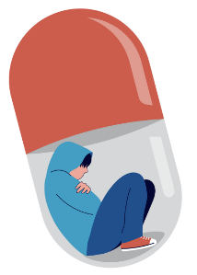
CONSIDERATIONS WHEN REFERRING A STUDENT FOR A SUBSTANCE USE CONCERN
Follow your school's-controlled substances policy.
SAP referral process may occur with or without a policy violation. Schools are required to offer SAPs, but student and parent or guardian participation is voluntary.
Regardless of other potential consequences, students, SAP referral should be made
.
BIG IDEA: Schools play a powerful role in intervening early with student substance use.
Notes:
Follow our school's controlled substances policy. Policy violations typically require the immediate involvement of school administrators, the school nurse and possibly an assessment with a licensed drug/alcohol provider as well as an agreement to follow the recommendations from the assessment.
SAP referral process may occur with or without a policy violation. Schools are required to offer SAPs, but student and parent or guardian participation is voluntary.
Anyone of any age may seek drug and alcohol treatment without parental consent.
42 CFR Part 2 prevents SAP Liaisons or treatment providers from revealing drug and alcohol information to anyone, including parents, guardians or the SAP team.
Schools may also offer the services of the SAP Liaison, who can help with linkage to the best level of care.
Regardless of other potential consequences, students with policy violations should be referred to SAP for follow-up and support.
If administration, upon extinguishing administrative remedies, chooses to refer the student to an Alternative Education for Disruptive Youth (AEDY) program, the student must be involved in SAP.

Slide 119

CASE STUDY: ALEX CHAPTER 6
Notes:
Let's take a look now, at how Alex's early developmental trauma contributes to the development of his issues with substance use. Referring to Alex's case study,

Slide 120
SUBSTANCE USE AWARENESS:
RISK & PROTECTIVE FACTORS
BIG IDEA: Person-centered language reduces stigma. Let’s focus on Alex’s journey through behavioral health challenges and evolution of his substance use disorder, with attention to person-centered language.
Alex began using cannabis and alcohol as a regular coping mechanism in an attempt to manage underlying anxiety, ADHD and depression. Recently, Alex has been frequently absent, and his grades have declined. He has demonstrated decreased motivation as seen by not handing in his assignments.
Eventually, Alex’s underlying mental health and substance use resulted in a policy violation for vaping.
Characterizing cannabis and alcohol use as substance use rather than abuse reduces stigma and shame for his best attempt to manage the underlying mental health issues.
Notes:
Alex has underlying behavioral health challenges that are risk factors contributing to substance use (ADHD depression, anxiety.)
Alex began using cannabis and alcohol as a regular coping mechanism in an attempt to manage underlying anxiety, ADHD and depression. Recently, Alex has been frequently absent, and his grades have declined. He has demonstrated decreased motivation as seen by not handing in his assignments.
Despite displaying clear signs of struggle, Alex's externalized behaviors minimized the apparent severity of internal turmoil to observers, often being dismissed by his caregivers as "typical teenage rebellion." Eventually, Alex’s underlying mental health and substance use resulted in a policy violation for vaping.
Characterizing cannabis and alcohol use as substance use rather than abuse reduces stigma and shame for his best attempt to manage the underlying mental health issues.
Historically, people who struggle with using substances have been called “chemically dependent.” Using person-centered language, the treatment community has reframed the diagnosis to “substance use disorder,” allowing for a more open and realistic discussion of addiction as a brain disorder.

Slide 121
ALEX CHAPTER 6: INCREASED SUBSTANCE USE
(11TH-12TH GRADES)
At school:
SAP referral for one-on-one counseling and support with counselor and SAP team member to increase connection
Continue mental health treatment with school-based provider
Academic and social supports
Step-down plan after discharge from IOP using person-centered planning for short- and long-term goal setting
  Passing classes
  Regular school attendance
  Avoid negative peer group, and
  Investigate career and technical education for culinary arts
Comprehensive multidisciplinary treatment for co-occurring disorders:
Substance use, underlying trauma, anxiety, depression and ADHD
Medication management
Full psychiatric evaluation
Individual, group, family therapy, and recovery education
Notes:
During the intensive outpatient treatment (IOP), his treatment team addressed both the substance use, underlying trauma, as well as anxiety, depression and ADHD diagnosis
Alex attended the IOP held after school three days a week for three hours each session for six weeks. There, he received individual, group, and family therapy, recovery education, as well as a full psychiatric evaluation and ongoing medication management
Since he was attending school regularly during the IOP, he met weekly with the school counselor, addressing academic issues as well as social issues
As IOP was ending, Alex, his mom Jackie, as well as the school counselor, school psychologist, and SAP Liaison, met with his IOP therapist to create a step-down plan and discuss both his short and long-term goals
Since Alex was a senior, he decided to focus on passing his classes, attending school regularly, avoiding the negative peer group, and investigating applying to a career and technical education program after graduation. He agreed to continue weekly therapy with the school-based mental health provider, who would coordinate his care with the IOP provider, school counselor, school psychologist, and IEP team

Slide 122


CASE STUDY
DISCUSSION + SUMMARY
Notes:
Questions to enter into this discussion.
Let's reflect on:
What did Alex need?
What did Alex get?
How did Alex's story unfold?
What would have been different if he didn’t get access to what he needed?

Slide 123
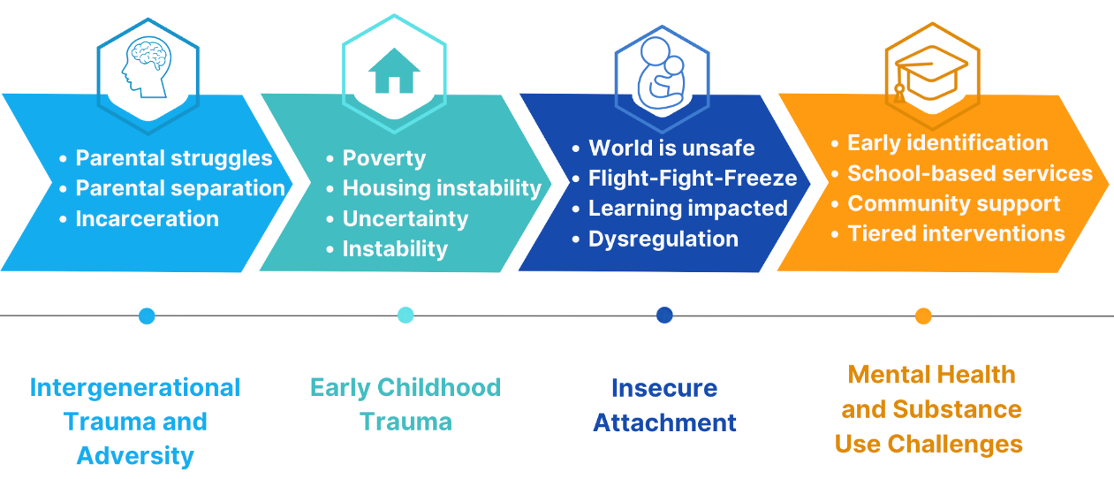
CASE STUDY SUMMARY
Notes:
Alex’s life trajectory demonstrates how early childhood trauma, characterized by instability, poverty, caregiver separation, and exposure to parental mental illness and incarceration, created a vulnerable foundation for emotional and behavioral development
The pervasive adversity and chaotic environment impeded the formation of secure attachments and the development of effective emotional regulation skills. Consequently, this culminated in internalizing behaviors, social difficulties, and later externalizing behaviors and substance use
Numerous studies highlight the direct correlation between early adversity and the later development of mental health challenges and substance use disorders, as seen in Alex’s life
Alex's substance use could be interpreted through the self-medication hypothesis, which suggests that individuals with histories of trauma and emotional pain might use substances to manage these unbearable feelings

Slide 124
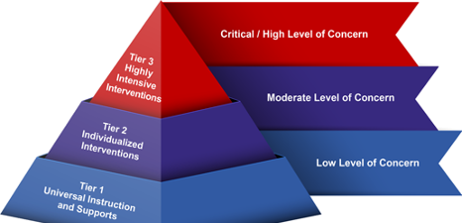
SUMMARY OF WHAT WAS PUT IN PLACE FOR ALEX​
School Attendance Improvement Plan
Referral for IOP behavioral health treatment Person centered planning – RENEW Re-entry and safety planning
Check-in/check-out, social skill groups, friendship groups as well as SSET (Skills for Students Exposed to Trauma)
Clear behavior expectations
Character education
Take-5-discipline process
Trauma informed approaches
Multi-Tiered Systems of Support (MTSS) is the framework that guided and supported the various interventions that were put in place for Alex.
Notes:
At the tier one level, Alex also benefited from universal support with behavior expectations clearly outlined and participated in classroom-wide character education (Elementary and Middle School) and a take-five discipline protocol designed to teach appropriate responses and emotional regulation during elementary and middle school. Part of his exposure to tier one support also came via the entire school's movement towards creating a trauma-informed school culture.
At the MTSS tier two, Alex participated in several targeted social skill groups, friendship groups as well as an SSET (Skills for Students Exposed to Trauma) that was co-facilitated by a trained school counselor and the SAP Liaison.
At the MTSS tier three level, Alex received a number of interventions as his needs increased, based on the recommendations of the SAP team, school psychologist and other behavioral health professionals.
For example, during intensive outpatient treatment, the clinicians addressed both the substance use and underlying mental health concerns that were imperative for Alex’s recovery.
To assist with his attendance issues, Alex participated in a School Attendance Improvement Plan that engaged his mom, grandmother, aunts, and school personnel. This in-home support addressed the underlying family and school stressors Alex faced while assisting the family with resources and tips for supporting Alex and each other. At tier three, he also received various academic interventions from a special educator, as well through his IEP.

Slide 125
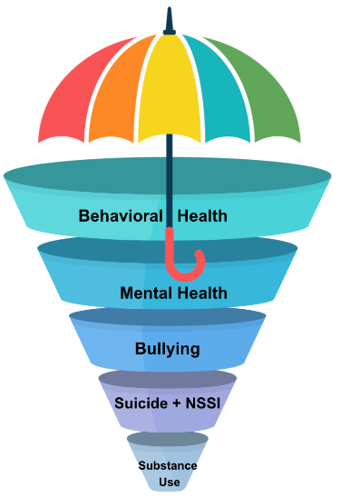
THE UMBRELLA OF TRAUMA-INFORMED CARE
Trauma informed schools promote safe and supportive environments by :
Recognizing the pervasive prevalence of trauma and deep impact on youth learning and relationships
Prioritizing understanding over judgement
Committing to ongoing professional development for all staff and promoting skill transfer to daily practice
Aligning trauma-sensitivity embedded withing MTSS, SAP. policies and procedures
Linking with community-based resources
These shifts in perspective and practices, not only benefit students with histories of chronic traumatic stress and adversity but also foster a more compassionate and adaptive learning community for all students.
Notes:
Speaker Notes: (PLEASE READ THIS OUT LOUD AFTER REVIEWING THIS SLIDE) This case highlights the significant impacts of early trauma on developmental trajectories, underlining the necessity of early interventions and support systems to redirect paths toward healthier outcomes. Moreover, it emphasizes the importance of a holistic, trauma-informed approach in addressing the resultant mental health and substance use issues.

Slide 126
ALEX UPDATE: WHERE IS HE NOW?
Notes:
Today at age 21 Alex has a job working in an upscale restaurant as a sous chef. He dreams of owning his own bistro someday. Alex continues with medication, recovery and therapy, engaging more recently in EMDR therapy to heal aspects of his childhood trauma. He has a girlfriend who works as a nurse at the area Children's Hospital. They've been together for two years. He is close to his grandmother and mother, and the extended family is a support to him. His network of friends in recovery support him in practicing healthy coping skills, and exploring spirituality as a source of hope. He states:
With the mental clarity that I’ve achieved in recovery, I’ve realized that my challenges came long before I even picked up a drug. It’s hard to be kind to myself after the years of struggling, and I certainly feel guilty, but this journey has helped me realize that healing, forgiveness, and redemption are all possible. It’s a process. I see people who struggle with trauma, depression, anxiety and substance use as very strong and resilient folks. I know that I am, too.
WHAT IS EMDR? Eye movement desensitization and reprocessing (EMDR) therapy is a mental health treatment technique. This method involves moving your eyes a specific way while you process traumatic memories. EMDR’s goal is to help you heal from trauma or other distressing life experiences. Compared to other therapy methods, EMDR is relatively new. The first clinical trial investigating EMDR was in 1989. Dozens of clinical trials since EMDR’s development show this technique is effective and can help a person faster than many other methods.

Slide 127


HOW DID ALEX'S JOURNEY UNFOLD?
Alex excelled in culinary school and now works as a sous chef in a local restaurant.
He is in treatment and sees a psychiatrist for medication management. He recently began EMDR to address his early trauma.
In therapy, he has been working on healthy relationships. He has a girlfriend and they have been together for over a year.
Alex's mom continues to struggle at times and their relationship can be challenging.
He has friends that he made through his recovery process and is practicing health coping skills.
He earns enough money to afford rent and uses public transportation to get to work. His employer provides him with health insurance.
"With the mental clarity that I’ve achieved in recovery, I’ve realized that my challenges came long before I even picked up a drug. It’s hard to be kind to myself after the years struggling, and I certainly feel guilty. This journey has helped me realize that healing, forgiveness, and redemption are all possible. It’s a process. I see people who struggle with trauma, depression, anxiety and substance use as very strong and resilient folks. I know that I am, too."
Notes:
Alex excelled in culinary school. He is now 21 years old and works as a sous chef in a local restaurant. He is being mentored by the head chef, who sees his potential. One day, he would love to become a head chef and even a restaurant owner. He now sees a potential pathway for himself.
He continues to engage in treatment and recovery and sees a psychiatrist for regular medication management. He recently began EMDR therapy to address his early childhood trauma.
In therapy, he has been working on building healthy relationships and right now, he has a girlfriend who is medical assistant at a local pediatrician's office. They have been together for over a year.
Alex's mom continues to struggle at times. Their relationship is difficult at times, but he is working on this in therapy. He also sees his grandmother regularly.
He has built a network of friends through his recovery process and is practicing health coping skills. He is also considering getting more involved in a faith community.
He earns enough money to afford rent. He lives in a studio apartment close to work. He uses public transportation to get to work, and his employer provides him with health insurance.
WHAT IS EMDR? Eye movement desensitization and reprocessing (EMDR) therapy is a mental health treatment technique. This method involves moving your eyes a specific way while you process traumatic memories. EMDR’s goal is to help you heal from trauma or other distressing life experiences. Compared to other therapy methods, EMDR is relatively new. The first clinical trial investigating EMDR was in 1989. Dozens of clinical trials since EMDR’s development show this technique is effective and can help a person faster than many other methods.

Slide 128




LUNCH: 1 HOUR

Slide 129



SITUATIONAL AWARENESS

Slide 130


Slide 131
Defining Situational Awareness
What is Situational Awareness?
How does Situational Awareness relate to an educational environment?
PCCD’s Definition of Situational Awareness: A mindset of being aware of one's surroundings and identifying potential threats and dangerous situations.
Notes:
(Prompt) What is Situational Awareness?
(Prompt) How does Situational Awareness relate to an educational environment?
(Display) PCCD’s Definition of Situational Awareness: A mindset of being aware of one's surroundings and identifying potential threats and dangerous situations.

Slide 132
Situational Awareness: Hollywood
Version One: 33 seconds
Version Two: 1minunte & 36 seconds
Version Three: 1minute & 26 seconds
Notes:
Here are three quick movie clips that demonstrate good examples of situational awareness

Slide 133



Situational Awareness Errors
Failure to comprehend the meaning of available information
Failure to project, anticipate or plan
Failure to perceive relevant information
Notes:
Would you categorize these pictures as demonstrating quality situational awareness on behalf of the prey?
The answer is no.
Situational Awareness involves knowing what is going on around you by having the ability to identify, process, comprehend and respond to critical elements of information regarding the environment in which one is located. PCCD (PA Commission on Crime & Delinquency) defines situational awareness as a mindset of being aware of one's surroundings and identifying potential threats and dangerous situations.

Slide 134
Building Situational Awareness
Understanding the body’s stress response
Incorporating Cooper’s Color Codes
Being familiar with the O.O.D.A. Loop
Practicing The 5 W’s
Notes:
In order to prepare for potential threats and dangerous situations, and remain in control of your mental and bodily faculties throughout these stressful events, we have to practice actionable awareness before these events take place. Understanding our natural stress response (fight, flight or freeze), practicing and using Cooper’s Color Codes within our daily life, and having a grasp on the concept of the OODA loop for making dynamic decisions, are not only important and actionable ways to embody situational awareness, but taking this information and applying it to your life could be life-saving as well.

Slide 135
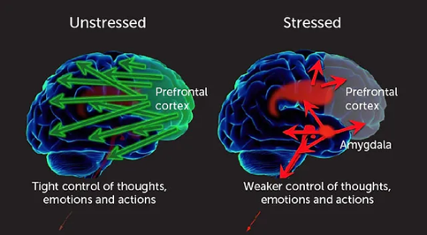
Flight, Flight or Freeze: The Brain
Moments of immediate and elongated stress (threats to location, life or bodily harm) can change one’s ability to make rational decisions. Intense stress impacts the brain and body in such a way that we can quickly go into fight, flight or freeze without being aware we have a choice.
Prefrontal connections to other brain areas are diminished
Notes:
As we talked about in the earlier session, the fight, flight, or freeze response refers to involuntary physiological changes that happen in the body and mind when a person feels threatened.
Under stress your brain may prevent you from hearing things that are happening around you. This can impact your situational awareness. Stress impacts your ability to process information. The higher the stress, the more difficult it can be to capture and process and understand information.
The fight-flight-freeze response is a type of stress response that helps you react to perceived threats, like an oncoming car or a growling dog. It’s a survival instinct that our ancient ancestors developed many years ago.
Specifically, fight-or-flight is an active defense response where you fight or flee. Your heart rate gets faster, which increases oxygen flow to your major muscles. Your pain perception drops, and your hearing sharpens. These changes help you act appropriately and rapidly.
Freezing is fight-or-flight on hold, where you further prepare to protect yourself. It’s also called reactive immobility or attentive immobility. It involves similar physiological changes, but instead, you stay completely still and get ready for the next move.
Fight-flight-freeze isn’t a conscious decision. It’s an automatic reaction, so you can’t control it. In this article, we’ll further explore what this response entails, along with examples.

Slide 136
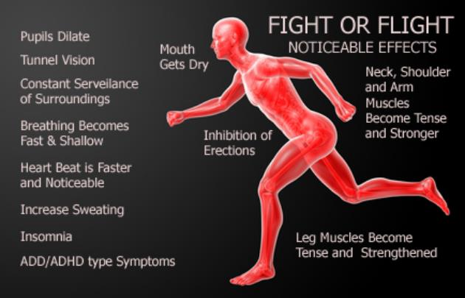
Fight, Flight or Freeze: The Body
This combination of reactions to stress is also known as the "fight-or-flight” because it evolved as a survival mechanism, enabling people and other mammals to react quickly to life-threatening situations.
Impact on the body and brain (Video)
Notes:
The carefully orchestrated yet near-instantaneous sequence of hormonal changes and physiological responses helps someone to fight the threat off or flee to safety. Unfortunately, the body can also overreact to stressors that are not life-threatening, such as traffic jams, work pressure, and family difficulties. Over the years, researchers have learned not only how and why these reactions occur, but have also gained insight into the long-term effects chronic stress has on physical and psychological health. Over time, repeated activation of the stress response takes a toll on the body.
During a fight-flight-freeze response, many physiological changes occur: The reaction begins in your amygdala, the part of your brain responsible for perceived fear. The amygdala responds by sending signals to the hypothalamus, which stimulates the autonomic nervous system (ANS).
The ANS consists of the sympathetic and parasympathetic nervous systems. The sympathetic nervous system drives the fight-or-flight response, while the parasympathetic nervous system drives freezing. How you react depends on which system dominates the response at the time.
In general, when your ANS is stimulated, your body releases adrenaline and cortisol, the stress hormone. These hormones are released very quickly, which can affect your: Heart rate. Your heart beats faster to bring oxygen to your major muscles. During freezing, your heart rate might increase or decrease. Lungs. Your breathing speeds up to deliver more oxygen to your blood. In the freeze response, you might hold your breath or restrict breathing. Eyes. Your peripheral vision increases so you can notice your surroundings. Your pupils dilate and let in more light, which helps you see better. Ears. Your ears “perk up” and your hearing becomes sharper. Blood. Blood thickens, which increases clotting factors. This prepares your body for injury.
Skin. Your skin might produce more sweat or get cold. You may look pale or have goosebumps. Hands and feet. As blood flow increases to your major muscles, your hands and feet might get cold. Pain perception. Fight-or-flight temporarily reduces your perception of pain.
Your specific physiological reactions depend on how you usually respond to stress. You might also shift between fight-or-flight and freezing, but this is very difficult to control.
Usually, your body will return to its natural state after 20 to 30 minutes.
https://www.healthline.com/health/mental-health/fight-flight-freeze#in-the-mind
For example, you may yell at your partner for pushing you into agreeing to speak at a conference when you don't feel ready (fight). Or you avoid going to a party or leave early because you don't feel comfortable around unfamiliar people (flight). Or, your mind goes blank when your boss asks you a question (freeze)

Slide 137
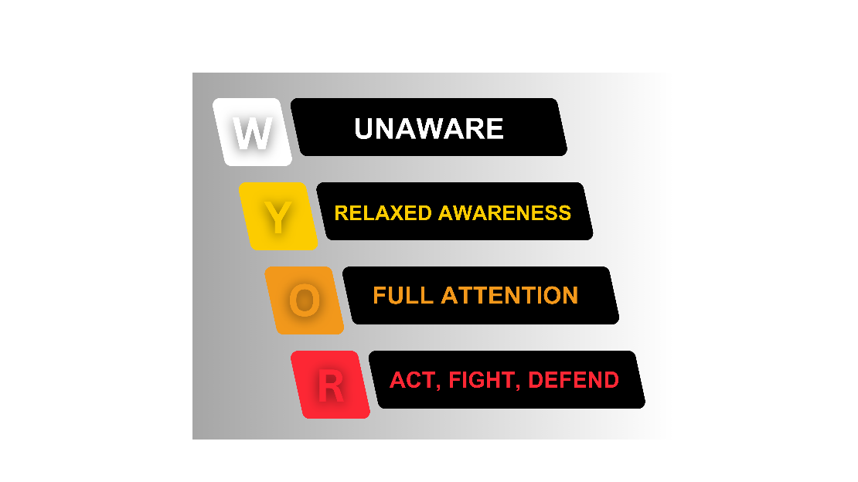
A short video describing Cooper’s color codes for more context
Notes:
Lt. Col. Jeff Cooper, retired from the United States Marine Corps and began a career traveling the world teaching, coaching and training. He is the creator of the modern technique for handgun shooting, as well as a world-famous expert in combat readiness and mindset. He is also widely known for the creation of his color codes which have been used by countless groups worldwide to illustrate the state of choosing to be aware despite one’s surroundings. The color codes of awareness are named after himself, the Cooper Color Codes.
Cooper’s Colors are a simple system for mentally applying and practicing situational awareness in your daily life, whether at school or away from it. These colors describe functional levels of awareness for yourself to apply within your surroundings. WHITE refers to a state of being unaware. YELLOW refers to a state of relaxed awareness. ORANGE refers to one’s full attention being triggered by an alert to the senses. RED refers to the choice made to act, fight or defend one’s self from likely danger. We all find ourselves within one of these colors during every waking hour. The goal for those practicing situational awareness is to remain resting in a state of YELLOW throughout most of your waking day, but how aware you choose to be at all times is up to you.

Slide 138

Notes:
Like the Cooper Color Codes, the OODA loop concept and theory was created by a military officer and strategist with combat experience, Lt. John Boyd, USAF retired. Boyd developed the OODA loop model after serving as a fighter pilot in the Korean War, and used it to explain the process for dynamic decision making. Over time, his theory was simplified and popularized for other audiences, and the merit of his theory became coopted into the para-military and law enforcement training world across the country, where it has gained widespread use.

Slide 139

The most common and simplified representation of the OODA loop theory: the OODA Loop in action: VIDEO
Notes:
“O” The OODA loops begins with making observations about what is happening in the environment, outside information, unfolding circumstances and implicit guidance and control.
“O” The orientation component of the OODA loop involves understanding, cross-referencing and combining genetic heritage, cultural traditions, analysis and synthesis, previous experiences and new information.
“D” The third component involves making the decision hypothesis and, finally, to implement an action.
“A” The action then unfolds and interacts with the environment and the process starts all over again. Hence, the term loop.

Slide 140
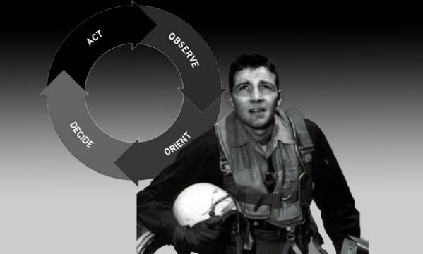
THE O.O.D.A. LOOP: CO-OPTED
The OODA loop can create a natural and trainable advantage for the practitioner of it.
Notes:
Over time, his theory was simplified and popularized for other audiences, and the merit of his theory became coopted into the para-military and law enforcement training world across the country, where it has gained widespread use.
The aspect of the OODA loop which promulgated popularity amongst law enforcement and combat minded individuals everywhere, specifically regarding situational awareness and active-shooter training, is by understanding that the OODA loop creates a natural and trainable advantage for the practitioner. One can throw their enemy off balance by getting inside their OODA loop which creates friction and can slow them down, causing the enemy to move from action with intent back to reaction and confusion, because it isolates the enemy mentally from changing orientation, essentially shifting the power balance back and forth for the advantage of the trained student using the theory and practicality of the OODA loop.

Slide 141
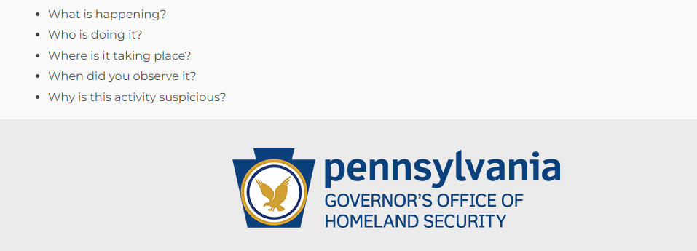
The 5 W’s
Notes:
Within the context of situational awareness and building the required muscles to be situationally aware more than you’re not, the 5 W’s are much more than a reporting tool, they’re being purposeful and mindful with your relation to the world around you. No matter where you are, what you’re doing, and what’s going on around you, you can practice your orientation with the environment at large.
There are five questions to ask yourself about a situation you observe or have become aware of, with the thrust of these answers creating a well-rounded orientation of a possible threat, emergency or a disaster of some sort. The 5 W’s are about orientation to a situation or possible emerging issue, with the answers to these questions playing a major role in providing a full picture to authorities or others in charge when making a tip. Whether you have a robust reporting system or are in need of creating one throughout your district, knowing how to train your faculty and staff using the 5 W’s is a quality place to start.
Throughout the regular course of your day or sporadically throughout the week, stop yourself from aimlessly moving from one point to another and try and answer the 5 W’s about where you are and what you’re seeing.
Stay alert. Always be aware of your environment and any possible dangers. If you see something, say something® to local authorities. That includes suspicious packages, people behaving strangely or someone using strange communications. Observe warning signs. Signs might include unusual or violent communications, substance abuse, expressed anger or intent to cause harm. These warning signs may increase over time. Have an exit plan. Identify exits and areas to hide wherever you go, including work, school and special events. Learn lifesaving skills. Consider taking trainings such as You Are the Help Until Help Arrives, Stop the Bleed, first aid or other lifesaving courses to assist the wounded before help arrives.

Slide 142
Safety Planning
Do you have problems with people using door props?
Are there areas of the building or times in the day when students are unattended when they could use supervision?
What happens when a door isn’t working or a lock stops locking?
Do staff and employees know where and how to report issues of safety and security concern?
A short video demonstrating quality situational awareness and safety planning within and educational setting: VIDEO
Notes:
When we talk about safety planning and situational awareness within our own educational environments, and then taking it a step further with regard to applying principals learned and training your staff, think about the common issues you might face around your school buildings and how they relate to situational awareness and safety planning.
Your plan in your district could range from common everyday checklists, to regular reminders for faculty and staff about the changes in readiness levels throughout the school year. Part of your safety plan for creating situationally aware educational environments could be as simple as making this resource available to all of your faculty, staff and employees.
Act 55 of 2022 requires all school employees to complete two hours of training annually on one or more of the following school safety and security topics: situational awareness, trauma-informed approaches, behavioral health awareness, suicide and bullying awareness, and substance use awareness. In addition, one hour of annual training is required for all school employees on the topics of emergency training drills (including fire, natural disaster, active shooter, hostage situation and bomb threat), and the identification or recognition of student behavior that may indicate a threat to the safety of the student, other students, school employees, other individuals, school facilities, or the community. If more insight is needed to properly build out your district’s Emergency Preparedness Plan, please look to FEMA’s Developing and Maintaining Emergency Operations Plans Comprehensive Preparedness Guide (fema.gov) for help and added guidance.
Act 55 Annual Training Requirements: Live / In-Person
Minimum of 1hr of training annually for all employees in the areas of Emergency Training Drills, which must be presented in-person and Identification of Concerning Behaviors that May Indicate a Threat.
Build in time to cover situational awareness and how that relates to engaging with your districts Emergency Preparedness Plan and broadly the threats it may encounter.
Situational awareness means being aware of what is happening around you and then being able to form a plan about how to deal with the stimuli you notice. Like sitting down for a movie and noting the exits in the theatre, or being on morning bus duty and noticing shards of glass on the ground where the busses unload students. In each case, you’re paying attention to your surroundings and scanning it for possible issues, concerns, or outright dangers.
Here is a short video from Washington County, Maryland School Distract which demonstrates quality situational awareness and safety planning within and educational setting:
When we talk about safety planning and situational awareness within our own educational environments, and then taking it a step further with regard to applying principals learned and training your staff, think about the common issues you might face around your school buildings and how they relate to situational awareness and safety planning. As some examples:
Do you have problems with people using door props?
Are there areas of the building or times in the day when students are unattended when they could use supervision?
What happens when a door isn’t working or a lock stops locking?
Do staff and employees know where and how to report issues of safety and security concern?
Your plan in your district could range from common everyday checklists, to regular reminders for faculty and staff about the changes in readiness levels throughout the school year. Part of your safety plan for creating situationally aware educational environments could be as simple as making this resource available to all of your faculty, staff and employees.

Slide 143
Special Needs: SECTION 504
VISUALLY IMPAIRED
WHEEL CHAIR BOUND
SOCIAL DISORDERS
SENSORY ISSUES
PHYSICAL DISABILITIES
SPEECH & LANGUAGE DISABILITIES
HARD OF HEARING
DEAF
NOT READILY APPARENT
BEHAVIORAL DISORDERS
BLIND
BROKEN LEG
TEMPORARY CONDITION
MILD TO SEVERE
DEVELOPMENTAL DISSABILITIES
EMOTIONAL DISORDERS
COGNITIVE DISABILITIES
The REMS Training Package is a resource that schools can use to plan for students and Faculty with Disabilities.
Notes:
It is important for school entities to understand the importance of identifying and preparing for the impact of a given situation on students and staff with special or specific needs. A few examples of these needs may include Sensory issues like being deaf or hard of hearing, blind or visually impaired, as well as adverse reactions to light, sound or physical contact. Other considerations should be given for people with Cognitive or Developmental disabilities, Speech and Language, or other Physical disabilities. Additionally, other considerations may include individuals with Social, Emotional, or Behavioral disorders that may manifest adversely during an emergency situation. These are just a few examples of the wide-ranging types of disabilities that require consideration during an emergency situation. Students with disabilities and the people who serve them often form their own unique community or culture. There are a range of disabilities and access and functional needs: The manifestation of a disability ranges from mild to severe; A mild disability may not be apparent and cause no significant effect on the functioning of the student; A temporary condition, such as a broken leg, is not considered a disability under ADA. Regardless, schools should always consider how temporary disabilities will be accommodated during an emergency event and include such considerations in their district and school emergency preparedness plan; It is not uncommon for some students to have several related disabilities.
As a reminder, Section 504 of the Rehabilitation, Comprehensive Services, and Developmental Disabilities Act of 1978 stresses that “no otherwise qualified individual with a disability shall, solely by reason of his or her disability, be excluded from participation in, be denied the benefits of, or be subjected to discrimination under any program or activity receiving Federal financial assistance. This would include emergency management programs and activities.”
In this resource from the Red Cross, Preparing for Disaster for People with Disabilities and Other Special Needs, you have a useful guide at your disposal which can be altered and applied to the school-based setting. Within this pdf, you’ll find it breaks information down into four main sections.
1. Complete a personal assessment: Decide what you will be able to do for yourself and what assistance you may need before, during and after a disaster. This will be based on the environment after the disaster, your capabilities and your limitations. To complete a personal assessment, make a list of your personal needs and your resources for meeting them in a disaster environment.
2. Make a Plan: Because a disaster can disrupt your primary emergency plan, it is also important for you to develop a back-up plan to ensure your safety.
3. Assemble a Disaster Supplies Kit: In the event you need to evacuate at a moment’s notice and take essentials with you, you probably will not have the opportunity to shop or search for the supplies you and your family will need. Every household should assemble a disaster supplies kit and keep it up to date.
4. Maintain your Plan and Kit: Quiz, drill, Re-stock and Test.

Slide 144
Future Threats
Schools: Social Media Surveillance (Brennan Center for Justice)
Social Media Surveillance in Schools: Rethinking Public Health Interventions in the Digital Age (National Institute of Health)
Why Expensive Social Media Monitoring Has Failed to Protect Schools (Slate Magazine)
How schools search students’ social media for threats, and why some experts warn against it (IndyStar)
School Climate Resources (Pennsylvania Department of education)
School Health Index (Centers for Disease Control and Prevention)
Notes:
Schools today face a greater need to know more and more about what is happening in their communities and throughout their districts at large, these resources provide insight into differing ways to monitor the local community for potential issues in safety, while keeping in mind a community’s right to privacy. There are four articles that deal with social media monitoring, with each article providing a different context for monitoring. We are not training today on should you use social media monitoring or not, but giving you resources to read on your own and decide for yourself if it makes sense to do so in your community. The fifth and sixth resources are related school climate, culture and the valuable information for understanding your local community that can come from performing regular checks on the overall health of your educational setting. Understanding your school’s climate and how it waxes and wanes is integral into understanding the culture being built and sustained in your community.
These articles can help you as you decide on the implementation of new strategies to monitor threats and to prepare for the future.

Slide 145
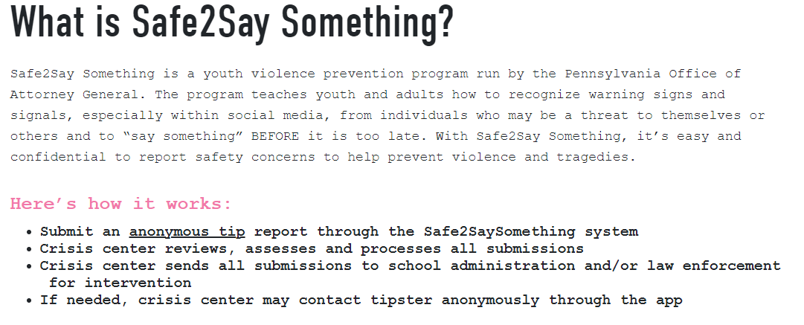
Safe2SayPA: Brief Overview
Notes:
Safe2Say Something is a youth violence prevention program run by the Pennsylvania Office of Attorney General. The program teaches youth and adults how to recognize warning signs and signals, especially within social media, from individuals who may be a threat to themselves or others and to “say something” BEFORE it is too late. With Safe2Say Something, it’s easy and confidential to report safety concerns to help prevent violence and tragedies.
Safe2Say is a free, online, call-in or app based, anonymous tip line and resource for all Pennsylvania schools. As a resource, it provides information teaching “…youth and adults how to recognize warning signs and signals, especially within social media, of individuals who may be a threat to themselves or others…” (Safe2Say website “For Parents & Educators”). To submit a tip through Safe2Say, anyone can call anonymously, text into the hotline, submit a web form or use the app. Safe2Say is a best practice within the state of Pennsylvania and schools are encouraged to make the use and training of it a priority throughout their educational setting. On top of using Safe2SayPA for reporting purposes, all schools in Pennsylvania are encouraged to conduct Safe2Say Something education and awareness programs on a yearly basis for all 6-12 grades enrolled students. There are four options available for educating students and others about the program: Online Videos, Virtual Live, DIY or requested In-Person trainings.
---
Provides anonymous reporting of unsafe, potentially harmful, dangerous, violent or criminal activities in a school entity or the threat of the activities in a school entity.
Establishes protocols and procedures for immediate threats of violence, life safety, or criminal activities by notification to the appropriate law enforcement agencies by 911 emergency centers
To ensure that the identity of the individual making a report remains unknown to any person, including law enforcement officers and employees of the office.
To ensure that information obtained from an individual making a report who voluntarily discloses his or her identity and verifies that he or she is willing to be identified may be shared with law enforcement officers, employees of the office and school officials.
To ensure that if the identity of an individual making a report becomes known through a means other than voluntary disclosure, the identity is not further disclosed.
To establish procedures to promptly forward information received by the program to the appropriate law enforcement agency, school official or organization, as determined by the office. The office may not be held liable for investigation of a report made to the program following confirmation of receipt of the report by the appropriate law enforcement agency, school official or organization.
To train or provide instruction to individuals, including, but not limited to, emergency dispatch centers and school entities, on appropriate awareness and response to the program.
To provide program awareness and education materials to school entities.
To, in consultation with the Department of Education, establish guidelines school entities may utilize to respond to a report received from the program.

Slide 146
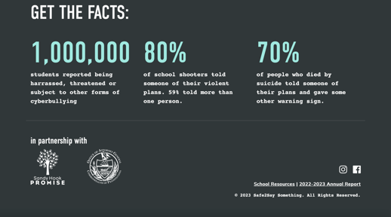
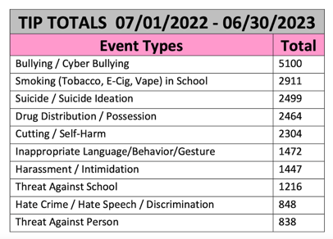
Safe2SayPA: Valuable Data
Notes:
Finding and downloading the annual reports from Safe2SayPA is a worthwhile endeavor for anyone in your position. If you have never looked over your meta data from within your IU footprint in this format, you should. You also have the data for your district directly from Safe2SayPA upon request, which is helpful to catalog overtime and forecast out based on trends you’re seeing.

Slide 147
PHYSICAL ASSESSMENTS & PHYSICAL SECURITY

Slide 148
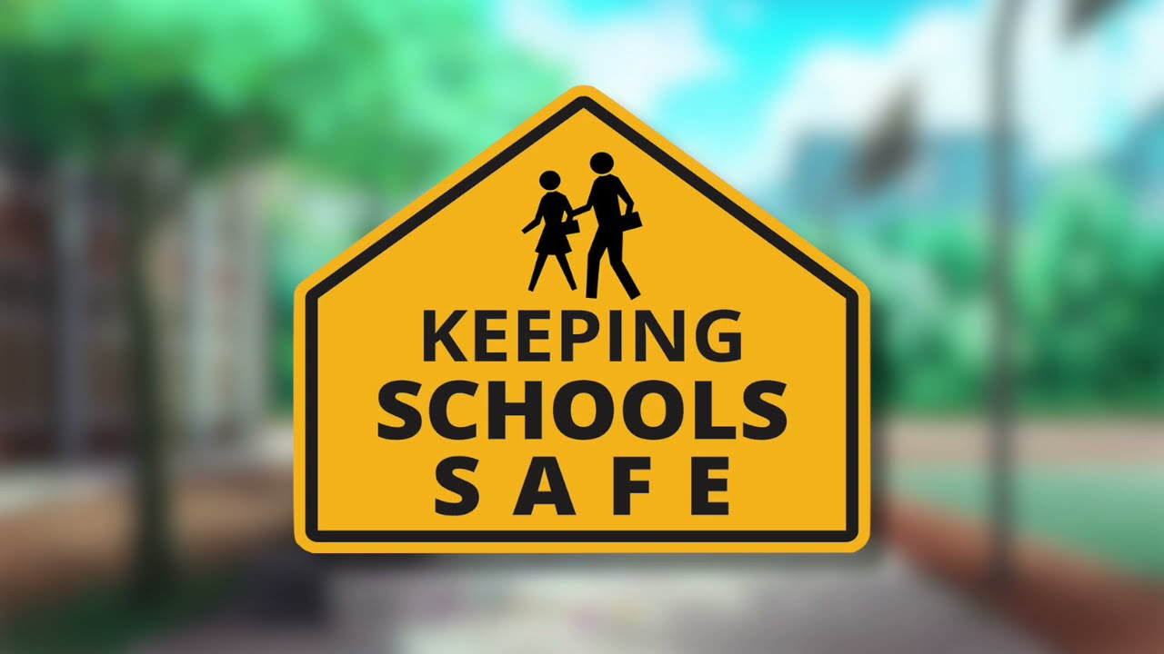
Notes:
Overview of Section 1309-B of the Public School Code
The safety and security of students and staff in our schools is our number one priority. As the Safety and Security Coordinator, you are required to understand the statutory requirements of laws to ensure that your school entity provides for the safety and security of children. Act 44 and as amended by Act 55 of 2022 require school districts to appoint a School Safety and Security Coordinator and to provide training in Physical Assessments and Security for the Coordinators. During this training, we will review several of the sections of Act 44 and Act 55 as they relate to the role of SSSCs and the safety and security of our schools.
Section 1309-B of PA Public School Code requires the chief school administrator of a school entity to appoint a school safety and security coordinator who is responsible for a number of duties related to school safety and security. General duties include overseeing all school police officers, school resource officers, and security guards. In addition, SSSCs are responsible for overseeing the policies and procedures related to school safety and security. The School Safety and Security Coordinator will report directly to the chief school administrator.
Specific duties are spelled out in section 1309-B and again in Use of Assessment Criteria by School Entities.
The specific duties section of 1309-B states that SSSCs shall:
3) Coordinate School Safety and Security Assessments as necessary. For additional context on ‘as necessary’ there is some guidance on the PCCD School Safety and Security Assessment Criteria Toolkit page that states “As the administrator responsible for coordinating school safety and security assessments as necessary, coordinators should review these criteria, and review the school entity’s policies and procedures relative to school safety and security to ensure compliance with Federal and State laws regarding school safety and security. The coordinator should work with his or her chief school administrator and governing board to determine what type of assessment may be beneficial to the school entity.”
When considering Physical Assessment options, it is recommended that you enlist the assistance of the PA State Police Risk and Vulnerability Assessment Team (RVAT) or a private individual or entity to conduct your physical security assessment. Private assessors must be approved by and registered with PCCD. Demand for the RVAT team assessment is extremely high. More information will be provided on this ahead in the training.
The above duties are what you must do by law, but your approach to safety and security and the manner in which you interact with the building principals, teachers and other school staff directly affects the safety and security of the buildings in your district. Your energy and attitude related to school safety and security is observable to your to administration, faculty, staff, students and parents. Encouraging and supporting the training and firm adherence to school safety and security policies and procedures makes your schools safer for students and staff. It is important to not be in denial about the possibility of something bad happening. A common thought among staff in our respective school districts is likely to be that the worst-case scenario cannot or will not happen at their school. It is our job to never fall into this trap of believing that “nothing bad can happen” and for you as the School Safety and Security Coordinator to impress this upon your staff.

Slide 149
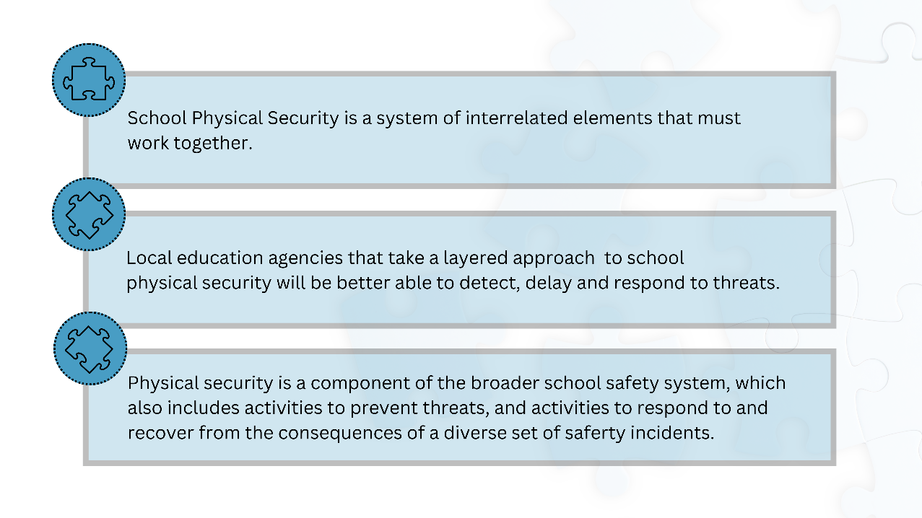
Notes:
Schools are complex environments that require balancing safety, teaching and learning, school operations and culture, and families and the surrounding community. School safety is just one piece of the puzzle, and a school cannot achieve its educational mission without all these elements working in concert.
What is physical security and what is a physical assessment?
Physical Security relates to measures taken to deny unauthorized access to facilities, resources, and equipment and to protect students, personnel and property from damage or harm. Physical Security’s goals are to deter intruders, detect intrusions and monitor or record them, and to trigger an appropriate and timely response, and mitigate the impacts of incidents when they do occur. You’ll notice that many of the best practice criteria are designed specifically to delay trespassers/intruders (buy time) until law enforcement arrives.
Some components of physical security are signs, fences, locks, vehicle barriers, lighting, alarms, cameras, communications, access control, and school security personnel.
A Physical Assessment is a strategic evaluation of a school entity’s facilities and programs used to identify potential safety and security threat potentials, and vulnerabilities in relation to threat potentials.
The assessment looks for vulnerabilities and deficiencies in physical security components and makes recommendations to strengthen or eliminate vulnerabilities and deficiencies. One of the responsibilities of the School Safety and Security Coordinator is to coordinate School Safety and Security Assessments as necessary.

Slide 150
Notes:
The National Preparedness System highlights five mission areas — prevention, mitigation, protection, response, and recovery — to help achieve elements of the goal. ​School safety, security, emergency management, and preparedness work to continually build capacity in each of the five preparedness missions, using the paradigm Before, During, and After. For example, we want to identify protection activities that can be carried out before, during, and after a possible emergency.​

Slide 151
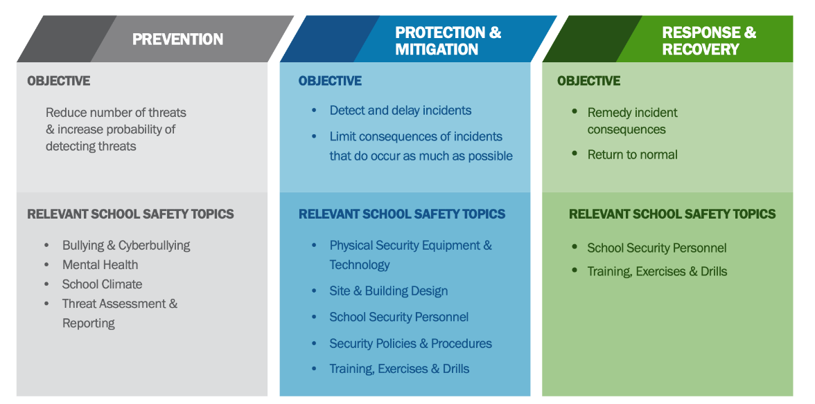
Notes:
Prevention is defined as the action schools and school districts take to prevent a threatened or actual incident from occurring.
Protection is the ongoing actions schools and school districts take to safeguard the school, students, and staff from an emergency event. School buildings and grounds can be used to provide protection to the school community.
Mitigation focuses on actions schools and school districts take to eliminate or reduce the loss of life, injuries, and property damage from an emergency event.
Response is putting the school’s and school district’s plans into place to effectively respond to an emergency event and provide for the immediate needs of students and staff. By examining the emergency preparedness and accessibility of buildings and grounds, site assessments provide schools with the opportunity to enhance their response capabilities during an emergency.
Recovery is teaming with community partners to restore educational programming; the physical environment; business operations; and social, emotional, and behavioral health. Site assessments can help document any damage and help schools recover from an emergency.

Slide 152
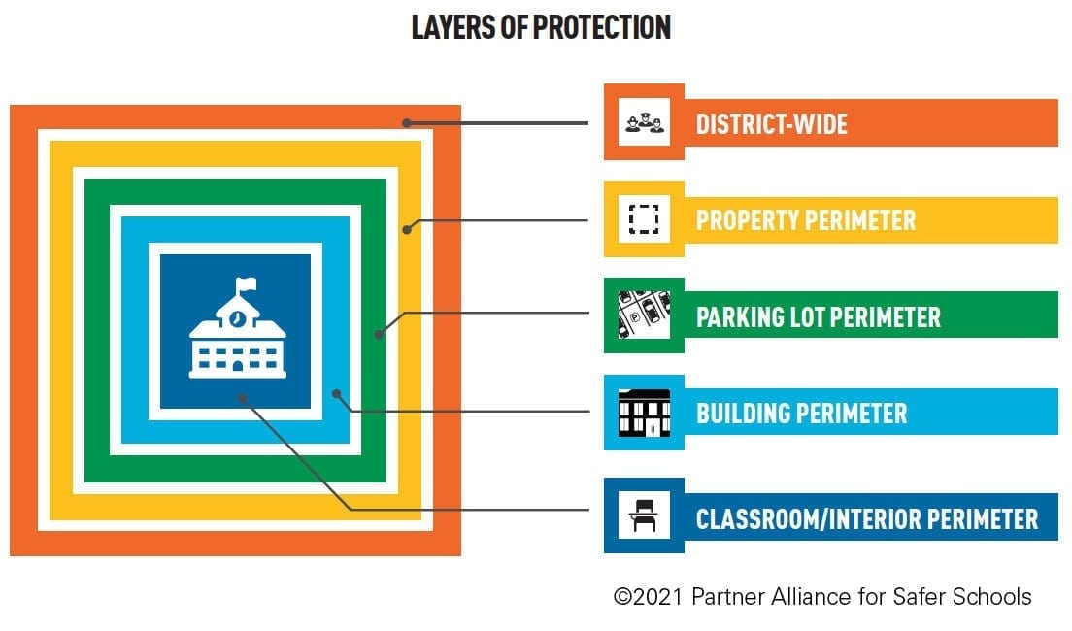

Slide 153
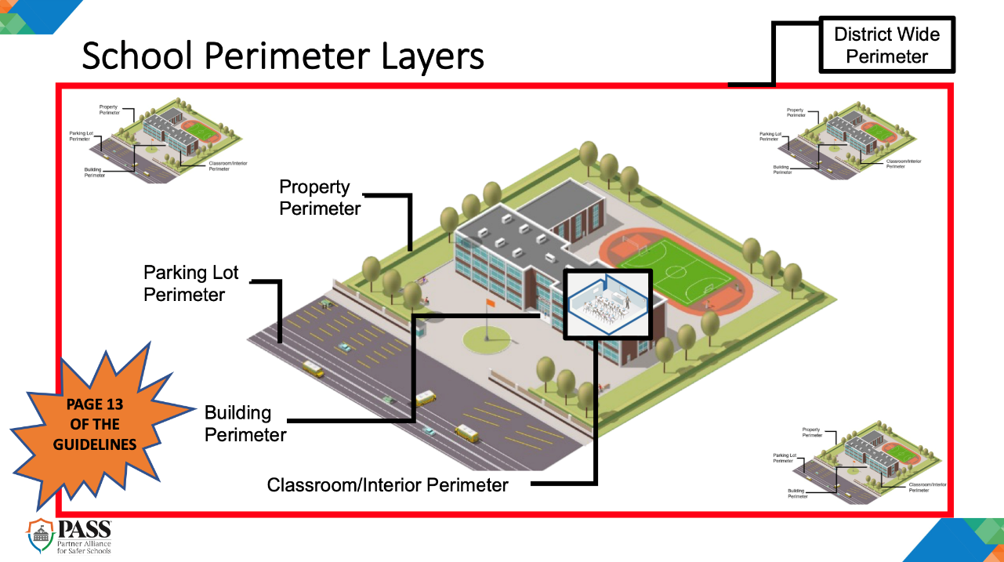


Slide 154
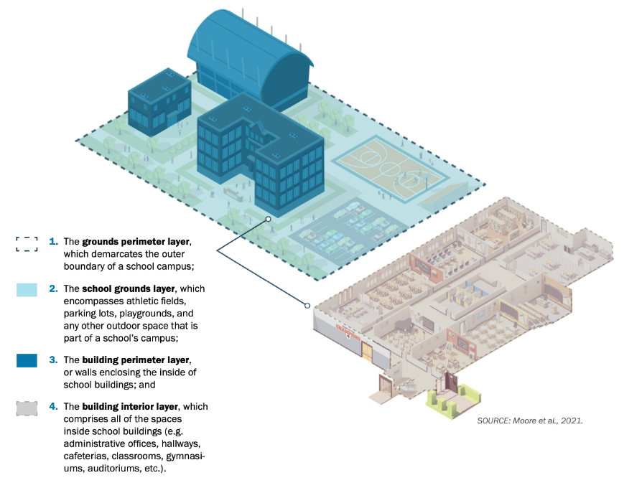
SCHOOL PHYSICAL
SECURITY
LAYERS
Notes:
A layered approach to school physical security prevents single points of failure within the system. Consider the example of an outside attacker attempting to enter a school with highly protected grounds to commit an attack. If the attacker successfully breaches a barrier such as a tall fence that surrounds school grounds (the school grounds perimeter layer), surveillance video from a CCTV system installed in the school parking lot (the school grounds layer) will alert security personnel monitoring the video feed in real time to their presence. Detection of the threat on school grounds can activate subsequent security measures at other layers, such as automatic door locks and lockdown procedures to protect both the building perimeter and building interior layers.
By organizing their physical security system into layers, local education agencies can better ensure that the system contains interconnected support elements that help avoid gaps in protection and mitigate against single points of failure. In layered systems, physical security technology, building or grounds design features, personnel, and policies all have specific functions based on whether they are in place to protect a school’s outer perimeter (for example, designated vehicle and pedestrian entrances), the area within school grounds but outside school buildings (for example, athletic fields and other venues that might host outdoor events), the school building perimeter (for example, entrances into the main building and additional buildings), or areas within the school building, such as classrooms, hallways, and common spaces.

Slide 155
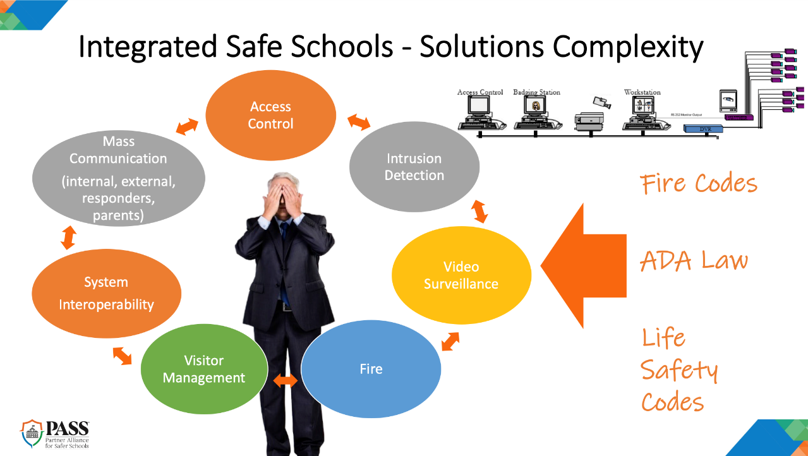

Slide 156
Key Questions for Addressing Physical Security:
What threats are likely to enter my school environment, and where are these threats likely to enter?
If a threat were to enter my campus, when would security measures already in place detect the presence of the threat?
How would existing policies and measures already in place across campus delay the threat, and for how long?
What policies and measures already in place across campus would allow enough time for responding to an incident?
  The answers to these questions define the starting point for considering ways to strengthen security.

Slide 157
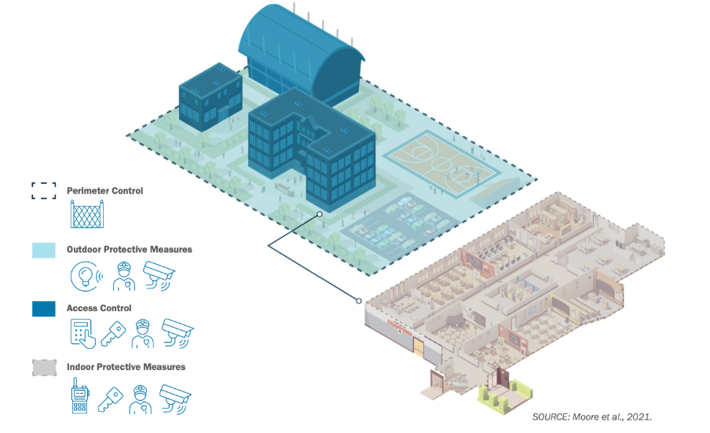
TAKING A LAYERED
APPROACH
Notes:
Because schools vary significantly, it is important to note the specific campus and school building layout for each school, as well as where the school is physically located; these factors should dictate the relevance of particular layers in providing security benefits. A school with an open campus and portable classrooms, for instance, would be forced to prioritize physical security at the school-grounds, building-perimeter, and building-interior layers since investing in measures designed to provide protection at the campus perimeter would be less viable. A closed-campus school might shift some resources away from securing its grounds in favor of investing in fencing, signage, and security cameras placed at entry points located at the campus-perimeter layer. Additionally, a school that allows community members to use its athletic fields outside of regular school hours and hosts large outdoor events such as musical or theatrical performances or sports games would also need to prioritize event protection measures at the school grounds layer.

Slide 158
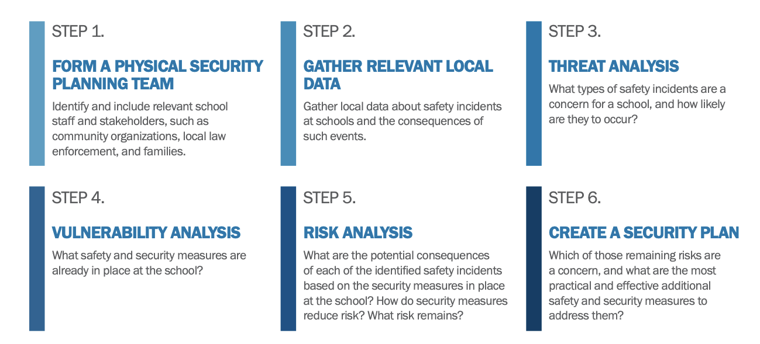
Notes:
Local education agencies should plan carefully as they prepare to implement or improve their physical security system. Planning is essentially a six-step process that begins with the formation of a planning team, follows with gathering relevant local data, and continues with conducting threat and vulnerability analyses. The last two steps involve conducting a risk analysis, which draws on results of the threat and vulnerability analyses, and the development of a comprehensive security plan that is unique to a particular school. Throughout the process, local education agencies should consult with local first responders to ensure that fire, police, and other emergency personnel are aware of any newly implemented security features, understand how they work, and confirm that they are not in violation of local codes or regulations. Importantly, care must be taken to avoid actions that impede access to egress and exit routes for students, teachers, and others with disabilities on the school grounds. Repeating this planning process on an annual basis can help local education agencies maximize the benefits of their security system over the long term.
A threat analysis determines what types of safety-related incidents are a concern to the school and how likely these are to occur. It is a key input to the complementary risk analysis, which examines the potential consequences of each type of incident for that specific school. Although school threat and risk analyses are beyond the scope of this guide, local education agencies should be aware that they are key parts of the process alongside a thorough vulnerability analysis. In the course of a vulnerability analysis, local education agencies take stock of the set of existing security measures in place at a specific school, and assess how these measures address threats a school has identified as relevant based on its local context. Local education agencies should use this guide to help them undertake a vulnerability analysis. The K-12 School Security Assessment Tool, which accompanies this guide, also walks users through a tailorable vulnerability analysis, and provides results and recommendations that local education agencies can integrate into revised physical security plans. Version 1.0 of the tool does not contain a threat or risk analysis component; local education agencies can refer to a number of other resources to help them through these steps of the planning process

Slide 159

PCCD Assessment Criteria
A school safety and security assessment is a strategic evaluation of a school entity’s facilities and programs used to identify potential safety and security threats - Assessments are to include consideration of the safety and security of a school entity’s physical environment, the school entity’s climate and behavioral health environment, and all related policies and training.
Notes:
This toolkit is intended to be used to inform both school entities and assessors as to the state of a school’s safety and security preparedness. The criteria are not meant to direct school entities to have all of these best practices in place, but rather to guide school officials with respect to what they may need to do to create a safer, more secure learning environment.
Tiers have been applied to the statements to indicate the uniqueness of each school entity. These tiers, tier 1, 2, and 3 (T1, T2, T3), provide information on the types of security equipment, services and programs, trainings, policies and procedures that are in place in each school. Tier 1 could be considered the baseline of services to be met with tiers 2 and 3 being considered additional elements that build upon and strengthen the foundations of the physical safety and security of buildings and grounds; policy/procedure and trainings, and the student assistance and behavioral health support of the school entity.

Slide 160
School Safety & Security Assessment: 3 Parts
A PHYSICAL ASSESSMENT (PHYSICAL SAFETY & SECURITY)
  Physical Assessment Criteria (Downloadable Document from Toolkit)
2. A POLICY AND TRAINING ASSESSMENT (WRITTEN DOCUMENTATION / EOP)
  Policy and Training Assessment Criteria (Downloadable Document from Toolkit)
3. A STUDENT ASSISTANCE AND BEHAVIORAL HEALTH SUPPORT ASSESSMENT (CLIMATE & CULTURE)
  Student Assistance and Behavioral Health Support Assessment Criteria (Downloadable Document from Toolkit)
Notes:
A PHYSICAL ASSESSMENT (PHYSICAL SAFETY & SECURITY) – The physical assessment shall be conducted during calendar months when school is in session and shall consist of an evaluation of the school entity's structural facilities and surrounding property that includes:
An evaluation of the school entity's structural facilities and surrounding property that includes
A review of the school entity's existing school safety and security plan.
A review of the school entity's existing plans for crisis response and mitigation.
An analysis of the school entity's crime prevention policy or practices, including environmental design.
Discussions with the local law enforcement agencies that are primarily responsible for protecting and securing the school.
An analysis of the school entity's cooperative agreements with the local law enforcement agencies that are primarily responsible for protecting and securing the school.
Discussions with the school entity's employees.
A POLICY AND TRAINING ASSESSMENT (WRITTEN DOCUMENTATION / EOP) - The policy and training assessment shall consist of an evaluation of the school entity's policies and practices, including:
An analysis of the school entity's policies related to student safety, security and management issues.
Discussions with the school entity's employees.
A review of the school entity's student code of conduct.
Recommendations for effective school safety and security training and practices for all school entity employees.
An analysis of the school entity's communications practices and available technology and tools.
A review of the school entity's safety and security training practices.
A general review of:
Statutory policies related to school safety and security
Criteria-based policies relating to school safety and security
Statutory training
Criteria-based training
A STUDENT ASSISSTANCE AND BEHAVIORAL HEALTH SUPPORT ASSESSMENT (CLIMATE & CULTURE) - The student assistance and behavioral health support assessment shall consist of an analysis of the school entity's climate, including:
The availability of student assistance programs and behavioral health professionals to provide assistance to the school entity.
A review of recommendations by behavioral and physical health professionals and consideration of their recommendations.

Slide 161
A PHYSICAL ASSESSMENT (PHYSICAL SAFETY & SECURITY) – The physical assessment shall be conducted during calendar months when school is in session and shall consist of an evaluation of the school entity's structural facilities and surrounding property that includes:
  An evaluation of the school entity's structural facilities and surrounding property that includes
  A review of the school entity's existing school safety and security plan.
  A review of the school entity's existing plans for crisis response and mitigation.
  An analysis of the school entity's crime prevention policy or practices, including environmental design.
  Discussions with the local law enforcement agencies that are primarily responsible for protecting and securing the school.
  An analysis of the school entity's cooperative agreements with the local law enforcement agencies that are primarily responsible for protecting and securing the school.
  Discussions with the school entity's employees.
Notes:
The Assessment Criteria is presented in a tiered approach. Tier 1 should be considered to be the baseline of approaches and should be considered mandatory when reviewing a building.
Tiers 2 and 3 are generally considered to be additional elements that build upon and strengthen the foundations of school security.
The Assessment Criteria for Physical Vulnerabilities section represents the best practices for the actual evaluation and assessment for physical vulnerabilities of a school. All physical criteria act in concert with one another to create a safe and secure environment. A flaw in any of the criteria can create a weak link or vulnerability which threatens the whole. When you download and review the entire document, you will see that the criteria are separated into categories related to the physical characteristics of your school. External assessors must use these criteria when completing an assessment.

Slide 162
A POLICY AND TRAINING ASSESSMENT (WRITTEN DOCUMENTATION / EOP) -- The policy and training assessment shall consist of an evaluation of the school entity's policies and practices, including:
  An analysis of the school entity's policies related to student safety, security and management issues.
  Discussions with the school entity's employees.
  A review of the school entity's student code of conduct.
  Recommendations for effective school safety and security training and practices for all school entity employees.
  An analysis of the school entity's communications practices and available technology and tools.
  A review of the school entity's safety and security training practices.
  A general review of:
1. Statutory policies related to school safety and security
2. Criteria-based policies relating to school safety and security
3. Statutory training
4. Criteria-based training
Notes:
According to Act 44 of 2018, policy and training assessment shall consist of an evaluation of the school entity’s policies and practices to include:
(i) An analysis of the school entity's policies related to student safety, security and
management issues.
(ii) Discussions with the school entity's employees.
(iii) A review of the school entity's student code of conduct.
(iv) A review of the school entity's safety and security training practices.
(v) Recommendations for effective school safety and security training and practices
for all school entity employees.
(vi) An analysis of the school entity's communications practices and available
technology and tools.
PCCD again has a wealth of information located in the Policy and Training Assessment Criteria document that is located on the PCCD School Safety and Security Assessment Criteria Toolkit webpage. School entities should be prepared to provide documentation of compliance with all mandated policies and procedures to assessors. A school safety assessor is required to review and analyze policies/procedures and make recommendations for effective school safety and security training and practices for all school entity employees.
This document is also in a tiered approach format. It is recommended that all School Safety and Security Coordinators are familiar with this document to understand the statutory and criteria-based policies and procedures relating to school safety and security.
Collaboration is key when understanding the importance of physical security in school. School leaders and school employees must have a clear understanding of the policies and procedures in place to keep the physical space not only within the school but also the school grounds safe and secure. There should be frequent communication around the expectations and clear procedures in place to report any suspected problems.

Slide 163
A STUDENT ASSISTANCE AND BEHAVIORAL HEALTH SUPPORT ASSESSMENT (CLIMATE & CULTURE) -- The student assistance and behavioral health support assessment shall consist of an analysis of the school entity's climate, including:
The availability of student assistance programs and behavioral health professionals to provide assistance to the school entity.
A review of recommendations by behavioral and physical health professionals and consideration of their recommendations.
Notes:
According to Act 44 of 2018, the student assistance and behavioral health support assessment shall consist of an analysis of the school entity's climate, including:
(i) The availability of student assistance programs and behavioral health professionals
to provide assistance to the school entity.
(ii) A review of recommendations by behavioral and physical health professionals and
consideration of their recommendations.
A link to Student Assistance and Behavioral Health Support Assessment Criteria can be found the on the PCCD School Safety and Security Assessment Criteria Toolkit webpage
NOTE: PCCD is currently in the process of convening a workgroup to assist with updating the behavioral health support assessment criteria toolkit to align with the baseline criteria for behavioral health which was updated in 2023. Until such time as the Assessment Criteria Toolkit is updated, the material in this presentation will focus on the existing toolkit. Materials will be updated when they become available.
Information on Student Assistance Programs and Behavioral Health topics are covered in detail in other parts of the School Safety and Security training modules.
An additional consideration in this section that is important is on school climate. School climate is a multi-faceted area that reflects the school community’s norms, goals, and values and is based on students’, parents’ or families’, and school staff’s perceptions of school life. Research has found that a negative school climate is associated with higher rates of school violence and disorder. A positive school climate is recognized as a protective factor supporting positive youth development.
School climate improvement strategies should be led by building level teams empowered to engage the broader school community in identifying needs and implementing improvement strategies. Climate assessments should involve multiple data sources and include, at minimum, surveys, of students’ and other stakeholders’ perceptions of the school climate. Quality climate assessments are psychometrically sound and include multiple domains informed by research, such as: safety, school connectedness, positive relationships, engagement, social-emotional learning, and student supports. When you are able, please review the tiered general guidelines for school climate considerations found within the document.
The assessment of behavioral health and school climate leads to an additional strategy on CPTED. The strategy is called the second generation of CPTED. This strategy shifts away from the physical environment to the emotional and psychological aspects of crime prevention and school security. Often the presence of highly visible security features like metal detectors can negatively impact school climate and the students’ perception of their safety. A positive school climate is a critical element of school safety and security. The concepts in the principles of second generation CPTED often overlap and relate back to the “first generation” principles of Natural Surveillance, Natural Access Control, Territoriality, and Maintenance.
Social Cohesion - promotes positive interactions between students, staff, families, and residents. Social cohesion involves inclusive activities that create a sense of unity among individuals. This principle is related to Territoriality and Activity Support from the First generation CPTED principles which encourages ownership of the school property by the entire school community.
Connectivity - This principle promotes connections to and communications with local residents, businesses, public libraries, and community organizations. This principle expands social cohesion to entities outside of the immediate school community.
Threshold Capacity - aims to create spaces that have multiple uses that are open and available for community use. For example, youth sports using the school’s fields, sharing the school stage for community theater, and allowing library use for youth book clubs.
Community Culture - fosters a sense of school pride and brings school community members together for a common purpose. This principle involves social activities that engage community members within a school. School clubs, and athletics as well as concerts, art shows, dances, and fairs are examples.
Student Assistance and Behavioral Health Support Assessment Criteria:
PCCD is currently in the process of convening a workgroup to assist with updating the behavioral health support assessment criteria toolkit to align with the baseline criteria for behavioral health which was updated in 2023. Until such time as the Assessment Criteria Toolkit is updated, the material in this presentation will focus on the existing toolkit. Materials will be updated when they become available.

Slide 164
Toolkit Links: Printable & Usable
Overview of Section 1303-B of Act 44
Use of Assessment Criteria by School Entities
Use of Assessment Criteria by Assessors
Physical Assessment Criteria
Student Assistance and Behavioral Health Support Assessment Criteria
Policy and Training Assessment Criteria
Additional Resources
Notes:
LINKS TO DOWNLOADBLE & PRINTABLE TOOLKIT DOCUMENTS:
Overview of Section 1303-B of Act 44 (Downloadable Document from Toolkit)
(1) A physical assessment. The physical assessment shall be conducted during calendar
months when school is in session and shall consist of an evaluation of the school entity's
structural facilities and surrounding property that includes:
(i) A review of the school entity's existing school safety and security plan.
(ii) A review of the school entity's existing plans for crisis response and mitigation.
(iii) An analysis of the school entity's crime prevention policy or practices, including
environmental design.
(iv) Discussions with the local law enforcement agencies that are primarily responsible
for protecting and securing the school.
(v) An analysis of the school entity's cooperative agreements with the local law
enforcement agencies that are primarily responsible for protecting and securing the
school.
(vi) Discussions with the school entity's employees.
(2) A policy and training assessment. The policy and training assessment shall consist of an
evaluation of the school entity's policies and practices, including:
(i) An analysis of the school entity's policies related to student safety, security and
management issues.
(ii) Discussions with the school entity's employees.
(iii) A review of the school entity's student code of conduct.
(iv) A review of the school entity's safety and security training practices.
(v) Recommendations for effective school safety and security training and practices
for all school entity employees.
(vi) An analysis of the school entity's communications practices and available
technology and tools.
(3) A student assistance and behavioral health support assessment. The student assistance
and behavioral health support assessment shall consist of an analysis of the school entity's
climate, including:
(i) The availability of student assistance programs and behavioral health professionals
to provide assistance to the school entity.
(ii) A review of recommendations by behavioral and physical health professionals and
consideration of their recommendations.
Use of Assessment Criteria by School Entities (Downloadable document from Toolkit)
(a) Appointment. -- The chief school administrator of a school entity shall appoint a school
administrator as the school safety and security coordinator for the school entity. The appointment
shall be made not later than August 31, 2018.
(b) General duties. -- The school safety and security coordinator shall oversee all school police
officers, school resource officers, school security guards and policies and procedures in the school
entity and report directly to the chief school administrator. As used in this subsection, the terms
"school police officer," "school resource officer" and "school security guard" shall have the
meanings given to them in section 1301-C.
(c) Specific duties. -- The school safety and security coordinator shall:
(1) Review the school entity's policies and procedures relative to school safety and security
and compliance with Federal and State laws regarding school safety and security.
(2) Coordinate training and resources for students and school entity staff in matters relating
to situational awareness, trauma-informed education awareness, behavioral health
awareness, suicide and bullying awareness, substance abuse awareness and emergency
procedures and training drills, including fire, natural disaster, active shooter, hostage
situation and bomb threat.
(3) Coordinate school safety and security assessments as necessary.
(4) Serve as the school entity liaison with the committee, the department, law enforcement
and other organizations on matters of school safety and security.
(5) Make a report no later than June 30, 2019, and each June 30 thereafter, to the school
entity's board of directors on the school entity's current safety and security practices that
identify strategies to improve school safety and security. The report shall be presented to the
school entity's board of directors at an executive session of the school entity's board of
directors. The report shall be submitted to the committee and shall not be subject to the act
of February 14, 2008 (P.L.6, No.3), known as the Right-to-Know Law.
(6) Coordinate a tour of the school entity's buildings and grounds biennially or when a
building is first occupied or reconfigured with the law enforcement agencies and first
responders that are primarily responsible for protecting and securing the school entity to
discuss and coordinate school safety and security matters.
As the administrator responsible for coordinating school safety and security assessments as necessary,
coordinators should review these criteria, and review the school entity’s policies and procedures relative
to school safety and security to ensure compliance with Federal and State laws regarding school safety
and security. The coordinator should work with his or her chief school administrator and governing
board to determine what type of assessment may be beneficial to the school entity.
If a school entity decides to undergo a school safety and security assessment with an external assessor,
school entities should consider whether or not the proposed assessor is registered with the Committee
pursuant to Section 1304-B of Act 44. The coordinator should also act as the point of contact for any
assessment conducted by an external assessor (e.g., Pennsylvania State Police, registered assessor, etc.).
Please note that this criterion is written so that a school entity with limited resources could opt to
perform a self-assessment of their safety and security. However, the Committee and Workgroups
recommend that external assessors or qualified professionals employed outside of the school entity
(e.g., professionals from a neighboring school entity or intermediate unit) should be utilized to assist in
the assessment. A registry of these qualified individuals established by the Committee, is continuously updated and is available online at Provider Registry.
Use of Assessment Criteria by Assessors (Downloadable Document from Toolkit)
Under Section 1307-B of the PA Public School Code, members of the Pennsylvania State Police Risk and Vulnerability Assessment Team (PSP RVAT) are qualified to engage in school safety and security assessments. Each PSP RVAT team shall conduct school safety and security assessments based upon the Committee’s criteria when school is in session at school entities on a systematic basis free of charge. Schools or school entities wishing to utilize the PSP RVAT team to conduct an assessment should contact ra-pspoffdomesticsecurity@pa.gov or the PSP Domestic Security Section at 717-346-4085.¹
Private individuals or entities who engage in the business of school safety and security assessments
should meet certain criteria that have been established by the Committee. Those who meet that criteria
can become registered school safety and security assessors via the registration system that is continuously updated. Please visit www.pccd.pa.gov for more information on registered school
safety assessment vendors.
Committee-registered assessors must evaluate school entities utilizing this criterion. Schools wishing to
utilize a private assessment can visit www.pccd.pa.gov to view registered school safety and security
assessors.
Again, these criteria are meant to give guidance regarding best practices in establishing a safe and
secure school. It is the duty and responsibility of assessors to undertake an assessment of a school
building in light of the criteria and produce a report indicating how the school might strive to meet the
best practices. Any assessment should be done in collaboration with a school entity’s school safety and
security coordinator.
Tiers have been applied to the statements to indicate the uniqueness of each school entity and assist
assessors on utilizing a rubric or scale based approach to the criteria to determine a
school’s current level of safety and security. Additionally, assessors should provide meaningful feedback
to schools based on the assessment that assists the school in advancing its safety initiatives and
prioritizing safety projects. You can find further information on the tiers at the beginning of each of the assessments.
Physical Assessment Criteria (Downloadable Document from Toolkit)
Entire Assessment
Student Assistance and Behavioral Health Support Assessment Criteria (Downloadable Document from Toolkit)
Entire Assessment
Policy and Training Assessment Criteria (Downloadable Document from Toolkit)
Entire Assessment
Additional Resources (Downloadable Document from Toolkit)
Phenomenal Resources for further reading, understanding, and practical use.
Great, great, great list of resources!
HIGHLIGHT SPECIFICALLY

Slide 165
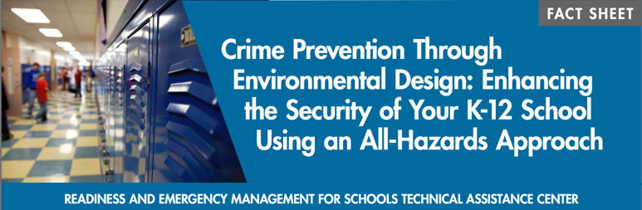
CPTED: A Lens for Aspects of Assessments
REMS CPTED Fact Sheet PDF
REMS CPTED Training Module
REMS Trainings & Overviews
Notes:
Concepts of Crime Prevention Through Environmental Design (CPTED) is a multidisciplinary strategy for deterring criminal behavior and protecting a community. The idea is to design a physical environment that positively influences human behavior. Proper design and effective use of a building or area can reduce the incidence of crime. According to Readiness Emergency Management for Schools (REMS), Narrator’s Note: pronounced as word Rems the strategy is based on four principles: Natural Access control, Natural surveillance, Territoriality, and Maintenance. Other CPTED publications list a fifth principle: Activity Support.
-------
Of the five mission areas identified from the previous slide, prevention and mitigation may be the most important in the context of CPTED.
This fact sheet presents an overview of the CPTED (Crime Prevention through Environmental Design) approach to reducing and removing opportunities for criminal behaviors, along with tips and strategies for applying CPTED in a K-12 school environment.
It is grounded in the idea that the physical environment can impact response to crime, and social control, and therefore changes to the environment can reduce opportunities for criminal behavior.
------
Training Module Understanding CPTED
60 minutes training module designed to understand the core principles of CPTED
Training Instructions
Presentation consisting of 25 slides
The goal of this training is to: Help practitioners understand the core principles of CPTED; Demonstrate how CPTED is applied in a school setting; Offer recommendations about how CPTED, through SITE ASSESS, can be implemented.

Slide 166


CPTED: Rooted in Psychology & Criminology
Like Attracts Like Video
Broken Windows Theory Video
Notes:
The broken windows theory states that visible signs of disorder and misbehavior in an environment encourage further disorder and misbehavior, leading to serious crimes. The principle was developed to explain the decay of neighborhoods, but it is often applied to work and educational environments (Article link in image)
A positive school climate—where students feel a sense of safety and belonging and where relational trust prevails— improves academic achievement, test scores, grades, and engagement and helps reduce the negative effects of poverty on academic achievement. To bring about such environments, teachers, paraprofessionals, and school and district leaders must be prepared to create the school and classroom structures that encourage secure relationships.
------------
Crime prevention through environmental design (CPTED) is an approach to problem-solving that asks, what is it about this location that places people at risk, or that results in opportunities for crime? In other words, why here? The following two examples will illustrate this point:
Example 1:
Custodial workers routinely find evidence of smoking, drinking, and vandalism in a school lavatory.
The question that we must ask ourselves is ‘Why here’?
The lavatory is in an isolated area of the building, adjacent to a ticket booth and concession stand that are active only during athletic events. The school’s open lunch policy allows students to eat anywhere on campus, while monitors are assigned only to the cafeteria.
Take some time to ask yourself how the four principals of CPTED apply.
The CPTED response is not complicated.
Access Control: A lock is installed on the lavatory door, and it remains locked unless there is an athletic event. The open lunch policy has been revised: students are still allowed to leave the cafeteria but must eat in designated areas, Natural Surveillance: a faculty member is charged with patrolling these areas during lunch periods. Territoriality: A sign is posted on the lavatory door indicating it is not to be used except during athletic events. Activity Support would come into play that use of this lavatory is only used during athletic events when members of the general public also use the lavatory discouraging illegal behavior by the students.
Example 2:
The back wall of a building in an office center is repeatedly tagged with graffiti.
Once again, why here?
The taggers have selected an area that is out of the view of passers-by: a rear corner location where two buildings come together at the end of a poorly lit service lane. Visibility is further reduced by hedges at the site’s perimeter. Businesses in the office center are open from 9 AM to 5 PM during the week; however the tagged building is next to a roller skating rink where activity peaks at night and on weekends.
Take some time to ask yourself how the four principals of CPTED apply. The CPTED response for this again isn’t complicated.
Access Control: It may be difficult to control access if fencing is not possible. However, after discussing the problem with the skating rink, the skating rink agrees to change to a “no readmission” policy to keep skaters inside the building and away from the office property.
Natural Surveillance can be enhanced by trimming the hedges, installing wall mounted light fixtures with motion detectors in the problem area. A closed-circuit camera can also be installed.
Territoriality: One or more signs are posted to delineate the space and advise that the area is monitored.
In each of these case examples, asking ‘why here?’ reveals that opportunities for crime and other problems arise out of a variety of environmental conditions related to the building, the site, and the location and how the place is used. Solving a problem thus requires a detailed understanding of both crime and place, and the response should consider one of the three objectives of crime prevention through environmental design: control access, provide opportunities to see and be seen, or define ownership and encourage the maintenance of territory.

Slide 167
CPTED: 1st Generation Principles
Training Module: Understanding CPTED
Notes:
The four principles of first-generation CPTED include:
Natural Surveillance — maximize visibility through design features to allow authorized adults to monitor and observe a particular setting, such as parking areas or building entrances.
Territorial Reinforcement — Clearly define your school boundaries with fencing, landscaping, and signs; express pride and ownership; and create a welcoming environment through art, pavement designs, and other amenities. The objective is to communicate to others that an area is claimed and cared for, and, therefore, unacceptable behavior will not be tolerated.
Natural Access Control — Guide people with signage, well-marked entrances and exits, and landscaping while limiting access to certain areas by using real or symbolic barriers. Arrange streets, sidewalks, building entrances, and neighborhood gateways to clearly indicate public routes and help ensure that only authorized persons may be on the grounds and in school buildings.
Maintenance and Management — Ensure that building services function properly and that the exterior, landscaping, and plantings are properly maintained. This strategy demonstrates ownership and respect for property through the timely repair, replacement, and general upkeep of spaces, so that grounds are clean and free of graffiti, litter, damage, and vandalism.
--------------
Natural Surveillance – When you use natural surveillance, you are maximizing the visibility of a property: the use of physical design to provide surveillance opportunities for school employees. The intended users of the property can easily and readily observe the property. For example, lighting, windows, removing certain trees and bushes, fencing height and visibility through the fence. Natural surveillance heightens the perception and reality that potential criminals or intruders are being monitored. It also allows legitimate occupants and casual observers increased observation, detection, and reporting of trespassers and misconduct.
Natural Access Control - Controlling and reducing the number of access points to the school property is vitally important to the safety of your school personnel and students. Natural Access Control also manages the entry and movement of individuals in a facility. Locked doors and designated entrance and exit points are examples of Natural Access Control. Fencing can also limit the number of access points and funnel visitors to the designated ingress points. The location of your front office at the main entrance naturally controls access.
Territoriality - The use of design elements to define ownership and the intended use of an area. Clearly marking the boundaries of an area discourages crime or intrusion by signaling to potential intruders that they are entering a controlled and monitored area which is used for a specific purpose. Territoriality creates a clear delineation of space and separates your space from non-legitimate users.
Clearly observable signage which identifies building or grounds use guidelines and/or ingress and egress routes. In addition, people protect an area that they feel is their own. We can take advantage of school employees’ familiarity with each other and the surroundings to keep the area safe.
Maintenance - Regular maintenance will ensure that Natural Surveillance, Territoriality, and Natural Access Control are maintained. Maintenance provides evidence that the school is cared for and valued and demonstrates that the school personnel take pride in their building and grounds. A well-maintained campus promotes safety and security, as well as demonstrates a commitment to the community and can be beneficial in creating good working relationships with surrounding neighbors. Maintaining the lighting, landscaping, fencing and outside building features discourages criminal activity.
An additional feature of CPTED not specifically mentioned in REMS, but referred to in other CPTED publications is Activity Support. Activity Support refers to placing activity where individuals become part of the natural surveillance. Activity Support also promotes legitimate activities within a facility or area engaging the users with the facility or area which fosters a sense of belonging and investment. It also fills an area with legitimate users so that abusers will leave and/or not enter the space.

Slide 168
CPTED: 2nd Generation Principles
Training Module: Understanding CPTED
Notes:
The four principles of second-generation CPTED include:
Social Cohesion -- promote positive interactions among school community members (e.g. students, staff, families, neighborhood residents) and align with other first generation CPTED elements like territoriality reinforcement. This can include activities like maintaining an active PTA and including students in school policy committees.
Connectivity -- activities situate a school as part of a larger neighborhood and community. Rather than isolate a school to its campus, these efforts promote connections to and communication with local residents, businesses, libraries, and community organizations.
Threshold Capacity -- aims to create spaces that have multiple uses and ensures a balance of spaces that reflect community need. A school sports field, for example, may also host community sporting events when not in use by the school. A school campus may share space with a daycare or a recreation center.
Community Culture -- fosters a sense of school pride and brings school community members together for a common purpose. This may include school beautification days, cultural festivals, school performances and celebrations, and family engagement activities.
These second generation CPTED concepts help school leaders to intentionally and thoughtfully plan school safety practices using a variety of school and community resources. All the above-mentioned CPTED principles relate directly to the balance between school safety and security and the education of our students. A school that resembles an armed fortress may not provide the security it intends for and may impinge on sound educational principles. If followed, the second generation CPTED principles lead to a positive school climate which ultimately makes schools safer.

Slide 169
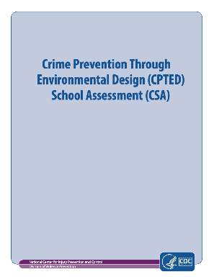
CPTED: Usable Assessment
Broken into 9 sections: INITIAL IMPRESSIONS; THE GROUNDS; THE BUILDINGS; THE INTERIORS; GLOBAL IMPRESSIONS; ADDITIONAL OBSERVATIONS; SURROUNDING LAND USE; SURROUNDING LAND USE CONDITION.
CPTED
School Assessment
Notes:
The purpose of the Crime Prevention Through Environmental Design (CPTED) School Assessment (CSA) is to rate the physical parts of the school which may have an impact on youth fear and aggressive behavior.
The Assessment is divided into nine sections:
Initial Impressions: statements to register your very first, overall impression of the grounds, buildings, and interiors. These impressions are generally spontaneous and represent a felt response versus an intellectual assessment, or a gut reaction versus a mental analysis. This would be equivalent to what is commonly referred to as “curb appeal.”
The Grounds: statements pertaining to the outside areas of the school property, such as parking, student pick-up/drop-off, and athletic areas.
The Buildings: statements pertaining to the physical parts of the building you can see from the outside, such as entryways, windows, and doors. This section also includes subsections for assessing additional buildings associated with the school but which may differ greatly in age, use, and style. It may be used by students or by the community. Examples include vocational, alternative education, or community health buildings.
The Interiors: statements pertaining to the space inside a building or buildings such as classrooms, corridors, and public areas. Blank sections are provided for any use which is not already covered by the assessment form. Examples might include home economics education classrooms or special theatrical workshops.
Global Impressions: statements to be completed after the physical assessment has been completed. These statements pertain to the overall atmosphere or ambiance of the school and are similar to the initial impressions in that the ratings are a felt response versus an intellectual assessment.
Additional Observations: an area to register any observations of the physical environment which has not been adequately covered in the assessment.
Surrounding Land Use: a list of land uses adjacent to the school property, i.e. properties observable from the school grounds. Check each one observed and circle the most predominant.
Surrounding Land Use Condition: the same list of land uses to be rated for the overall physical conditions on a scale of 1-5: with 1 for unsightly, poorly maintained, signs of vandalism (including graffiti), and no enhancements to a rating of 5 for attractive, well maintained, lack of vandalism and with enhancements such as flower beds, decorative lighting, pavement treatments and other decorative features.
Assessment Day Information: notations regarding date, time, weather and any unique factors that might affect the assessment on that particular day. Examples of unique factors are special, one-time events or unusual or traumatic incidents.

Slide 170
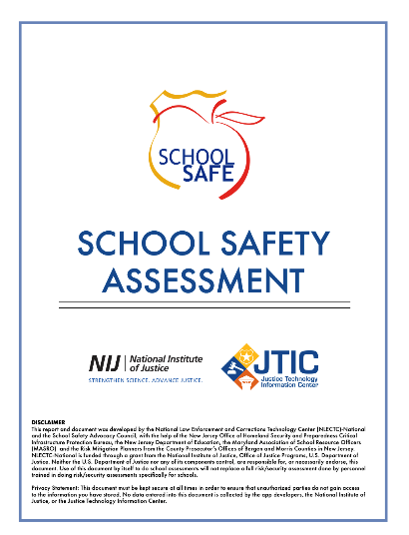
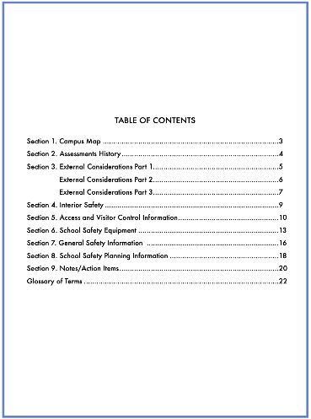
School Safety Assessment Interactive PDF through the NIJ
(National Institute of Justice)
Notes:
This report and document was developed by the National Law Enforcement and Corrections Technology Center (NLECTC)-National and the School Safety Advocacy Council, with the help of the New Jersey Office of Homeland Security and Preparedness Critical Infrastructure Protection Bureau, the New Jersey Department of Education, the Maryland Association of School Resource Officers (MASRO) and the Risk Mitigation Planners from the County Prosecutor's Offices of Bergen and Morris Counties in New Jersey. NLECTC-National is funded through a grant from the National Institute of Justice, Office of Justice Programs, U.S. Department of Justice.
This document must be kept secure at all times in order to ensure that unauthorized parties do not gain access to the information you have stored. No data entered into this document is collected by the app developers, the National Institute of Justice, or the Justice Technology Information Center.

Slide 171


PASS: Guidelines & Usable Checklist
The Partner Alliance for Safer Schools (PASS)
Vetted security practices
specific to K-12
environments
Notes:
First established in 2014, the Partner Alliance for Safer Schools (PASS) brings together expertise from the education, public safety and industry communities to develop and support a coordinated approach to making effective use of proven security practices specific to K-12 environments, and informed decisions on security investments.
The PASS Guidelines identify and classify best practices for securing K-12 facilities in response to urgent needs for information identified by the education community. The guidelines include: Specific actions that can effectively raise the baseline of security; Vetted security practices specific to K-12 environments; Objective, reliable information on available safety and security technology; Assessment of current security measures against nationwide best practices; Multiple options for addressing security needs identified, based on available resources; How to distinguish needed and effective solutions from sales pitches on unnecessary products. The primary focuses of the PASS Guidelines are physical security and life safety, and recommendations are limited to related policies, procedures, equipment and technology.
----------------
As a reminder, many school entities have a Certified Workplace Safety Committee (under 24 P.S. 2-223 and 34 Pa Code Chapter 129) - the coordinator should be aware of this Workplace Safety Committee and build relationships to share information and address findings of reported hazards and accidents to promote overall school safety.

Slide 172
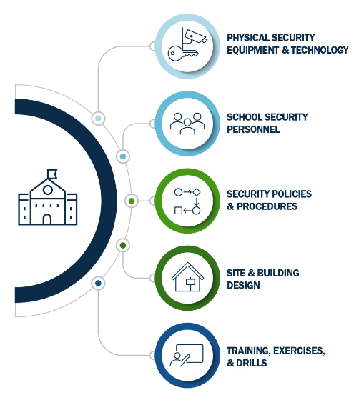
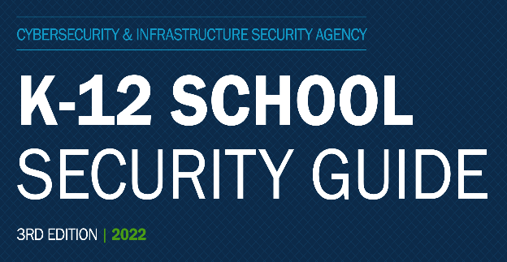
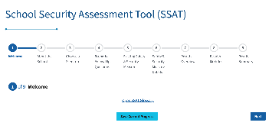
CISA: k-12 Security Guide
Notes:
The 3rd edition of the K-12 School Security Guide is designed to help local education agencies across the United States adopt a systems-based approach to school physical security planning and implementation. This guide demonstrates how taking a systems-based approach to layered physical security can help schools create safe and secure learning environments without asking staff members to become security experts. The purpose of the guide is to provide guidance to local education agencies on how to plan for and implement this type of approach to school security.
The guide is designed and organized for local education agencies to employ in conjunction with the K-12 School Security Assessment Tool (SSAT), a web-based tool that provides further guidance on school physical security planning and implementation. Together, this guide and the companion tool outline action-oriented security practices and options for consideration across the K-12 school community.
----------------
A LAYERED AND COMMUNICATION-BASED FOCUS – Coordination with administrators and educators
Safety is a critical topic for school administration and law enforcement to be on the same page with, this includes the SSSC as the central point for communicating with both parties. It is essential to prepare for extreme events such as weather disasters, large events on school grounds, possible mass casualty events, chemical hazard spills among other possibilities. It is of great importance to have a sense of inclusion from your staff when it comes to physical security.
Experts recommend a multidisciplinary approach to school safety planning that involves school personnel (including both teachers and support staff such as custodians and school bus drivers), law enforcement and first responders, community-based resources, and families—as well as students in the school. Communication and coordination can make a significant impact on safety and security.
A school safety committee is one way to create and facilitate a positive and layered impact in your school entity and to each building within the entity. To promote inclusivity and buy-in, the committee should include a cross section of staff from within and should allow each of the members to have a voice in developing and monitoring practices within to promote physical safety. As an example, this committee could be responsible for ensuring processes are in place and followed for understanding and reporting concerns, such as broken windows, locks, malfunctioning lighting, poor camera visibility, playground, or athletic facilities problems.
As a reminder, many school entities have a Certified Workplace Safety Committee (under 24 P.S. 2-223 and 34 Pa Code Chapter 129) - the coordinator should be aware of this Workplace Safety Committee and build relationships to share information and address findings of reported hazards and accidents to promote overall school safety.

Slide 173

Several popular programs and resources offered at no cost by PSP:
Classroom-based presentation that prepares individuals for an active shooter situation: different mental strategies and response tactics; active shooter statistics, trends, and real incidents; the basics of the federally-suggested actions of “Run, Hide, Fight.”
Community Services Officers offer no-cost training, such as: Cyberbullying; Internet/social media safety; Drug and alcohol awareness; Driver education

Slide 174

The RVAT program provides: In-depth security vulnerability assessments; Options for consideration to improve the security posture of PA public or private facilities, excluding residences
RVAT personnel are State Troopers trained on assessment procedures related to: Physical security; Explosive effects on structural design; Threat analysis; Practical target hardening techniques.
For more information or to schedule a Risk and Vulnerability Assessment contact the PSP RVAT by email or call the PSP Domestic Security Section at 717-346-4085.

Slide 175
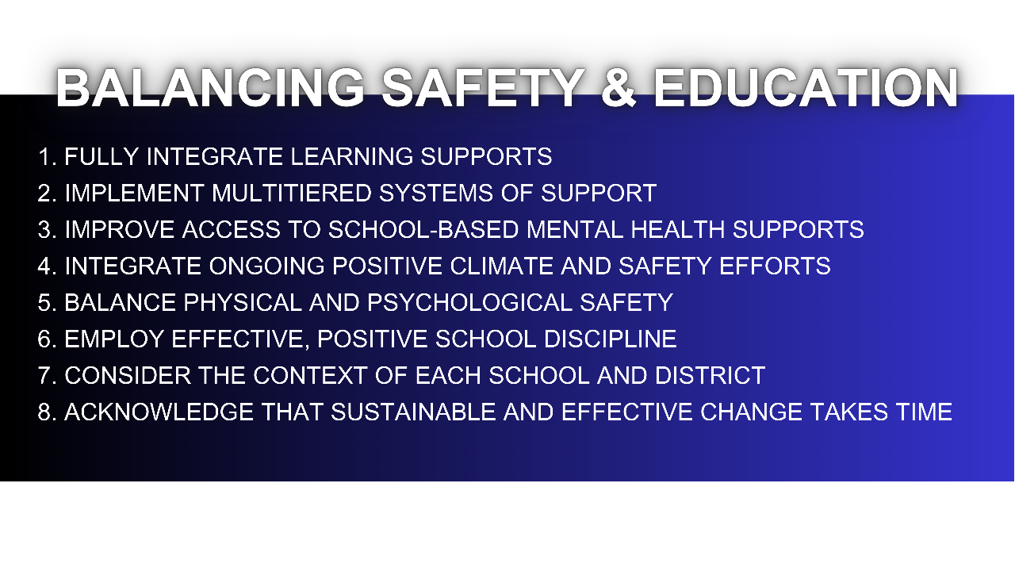
Notes:
Balancing Physical Safety and the Educational Process
Although our intentions may be good, over abundant safety measures may be having opposite effects on student learning, often leading to additional stress and a negative impact on the learning environment.
Schools can take a balanced approach to security measures. A balanced approach addresses the physical safety of students without sacrificing their emotional health. It doesn’t rely on heavy-handed tactics that cause unnecessary anxiety and it contributes to a secure school without negatively impacting a welcoming learning environment. Having a well-articulated and practiced safety plan, staff that is trained on handling emergency situations, having an approach that adheres the first and second generation CPTED principals, and staff that is knowledgeable about the three types of assessments talked about earlier in this training are all very important components to achieving the goal of a balanced approach to physical safety.
The National Association of Elementary School Principals’ Framework for Safe and Effective Schools states the 8 best practices for creating safe and effective schools as follows:
Fully integrate learning supports (e.g., behavioral, mental health, and social services), instruction, and school management within a comprehensive, cohesive approach that facilitates multidisciplinary collaboration.
2. Implement multitiered systems of support (MTSS) that encompass prevention, wellness promotion, and interventions that increase with intensity based on student need, and that promote close school– community collaboration. MTSS is discussed in greater detail during the Universal Supports section of this training.
3. Improve access to school-based mental health supports by ensuring access to adequate staff in terms of mental health professionals who are trained to infuse prevention and intervention services into the learning process and to help integrate services provided through school–community partnerships into existing school initiatives.
4. Integrate ongoing positive climate and safety efforts with crisis prevention, preparedness, response, and recovery to ensure that crisis training and plans: (a) are relevant to the school context, (b) reinforce learning, (c) make maximum use of existing staff resources, (d) facilitate effective threat assessment, and (e) are consistently reviewed and practiced.
5. Balance physical and psychological safety to avoid overly restrictive measures that can undermine the learning environment and instead combine reasonable physical security measures with efforts to enhance school climate, build trusting relationships, and encourage students and adults to report potential threats.
6. Employ effective, positive school discipline that: (a) functions in concert with efforts to address school safety and climate; (b) is not simply punitive (e.g., zero tolerance); (c) is clear, consistent, and equitable; and (d) reinforces positive behaviors.
7. Consider the context of each school and district and provide services that are most needed, appropriate, and culturally sensitive to a school’s unique student populations and learning communities.
8. Acknowledge that sustainable and effective change takes time, and that individual schools will vary in their readiness to implement improvements and should be afforded the time and resources to sustain change over time.

Slide 176
BREAK: 10 MINUTES

Slide 177


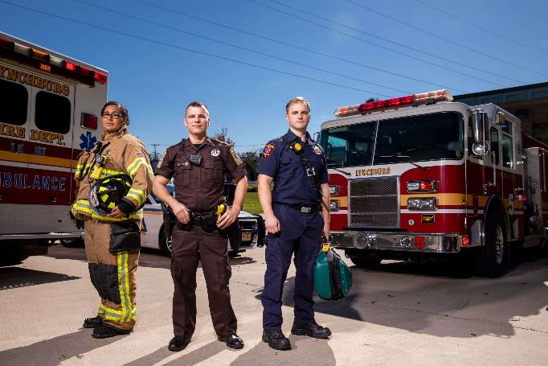

Emergency Preparedness

Slide 178

PART 1 OF 2
Notes:
The overall goal of this training is to provide a general context for understanding emergency Preparedness within the lens of educational environment readiness, as well as collecting in one place a list of valuable resources intended to help in the contextual pursuit of safer educational environments statewide.
Emergency Preparedness works best when everyone not only understands what to do, but also why. Understanding why something is to be done enables people to react more flexibly – because they understand the intent of what is being asked of them – when situations do not conform to a typical pattern – as is often the case in an emergency!
For example, if we understand that the reason why people are assembling at a certain place because it is away from a particular danger, but the actual situation puts the assembly area at risk for some reason, they know they need to think of somewhere else to go that is away from both the primary and the secondary threat. If people do not understand why, they may either stay where they are because their assembly area is under threat or move to the assembly area ‘because they were told to do so and do not have the knowledge of why they were doing that in the first place that would enable them to make a context-led decision to do something else.

Slide 179
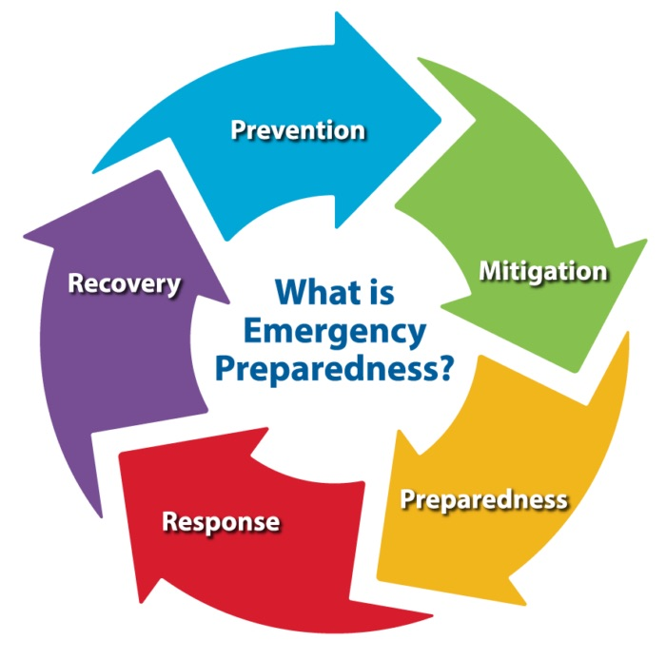
Notes:
For this part of the training, we will discuss the foundational principles of emergency management, the importance of partner organizations and their contribution to emergency management in your community, and the roles of identified partners in emergency management.
This refers to the steps you take to make sure you are safe before, during and after an emergency or natural disaster. These plans are important for your safety in both natural disasters and man-made disasters.
Planning, Training, Exercising, and Drilling. Activities to familiarize school staff, students, and community partners with their roles and responsibilities during an emergency and an opportunity to practice and strengthen emergency policies and procedures. Plan for emergencies and know how to respond.
Emergency Management has five core principles which guide execution, evaluation, implementation, and training: Prevention, Mitigation, Preparedness, Response, and Recovery.

Slide 180

Notes:
Prevention focuses on preventing hazards from occurring, whether they are natural, technological or caused by humans. Not all hazards are preventable, but the risk of loss of life and injury can be limited with good evacuation plans, environmental planning and design standards. An example of this would be to review and update your Emergency Preparedness Plan regularly and systematically.

Slide 181

Notes:
Mitigation is the effort to reduce loss of life and property by lessening the impact of disasters and emergencies. It refers to measures or actions that can prevent an emergency, reduce the chance of an emergency or reduce the damaging effects of unavoidable emergencies. The establishment of building codes and zoning requirements or the creation of defensible space around homes to protect them from wildfire are examples of mitigation efforts. An example of a mitigation strategy on your school grounds would be to place bollards in front of playground entrances throughout educational settings.

Slide 182

Notes:
Preparedness is a continuous cycle of planning, organizing, training, equipping, exercising, evaluating and taking corrective action. Training and exercising plans is the cornerstone of preparedness, which focuses on readiness to respond to all hazards, incidents and emergencies. Training and emergency preparedness plans increase a community’s ability to respond when a disaster occurs. Typical preparedness measures include developing mutual aid agreements and memorandums of understanding, training for both response personnel and concerned citizens, conducting disaster exercises to reinforce training and test capabilities, and presenting all-hazards education campaigns. Conducting drills (with and without local emergency agency presence) and training the school population regularly on different aspects of your EPP will help school staff remain prepared.

Slide 183
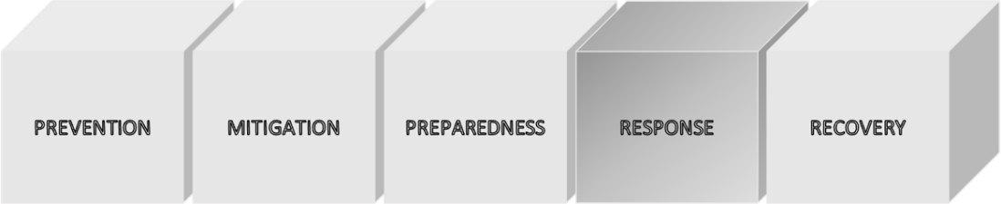
Notes:
The response phase is a reaction to the occurrence of a catastrophic disaster or emergency. It consists of actions which are aimed at saving lives, reducing economic losses and alleviating suffering. The response phase comprises the coordination and management of resources utilizing the Incident Command System. Response actions may include activating the emergency operations center, evacuating threatened populations, opening shelters and providing mass care, emergency rescue and medical care, firefighting, and urban search and rescue. You can utilize “Run, Hide, Fight” as trained choices and reactions to danger approaching your district.

Slide 184

Notes:
Recovery consists of those activities that continue beyond the emergency period to restore critical community functions and begin to manage stabilization efforts. The recovery phase begins immediately after the threat to human life has subsided. The goal of the recovery phase is to bring the affected area back to some degree of normalcy, including the restoration of basic services and the repair of physical, social and economic damages. Typical recovery actions include debris cleanup, financial assistance to individuals and governments, rebuilding of roads and bridges and key facilities, and sustained mass care for displaced human and animal populations. During the recovery phase, having psychologists and counselors available to assist students and staff during the reopening schools after an event.

Slide 185
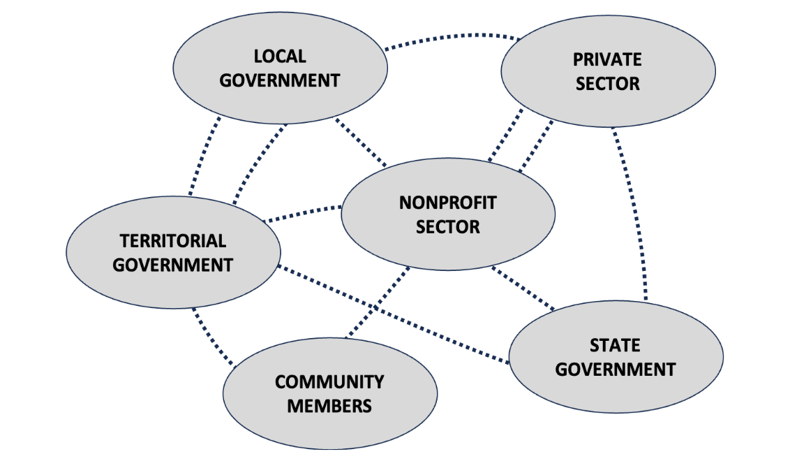
Notes:
Working with community partners and collaborators is a key component of a successful emergency preparedness and response program. Partners can contribute to all aspects of the emergency management cycle by supporting risk assessments, communication, and other response and recovery activities. Effective action to prevent, protect against, mitigate, respond to, and recover from any type of threat or hazard requires the active involvement of numerous partners. These partners include the private and nonprofit sectors: businesses, faith-based organizations, advocacy groups for those with disabilities and other access and functional needs, and community members, in conjunction with local, tribal, territorial, State, and Federal Government partners. This focus on enabling the participation of partners in national preparedness activities is referred to as the Whole Community approach. We will introduce some of the approach during this training but for an in-depth course, see (Lesson 2 Overview: FEMA from IS-230.E: Fundamentals of Emergency Management)

Slide 186
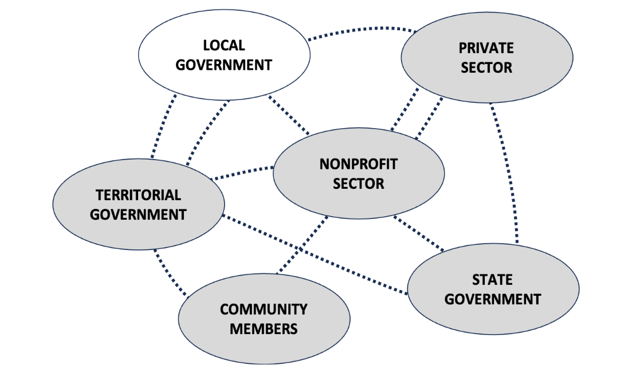
Notes:
Local government has direct responsibility for the safety of its people, knowledge of the situation and accompanying resource requirements, and proximity to both event and resources. Within local government are emergency services departments that are capable of responding to emergencies 24 hours a day. They include law enforcement, fire/emergency medical services, and public works. They may also be referred to as emergency response personnel or first responders.

Slide 187
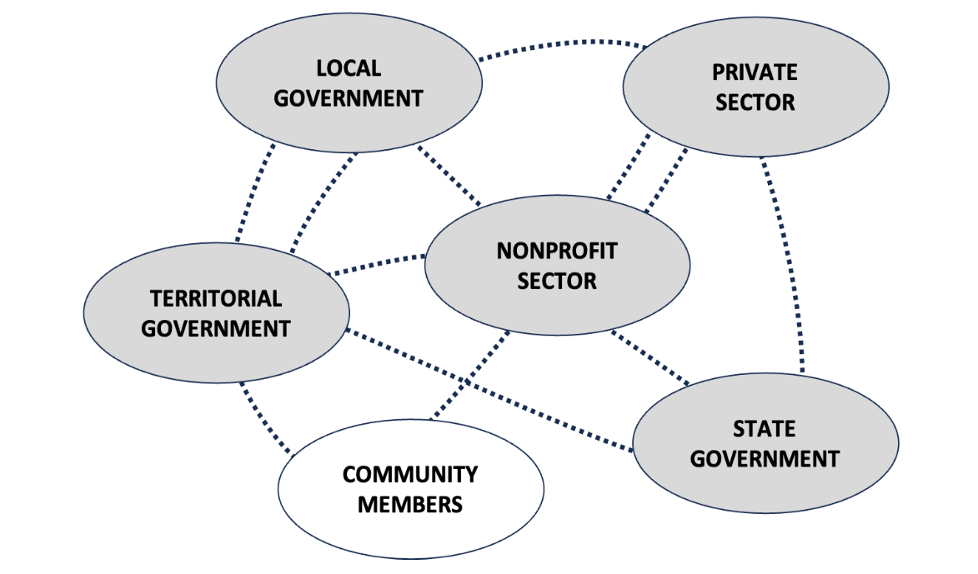
Notes:
Individuals need to help by taking responsibility for their own self-preparedness efforts. As they prepare and work with others, they will build their communities' security and resilience. Individuals and families can contribute by: Reducing hazards in and around their homes; Developing a preparedness plan; Assembling emergency supplies; Monitoring emergency communications; Volunteering with an established organization; Taking training in emergency response.

Slide 188
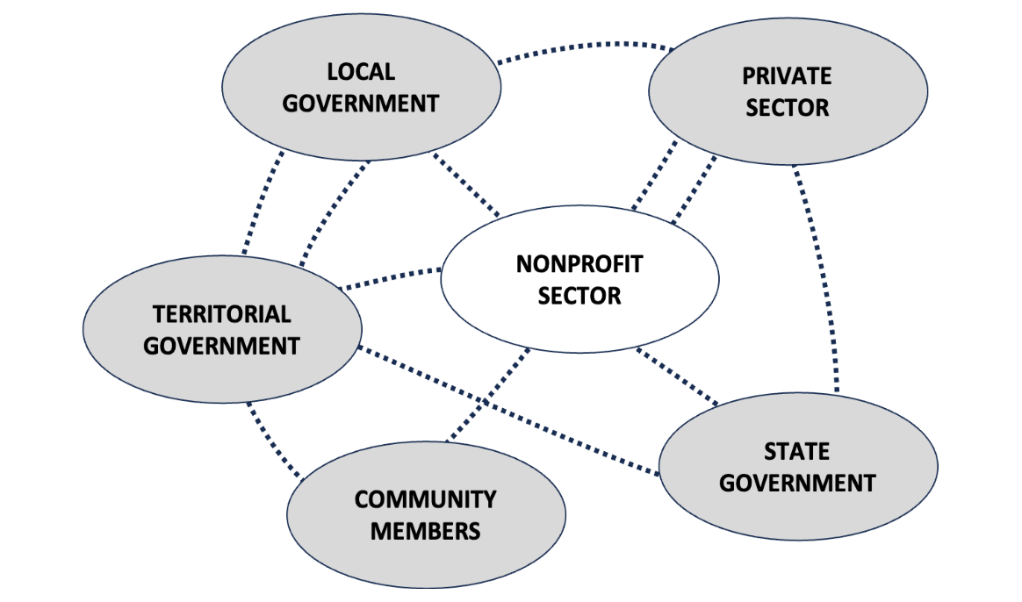
Notes:
Organizations in the nonprofit sector, including nongovernmental organizations, have enormously important roles before, during, and after an incident. They provide: Sheltering, emergency food supplies, counseling services, and other vital support services to support response and promote the recovery of disaster survivors; as well as Specialized services that help individuals with disabilities and other access and functional needs.

Slide 189
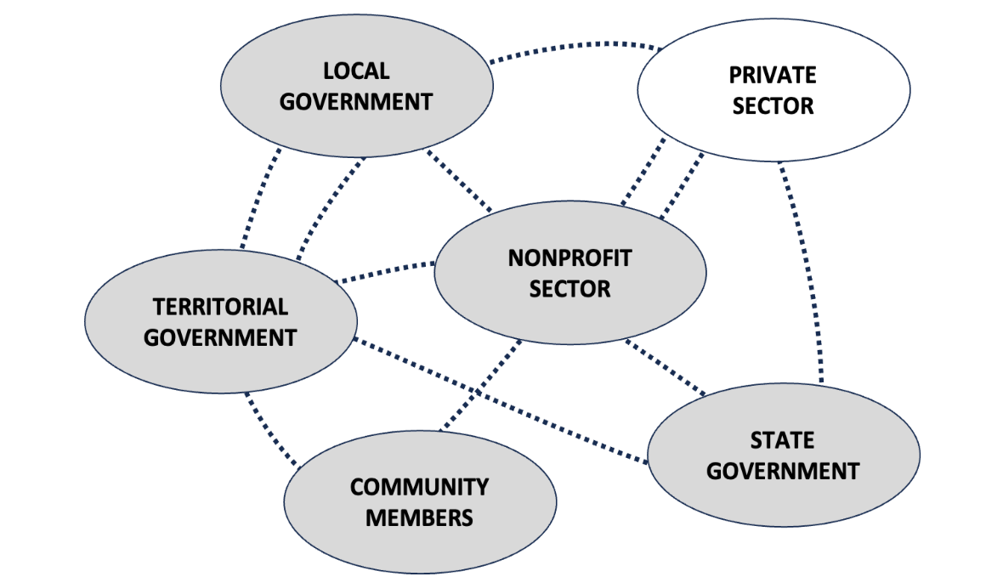
Notes:
Private-sector organizations play a key role before, during, and after an incident and are important in building resilient communities. Businesses must consider what they need to survive an emergency or disaster, as well as the needs of their customers and employees.

Slide 190
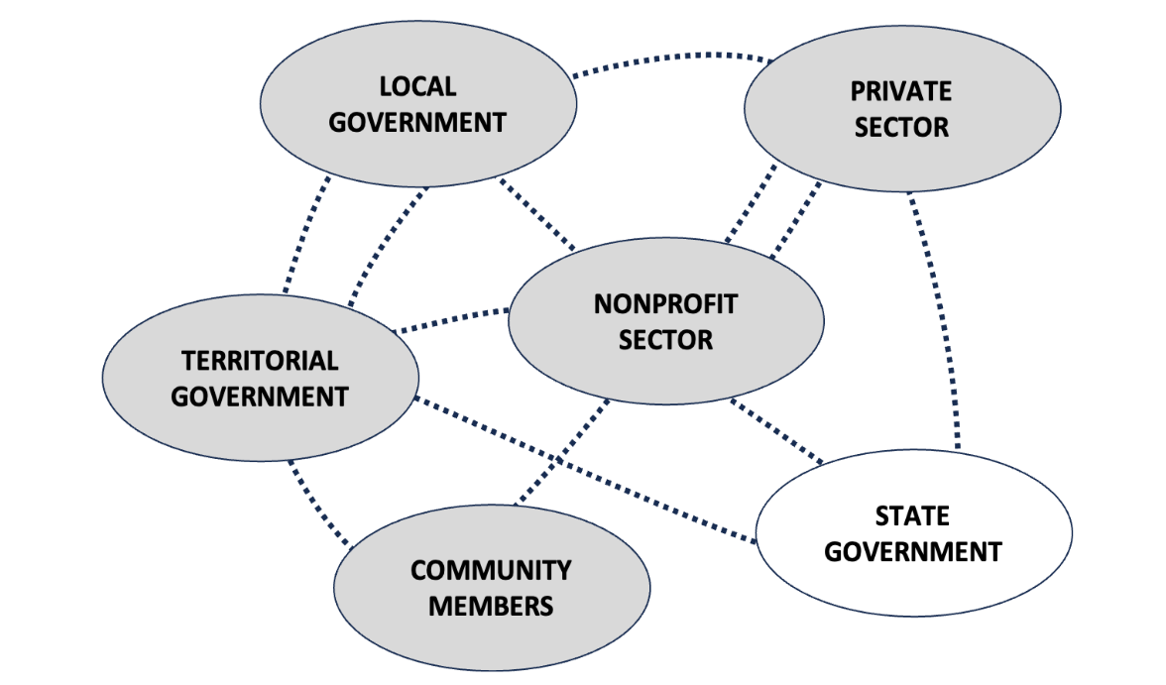
Notes:
Each State government has legal authority for emergency response and recovery and serves as the point of contact between local and Federal governments. At the State level, the Governor’s Authorized Representative (GAR), State Director of Emergency Management, and State Coordinating Officer can share information with State agencies (e.g., Department of Agriculture) and FEMA regional representatives to bring the necessary response and recovery resources to bear on the incident.

Slide 191
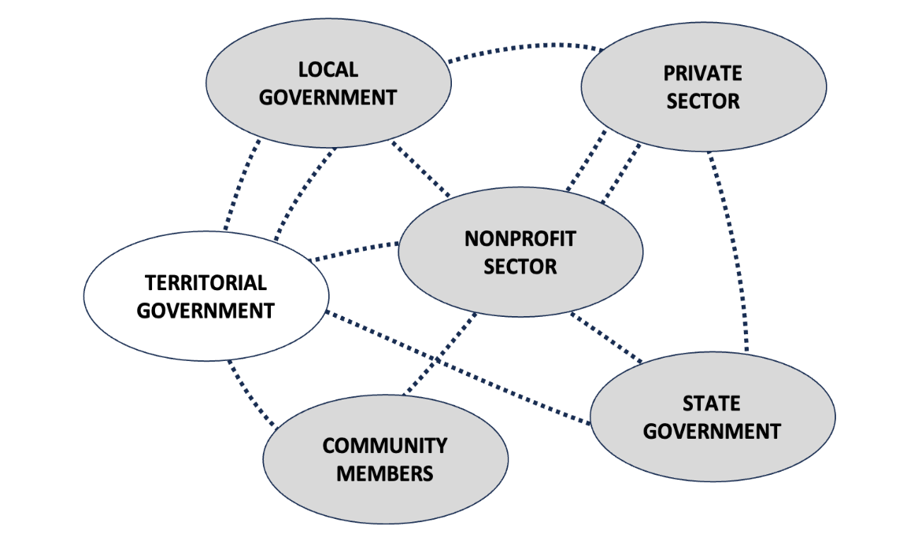
Notes:
Territorial governments are responsible for coordinating resources to address actual or potential incidents. Due to their remote locations, territories and insular area governments often face unique challenges in receiving assistance from outside the jurisdiction quickly and often request assistance from neighboring islands, other nearby countries, States, the private sector or nongovernmental organization resources, or the Federal Government.

Slide 192

Notes:
We will discuss Emergency Preparedness Planning and provide brief overviews of the resources designed to assist School Safety and Security Coordinators to effectively execute their duties.
REMS (Readiness & Emergency Management for Schools)
Learning “How & Why”
Education focused
Federally funded
Federal reach
Federal agency
How and Why
PEMA (Pennsylvania Emergency Management Agency)
Usable for the “What”
Template focused
State funded
State reach
State agency
What
Both REMS & PEMA are arbiters of high-quality information with regards to school safety and security. By the very nature of REMS, it is geared specifically towards school safety and security, whereas PEMA is a state agency designed to deal with and prepare for all hazards, both natural and manmade. PEMA is a state agency which has demands and dictates different than REMS which is a pseudo federal agency tasked primarily with education related to schools and their mandated and best-practice safety needs.
PEMA is emergency management and REMS is preparing for safety and security concerns, so there is definitely a noticeable crossover effect but the two groups are entirely different organizations. One group is not better than another, however, REMS was created specifically for school safety, and because of this fact it has a funding focus which represents its mission more than PEMA represents a mission of just school safety. PEMA has templates worth using and REMS has trainings and other resources worth using. Together, REMS and PEMA create a nice state/federal partnership for helping schools prepare for the day-to-day nuisances all the way to the worse-case scenarios.

Slide 193

Notes:
PEMA shares all-hazard school planning resources with schools, child care centers, and others. The Readiness and Emergency Management for Schools Technical Assistance Center provides guidance, resources, tools, and training opportunities for school districts/schools and communities to address all types of crises, emergencies, and disasters that might impact their campuses. These resources are a compilation of best practices that have been developed at the federal, state, and local levels of government in addition to private and nonprofit sector experts with the intent of creating a foundation for planning and a framework for response as events transpire. Within the “additional documents” section on the School and Child Care Safety website, you’ll find a host of planning resources and usable templates for all things hazard and emergency operations plans related specific to schools – from PEMA’s Model Emergency Operations Plan as a template downloadable as a Word document, to Threat Hazard evaluation worksheets. Also, on this valuable website you’ll find emergency-based planning resources for child care facilities, access to the CEM planner, as well as the link to Pennsylvania’s k-12 Threat Assessment Technical Assistance & Training Network, of which you can request comprehensive training, technical assistance, and other support for schools across the commonwealth at no charge.
--------------------------
The CEM Planner is a planning software tool utilizing a continual preparedness system designed to enhance planning and resource management capabilities. The CEM Planner is a central access point for every stakeholder of a plan to view the most current and up-to-date plan for that entity. The program guides you through every step of the planning process. It is designed so that individual sections of your plan can be updated and approved, without the need for a complete plan revision. Plans developed are then stored in a secured and centralized virtual library assuring every stakeholder is viewing the most up-to-date plan. CEM Planner is web-based allowing you to access your plans from virtually anywhere, adding to your continuity of operations program and the ability to operate from any location.
CEM Planner
The CEM Planner is a central access point for every stakeholder of a plan to view the most current and up-to-date plan for that entity.
All aspects of the CEM Planner training breakdown every component a school would need in order to use the planner… not to create an Emergency Operations Plan
PEMA’s model school EOP is available through the CEM Planning Tool.
Training takes a total of 3 hours and encompasses three modules of learning objectives.
*Please note that while the CEM planner is still in the training standard and this presentation that it is being reviewed and may be replaced soon.

Slide 194

REMS SERVES:
Schools and school districts
IHEs Local education agencies (LEAs) Regional education agencies (REAs) State education agencies (SEAs) Community partners agencies)
Current or former grantees
Other stakeholders in K-12 or IHE emergency management
Notes:
The Readiness and Emergency Management for Schools (REMS) Narrator’s Note: Pronounced as word Rems Technical Assistance Center provides guidance, resources, tools, and training opportunities for school districts, schools and communities to address all types of crises, emergencies, and disasters that might impact their campuses. These resources are a compilation of best practices that have been developed at the federal, state, and local levels of government in addition to private and nonprofit sector experts with the intent of creating a foundation for planning and a framework for response as events transpire.
The U.S. Department of Education’s Office of Safe and Supportive Schools has administered the REMS Technical Assistance (TA) Center to serve two critical functions aimed at helping education agencies, with their community partners to manage safety, security, and emergency management programs. REMS helps to build the preparedness capacity (including prevention, protection, mitigation, response, and recovery efforts) of schools, school districts, and their community partners at the local, state, and Federal levels. They also serve as the primary source of information dissemination for schools and school districts for emergencies via the REMS TA Center Website. The REMS TA Center does not endorse products, services, or service providers. Additionally, the REMS TA Center does not provide certificates other than certificates of attendance.
An official website of the U.S. Government
A site dedicated to building preparedness capacity within k-12 and higher education settings, as well as serving as the primary source of information dissemination for schools, school districts, and IHE’s for emergencies
REMS TA Center does not endorse products, services, or service providers.
A free and immense resource for schools with regards to all things school safety and security, including preparedness tools and training.
REMS SERVES: Schools and school districts (e.g., K-12, public, nonpublic, private); IHEs (e.g., community colleges, universities, technical schools); Local education agencies (LEAs); Regional education agencies (REAs); State education agencies (SEAs); Community partners (e.g., law enforcement, fire department, public safety, emergency medical services, health and mental/behavioral health agencies); Current or former grantees (e.g., Grants to States for School Emergency Management, Emergency Response and Crisis Management/REMS, Emergency Management for Higher Education); and Other stakeholders in K-12 or IHE emergency management (e.g., families, nonprofit organizations).
The U.S. Department of Education’s Office of Safe and Supportive Schools has administered the REMS TA Center to serve two critical functions aimed at helping education agencies, with their community partners, manage safety, security, and emergency management programs:
We build the preparedness capacity (including prevention, protection, mitigation, response, and recovery efforts) of schools, school districts, IHEs, and their community partners at the local, state, and Federal levels.
We also serve as the primary source of information dissemination for schools, school districts, and IHEs for emergencies via the REMS TA Center Website. The REMS TA Center does not endorse products, services, or service providers. Additionally, the REMS TA Center does not provide certificates other than certificates of attendance.

Slide 195

MEPS (Multihazard Emergency Planning for Schools) Toolkit is an incredibly robust and useful online, user-friendly, federal resource for educational environments nationwide - allowing communities to prepare for and create their own emergency procedures and corresponding documents related to multihazard preparedness.
Notes:
The Multihazard Emergency Planning for Schools (MEPS) Toolkit is an incredibly robust and useful online, user-friendly, federal resource for educational environments nationwide - allowing communities to prepare for and create their own emergency procedures and corresponding documents related to multihazard preparedness.
The MEPS Toolkit is useful at any level of emergency preparedness your district may find themselves. If you haven’t yet used this valuable resource for your multihazard planning needs, please take the time to look through it. If you feel confident in your district’s plans and procedures, you can use the MEPS Toolkit as a means of training key staff, refreshing ideas within your planning teams, and double-checking the validity of your Emergency Operations and corresponding Emergency Preparedness Plan.
The MEPS (Multihazard Emergency Planning for Schools) Toolkit might be familiar to you before this training. Maybe you have used it in emergency planning, maybe you have not, however, regardless of your familiarity with the toolkit, it is almost an invaluable resource for emergency planning whether you or your safety team decides to use it. As you can see from the image, which is the landing page for the Toolkit, the user interface is straightforward and simple to understand. By clicking any box it brings up another set of selections, and so on and so forth. Moving forward, we’ll break down a few of the selections one can make from the home screen, and how those selections can impact emergency planning in your educational setting.
FEMA’s Multihazard Emergency Planning for Schools Toolkit is a resource worth its weight in gold for anyone holding the position of Safety & Security Coordinator within an educational setting across Pennsylvania. The time and labor needed to prepare for emergencies, build out Emergency Operations Plans, and then make sure your plans and procedures stack up against liability proof interpretation, can be daunting. This toolkit is a national resource designed to be used at the most local levels.
Navigation notes for presenters as you review the toolkit:
Once clicking on Course Materials, two links become available - Sample School Emergency Operations Plan, which is a quality overview to compare your current EOP or emergency preparedness plan against, but should not be copied and pasted to act as your EOP, and Action Planning Worksheet.
Once clicking on Comprehensive Preparedness Guide, a PDF on Developing & Maintaining Emergency Operations Plans opens in a new browser window. This guide walks you through the steps and processes necessary to complete your educational setting’s Emergency Operations Plan or emergency preparedness plan.
Once clicking on Developing Procedures and Protocols, another screen becomes available with a world of valuable resources at your fingertips. For the purpose of making the final point here, we’ll take a look at yet another resource to help with evacuating special needs populations.

Slide 196


Ready is a National public service campaign designed to educate and empower the American people to prepare for, respond to and mitigate emergencies and disasters.
Notes:
Launched in February 2003, Ready.gov is a National public service campaign designed to educate and empower the American people to prepare for, respond to and mitigate emergencies and disasters. The goal of the campaign is to promote preparedness through public involvement. This campaign and corresponding website, is filled with worthwhile, high-quality and life-saving information designed for the community member. Ready.gov is worth sharing with your employees as you train them throughout their time under your care, and to use as a resource for you lives away from the educational environment. This site makes difficult topics easier to talk about through the use of their information and verbiage, as well as imagery already created. Ready.gov is designed to be a bridge to emergency preparedness for the American public.

Slide 197





Notes:
NIMS enhances the management of domestic incidents by establishing a single, comprehensive system for incident management and helps achieve greater cooperation among departments and agencies at all levels of government. Implementing NIMS strengthens Pennsylvania’s capability and resolve to fulfill its responsibilities to all the citizens of Pennsylvania in times of emergency.
Within Pennsylvania’s NIMS Implementation Strategy, pages 49 and 50 deal directly with levels of training required by the type of position held within an educational environment.
-------------------
PEMA’s Integrated Preparedness Calendar is a valuable and ongoing resource which displays training available across the state to include both ICS and other applicable training for K-12 schools that is being hosted by counties and regional task forces.
Here, you’ll find all-hazards planning, trainings, and realistic exercises to enhance Pennsylvania’s overall preparedness capabilities.
-------------------
Train PA is another resource worth looking into, because it not only can be used to access the FEMA NIMS Courses, but also a number of other school centric courses offered through various other entities.
-------------------
Many institutions develop plans on paper using a template, but do not follow the correct planning process. The planning process is probably the most important aspect since it brings all the stakeholders together to collaboratively build the plan, resulting in greater understanding of the plan.
The Comprehensive Planning Guide 101 discusses the process for developing and reviewing EPP’s. Pages 43-61 provide the oversight and information regarding the planning process form start to finish.
----------------
Partner Alliance for Safer Schools (PASS) - School Safety and Security Guidelines and Checklist
First established in 2014, the Partner Alliance for Safer Schools (PASS) brings together expertise from the education, public safety and industry communities to develop and support a coordinated approach to making effective use of proven security practices specific to K-12 environments, and informed decisions on security investments.
The PASS Guidelines identify and classify best practices for securing K-12 facilities in response to urgent needs for information identified by the education community. The guidelines include: Specific actions that can effectively raise the baseline of security; Vetted security practices specific to K-12 environments; Objective, reliable information on available safety and security technology; Assessment of current security measures against nationwide best practices; Multiple options for addressing security needs identified, based on available resources; How to distinguish needed and effective solutions from sales pitches on unnecessary products. The primary focuses of the PASS Guidelines are physical security and life safety, and recommendations are limited to related policies, procedures, equipment and technology.

Slide 198

Notes:
The National Incident Management System (NIMS) guides all levels of government, nongovernmental organizations and the private sector to work together to prevent, protect against, mitigate, respond to and recover from incidents. NIMS provides stakeholders across the whole community with the shared vocabulary, systems and processes to successfully deliver the capabilities described in the National Preparedness System. NIMS defines operational systems that guide how personnel work together during incidents.
This section will discuss the overall resource of FEMA trainings for emergency preparedness and how these trainings create a deeper context for overall emergency preparedness. Diving deeper into each course recommended through PCCD’s coordinator training: (IS- 100.C; IS-200.C; IS-362A; IS-360; IS-700.B; IS800.D: Course overview & objectives, timeline for completion, and the value briefly of each individual training
The Commonwealth of Pennsylvania has made it clear through the Act 55 School Safety and Security Coordinator Training Standards, these levels of FEMA emergency training should be worked through and completed for all parties engaged in the position of Safety & Security Coordinator for an Educational Setting. Each course looks at emergencies through a specific lens, and each training differs from every other training in scope and time with regards to completion. As you can see from the brief course descriptions, from levels 100 through 800, each course is valuable in its own right as a singular pursuit, but certainly builds upon one another as you progress through the entire set of FEMA trainings considered required knowledge at this time for your position. Each course is completed in a differing amount of time, with each course completion generating a certificate of accomplishment. These trainings are only required to be completed once; however, periodic check-backs and re-training is a quality idea as time starts to pass from your original training completion.

Slide 199
IS-100.C
IS-200.C
IS-362A
This course introduces the Incident Command System (ICS) and provides the foundation for higher level ICS training. This course describes the history, features and principles, and organizational structure of the Incident Command System. It also explains the relationship between ICS and the National Incident Management System (NIMS).
This course reviews the Incident Command System (ICS), provides the context for ICS within initial response, and supports higher level ICS training. This course provides training on, and resources for, personnel who are likely to assume a supervisory position within ICS.
This course covers basic information about developing, implementing, and maintaining a school emergency operations plan (EOP). The goal of this course is to provide students with an understanding of the importance of schools having an EOP and basic information on how an EOP is developed, exercised, and maintained.

Slide 200
IS-360
IS-700.B
IS-800.D
This course provides leading practices and resources to assist elementary and secondary schools, institutions of higher education, and houses of worship in developing emergency plans for preparing for, responding to, and recovering from mass casualty incidents.
This course provides an overview of the National Incident Management System (NIMS). The course provides learners with a basic understanding of NIMS concepts, principles, and components.
The goal of the course is to provide guidance for the whole community. Within this broad audience, the National Response Framework focuses especially on those who are involved in delivering and applying the response core capabilities.

Slide 201
Laws relevant to Emergency Planning
Chapter 10 Safe Schools (24 P. S. §13-1306.2-B)
35 Pa.C.S. §7701(g) – Duties Concerning Disaster Prevention
Notes:
Here is a brief overview of the laws relevant to Emergency Planning – This can also be found the laws annex
For purposes of Emergency Preparedness, the most important subsection of this Chapter is summarized below:
Section 10.24: Requires that every school district develop a comprehensive disaster response and emergency preparedness plan in cooperation with the local emergency management agency and the Pennsylvania Emergency Management Agency (PEMA).
This plan must be reviewed annually
The plan must consider the framework presented in the National Incident Management System
The plan must be provided to the emergency management agency of every county of which the school district is a part.
The plan must provide each local police department and local fire department having geographic territory over the school district with the plan.
The district shall follow the procedures in the plan in the event of an emergency.
In addition to requirements relating to the plan, section 10.24 of Chapter 10 also requires that school entities prepare certain materials for immediate deployment to the incident command post for the purpose of assisting local police and fire departments in responding to an emergency. The materials that MUST be assembled and ready for deployment to the Incident Command Post by September 30 of each year include:
(1) Blueprints or floor plans of the school buildings.
(2) Aerial photo, map or layout of the school campus, adjacent properties and surrounding streets or roads.
(3) Locations of predetermined or prospective command posts.
(4) Current teacher/employee roster.
(5) Current student roster.
(6) Most recent school yearbook.
(7) School fire-alarm shutoff location and procedures.
(8) School sprinkler system shutoff location and procedures.
(9) Gas/utility line layouts and shutoff valve locations.
(10) Cable/satellite television shutoff location and procedures.
(11) Other information the school entity deems pertinent to assist local police and fire departments in responding to an emergency.
35 Pa.C.S. §7701(g) – Duties Concerning Disaster Prevention
This statute broadly describes the requirements that school districts have to develop disaster prevention plans. The regulations above under Chapter 10 are more specific as to information required for disaster response. All coordinators should be familiar with their school entity’s emergency response plan. The statute requires:
Every school district to develop and implement a comprehensive disaster response and emergency preparedness plan;
The plan must be consistent with the guidelines developed by the Pennsylvania Emergency Management Agency and other pertinent state requirements;
The plan must be reviewed annually and modified as necessary; and
A copy of the plan must be provided to the county emergency management agency.

Slide 202
Coordination & Communication with Law Enforcement and Emergency Personnel
Notes:
The aim and goals if this section of the training:
To provide information about the legal requirements about coordination and communication with law enforcement and emergency personnel
To review recognized best practice elements necessary to create and develop critical relationships with law enforcement and emergency personnel
To develop and provide insight in reviewing your school entities policies, procedures, and interagency agreements pertaining to law enforcement and emergency personnel engagement with your school entity’s students and staff

Slide 203


Slide 204

Notes:
Article XIII-A (Student Supports)
(Diversion Programming and definitions)
Section 1301-A. Definitions.--As used in this article,
"Chief school administrator" shall mean the superintendent of a public school district, superintendent of an area career and technical school, executive director of an intermediate unit or chief executive officer of a charter school.
"Office" (Def. deleted by amendment).
"School entity" shall mean any public school district, intermediate unit, area career and technical school or charter school.
"School-based diversion programs" shall mean programs and interventions designed to redirect youth who commit minor offenses in school from exclusionary disciplinary practices or formal processing in the juvenile justice system, while still holding the student accountable for the student's actions. These programs include, but are not limited to, youth aid panels, positive youth development programming, teen/youth courts, restorative justice interventions, truancy prevention and intervention programs, mentoring programs and intervention programs and educational practices to assist students with persistent disruptive and serious problem behaviors.
"School property" shall mean any public school grounds, any school-sponsored activity or any conveyance providing transportation to a school entity or school-sponsored activity.
"School-wide positive behavior support" means a school-wide, evidence-based tiered framework for supporting students' behavioral, academic, social, emotional and mental health.
"Student with a disability" (Def. deleted by amendment).
"Weapon" shall include, but not be limited to, any knife, cutting instrument, cutting tool, nunchaku, firearm, shotgun, rifle and any other tool, instrument or implement capable of inflicting serious bodily injury.
(1301-A amended Dec. 13, 2023, P.L.187, No.33)
(Code of Conduct, programs for positive behaviors and violence prevention, Risk Assessment and trainings to do so)
Compiler's Note: Section 24 of Act 104 of 2010, which amended section 1301-A, provided that any regulations that are inconsistent with Act 104 are hereby abrogated to the extent of the inconsistency.
Section 1302-A. Student Supports.--(a) (Reserved).
(b) The Department of Education shall have the power and duty to implement the following:
(1) To collect, develop and disseminate information, policies, strategies and other information to assist in the development of programs that support students, reduce unnecessary student disciplinary actions and promote an environment of greater productivity, safety and learning, including, but not limited to:
(i) School-wide positive behavior support that includes primary or universal, secondary and tertiary supports and interventions in school entities.
(ii) School-based diversion programs.
(iii) Classroom management.
(iv) Student discipline.
(v) Student codes of conduct.
(vi) Training to assess risk factors that increase the likelihood of problem behaviors among students.
(vii) Conflict resolution and dispute management.
(viii) Staff training programs in the use of positive behavior supports, de-escalation techniques, appropriate responses to student behavior that may require immediate intervention and trauma-informed treatment for mental health providers in schools.
(ix) Research-based violence prevention programs that address risk factors to reduce incidents of problem behaviors among students, including, but not limited to, mental health early intervention, self-care, bullying and suicide awareness and prevention.
(x) Risk assessment, safety-related, violence prevention curricula, including dating violence curricula, restorative justice strategies, mental health early intervention, self-care and suicide awareness and prevention curricula.
(xi) Evidence-based screenings for adverse childhood experiences that are proven to be determinants of physical, social and behavioral health and provide trauma-informed counseling services as necessary to students based upon the screening results.
(xii) Trauma-informed approaches that increase student and school employee access to quality trauma support services and behavioral health care.
(2) To provide direct training to school employees, parents, law enforcement officials and communities on effective measures to maintain and improve learning environments for students and staff.
(2.1) ((2.1) deleted by amendment).
(3) To assist in collaboration and coordination with the School Safety and Security Committee established under section 1302-B and school entities and nonpublic schools on the development of policies to be used regarding possession of weapons by any person, acts of violence and protocols for coordination with and reporting to law enforcement officials and the Department of Education.
(4) To verify the existence of corrective action plans to reduce incidents of violence as required in the Every Student Succeeds Act (Public Law 114-95, 129 Stat. 1802).
(4.1) ((4.1) deleted by amendment).
(5) To develop in collaboration and coordination with the School Safety and Security Committee established under section 1302-B forms to be used by school entities and police departments for reporting incidents involving acts of violence and possession of weapons on school property. The forms shall be reviewed on a biennial basis and revised when necessary.
(6) ((6) deleted by amendment).
(7) ((7) deleted by amendment).
(8) ((8) deleted by amendment).
(9) ((9) deleted by amendment).
(b.1) The Department of Education shall process and tabulate the data on an annual basis to assist school administrators, the School Safety and Security Committee established under section 1302-B and law enforcement officials in their duties under this article.
(c) ((c) deleted by amendment).
(c.1) ((c.1) deleted by amendment).
(d) ((d) deleted by amendment).
(e) ((e) deleted by amendment).
(e.1) ((e.1) deleted by amendment).
(e.2) ((e.2) deleted by amendment).
(f) ((f) deleted by amendment).
(1302-A amended Dec. 13, 2023, P.L.187, No.33)
(Bullying)
Compiler's Note: Section 24 of Act 104 of 2010, which amended section 1303-A, provided that any regulations that are inconsistent with Act 104 are hereby abrogated to the extent of the inconsistency.
Section 1303.1-A. Policy Relating to Bullying.--(a) No later than January 1, 2009, each school entity shall adopt a policy or amend its existing policy relating to bullying and incorporate the policy into the school entity's code of student conduct required under 22 Pa. Code § 12.3(c) (relating to school rules). The policy shall delineate disciplinary consequences for bullying and may provide for prevention, intervention and education programs, provided that no school entity shall be required to establish a new policy under this section if one currently exists and reasonably fulfills the requirements of this section. The policy shall identify the appropriate school staff person to receive reports of incidents of alleged bullying.
(b) Each school entity shall make the policy available on its publicly accessible Internet website, if available, and in every classroom. Each school entity shall post the policy at a prominent location within each school building where such notices are usually posted. Each school entity shall ensure that the policy and procedures for reporting bullying incidents are reviewed with students within ninety (90) days after their adoption and thereafter at least once each school year.
(c) Each school entity shall review its policy every three (3) years and annually provide the Department of Education with a copy of its policy relating to bullying, including information related to the development and implementation of any bullying prevention, intervention and education programs. The information required under this subsection shall be attached to or made part of the annual report required under section 1319-B(b). ((c) amended Dec. 13, 2023, P.L.187, No.33)
(d) In its policy relating to bullying adopted or maintained under subsection (a), a school entity shall not be prohibited from defining bullying in such a way as to encompass acts that occur outside a school setting if those acts meet the requirements contained in subsection (e)(1), (3) and (4). If a school entity reports acts of bullying to the Department of Education in accordance with section 1319-B(b), it shall report all incidents that qualify as bullying under the entity's adopted definition of that term. ((d) amended Dec. 13, 2023, P.L.187, No.33)
(e) For purposes of this article, "bullying" shall mean an intentional electronic, written, verbal or physical act, or a series of acts:
(1) directed at another student or students;
(2) which occurs in a school setting;
(3) that is severe, persistent or pervasive; and
(4) that has the effect of doing any of the following:
(i) substantially interfering with a student's education;
(ii) creating a threatening environment; or
(iii) substantially disrupting the orderly operation of the school; and
"school setting" shall mean in the school, on school grounds, in school vehicles, at a designated bus stop or at any activity sponsored, supervised or sanctioned by the school.
(1303.1-A added July 9, 2008, P.L.846, No.61)
Section 1304-A. Sworn Statement.--(a) Prior to admission to any school entity, the parent, guardian or other person having control or charge of a student shall, upon registration, provide a sworn statement or affirmation stating whether the pupil was previously or is presently suspended or expelled from any public or private school of this Commonwealth or any other state for an act or offense involving weapons, alcohol or drugs or for the wilful infliction of injury to another person or for any act of violence committed on school property. The registration shall include the name of the school from which the student was expelled or suspended for the above-listed reasons with the dates of expulsion or suspension and shall be maintained as part of the student's disciplinary record.
(b) Any wilful false statement made under this section shall be a misdemeanor of the third degree.
(1304-A amended June 25, 1997, P.L.297, No.30)
Section 1305-A. Transfer of Records.--Whenever a pupil transfers to another school entity or nonpublic school, a certified copy of the student's disciplinary record shall be transmitted to the school entity or nonpublic school to which the pupil has transferred. The school entity or nonpublic school to which the student has transferred should request the record. The sending school entity or nonpublic school shall have ten (10) days from receipt of the request to supply a certified copy of the student's disciplinary record. The requirements of this section apply as well to transfers between schools within the same school entity.
(1305-A amended July 9, 2008, P.L.846, No.61)
(Student Discipline Records)
Compiler's Note: Section 34 of Act 61 of 2008, which amended section 1305-A, provided that Act 61 shall apply retroactively to July 1 2008.
Section 1306-A. Availability of Records.--A student's disciplinary record, as well as records maintained under section 1307-A, shall be available for inspection to the student and his parent, guardian or other person having control or charge of the student, to school officials and to State and local law enforcement officials as provided by law. Permission of the parent, guardian or other person having control or charge of the student shall not be required for transfer of the individual's student record to another school entity within this Commonwealth or in another state in which the student seeks enrollment or is enrolled.
(1306-A added June 30, 1995, P.L.220, No.26)
Section 1307-A. Maintenance of Records.--All school entities and private schools within this Commonwealth shall maintain updated records of all incidents of violence, incidents involving possession of a weapon and convictions or adjudications of delinquency for acts committed on school property by students enrolled therein on both a district-wide and school-by-school basis. Records maintained under this section shall be contained in a format developed by the Pennsylvania State Police in cooperation with the Department of Education. A statistical summary of these records shall be made accessible to the public for examination by the public during regular business hours.
(1307-A amended Dec. 13, 2023, P.L.187, No.33)
Section 1308-A. Report.--(1308-A repealed June 5, 2020, P.L.223, No.30)
Section 1309-A. Technical Assistance.--The Department of Education shall provide guidelines and technical assistance to assist school districts and nonpublic schools in implementing the provisions of this act.
(1309-A added June 30, 1995, P.L.220, No.26)
Section 1310-A. Safe Schools Advocate in School Districts of the First Class.--(1310-A repealed Dec. 13, 2023, P.L.187, No.33)
Section 1311-A. Standing.--(1311-A repealed Dec. 13, 2023, P.L.187, No.33)
Section 1312-A. Enforcement.--(1312-A repealed Dec. 13, 2023, P.L.187, No.33)
Section 1313-A. Construction of Article and Other Laws.--(1313-A repealed Dec. 13, 2023, P.L.187, No.33)

Slide 205

Notes:
Article XIII-A (Student Supports)
(Diversion Programming and definitions)
Section 1301-A. Definitions.--As used in this article,
"Chief school administrator" shall mean the superintendent of a public school district, superintendent of an area career and technical school, executive director of an intermediate unit or chief executive officer of a charter school.
"Office" (Def. deleted by amendment).
"School entity" shall mean any public school district, intermediate unit, area career and technical school or charter school.
"School-based diversion programs" shall mean programs and interventions designed to redirect youth who commit minor offenses in school from exclusionary disciplinary practices or formal processing in the juvenile justice system, while still holding the student accountable for the student's actions. These programs include, but are not limited to, youth aid panels, positive youth development programming, teen/youth courts, restorative justice interventions, truancy prevention and intervention programs, mentoring programs and intervention programs and educational practices to assist students with persistent disruptive and serious problem behaviors.
"School property" shall mean any public school grounds, any school-sponsored activity or any conveyance providing transportation to a school entity or school-sponsored activity.
"School-wide positive behavior support" means a school-wide, evidence-based tiered framework for supporting students' behavioral, academic, social, emotional and mental health.
"Student with a disability" (Def. deleted by amendment).
"Weapon" shall include, but not be limited to, any knife, cutting instrument, cutting tool, nunchaku, firearm, shotgun, rifle and any other tool, instrument or implement capable of inflicting serious bodily injury.
(1301-A amended Dec. 13, 2023, P.L.187, No.33)
(Code of Conduct, programs for positive behaviors and violence prevention, Risk Assessment and trainings to do so)
Compiler's Note: Section 24 of Act 104 of 2010, which amended section 1301-A, provided that any regulations that are inconsistent with Act 104 are hereby abrogated to the extent of the inconsistency.
Section 1302-A. Student Supports.--(a) (Reserved).
(b) The Department of Education shall have the power and duty to implement the following:
(1) To collect, develop and disseminate information, policies, strategies and other information to assist in the development of programs that support students, reduce unnecessary student disciplinary actions and promote an environment of greater productivity, safety and learning, including, but not limited to:
(i) School-wide positive behavior support that includes primary or universal, secondary and tertiary supports and interventions in school entities.
(ii) School-based diversion programs.
(iii) Classroom management.
(iv) Student discipline.
(v) Student codes of conduct.
(vi) Training to assess risk factors that increase the likelihood of problem behaviors among students.
(vii) Conflict resolution and dispute management.
(viii) Staff training programs in the use of positive behavior supports, de-escalation techniques, appropriate responses to student behavior that may require immediate intervention and trauma-informed treatment for mental health providers in schools.
(ix) Research-based violence prevention programs that address risk factors to reduce incidents of problem behaviors among students, including, but not limited to, mental health early intervention, self-care, bullying and suicide awareness and prevention.
(x) Risk assessment, safety-related, violence prevention curricula, including dating violence curricula, restorative justice strategies, mental health early intervention, self-care and suicide awareness and prevention curricula.
(xi) Evidence-based screenings for adverse childhood experiences that are proven to be determinants of physical, social and behavioral health and provide trauma-informed counseling services as necessary to students based upon the screening results.
(xii) Trauma-informed approaches that increase student and school employee access to quality trauma support services and behavioral health care.
(2) To provide direct training to school employees, parents, law enforcement officials and communities on effective measures to maintain and improve learning environments for students and staff.
(2.1) ((2.1) deleted by amendment).
(3) To assist in collaboration and coordination with the School Safety and Security Committee established under section 1302-B and school entities and nonpublic schools on the development of policies to be used regarding possession of weapons by any person, acts of violence and protocols for coordination with and reporting to law enforcement officials and the Department of Education.
(4) To verify the existence of corrective action plans to reduce incidents of violence as required in the Every Student Succeeds Act (Public Law 114-95, 129 Stat. 1802).
(4.1) ((4.1) deleted by amendment).
(5) To develop in collaboration and coordination with the School Safety and Security Committee established under section 1302-B forms to be used by school entities and police departments for reporting incidents involving acts of violence and possession of weapons on school property. The forms shall be reviewed on a biennial basis and revised when necessary.
(6) ((6) deleted by amendment).
(7) ((7) deleted by amendment).
(8) ((8) deleted by amendment).
(9) ((9) deleted by amendment).
(b.1) The Department of Education shall process and tabulate the data on an annual basis to assist school administrators, the School Safety and Security Committee established under section 1302-B and law enforcement officials in their duties under this article.
(c) ((c) deleted by amendment).
(c.1) ((c.1) deleted by amendment).
(d) ((d) deleted by amendment).
(e) ((e) deleted by amendment).
(e.1) ((e.1) deleted by amendment).
(e.2) ((e.2) deleted by amendment).
(f) ((f) deleted by amendment).
(1302-A amended Dec. 13, 2023, P.L.187, No.33)
(Bullying)
Compiler's Note: Section 24 of Act 104 of 2010, which amended section 1303-A, provided that any regulations that are inconsistent with Act 104 are hereby abrogated to the extent of the inconsistency.
Section 1303.1-A. Policy Relating to Bullying.--(a) No later than January 1, 2009, each school entity shall adopt a policy or amend its existing policy relating to bullying and incorporate the policy into the school entity's code of student conduct required under 22 Pa. Code § 12.3(c) (relating to school rules). The policy shall delineate disciplinary consequences for bullying and may provide for prevention, intervention and education programs, provided that no school entity shall be required to establish a new policy under this section if one currently exists and reasonably fulfills the requirements of this section. The policy shall identify the appropriate school staff person to receive reports of incidents of alleged bullying.
(b) Each school entity shall make the policy available on its publicly accessible Internet website, if available, and in every classroom. Each school entity shall post the policy at a prominent location within each school building where such notices are usually posted. Each school entity shall ensure that the policy and procedures for reporting bullying incidents are reviewed with students within ninety (90) days after their adoption and thereafter at least once each school year.
(c) Each school entity shall review its policy every three (3) years and annually provide the Department of Education with a copy of its policy relating to bullying, including information related to the development and implementation of any bullying prevention, intervention and education programs. The information required under this subsection shall be attached to or made part of the annual report required under section 1319-B(b). ((c) amended Dec. 13, 2023, P.L.187, No.33)
(d) In its policy relating to bullying adopted or maintained under subsection (a), a school entity shall not be prohibited from defining bullying in such a way as to encompass acts that occur outside a school setting if those acts meet the requirements contained in subsection (e)(1), (3) and (4). If a school entity reports acts of bullying to the Department of Education in accordance with section 1319-B(b), it shall report all incidents that qualify as bullying under the entity's adopted definition of that term. ((d) amended Dec. 13, 2023, P.L.187, No.33)
(e) For purposes of this article, "bullying" shall mean an intentional electronic, written, verbal or physical act, or a series of acts:
(1) directed at another student or students;
(2) which occurs in a school setting;
(3) that is severe, persistent or pervasive; and
(4) that has the effect of doing any of the following:
(i) substantially interfering with a student's education;
(ii) creating a threatening environment; or
(iii) substantially disrupting the orderly operation of the school; and
"school setting" shall mean in the school, on school grounds, in school vehicles, at a designated bus stop or at any activity sponsored, supervised or sanctioned by the school.
(1303.1-A added July 9, 2008, P.L.846, No.61)
Section 1304-A. Sworn Statement.--(a) Prior to admission to any school entity, the parent, guardian or other person having control or charge of a student shall, upon registration, provide a sworn statement or affirmation stating whether the pupil was previously or is presently suspended or expelled from any public or private school of this Commonwealth or any other state for an act or offense involving weapons, alcohol or drugs or for the wilful infliction of injury to another person or for any act of violence committed on school property. The registration shall include the name of the school from which the student was expelled or suspended for the above-listed reasons with the dates of expulsion or suspension and shall be maintained as part of the student's disciplinary record.
(b) Any wilful false statement made under this section shall be a misdemeanor of the third degree.
(1304-A amended June 25, 1997, P.L.297, No.30)
Section 1305-A. Transfer of Records.--Whenever a pupil transfers to another school entity or nonpublic school, a certified copy of the student's disciplinary record shall be transmitted to the school entity or nonpublic school to which the pupil has transferred. The school entity or nonpublic school to which the student has transferred should request the record. The sending school entity or nonpublic school shall have ten (10) days from receipt of the request to supply a certified copy of the student's disciplinary record. The requirements of this section apply as well to transfers between schools within the same school entity.
(1305-A amended July 9, 2008, P.L.846, No.61)
(Student Discipline Records)
Compiler's Note: Section 34 of Act 61 of 2008, which amended section 1305-A, provided that Act 61 shall apply retroactively to July 1 2008.
Section 1306-A. Availability of Records.--A student's disciplinary record, as well as records maintained under section 1307-A, shall be available for inspection to the student and his parent, guardian or other person having control or charge of the student, to school officials and to State and local law enforcement officials as provided by law. Permission of the parent, guardian or other person having control or charge of the student shall not be required for transfer of the individual's student record to another school entity within this Commonwealth or in another state in which the student seeks enrollment or is enrolled.
(1306-A added June 30, 1995, P.L.220, No.26)
Section 1307-A. Maintenance of Records.--All school entities and private schools within this Commonwealth shall maintain updated records of all incidents of violence, incidents involving possession of a weapon and convictions or adjudications of delinquency for acts committed on school property by students enrolled therein on both a district-wide and school-by-school basis. Records maintained under this section shall be contained in a format developed by the Pennsylvania State Police in cooperation with the Department of Education. A statistical summary of these records shall be made accessible to the public for examination by the public during regular business hours.
(1307-A amended Dec. 13, 2023, P.L.187, No.33)
Section 1308-A. Report.--(1308-A repealed June 5, 2020, P.L.223, No.30)
Section 1309-A. Technical Assistance.--The Department of Education shall provide guidelines and technical assistance to assist school districts and nonpublic schools in implementing the provisions of this act.
(1309-A added June 30, 1995, P.L.220, No.26)
Section 1310-A. Safe Schools Advocate in School Districts of the First Class.--(1310-A repealed Dec. 13, 2023, P.L.187, No.33)
Section 1311-A. Standing.--(1311-A repealed Dec. 13, 2023, P.L.187, No.33)
Section 1312-A. Enforcement.--(1312-A repealed Dec. 13, 2023, P.L.187, No.33)
Section 1313-A. Construction of Article and Other Laws.--(1313-A repealed Dec. 13, 2023, P.L.187, No.33)

Slide 206

Notes:
24 P.S. §13-1306.2-B (Section 1306.2-B of the Public School Code)
Section 1306.2-B was recently added to the Public School Code of 1949 via Act 33 of 2023 (most of its provisions were previously contained in section 1302.1-A). This section simply describes what must be included in the Chapter 10 regulations above related to the MOU with policy and reporting of criminal incidents to police. The recent amendment, which took effect on December 13, 2023, made some very minor adjustments to what is to be included in Chapter 10, however, the regulations currently found in Chapter 10 will remain the same until such time as they are updated.
SUMMARY
General Provisions
10.1 Purpose: Establishes the intent to maintain a cooperative relationship between school entities and local police departments for reporting and resolving incidents occurring on school property or during school-related activities.
10.2 Definitions: Provides definitions for terms used in the chapter, such as "Charter School," "Chief School Administrator," "Incident," "Local Police Department," "Memorandum of Understanding," and others, including various categories of incidents (e.g., acts of violence, possession of weapons, drug-related activities).
Memorandum of Understanding
10.11 Memorandum of Understanding: Requires each chief school administrator to create and update a memorandum of understanding with local police departments biennially. This document outlines the cooperation terms between schools and police for handling incidents on school property. A model memorandum of understanding is included in the Appendix of Chapter 10 to be used by school entities when developing their own MOU with local law enforcement. Section 1319-B (largely formerly contained in section 1303-A) of the public School Code provides the underlying statutory authority for the memorandum of understanding and details the incidents that must be reported to police.
Notification of Incidents
10.21 Immediate Notification: Mandates immediate notification by the chief school administrator to local police when the criminal offenses in section 1319-B(b)(7) of the School Code (formerly section 1303-A(b)(4.1)) occur on school property or during school activities.
10.22 Discretionary Notification: Gives the chief school administrator the discretion to notify police for the criminal offenses listed under section 1319-B(b)(8) of the School Code (formerly section 1303-A(b)(4.2)) and allows for consideration of factors like seriousness, the student’s age, and whether the student has a disability.
10.23 Response and Handling of a Student with a Disability: Outlines specific procedures for handling incidents involving students with disabilities, including provision of a copy of the school’s behavior support services to local law enforcement and consulting individualized education plans (IEPs) and behavior support plans.
10.24 Emergency and Nonemergency Response and Preparedness: Requires school districts to develop and implement comprehensive disaster response and emergency preparedness plans in cooperation with local emergency management agencies. (See “Emergency Preparedness” section for more specific information).
10.25 Notification to Parents/Guardians Requires immediate notification of the parents or guardians of victims or suspects involved in an incident listed in section 1319-B(B)(7) or (8) of the School Code. Requires that the notification include whether the incident has been or may be reported to police.
Appendix A – Model Memorandum of Understanding – Provides a model or sample MOU for use when school entities develop their own MOU with a law enforcement agency. PDE also provides this model MOU and it can be located here.
DETAILED
Chapter 10 (Safe Schools)
(MEMORANDUM OF UNDERSTANDING)
§ 10.11. Memorandum of understanding.
(a) Each chief school administrator shall execute and update, on a biennial basis, a memorandum of understanding with each local police department having jurisdiction over school property of the school entity.
(b) A memorandum of understanding between a school entity and a local police department, including its development and implementation, must meet the requirements of section 1303-A(c) of the Safe Schools Act (24 P. S. § 13-1303-A(c)).
(c) In developing a memorandum of understanding to execute with a local police department, a school entity shall consult and consider the model memorandum of understanding promulgated by the Board in Appendix A (relating to model memorandum of understanding).
(d) On a biennial basis, a school entity shall file with the Department’s Office for Safe Schools a memorandum of understanding with each local police department having jurisdiction over property of the school entity. As part of its filing with the Department, a school entity shall identify substantive differences between the memorandum of understanding adopted by the school entity and the model memorandum of understanding and provide a statement of reasons for the differences.
(e) The Board, on a biennial basis, will review and, as necessary, revise its model memorandum of understanding in Appendix A. As part of its biennial review, the Board will consider the memoranda of understanding filed by school entities with the Department’s Office for Safe Schools and statements explaining school entities’ reasons for adopting memoranda of understanding having substantive differences with the model memorandum of understanding.
(NOTIFICATION OF INCIDENTS)
§ 10.21. Immediate notification.
(a) The chief school administrator, or a designee, shall immediately notify the local police department when an offense listed in section 1303-A(b)(4.1) of the Safe Schools Act (24 P. S. § 13-1303-A(b)(4.1)) occurs on school property, at a school sponsored activity or on a conveyance as described in the Safe Schools Act, such as a school bus, providing transportation to or from a school or school sponsored activity.
(b) Notification shall be made to the local police department by the most expeditious means practicable.
(c) As part of its notification of the incident to the local police department, the chief school administrator or a designee shall provide as much of the information in this subsection as is available at the time of notification. The gathering of information should not unnecessarily delay notification.
(1) Whether the incident is in-progress or has concluded.
(2) Nature of the incident.
(3) Exact location of the incident.
(4) Number of persons involved in the incident.
(5) Names and ages of the individuals involved.
(6) Weapons involved in the incident.
(7) Whether the weapons have been secured and the custodian of the weapons.
(8) Injuries.
(9) Whether emergency medical services or the fire department was notified.
(10) Identity of the school contact person.
(11) Identity of the witnesses.
(12) Whether the incident involves a student with a disability, the type of disability and its impact on the student’s behavior.
(13) Other information as is known to the school entity and believed to be relevant to the incident.
(d) In responding to students who commit an incident listed in section 1303-A(b)(4.1) of the Safe Schools Act, a school entity may consider the propriety of utilizing available school-based programs, such as school-wide positive behavior supports, to address the student’s behavior and shall notify the local police department of the student’s placement in the program. This subsection does not limit law enforcement’s discretion.
§ 10.22. Discretionary notification.
(a) The chief school administrator, or a designee, may notify the local police department having jurisdiction when an offense listed in section 1303-A(b)(4.2) of the Safe Schools Act (24 P. S. § 13-1303-A(b)(4.2)) occurs on school property, at a school sponsored activity or on a conveyance as described in the Safe Schools Act, such as a school bus, providing transportation to or from a school or school sponsored activity.
(b) In determining whether to notify the local police department of an incident described in subsection (a), the chief school administrator, or a designee, may consider the following factors:
(1) The seriousness of the situation.
(2) The school’s ability to defuse or resolve the situation.
(3) The child’s intent.
(4) The child’s age.
(5) Whether the student has a disability, the type of disability and its impact on the student’s behavior.
(6) Other factors believed to be relevant.
(c) In making a determination whether to notify law enforcement when an offense listed in section 1303-A(b)(4.2) of the Safe Schools Act occurs on school property, at a school sponsored activity or on a conveyance as described in the Safe Schools Act, such as a school bus, providing transportation to or from a school or school sponsored activity, and to the extent that it has authority, a school entity may consider addressing the student’s behavior through the use of available school-based diversion programs and available school-wide positive behavior supports.
(d) Upon notification of the incident to the local police department, the chief school administrator or a designee shall provide as much of the information in this subsection as is available at the time of notification. The gathering of information should not unnecessarily delay notification.
(1) Whether the incident is in-progress or has concluded.
(2) Nature of the incident.
(3) Exact location of the incident.
(4) Number of persons involved in the incident.
(5) Names and ages of the individuals involved.
(6) Weapons involved in the incident.
(7) Whether the weapons have been secured and the custodian of the weapons.
(8) Injuries.
(9) Whether emergency medical services or the fire department was notified.
(10) Identity of the school contact person.
(11) Identity of the witnesses.
(12) Whether the incident involves a student with a disability, the type of disability and its impact on the student’s behavior.
(13) Other information known to the school entity and believed to be relevant to the incident.
§ 10.23. Response and handling of a student with a disability.
(a) A school entity shall provide to each local police department having jurisdiction over property of the school entity a copy of its procedures on behavior support services (see § 14.104 (relating to special education plans)) by September 30, 2012. Thereafter, a school entity shall provide to each local police department a copy of its procedures on behavior support services each time the procedures are revised by the school entity.
(b) A school entity shall invite representatives of each local police department having jurisdiction over property of the school entity to participate in trainings in the use of positive behavior supports, de-escalation techniques and appropriate responses to student behavior that may require immediate intervention, as provided by the school entity’s special education plan (see § 14.104) and the school entity’s positive behavior support program (see § § 14.133 and 711.46 (relating to positive behavior support)).
(c) When a student with a disability commits an incident listed in section 1303-A(b)(4.1) or (4.2) of the Safe Schools Act (24 P. S. § 13-1303-A(b)(4.1) and (4.2)), the school entity shall respond in a manner that is consistent with the training provided in accordance with the school entity’s special education plan (see § 14.104) and, if applicable, with the procedures, methods and techniques defined in the student’s behavior support plan (see § § 14.133 and 711.46).
(d) When a protected handicapped student commits an incident listed in section 1303-A(b)(4.1) or (4.2) of the Safe Schools Act, the school entity, including a charter school, shall respond in a manner that is consistent with the student’s service agreement (see § § 15.2 and 15.7 (relating to definitions; and service agreement)).
(e) For a student with a disability who has a positive behavior support plan, upon notification to a local police department that a student with a disability has committed an incident listed in section 1303-A(b)(4.1) or (4.2) of the Safe Schools Act, a school entity shall act in accordance with § 14.133(h) or § 711.46(h).
(f) For a protected handicapped student whose service agreement includes a positive behavior support plan, upon notification to a local police department that a protected handicapped student has committed an incident listed in section 1303-A(b)(4.1) or (4.2) of the Safe Schools Act, a school entity, including a charter school, shall act in accordance with § 15.3 (relating to general).
(g) For a student with a disability who does not have a positive behavior support plan, upon notification to a local police department that a student with a disability has committed an incident listed in section 1303-A(b)(4.1) or (4.2) of the Safe Schools Act, the school entity shall convene the student’s IEP team. At this meeting, the IEP team shall consider whether a positive behavior support plan should be developed to address the student’s behavior.
(h) For a protected handicapped student whose service agreement does not include a positive behavior support plan, upon notification to a local police department that a protected handicapped student has committed an incident listed in section 1303-A(b)(4.1) or (4.2) of the Safe Schools Act, the school entity, including a charter school, in consultation with the student’s parents, shall consider whether a positive behavior support plan should be developed as part of the service agreement to address the student’s behavior.
§ 10.24. Emergency and nonemergency response and preparedness.
(a) Each school district, in cooperation with the local emergency management agency and the Pennsylvania Emergency Management Agency, shall develop and implement a comprehensive disaster response and emergency preparedness plan as required under 35 Pa.C.S. § 7701(g) (relating to duties concerning disaster prevention). The plan shall be reviewed annually and modified as necessary.
(b) A school district’s comprehensive disaster response and emergency preparedness plan shall be consistent with the guidelines developed by the Pennsylvania Emergency Management Agency and other applicable State requirements as required under 35 Pa.C.S. § 7701(g).
(c) In developing a comprehensive disaster response and emergency preparedness plan, a school district shall consider the framework presented in the National Incident Management System.
(d) A school district shall provide the emergency management agency of every county of which the school district is a part a copy of the district’s comprehensive disaster response and emergency preparedness plan as required under 35 Pa.C.S. § 7701(g).
(e) A school district shall provide to each local police department and each local fire department having jurisdiction over geographic territory of which the school district is a part a copy of the district’s comprehensive disaster and response emergency preparedness plan.
(f) In an emergency, a school district shall follow the procedures in its comprehensive disaster response and emergency preparedness plan adopted under 35 Pa.C.S. § 7701(g).
(g) By September 30 of each year, a school entity shall assemble and make ready for immediate deployment to the Incident Command Post, that is, a physical location established in accordance with the school entity’s plan adopted under 35 Pa.C.S. § 7701(g) to manage an emergency incident or disaster, the following information for the purpose of assisting local police and fire departments in responding to an emergency:
(1) Blueprints or floor plans of the school buildings.
(2) Aerial photo, map or layout of the school campus, adjacent properties and surrounding streets or roads.
(3) Locations of predetermined or prospective command posts.
(4) Current teacher/employee roster.
(5) Current student roster.
(6) Most recent school yearbook.
(7) School fire-alarm shutoff location and procedures.
(8) School sprinkler system shutoff location and procedures.
(9) Gas/utility line layouts and shutoff valve locations.
(10) Cable/satellite television shutoff location and procedures.
(11) Other information the school entity deems pertinent to assist local police and fire departments in responding to an emergency.
§ 10.25. Notification to parents/guardians.
(a) A school entity shall immediately notify, as soon as practicable, the parent or guardian of a victim or suspect directly involved in an incident listed in section 1303-A(b)(4.1) or (4.2) of the Safe Schools Act (24 P.S. § 13-1303-A(b)(4.1) and (4.2)). In making the notification, the school entity shall inform the parent or guardian as to whether the local police department having jurisdiction over property of the school entity has been, or may be, notified of the incident.
(b) A school entity shall document attempts made to reach the parent or guardian of a victim or suspect directly involved in an incident listed in section 1303-A(b)(4.1) or (4.2) of the Safe Schools Act.

Slide 207

Notes:
Section 1309-B
(School Safety & Security Coordinator): Section 1309-B. School safety and security coordinator.
Appointment.--The chief school administrator of a school entity shall appoint a school administrator as the school safety and security coordinator for the school entity. The appointment shall be made not later than August 31, 2018.
Deadline for appointment and vacancies.--
(1) Within 30 days of the effective date of this subsection, the chief school administrator of a school entity shall ensure the school entity has appointed a school administrator as the school safety and security coordinator for the school entity.
(2) Whenever a vacancy in a school entity's school safety and security coordinator occurs, the chief school administrator of a school entity shall, within 30 days of the vacancy, appoint a new school safety and security coordinator in accordance with this section.
((a.1) added July 8, 2022, P.L.620, No.55)
(a.2) Submission.--A school entity shall submit to the committee the name and contact information for a chief school administrator appointed as a school safety and security coordinator within 30 days of the appointment. ((a.2) added July 8, 2022, P.L.620, No.55)
(b) General duties.--The school safety and security coordinator shall oversee all school police officers, school resource officers, school security guards and policies and procedures in the school entity and report directly to the chief school administrator. As used in this subsection, the terms "school police officer," "school resource officer" and "school security guard" shall have the meanings given to them in section 1301-C.
(c) Specific duties.--The school safety and security coordinator shall:
(1) Review the school entity's policies and procedures relative to school safety and security and compliance with Federal and State laws regarding school safety and security.
(2) Coordinate training and resources for students and school entity staff in matters relating to situational awareness, trauma-informed approaches, behavioral health awareness, suicide and bullying awareness, substance abuse awareness and emergency procedures and training drills, including fire, natural disaster, active shooter, hostage situation and bomb threat. ((2) amended June 28, 2019, P.L.146, No.18)
(3) Coordinate school safety and security assessments as necessary.
(4) Serve as the school entity liaison with the committee, the department, law enforcement and other organizations on matters of school safety and security.
(5) Make a report no later than June 30, 2019, and each June 30 thereafter, to the school entity's board of directors on the school entity's current safety and security practices that identify strategies to improve school safety and security. The report shall be presented to the school entity's board of directors at an executive session of the school entity's board of directors. The report shall be submitted to the committee and shall not be subject to the act of February 14, 2008 (P.L.6, No.3), known as the Right-to-Know Law.
(6) Coordinate a tour of the school entity's buildings and grounds biennially or when a building is first occupied or reconfigured with the law enforcement agencies and first responders that are primarily responsible for protecting and securing the school entity to discuss and coordinate school safety and security matters.
NOTE: As SSSC, one of the responsibilities put forth by 1309-B is to coordinate a tour of the school entity's buildings and grounds biennially or when a building is first occupied or reconfigured with the law enforcement agencies and first responders that are primarily responsible for protecting and securing the school entity to discuss and coordinate school safety and security matters.
(d) Training required.--
(1) School administrators appointed as school safety and security coordinators shall complete the training required under section 1316-B within one year from the time the first trainings that meet the criteria are posted by the committee.
(2) School administrators appointed as safety and security coordinators after trainings are posted shall complete the training within one year of appointment.
((d) added July 8, 2022, P.L.620, No.55)
(1309-B added June 22, 2018, P.L.327, No.44)

Slide 208

Notes:
Section 1303-D
(Safe2Say Program): Section 1303-D. Safe2Say Program.
Establishment.--The Safe2Say Program is established within the office.
Administration.--The Attorney General shall:
(1) administer the program pursuant to the requirements under subsection (c); and
(2) promulgate regulations and adopt all guidelines necessary for the establishment of the program and administration of this article, in consultation with Statewide organizations.
(c) Program requirements.--Beginning January 14, 2019, the program shall be responsible for the following:
(1) To ensure anonymous reporting concerning unsafe, potentially harmful, dangerous, violent or criminal activities in a school entity or the threat of the activities in a school entity.
(2) To establish protocols and procedures to promptly notify the appropriate law enforcement agency via 911 centers and the Pennsylvania State Police when the program receives an anonymous report of violent or criminal activities in a school entity that poses an immediate threat of violence or criminal activity.
(3) To ensure that the identity of the individual making a report remains unknown to any person, including law enforcement officers and employees of the office.
(4) To ensure that information obtained from an individual making a report who voluntarily discloses his or her identity and verifies that he or she is willing to be identified may be shared with law enforcement officers, employees of the office and school officials.
(5) To ensure that if the identity of an individual making a report becomes known through a means other than voluntary disclosure, the identity is not further disclosed.
(6) To establish procedures to promptly forward information received by the program to the appropriate law enforcement agency, school official or organization, as determined by the office. The office may not be held liable for investigation of a report made to the program following confirmation of receipt of the report by the appropriate law enforcement agency, school official or organization.
(7) To train or provide instruction to individuals, including, but not limited to, emergency dispatch centers and school entities, on appropriate awareness and response to the program.
(8) To provide program awareness and education materials to school entities.
(9) To, in consultation with the Department of Education, establish guidelines school entities may utilize to respond to a report received from the program.
(10) To work with school entities, local law enforcement agencies and organizations to identify each person to whom a report from the program will be sent.
(d) School entity.--Each school entity shall develop procedures for assessing and responding to reports received from the program.
(1303-D added June 22, 2018, P.L.327, No.44)
Summary:
Safe2Say Something is a youth violence prevention program run by the Pennsylvania Office of Attorney General. The program teaches youth and adults how to recognize warning signs and signals, especially within social media, from individuals who may be a threat to themselves or others and to “say something” BEFORE it is too late. With Safe2Say Something, it’s easy and confidential to report safety concerns to help prevent violence and tragedies.
Provides anonymous reporting of unsafe, potentially harmful, dangerous, violent or criminal activities in a school entity or the threat of the activities in a school entity.
Establishes protocols and procedures for immediate threats of violence, life safety, or criminal activities by notification to the appropriate law enforcement agencies by 911 emergency centers; law enforcement agencies will often contact the school entity’s Safe2Say Something response team for student or family contact information or address.
To ensure that the identity of the individual making a report remains unknown to any person, including law enforcement officers and employees of the office.
To ensure that information obtained from an individual making a report who voluntarily discloses his or her identity and verifies that he or she is willing to be identified may be shared with law enforcement officers, employees of the Office Attorney General and school officials.
To ensure that if the identity of an individual making a report becomes known through a means other than voluntary disclosure, the identity is not further disclosed.
To establish procedures to promptly forward information received by the program to the appropriate law enforcement agency, school official or organization, as determined by the Office of Attorney General.
To train or provide instruction to individuals, including, but not limited to, emergency dispatch centers and school entities, on appropriate awareness and response to the program.
To provide program awareness and education materials to school entities.
To, in consultation with the Department of Education, establish guidelines school entities may utilize to respond to a report received from the program.

Slide 209

Notes:
Section 1302-E
(THREAT ASSESSMENT TEAMS): Section 1302-E. Threat assessment teams.
Summary:
Section 1302-E states that schools shall establish a threat assessment team. These teams confidentially review any threat that is reported to the threat assessment team. Any person having concern regarding a student should refer the matter immediately to the designated personnel. The concern will be reviewed by the designated personnel, and as appropriate activate the threat assessment process .
Here are some things to consider regarding threat assessment:
At least one Threat Assessment Team shall be established for each school entity (Local Education Agency).
Threat assessment teams are required to address assessment of and intervention with students whose behavior may indicate a threat to the safety of the student, other students, school employees, school facilities, the community, or others.
Though not required, a member of law enforcement should be considered to be a standing member of the school entity’s threat assessment team. At minimum, a member of law enforcement should be consulted in substantive cases of threats.
When a threat assessment team determines that a threat is immediate or imminent, the team should consult with the chief school administrator, School Safety and Security Coordinator, building principal and law enforcement to address the immediate threat.
Additional information, such as training and resources for Threat Assessment and Threat Assessment teams can be found on the PCCD Threat Assessment webpage
School personnel must be informed of who is on the threat assessment team, and concerns could be reported to anyone on the team, so I think it’s more important to activate the threat assessment “process” since anyone on the team could be the “designated personnel” who receive the report.
That makes sense
(a) Duties of school entities and chief school administrators.--
(1) A school entity shall establish at least one team as provided under subsection (b) for the assessment of and intervention with students whose behavior may indicate a threat to the safety of the student, other students, school employees, school facilities, the community or others.
(2) The chief school administrator or a designee, after consultation with the school entity's safety and security coordinator, shall:
(i) Appoint the members of the team and designate a member to serve as team leader.
(ii) Ensure and establish procedures for the implementation of this section.
(iii) Annually facilitate opportunities for members of the team to complete group or individual training consistent with nationally recognized best practices during paid working hours or as in-service training.
(iv) Annually ensure that students, school employees and parents and guardians are informed of the existence and purpose of the team. The information under this subparagraph shall be posted on the school entity's publicly accessible Internet website.
(v) Annually develop and present to the school entity's board of directors at an executive session a report generally outlining the school entity's approach to threat assessment. The report shall also be submitted to the school entity's school safety and security coordinator for inclusion in the required report under section 1309-B(c)(5) to the committee, which shall include:
(A) A verification that the school entity is in compliance with this article.
(B) The number and composition of established teams.
(C) The total number of threats assessed in the school entity.
(D) Additional information determined by the chief school administrator or designee.
(vi) Annually present to the school entity's board of directors at an executive session the following:
(A) A summary of interactions with outside law enforcement, juvenile probation and behavioral service providers.
(B) An assessment of the operation of the school entity's teams.
(C) Recommendations for improvement of the school entity's threat assessment processes.
(D) Any additional information determined by the chief school administrator or designee.
((a) amended July 8, 2022, P.L.620, No.55)
(b) Team requirements.--The following shall apply to teams established under subsection (a):
(1) Each team shall:
(i) Include individuals with expertise in:
(A) School health.
(B) Counseling, school psychology or social work.
(C) Special education.
(D) School administration.
(ii) Include:
(A) The school safety and security coordinator appointed under section 1309-B or a designee.
(B) Other school staff or community resources who may serve as regular team members or be consulted during the threat assessment process, as appropriate, and as determined necessary by the team, including:
(I) School security personnel.
(II) Law enforcement agency representation.
(III) Behavioral health professionals.
(IV) The individual identified by the school entity to receive reports from the Safe2Say Program.
(V) An individual who serves on the student assistance program.
(VI) Juvenile probation professionals.
(iii) Have a designated leader.
(iv) Be responsible, at a minimum, for the following:
(A) Making age-appropriate informational materials available to students regarding recognition of threatening or at-risk behavior that may present a threat to the student, other students, school employees, school facilities, the community or others and how to report their concerns, including through the Safe2Say Program.
(B) Making informational materials available to school employees regarding recognition of threatening or at-risk behavior that may present a threat to the student, other students, school employees, school facilities, the community or others and how to report their concerns, including through the Safe2Say Program.
(C) Ensuring that school employees are aware of the staff members who are appointed to the team and how to report threatening or at-risk behavior, including through the Safe2Say program.
(D) Assisting in assessing and responding to reports received through the Safe2Say Program. Where a school entity has only one team, that team may also serve as the school entity's team for assessing and responding to reports received through the Safe2Say Program.
(E) Assessing and responding to reports of students exhibiting self-harm or suicide risk factors or warning signs as provided for under section 1526.
(F) Assessing, responding and making appropriate determinations and referrals under subsection (c) based on the information available to the team. The team, when appropriate, may coordinate with the student assistance program.
(G) Providing required information to the chief school administrator or designee to make the report provided for under subsection (a)(2)(v).
(v) Ensure that parents and guardians are notified as provided under subsection (c).
(vi) Undergo training which shall address, at a minimum, the following:
(A) Responsibilities of team members.
(B) The process of identifying, reporting, assessing, responding to and intervening with threats, including identifying and avoiding racial, cultural or disability bias.
(C) Confidentiality requirements under Federal and State law.
(2) The training required under this section shall be credited toward a professional educator's continuing professional education requirement under section 1205.2, any staff development requirements for paraprofessionals under 22 Pa. Code § 14.105 (relating to personnel), a school or system leader's continuing professional education requirement under section 1205.5 and the school safety and security training required under section 1310-B.
(3) A school entity may satisfy the requirements of subsection (a)(1) by assigning the duties listed under paragraph (1) to an existing team established by the school entity. For purposes of this paragraph, the existing team established may include, but is not limited to, the student assistance program.
(4) A team established by a school entity may serve one or more schools within the school entity.
(c) Notification and referral.--Upon a preliminary determination that a student's behavior may indicate a threat to the safety of the student, other students, school employees, school facilities, the community or others, the following shall apply:
(1) The team shall immediately notify the chief school administrator or a designee, the student's building principal and the school safety and security coordinator. The building principal or designee shall then immediately notify the student's parent or guardian.
(2) Following notification of the parent or guardian, the team may refer the student, as appropriate, to:
(i) a student assistance program;
(ii) a law enforcement agency;
(iii) an evaluation under the Individuals with Disabilities Education Act (Public Law 91-230, 20 U.S.C. § 1400 et seq.) or section 504 of the Rehabilitation Act of 1973 (Public Law 93-112, 29 U.S.C. § 701 et seq.);
(iv) a student's existing individualized education program team established under the Individuals with Disabilities Education Act and 22 Pa. Code Ch. 14 (relating to special education services and programs); or
(v) an existing team established to implement a student's section 504 service agreement established under section 504 of the Rehabilitation Act of 1973 and 22 Pa. Code Ch. 15 (relating to protected handicapped students).
(3) A parent or guardian shall provide consent prior to a team referring a student to:
(i) a behavioral service provider;
(ii) a health care provider; or
(iii) a county agency.
(4) Nothing in this section shall:
(i) Preclude school employees from acting immediately to address an imminent threat. Imminent threats and emergencies shall be promptly reported to a law enforcement agency.
(ii) Limit the responsibilities of school employees or other mandated reporters to report suspected child abuse as required by law.
(iii) Limit the authority of a school entity to refer a student to the student assistance program without referral by a team, so long as the student's behavior does not indicate a threat to the safety of the student, other students, school employees, school facilities, the community or others.
(d) Access to student information.--In order to carry out the duties under subsections (b) and (c) and facilitate the timely assessment of, and intervention with, students whose behavior may indicate a threat to the safety of the student, other students, school employees, school facilities, the community or others, a team shall have access to the following student information to the extent permissible under Federal law:
(1) Notwithstanding any provision of section 1409 to the contrary, student health records.
(2) Prior school disciplinary records.
(3) Records or information shared with the school entity under Article XIII-A and 42 Pa.C.S. § 6341(b.1) (relating to adjudication).
(4) Records of any prior behavioral or mental health or psychological evaluations or screenings maintained by the school entity.
(5) Other records or information that may be relevant to evaluating a threat or determining treatment or referral options for a student that are maintained by the school entity.
(e) Cooperation of county agency or juvenile probation department.--Notwithstanding 42 Pa.C.S. § 6352.2 (relating to interagency information sharing), upon a preliminary determination that a student's behavior indicates a threat to the safety of the student, other students, school employees, school facilities, the community or others, a team may request that the county agency or juvenile probation department consult and cooperate with the team in assessing the student who is the subject of the preliminary determination. The county agency or juvenile probation department shall comply with the team's request except as prohibited by the following:
(1) 42 Pa.C.S. § 5944 (relating to confidential communications to psychiatrists or licensed psychologists).
(2) The act of February 13, 1970 (P.L.19, No.10), entitled "An act enabling certain minors to consent to medical, dental and health services, declaring consent unnecessary under certain circumstances."
(3) The act of July 9, 1976 (P.L.817, No.143), known as the Mental Health Procedures Act.
(4) The act of November 29, 1990 (P.L.585, No.148), known as the Confidentiality of HIV-Related Information Act.
(5) Federal law, including the Family Educational Rights and Privacy Act of 1974 (Public Law 90-247, 20 U.S.C. § 1232g), the Individuals with Disabilities Education Act, the Health Insurance Portability and Accountability Act of 1996 (Public Law 104-191, 110 Stat. 1936), and the procedures, limitations and criteria set forth in regulations adopted by the United States Department of Health and Human Services relating to the confidentiality of drug and alcohol treatment records.
(f) Use of information or records.--The team shall use the information or records obtained under subsection (d) or (e) in fulfilling the team's duty to evaluate a threat or the recommended disposition of a threat. No member of a team may redisclose any record or information obtained under this section or otherwise use any record of a student beyond the purpose for which the disclosure was made to the team.
(g) Disclosure.--The following shall apply:
(1) Records or documentation developed or maintained by a team shall not be subject to the act of February 14, 2008 (P.L.6, No.3), known as the Right-to-Know Law.
(2) The report and information presented to the school entity's board of directors and submitted to the committee under subsection (a)(2)(v) shall not be subject to the Right-to-Know Law.
(3) School entities shall not be required to report any data on the functioning of the team other than specifically required under this article.
(1302-E added June 28, 2019, P.L.146, No.18)
Compiler's Note: Section 24 of Act 18 of 2019 provided that the amendment or addition of section 1320-B(1) and this section shall apply beginning in the 2021-2022 school year.

Slide 210
(FERPA): PART 99 OF THE FAMILY EDUCATIONAL RIGHTS AND PRIVACY ACT
(IDEA): PART 300 OF THE INDIVIDUALS WITH DISABILITIES EDUCATION ACT
(HIPAA): THE HEALTH INSURANCE PORTABILITY AND ACCOUNTABILITY ACT OF 1996
Notes:
Note to Presenter: HIPPA, FERPA and IDEA are noted below due to their relevance with students (students with disabilities):
Part 99 of the Family Educational Rights and Privacy Act (FERPA)
Sets out regulations for the protection of privacy of parents/guardians and students in educational settings. Key aspects for coordination with Law Enforcement include:
Enforcement: Describes the enforcement responsibilities of the Office of the Chief Privacy Officer, U.S. Department of Education, including investigating complaints and violations.
Crimes of Violence Definitions: Includes definitions for various crimes of violence and nonforcible sex offenses for the purpose of disciplinary proceedings disclosures.
PART 300 of the Individuals with Disabilities Education Act (IDEA)
Focuses on providing assistance to states for the education of children with disabilities. Here are the key points for coordination with Law Enforcement:
Referral to and action by law enforcement and judicial authorities (§300.535): Requires school entities who report a crime by a student with a disability to law enforcement or judicial authorities to ensure that copies of the special education and disciplinary records of the student are transmitted for consideration by the appropriate authorities. The school entity must comply with FERPA provisions when transmitting records.
Confidentiality of special education student information (§§ 300.611-300.627): Requires school entities to protect the confidentiality of students’ records and personally identifiable information when collecting, retaining, disclosing and destroying student special education records. Provides similar provisions to FERPA in regard to review and amendment of records, but specifically pertains to special education records.
The Health Insurance Portability and Accountability Act of 1996 (HIPAA)
HIPAA significantly impacts how health information is handled in the healthcare and insurance industries, with a strong emphasis on protecting the privacy and security of individual health information. Here are the key points for coordination with Law Enforcement:
Public Interest and Benefit Activities: The Privacy Rule permits use and disclosure of protected health information, without an individual's authorization or permission, for 12 national priority purposes. The potentially relevant categories include “law enforcement purposes” and “serious threat to health or safety.”
Law Enforcement Purposes. Covered entities may disclose protected health information to law enforcement officials for law enforcement purposes in circumstances specified in the law, this includes in response to law enforcement request for information about a victim or suspected victim, and a medical emergency not occurring on its premises, when necessary to inform law enforcement about the commission or nature of a crime, the location of the crime or crime victims, and the perpetrator.
Serious Threat to Health or Safety. Covered entities may disclose protected health information that they believe is necessary to prevent or lessen a serious and imminent threat to a person or the public, when such disclosure is made to someone they believe can prevent or lessen the threat (including the target of the threat). Covered entities may also disclose to law enforcement if the information is needed to identify or apprehend an escapee or violent criminal.”

Slide 211

Notes:
Section 1302-E states that schools shall establish a threat assessment team. These teams confidentially review any threat that is brought to the attention of a school employee. Any person having concern regarding a student should refer the matter immediately to the designated personnel. The concern will be reviewed by the designated personnel, and as appropriate activate the Threat Assessment Team.
Here are some things to consider regarding threat assessment:
At least one Threat Assessment Team shall be established for each school entity.
The assessment of and intervention with students whose behavior may indicate a threat to the safety of the student, other students, school employees, school facilities, the community, or others.
Though not required, a member of law enforcement should be considered to be a standing member of the school entity’s threat assessment team. At minimum, a member of law enforcement should be consulted in substantive cases of threats.
Additional information, such as training and resources for Threat Assessment and Threat Assessment teams can be found on the PCCD Threat Assessment webpage

Slide 212


Slide 213


Notes:
One of the most significant frameworks that outlines your work with law enforcement and emergency personnel is an interagency agreement known as a Memorandum of Understanding (MOU). The MOU is a legal document indicating a formal agreement between your school entity and local law enforcement to engage as cooperative partners to address safety and security work in your school entity. While the MOU indicates a common line of action, it is not necessarily legally binding.
Review the Model MOU either in groups at table or led by instructor (IF TIME ALLOWS)
Based upon regulations of Chapter 10 (Safe Schools), the MOU that your school entity develops and maintains with law enforcement must outline and address the following required elements:
Review on a biannual basis and revised when necessary.
Immediate notification to Law Enforcement for specific crimes that occur on school property, which are outlined in school code section 1303-A(b)(4.1)
Protocols for the notification to Law Enforcement at the discretion of the chief school administrator regarding an offense listed under section 1303-A(b)(4.2) or any other offense that occurs on school property.
Protocols for emergency and nonemergency response by the local police department, which shall include a requirement that the school district shall supply the police department with a copy of the comprehensive disaster response and emergency preparedness plan as required by 35 Pa.C.S. § 7701(g) (relating to duties concerning disaster prevention).
Procedures and protocols for the response and handling of students with a disability, including procedures related to student behavior as required by 22 Pa. Code §§ 14.104 (relating to special education plans) and 14.133 (relating to positive behavior support).
------------------
Based upon regulations of Chapter 10 (Safe Schools), the MOU that your school entity develops and maintains with each law enforcement agency with jurisdiction over school property in your school entity must outline and address the following required elements:
Review on a biannual basis and revise when necessary.
Immediate notification to law enforcement for specific crimes that occur on school property, which are outlined in School Code section 1319-B(b)(7)
Protocols for the notification to law enforcement at the discretion of the chief school administrator regarding an offense listed under section 1319-B(b)(8) or any other offense that occurs on school property.
Protocols for emergency and nonemergency response by the local police department, which shall include a requirement that the school district shall supply the police department with a copy of the comprehensive disaster response and emergency preparedness plan as required by 35 Pa.C.S. § 7701(g) (relating to duties concerning disaster prevention).
Procedures and protocols for the response and handling of students with a disability, including procedures related to student behavior as required by 22 Pa. Code §§ 14.104 (relating to special education plans) and 14.133 (relating to positive behavior support).
The first steps in establishing a school-police partnership should be the creation of an interagency agreement. This Memorandum of Understanding (MOU) should be built on a foundation of instituting a positive relationship based upon mutual respect for each other’s function.
This document will be an interagency consensus outlining and, to help reduce uncertainties, with communication, procedures and reporting mechanisms required when dealing with school-based incidents.
As a means to understand all required aspects of the MOU, we will review the PA Department of Education’s Model MOU for this section of the training.
The MOU begins with:
Listing the cooperative parties, namely:
The Law Enforcement Authority(s)
School Entity(s)
B. Date of agreement
This is followed by:
An introduction of the parties involved
“Procedures to be followed when certain incidents occur on school property, at any school-sponsored activity, or on a conveyance as described in the School Code….”
A statement to establish and maintain a cooperative relationship.
The legal authority of each cooperative party
Priorities of the Law Enforcement Authority
Priorities of the School Entity
Notification of Incidents to Law Enforcement
Law Enforcement Response to Notification
Notification of the Law Enforcement’s Authority when an incident involves children with disabilities
The range of Law Enforcement’s response to notifications by the school entity, as in:
a. Criminal Investigations - including interviews and interrogations
b. Arrest - on school property, school events or conveyances (ex. School bus).
c. School searches
The need for inclusion of procedures related to responding to school-based incidents and incidents involving a student with a disability
Response and handling of students with disabilities – to include the child’s behavior may be a manifestation of the disability.
22 Pa. Code § 10.23. Response and handling of a student with a disability. (pacodeandbulletin.gov)
Law Enforcement's Response to critical incidents or emergencies, for example, tactical and emergency response plans.
Assistance of School Entities
General Provisions
Biennial review of school entity’s existing MOU as required by law
On a biennial basis, a review of the school entity’s current MOU is required. The school entity shall file, annually with the PA Department of Education a Memorandum of Understanding with each local police department having jurisdiction over property of the school entity.
Each MOU must be signed by the chief school administrator, chief of police of the law enforcement agency and principals of each school building. As part of its filing with the Department of Education, a school entity shall identify substantive differences between the Memorandum of Understanding adopted by the school entity and the model memorandum of understanding and provide a statement of reasons for the differences.
The inclusion of all necessary parties to the MOU and the need for regular review and update with all local emergency personnel partners
The MOU is required by law to be focused on the relationship between your school entity and any local police department with jurisdiction over school property of the school entity. This might mean an MOU is required with multiple local police departments. In addition, the MOU should be provided to, and reviewed regularly with all local emergency personnel partners (not just police departments) to ensure that all first responders are aware of the agreement between your school entity and law enforcement.
The impact of turnover (both at the school entity and at the local law enforcement agency) on the MOU
The cooperative partners your school entity works with and that are outlined in the MOU must be mindful of employee turnover within each other’s organizations. A new employee or a current employee with a new role inside the entity shall have full knowledge of the procedures specified in the MOU to work effectively and, in some cases, legally with a student or school-based incident. It is suggested that if a police department chief or school superintendent is replaced that the MOU be reviewed and re-signed with the new chief or superintendent.

Slide 214

PA Dept of Education Model Memorandum of Understanding (MOU)
Notes:
As a means to understand all required aspects of the MOU, we will review the PA Department of Education’s Model MOU for this section of the training.
The first steps in establishing a school-police partnership should be the creation of an interagency agreement. This Memorandum of Understanding (MOU) should be built on a foundation of instituting a positive relationship based upon mutual respect for each other’s function. This document will be an interagency consensus outlining and, to help reduce uncertainties, with communication, procedures and reporting mechanisms required when dealing with school-based incidents. The MOU is a legal document indicating a formal agreement between your school entity and local law enforcement to engage as cooperative partners to address safety and security work in your school entity. While the MOU indicates a common line of action, it is not necessarily legally binding.
Biennial review of school entity’s existing MOU as required by law: On a biennial basis, a review of the school entity’s current MOU is required. The school entity shall file, annually with the PA Department of Education a Memorandum of Understanding with each local police department having jurisdiction over property of the school entity.
Each MOU must be signed by the chief school administrator, chief of police of the law enforcement agency and principals of each school building. As part of its filing with the Department of Education, a school entity shall identify substantive differences between the Memorandum of Understanding adopted by the school entity and the model memorandum of understanding and provide a statement of reasons for the differences.
The inclusion of all necessary parties to the MOU and the need for regular review and update with all local emergency personnel partners: The MOU is required by law to be focused on the relationship between your school entity and any local police department with jurisdiction over school property of the school entity. This might mean an MOU is required with multiple local police departments. In addition, the MOU should be provided to, and reviewed regularly with all local emergency personnel partners (not just police departments) to ensure that all first responders are aware of the agreement between your school entity and law enforcement.
The impact of turnover (both at the school entity and at the local law enforcement agency) on the MOU: The cooperative partners your school entity works with and that are outlined in the MOU must be mindful of employee turnover within each other’s organizations. A new employee or a current employee with a new role inside the entity shall have full knowledge of the procedures specified in the MOU to work effectively and, in some cases, legally with a student or school-based incident. It is suggested that if a police department chief or school superintendent is replaced that the MOU be reviewed and re-signed with the new chief or superintendent.

Slide 215

Notes:
Key Stakeholders/Relationships: One of the most important goals of a school safety and security coordinator is to have a positive relationship with key stakeholders, especially those stakeholders that uphold school safety and security. Having transparent, clear, and effective communication with these stakeholders will help reduce misunderstandings and provide meaningful guidance with school-based incidents.
POLICE, FIRE, EMS, EMA
-----------------
Other local school policies and procedures related to communication with law enforcement and emergency personnel include, but are not limited to, those addressing:
Weapons
Terroristic threats
Students convicted/adjudicated of sexual assault
Building safety
School visitors
Searches
Emergency preparedness and response
Controlled substances/paraphernalia
Threat assessment
Child abuse
Trauma-informed approach
Nondiscrimination/Harassment, Hazing, Bullying and Dating Violence
Suicide Awareness, Prevention and Response
CPR
Naloxone
Breach of computerized personal information
It is important for the School Safety and Security Coordinator to be familiar with these policies and procedures, how they are interrelated, and how to communicate among staff and with law enforcement and emergency personnel to address these types of situations.

Slide 216

Notes:
One of the most important goals of a School Safety and Security Coordinator is to have a positive relationship with key stakeholders, especially those stakeholders that uphold school safety and security. Having transparent, clear, and effective communication with these stakeholders will help reduce misunderstandings and provide meaningful guidance with school-based incidents.
It is important to identify and connect with the following key safety and security stakeholders who can assist you in your role as School Safety and Security Coordinator:
Local Law Enforcement:
Districts with multiple campuses may have more than one local police department servicing the school district.
State Police who cover the jurisdiction of your school district
County District Attorney’s Office and its specialized subdivisions
Juvenile Prosecutor and Special Victims
Detective Division
Child Abuse Unit/Child Advocacy Center
County or State Juvenile Probation
Office of Attorney General
Fire Department
Districts with multiple campuses may have more than one fire department servicing the school district.
Emergency Medical Services (EMS)
Districts with multiple campuses may have more than one EMS agency servicing the school district.
County Emergency Management Agency (EMA)
Districts that cross county borders will have more than one county EMA to collaborate with.
PA Emergency Management Agency (PEMA)
Local Municipality or City Leaders
Mayor
Council
Commissioners
Managers
Special Agents from the Federal Bureau of Investigation (F.B.I.) who are assigned to your region of PA.
Local Intermediate Unit – school safety and security coordinator
Statewide – PCCD and PDE
All of these outside resources can provide significant assistance to uphold the safety and security of your school entity. Law enforcement and other first responders are excellent resources for school safety plans and are ready and willing to help the school community. They are experienced in real-world events, while also offering ideas and answers for theoretical situations. They may find potential gaps in building security and/or emergency preparedness or operations plans. It is important to reach out and connect with these individuals regularly, to be aware of any turnover in positions and contact information, and to build bridges and share pertinent information about your school entity initiatives, building projects and programs, so they feel well-informed and connected to your schools.

Slide 217

Notes:
An important step in developing a strong culture of safety and security is to provide an open invitation to law enforcement and other first responders, including fire and rescue, by granting them access to your schools at appropriate times and for planned programs. First responders are vital to school safety planning and emergency preparedness. By welcoming them onto and into your school grounds and buildings, your students grow accustomed to seeing local law enforcement and other public safety departments around school. Equally important to the creation of a collaborative relationship is that access to schools proactively grants law enforcement and first responders the opportunity to become accustomed to campus layouts, including entrances/exits, locations of hallways, classrooms, gymnasium, cafeteria, auditorium, fire extinguishers, A.E.D., and first aid kits. These walkthroughs also afford the opportunity for law enforcement and first responders to develop a recognition of the employees and students in your school community and to deepen a relationship with them.

Slide 218

Notes:
Create a schedule for planned walkthroughs:
Coordinate a tour of the school entity's buildings and grounds biennially or when a building is first occupied or reconfigured with law enforcement, first responders, and key school administrators. This promotes discussion and coordination of school safety and security concerns..
Schedule regular and frequent walkthroughs with law enforcement and other first responders. Frequent walkthroughs provide you with opportunities to assess, evaluate and receive feedback from law enforcement and first responders about your school entity’s emergency preparedness for all types of critical incidents. During walkthroughs, open dialogue and asking questions about approaches to improving your school entity’s approaches to prevention, mitigation, preparation, and response protocols should be the focus of the walkthroughs. First responders can share their skills, knowledge and experiences for a more effective and inclusive emergency plan. It is also important to discuss communication protocols and how school employees should assist when law enforcement or first responders are first entering a building during an emergency.
Opportunities for additional engagement with law enforcement and first responders:
Outside of deliberate walkthroughs and visits with first responders, another opportunity is to invite them into classrooms when students are present, to school programs teaching about fire safety, emergency response or health and safety, and to high profile special school events that involve multiple stakeholder groups.
Back to School events, Safe School Nights, Law Enforcement led classroom lessons, Fire Safety Awareness programs, Parent/Teacher conference nights, career fair days and graduation ceremonies are just a few of the ideal opportunities to invite law enforcement and first responders to participate in building relationships with all school community stakeholders. You can also invite your law enforcement officers and first responders in to have lunch in the cafeteria with students and staff. This provides a wonderful opportunity for them to get to know your students and staff.
Finally, collaborative relationships with law enforcement and first responders should extend beyond your role as a School Safety and Security Coordinator. Encouraging administrators, teachers and extracurricular sponsors to open their classrooms and events to law enforcement and first responders is an excellent way to nurture safe and respectful relationships with students.
Ongoing and multiple opportunities to deepen relationships between school employees, students, law enforcement and first responders is helpful to build an overall culture that supports high-functioning safety and security practices.

Slide 219

Notes:
We go into the Incident Command Structure in greater detail within the Emergency Procedures and Training Drills section, but in relation to Incident Command Structure in schools, and for his section, it is important to reference PEMA’s Model School EOP, with specific attention paid to page 10 and the information related to ICS, as a refresher of what’s expected from a best practice standpoint:
The designated incident commander (IC) for the [district/school] will implement the ICS and serve as the IC until relieved by a more senior or more qualified individual. The IC will establish an incident command post (ICP) and provide an assessment of the situation to local officials, identify response resources required, and direct the on-scene response from the ICP.
For disaster situations, a specific incident scene may not exist in the initial response phase and the local Emergency Operations Center may accomplish initial response actions, such as mobilizing personnel and equipment and issuing precautionary warnings to the public. As the potential threat becomes clearer and a specific impact site or sites identified, an Incident Command Post may be established at the school, and direction and control of the response transitioned to the IC. This scenario would likely occur during a community wide disaster.
By law (§ 10.24.(g)), all school entities by September 30 of each year, shall assemble and make ready for immediate deployment to the Incident Command Post, a physical location, the following information for the purpose of assisting local police and fire departments in responding to an emergency:
·Blueprints or floor plans of the school buildings.
·Aerial photo, map or layout of the school campus, adjacent properties and surrounding streets or roads.
·Locations of predetermined or prospective command posts.
·Current teacher/employee roster.
·Current student roster.
·Most recent school yearbook or current photo in the school entity’s Student Information System, if accessible.
·School fire-alarm shutoff location and procedures.
·School sprinkler system shutoff location and procedures.
·Gas/utility line layouts and shutoff valve locations.
·Cable/satellite television shutoff location and procedures.
·Other information the school entity deems pertinent to assist local police and fire departments in responding to an emergency.
This will generally be stored in a ‘Go-Bag’, to enable the Incident Commander the flexibility to relocate their ICP. The information contained in the ‘Go Bag’ is one example of the type of information that will be restricted to a small group of individuals, as it may provide a person with hostile intent with information they could use against the school. Establishing these protocols and Incident Command Systems in collaboration local law enforcement and other first responders is a critical aspect of communicating with these experts. Additionally, school policies and procedures for creating and engaging in joint training to test these systems is crucial to establishing clear and consistent responses in emergencies.
We hope you have found this training useful. Having positive relationships with law enforcement and emergency personnel is a critical component to school safety.

Slide 220
BREAK: 10 MINUTES

Slide 221

EMERGENCY PROCEDURES & TRAINING DRILLS
Notes:
Welcome to this module/section on EMERGENCY PROCEDURES AND TRAINING DRILLS, INCLUDING, FIRE, NATURAL DISASTER, ACTIVE SHOOTER, HOSTAGE SITUATION AND BOMB THREATS. The objective of this training is to provide School Safety and Security Coordinators with important knowledge and understanding of Emergency Procedures and Training Drills and how it pertains to school officials both on and off-site.
Poll participants as to how many can talk with confidence about their own school entity’s EPP, and the roles and responsibilities within it?
Are people confident that everyone within their school community knows what to do and how to do it in different emergencies?
The answer is unlikely to be yes! As, even in highly mature, safety-driven enterprises, there are always detectible gaps in knowledge and confidence in how to carry out a plan or an action.

Slide 222

Notes:
Emergency Preparedness Plans (EPP) are known by lots of different names but essentially cover the same ground:
The name does not matter – and will vary across school entities. They all provide the codified reference for doing the following:
Prevent and Protect Preparing for and preventing emergencies from occurring – as far as is possible.
Mitigate and Respond: The initial response to an emergency event and then the management of the response through to the full containment of any further direct threat.
Recover: Transitioning out of emergency response by dealing with any residual risks and then recovering to a situation where the school can get back to its business of educating young people.
Note the way the EPP breaks down the approach into three distinct phases. This is commonly seen as good practice across the world and across sectors, when structuring approaches to dealing with events that could present a threat to people and places.
As you reflect on your school entity’s EPP does it cover these aspects? Note the way the EPP breaks down the approach into those three distinct phases. This is commonly seen as good practice across the world and across sectors, when structuring approaches to dealing with events that could present a threat to people and places.
EPPs are plans. And this means they should be:
Clear and prescriptive: It should indicate who does what, when they do it, which part of the plan is triggered by what action, who needs to be communicated with, how are external agencies integrated into the response.
Owned: With clear roles and responsibilities assigned, at all phases of the plan.
Shared: Everyone with specific roles or responsibilities must know the details of their given roles and responsibilities and be supported when carrying them out.
Current: Plans must be maintained – and that must be an assigned responsibility – so that important information, such as the emergency communications contact details, or incorporation of new mandated or best practice requirements is actioned and verifiably documented. EPPs are living documents.

Slide 223

Model School Emergency Operations Plan
Notes:
There is no absolute standard structure to an EPP, although most will, in some way, conform to the three phases of prepare and prevent, respond and manage, and transition and recover. PEMA’s Model School Emergency Operations Plan however contains a comprehensive and coherent structure that reflects good practice in its treatment of the full scope of emergency preparedness planning and response. PEMA advise breaking an EPP down as follows:
The Basic Plan: This is the core of the EPP, detailing, among other things, planning assumptions, organizational structure and assigned responsibilities, and generalized guidance on how incident response will be directed, controlled, and coordinated.
Functional Annexes: Recognizing that, in response to an emergency there are some things that will always or often happen. The Functional Annexes are where planned guidance on aspects of emergency preparedness and response will be found. For example: communications, evacuations, sheltering-in-place, lockdowns, accounting for all people, reunification processes, etc. will be found in the functional annexes.
Threat- or Hazard-Specific Annexes: Building out of the Functional Annexes, the Threat- or Hazard-Specific Annexes will provide the tactical instructions for what will happen in relation to specific emergencies, such as active shooter events, hazardous materials incidents, or severe storms. In PEMA’s tool kit for schools, these annexes can be prepared using simple checklists that detail individual responsibilities before, during and after an incident.
An important caveat here: there will be aspects of the EPP that will not be shared with the whole school community. In the hands of someone who might have hostile intent, this could enable them to anticipate how the school will respond – where people will go, what will trigger an alert and so on, and enable them to plan around these defensive measures. Many schools will have emergency reference documents such as a flipchart that are posted in each room in the building. Staff members, substitutes, itinerants, and other non-regular building employees should be made aware of the location and content of these emergency documents and their location.
On a final note, related to emergency training drills and the EPP; training is of limited value where individuals ‘go through the motions’. Safety training requires people to ‘situate’ themselves ‘inside’ the scenario, placing themselves under a little stress as they visualize what might actually be happening for instance when a fire alarm sounds, or they receive a notification to shelter-in-place, or lockdown. Those that are conducting safety drills are encouraged to develop a plan to receive feedback from all people that are participating in said drill. This can be accomplished in multiple ways, group or staff meeting, email, online poll, etc. No matter the method, it is important to gather information on the effectiveness of your procedures and drills and make informed changes accordingly.
*Substitutes and New Hires: How do they know this information?
*Flip Charts could be a valuable resource for each classroom.

Slide 224


Notes:
The Pennsylvania Emergency Management Agency (PEMA) currently provides extensive guidance to school entities to comply with their legal obligations in developing a comprehensive disaster response and emergency preparedness plan.
School entities are explicitly directed to develop emergency preparedness plans that are consistent with PEMA guidelines and that all first responders—local police, fire departments and county emergency management agencies—will be provided with a copy of their EPP.
While the majority of PEMA’s guidance is aimed at administrators and others involved in developing EPPs, there are aspects which all who are impacted should understand. It is good practice to ensure planning that:
…uses assessment to customize plans at the building level. This means that the specific context provided by individual buildings might have an influence on what individual employees might be required to do during an emergency and this may be different to what those in other buildings may do.
…considers all settings at all times. This includes planning that accounts for incidents that may occur during and outside the school day as well as on and off campus (e.g., sporting events, field trips).
…provides for the functional needs of the whole school community. The “whole school community” includes children, individuals with disabilities and others with access and functional needs, those from religiously, racially, and ethnically diverse backgrounds, and people with limited English proficiency. Everyone must be able to equally access parts of the EPP applicable to their specific roles and expectations and take from it fully what they need.
Through inclusive planning, we can create an all-hazards approach to preparing for and responding to emergencies that meet the special needs of our more vulnerable populations within our school communities. This includes members of our faculties, staff, and student bodies who belong to groups whose needs are not fully addressed by traditional emergency planning, training, or responses. This includes the different categories of support necessary during emergencies such as assisting those with communication, cognitive & processing, medical, flexibility/rigidity, behavior, sensory, or mobility needs. On this last point, if you would like to explore this important topic more deeply, the Readiness and Emergency Management for School Technical Assistance Center (REMS) is a rich source of training and the technical assistance materials that will provide you with an extensive range of topics associated with safety and security emergency preparedness and response. These include a specific training and resource pack on Integrating the needs of students and staff with disabilities and other access and functional needs.
As an example, some of the considerations should include:
Accounting for varied physical needs during lockdown, evacuation, reverse evacuation, and shelter-in place.
Additional devices or sensory tools included in kits used during emergencies.
Consideration of alternate forms of notification to address communication barriers
Using age appropriate and developmentally appropriate training resources.
flashcards
taking field trips to rally points
Directions written out for the student to read
Pictures of each direction
A social story describing the directions for the student.
flashcards
taking field trips to rally points
Directions written out for the student to read
Pictures of each direction
A social story describing the directions for the student.

Slide 225

Notes:
For most school entities, PEMA’s EPP Functional Annex on Communications provides the good practice structure. It works through the following sections of relevance to school employees in general:
Actions that, taken before an incident, will optimize the ability of the school and its community to talk to each other, including the need to develop a relationship with parents/guardians so that they trust and know how to access alerts and incident information; the requirement to inform parents/guardians about the school’s EPP, its purpose, and its objectives, such as through the school newsletter and a presentation delivered at Back–to-School Night; and the need to be prepared with translation services for non-English-speaking families and students with limited English proficiency.
An overview of possible internal communications systems for use in an emergency:
A telephone tree which is a simple solution to cascading information quickly to a large group. Typically, the tree originates with the principal, who contacts the members of a pre-designated Incident Management Team. Team members then will contact groups of staff – teachers, administrators, and support staff.
Public Address systems: everyone should have access
Mass Notification Systems, such as bulk SMS text, phone, and email blast.
Two-way radio systems using pre-defined channels for different teams: Who should have these?
Depending on the nature of the threat and the warning time available, school officials might use face to face classroom visits or even school assemblies to pass information. Of course, the warning time for a major storm, with its predicted storm track and meteorological monitoring is far greater than most types of security incidents, such as where there is an unknown and potentially hostile person on school grounds, or there is an active threat. The communications channel used will be specific to the nature of the incident.
An overview of external communications channels and protocols, including communication to parents/guardians and the media, noting that much of the responsibility associated with media engagement will fall to the individual designated as the Public Information Officer (PIO), and school employees should always refer media to this individual, and not answer questions from the media themselves during an emergency.
A consideration of the importance of ‘rumor control’. Incidents – and particularly those of high consequence – will generate a lot of rumor, and there is high potential for this to make it very quickly onto social media. For this reason, the Communications Plan should prioritize how factually accurate information should be collated and communicated to external stakeholders and, critically, within the school to internal groups including administrators, teachers, students, custodians, secretaries, instructional assistants, cafeteria workers, and bus drivers.
How communications will play an important role in the transition and recovery phase after an incident is over and the safety and status of staff and students has been assured, and emergency conditions have stabilized. School employees should know that there may be follow up meetings and/or public forums in extreme situations.

Slide 226

Developing a Communications and Warning Annex
Notes:
Good practice as documented by both FEMA and PEMA is that a Communications Plan is a functional annex found in the EPP.
In an emergency, the timely passage of accurate information to people who need information to respond quickly and effectively to contain risk is essential. The Communications Plan explains how this will be achieved. For that reason, every school employee should have an understanding of this plan as they may be one or all of the following:
A reporter of a threat or some kind of behavior or event that is of concern. And, at its most effective, an EPP – and the wider school safety and security culture – should support every member of the school community – from student to Chief School Administrator – to be alert to concerning behaviors or communications and to circumstances that more generally might present risk, and to report these with confidence, knowing the mechanisms to do so.
Have a specific responsibility to collate information – such as the location and status of people affected by an incident – to ensure those coordinating the response are fully aware of this important information, as it is very likely to influence to where a response is directed to and the nature of the response.
Have a responsibility for the actual direction or coordination of a response – this could be the Incident Commander – a role we will discuss later, or facilities or transportation manager who may have specific roles dependent on the type of emergency, or it could be the individual designated as a spokesperson, speaking to the media, where the need to have accurate information is paramount.
For those who wish to examine communications planning in emergencies in more detail, the Readiness and Emergency Management for Schools Technical Assistance Center again has some useful additional resources, including: Developing a Communications and Warning Annex (for EPPs).

Slide 227

National Association of School Psychologists - Using Social Media Before, During and After School Crises
Notes:
An ever-evolving aspect of our world, including schools, is social media. Specifically in this case of this training module is how does your communications plan utilize social media. This resource document provides some excellent information about using social media before, during and after school crises. The U.S. Department of Education recommends five mission areas for high-quality school emergency operations planning: prevention, protection, mitigation, response, and recovery. Careful use of social media within each mission area can contribute to more effective school crisis safety and intervention efforts. You may or may not find any or all of them to be a match for your school entity’s needs, however with the explosion of social media use, it will be near impossible in the future not to have a communication plan that doesn’t contain social media as an important tool. The following summarizes some practices for using social media within the areas of mitigation. For additional information on all areas, you can check out the document from the National Association of School Psychologists.
-------------
Given the ever increasing number of social media users at all age levels, schools are encouraged to create and implement social media policies and plans. School administrators and crisis response team members must recognize the numerous assets of social media while considering the potential liabilities they create before, during, and after school crises.
The U.S. Department of Education recommends five mission areas for high-quality school emergency operations planning: prevention, protection, mitigation, response, and recovery. Careful use of social media within each mission area can contribute to more effective school crisis safety and intervention efforts.

Slide 228


Slide 229


Slide 230


Slide 231


Slide 232


Slide 233

FEMA after-action review template
Notes:
Communications Plans are effective when they are up to date, as they will contain important emergency contact information that needs to be reviewed and refreshed on a regular basis. As part of Emergency Training Drills, the Communications Plan should be tested, and School Safety and Security Coordinators should reflect on the following after any drill has concluded:
How quickly do the affected people find out something was going on that could have presented a threat?
When someone with a specific role in the communications plan receives a notification or an alarm, is it clear as to what is needed to do next?
When information or communication is needed about an event, is it happening in a timely manner that is consistent with the communications plan?
Are the correct people receiving timely, accurate information?
If the answer to any one of these is No, the Communications Plan is not working effectively, and your concerns should be raised during the post-drill after-action review which is designed to show the strengths and weaknesses with a given drill. FEMA has a good example of an after-action review template. If there is no after-action communication process, that is also something that needs to be addressed as emergency training drills serve a purpose not only in rehearsing actions to take, but also in identifying gaps or weakness in the planned response that need to be addressed. The after-action review doesn’t need to be conducted as an all-staff meeting. Options, such as email or electronic forms/polls can be useful tools for school employees to provide feedback.
For those who wish to examine communications planning in emergencies in more detail, the Readiness and Emergency Management for Schools Technical Assistance Center again has some useful additional resources, including: Developing a Communications and Warning Annex (for EPPs).
A final note on the passage of information. The School Safety and Security Coordinator should be able to provide guidance to any school employee who may find themselves in a position to provide information to emergency responders or to their Incident Management Team. It will be essential for them to do it thinking ABC:
Accuracy: Do not make assumptions. Report only what is known to be fact. They should not be making informed judgments, just facts.
Brevity: Short and sharp is best. Responders and those involved in incident management will be processing a large amount of information under considerable stress – reporters should support them by being as brief as possible.
Completeness: Reporters should not leave out important details. This can be difficult in an emergency; encourage staff to use paper or their phone to make notes to share the information with emergency responders upon arrival.
When giving guidance to those providing information to the ICS, here is a helpful reporting format. It can be used when giving a verbal report or a short-written report:
What – What happened, and what is happening now?
Who – Who is involved in the incident? Be careful to only report verified facts where naming individuals who have been injured, killed, kidnapped, or arrested, and never do so using social media.
Why – Why did the incident happen; is there a background or context to the situation?
When – When did the incident happen and is it still ongoing?
Where – Where did the incident take place and was it a specific location or is an incident, such as an episode of civil disorder, affecting a wider area and potentially spreading?
Needs – What support do you assess as being immediately required?
Risks – What are the risks now? Do they present a continued direct or indirect threat? How likely are they to occur, and what is being done now to limit further risk and respond to the incident?
Impacts – What are the implications if the risks do occur?
At all times, when making a report care must be taken to detail facts vs. assumptions or judgements.
In most cases, it is just points 1 thru 5 that you would be able to give, but if required, 6-8 would still be of great help to responders who might otherwise be coming blind into a situation.
note: clicking the link will send the developing a communications and warning annex document to your downloads from the REMS technical assistance center

Slide 234

Notes:
The overarching goal of a Family Reunification Plan is to reunite children with verified and authorized family members. By preparing in advance, a school or school district can develop, train, and mobilize a reunification team and implement effective on-site and off-site reunification plans while supporting the whole community. It is important to collaborate in the development of a Family Reunification Plan and to engage stakeholders, including families, to help maximize efficiency and effectiveness of implementation of the reunification process, should implementation become necessary. School leaders and community partners have a direct connection to the families and communities they serve, and their insight is invaluable at all stages of the reunification process — from planning through implementation.
It is important to have a unification plan in place before it is necessary. Here are some things to consider as you think about the needs of your unification plan:
The following action steps are addressed during the family reunification process:
Develop
Prepare
Provide
Communicate
Coordinate
Provide

Slide 235

Notes:
Develop
A plan and design for the reunification site, including on-campus and off-campus reunification locations, the site’s components, and logistics;
Processes for comprehensively closing the reunification site, including courses of action for caring for children who are still waiting for a caregiver to arrive; and
A checklist to identify, monitor, and replenish, as applicable, the emergency supplies, equipment (including signage and barriers, such as temporary fencing), and information necessary to carry out an orderly reunification under potentially high-stress conditions.
Keep in mind the importance of adequate staffing needed during the family reunification process.

Slide 236

Notes:
Prepare
For the arrival of parents/caregivers; To engage the person responsible for managing reunification to initiate the reunification; and
To set up and staff the site, including the family reunification center.

Slide 237

Notes:
Provide
A thorough process to check documentation to release students to parents/caregivers;
Support to reunite families;
Critical information to families regarding a missing or injured student or the loss of a student, and ensure appropriate emotional support for families as they process the traumatic information in a private area, to the extent possible; and
Mental health and counseling support to students, families, teachers, and other key response team members.

Slide 238

Notes:
Communicate
Appropriate, timely, and adequate information to the media; and
With the response team to enact the reunification annex.

Slide 239

Notes:
After the family reunification process successfully concludes:
Coordinate
The transfer of operational control back to those people responsible for developing strategies and overseeing the implementation of tactics, while providing for the safety of the public and all personnel assigned to the incident.
Temporary supervision for those students whose parents or guardians cannot be contacted;
Necessary photographing or note taking of any damage to property; and
The return of the building to pre-reunification condition.

Slide 240

Notes:
Provide
Any necessary transportation to those who must return to school for vehicles or require transportation home, such as school staff;
Ongoing mental health support for students and staff by the Guidance Director, with Guidance staff and community mental health partners; and
Ongoing public information updates to parents/guardians and the media.
Convene the school safety team as soon as possible, but within 2 weeks of the event, to debrief the event and adjust the Family Reunification Annex as needed, based on lessons learned.
Additional information about family reunification plans can be found on the PEMA School and Child Care Safety website. Specifically, the Parent-Student Reunification Annex (downloadable document) and the Family Reunification Annex (downloadable document). The I Love You Guys Standard Reunification Model is also easily accessible and free to download.

Slide 241

National Incident Management System
Notes:
For this part of the training, we will discuss FEMA’s National Incident Management System and its impact on a school entity’s Incident Command Structure.

Slide 242

Notes:
FEMA’s National Incident Management System – NIMS – is the strategic framework that enables governmental bodies, non-governmental organizations and the private sector to effectively work together in preparing for and responding to high consequence events – whether natural disasters, industrial accidents or major security incidents, that present threat to life and property.
NIMS provides a shared vocabulary and focus for all organizations to optimize interagency response.
The aspect of NIMS that is relevant to you as a School Safety & Security Coordinator is the Incident Command System, or ICS.

Slide 243

Incident Command Structure
Notes:
ICS is the standard approach to the on-scene command, control, and coordination of incidents. In other words, it is a ready-to-go, best practice approach that all schools can use. For those in receipt of emergency preparedness funding (such as from the Readiness and Emergency Management for Schools and Catalog of Federal Domestic Assistance 84 184 E grants), there is a requirement that ICS is used in the receiving school entity, so it may be that your school uses ICS fully. If not, as the training and tools are freely available to schools through FEMA, and it is something schools may elect to use.
ICS sets out the advised organizational structure, processes, reporting, and responsibilities associated with incident management.
In many ways it can be regarded as the ‘tactical’ system that enables the school to respond to and manage an incident while they await external support. This recognizes that – for a while at least – schools will be on their own in dealing with incidents. The ICS is in place to ensure sound decisions are made and a coherent plan is executed. When an outside entity assumes the role of incident commander, on a district level, communication to families and school personnel will remain with the school entity. This can include messaging, student accountability and reunification planning.
At the point that external agencies – which could be fire / EMS, county or municipal Emergency Management Agencies, HAZMAT responders or law enforcement – arrive, ICS enables an organized transfer of command and control, as these external agencies are familiar with ICS and the system enables the Incident Commander to transfer responsibility in a rehearsed fashion. This handover will often take place at the Incident Command Post, or ICP – a pre-designated physical location on school grounds that, unless itself under direct threat, will provide a meeting and briefing point for responders, and serve as a physical ‘base of operations’ for the Incident Commander. District level ICS may stay active with duties such as communications, reunification, etc. at this time.

Slide 244

Notes:
Within ICS, two particular aspects are of general relevance to schools:
Designation of the Incident Commander: The Incident Commander (IC) is the individual designated by the school leadership to manage a specific incident or event. And, this is an important point, it is not going to be the same person every time. He or she has overall responsibility, and will set the objectives, strategies, and priorities for incident response. It is also important to note that the Incident Commander is not always the highest ranking or most senior member of the staff on site—it is the person best positioned to serve in this particular role during an emergency. The Incident Commander is the only ICS position continually staffed throughout an incident or event, although there should also be a clearly designated alternate, should the primary individual not be available.
Designation of the Operations Section: The Operations Section are the small group of individuals assigned to manage response tasks and direct resources. If an Incident Commander for a school incident or event establishes only one section, it will most likely be an operations section. A group of trained team members are needed to provide support to the Incident Commander, particularly in prolonged, high-consequence events there will be numerous tasks to carry out, from verifying the security of points of access to communicating with parents and guardians, and it will be too much for one individual to do this.
The documented ICS designates other groupings covering planning, logistics and finance/administration but, for the purposes of this training, school employees do need to understand the detail of what these comprise.
As the SSSC, it is important to understand that school personnel are likely to be the first on the scene when an incident occurs on school property or involves school staff or students. As school personnel review their duties and responsibilities during a crisis drill or event, you may be asked for clarification by them about what they should do in this situation. If you don’t know the answer, you should be able direct them to the person who does. In the event that an incident happens, eventually police, fire, emergency medical services or another external agency will manage response. However, the first response will likely be from school employees. They will act as a bridge, conducting initial response activities until first responders such as police, fire and emergency services can arrive.
ICS is therefore an important capacity building tool for school personnel on site to quickly take command and control of a potentially chaotic situation, or at the very least, be prepared to help save lives and limit property damage. You should review your ICS documents to ensure that you are able to answer questions that may arise from school personnel.
ICS can also be utilized as an effective management structure for pre-planned, non-emergency events such as a football game or a school graduation. If you want to know more about this, please see this introductory FEMA course on incident management: IS-100.C: Introduction to the Incident Command System.
And, for those looking to examine the subject in further depth, IS-700.B: An Introduction to the National Incident Management System sets out the wider context of NIMS which ICS falls under, and finally diving deeper into understanding how NIMS and ICS play a role within the educational environment through IS-362A: IS-362A: Multi-Hazard Emergency Planning for Schools
------------
The designated incident commander (IC) for the [district/school] will implement the ICS and serve as the IC until relieved by a more senior or more qualified individual. The IC will establish an incident command post (ICP) and provide an assessment of the situation to local officials, identify response resources required, and direct the on-scene response from the ICP.
For disaster situations, a specific incident scene may not exist in the initial response phase and the local Emergency Operations Center may accomplish initial response actions, such as mobilizing personnel and equipment and issuing precautionary warnings to the public. As the potential threat becomes clearer and a specific impact site or sites identified, an Incident Command Post may be established at the school, and direction and control of the response transitioned to the IC. This scenario would likely occur during a community wide disaster.

Slide 245

Notes:
When giving guidance to those providing information to the ICS, here is a helpful reporting format. It can be used when giving a verbal report or a short-written report:
What – What happened, and what is happening now?
Who – Who is involved in the incident? Be careful to only report verified facts where naming individuals who have been injured, killed, kidnapped, or arrested, and never do so using social media.
Why – Why did the incident happen; is there a background or context to the situation?
When – When did the incident happen and is it still ongoing?
Where – Where did the incident take place and was it a specific location or is an incident, such as an episode of civil disorder, affecting a wider area and potentially spreading?
Needs – What support do you assess as being immediately required?
Risks – What are the risks now? Do they present a continued direct or indirect threat? How likely are they to occur, and what is being done now to limit further risk and respond to the incident?
Impacts – What are the implications if the risks do occur?
At all times, when making a report care must be taken to detail facts vs. assumptions or judgements.
In most cases, it is just points 1 thru 5 that you would be able to give, but if required would still be of great help to responders who might otherwise coming blind into a situation.
The documented ICS designates other groupings covering planning, logistics and finance/administration but, for the purposes of this training, school employees do need to understand the detail of what these comprise.

Slide 246

Notes:
An emergency situation, no matter where or when it occurs, is very stressful. An emergency situation in the school setting where you and school personnel that you work with have the responsibility for the safety of children can take it to another level. As the SSSC, you should understand how stress impacts the brain and reactions on school personnel during an emergency and be able to guide them to the appropriate source of support before, during or after an incident.
Trauma reactions, such as ‘fight-flight-freeze’ were covered in-depth in the Trauma Informed Approaches Module and revisited in Situational Awareness.
You may also recall the video from Allison Sampson Jackson that described emotional regulation.
You may also recall from Situational Awareness module the examples that were given about the toll on the body and brain from stress along with Cooper’s Colors.

Slide 247


The need to practice emergency preparedness not only helps alleviate overall stress within an educational setting during the best of times, but could be the difference between freezing or acting in the event violence and/or an emergency comes knocking at the doorsteps of your educational setting.
Notes:
Testing Your Level of Emergency Preparedness
Without testing your level of emergency preparedness, how will you know where you’re competent and where you need more work to be competent? Testing levels of preparedness looks different at each step along the matrix of preparedness - however, each step is designed to build on itself in best practice fashion and cascading form. For example, we never jump to full scale active shooter drills before we’ve done many things as a staff and as safety leaders to get our community ready for live-action scenario-based drills. As we look closer at testing our levels of emergency preparedness in this section of the training, we’ll be mostly discussing best practice considerations for armed assailant drills in educational settings. As we learned from earlier sections of this training, information regarding fight, flight and freeze, as well as through understanding readiness in our everyday lives through the lens of the Cooper Color Codes, the need to practice emergency preparedness not only helps alleviate overall stress within an educational setting during the best of times, but could be the difference between freezing or acting in the event violence and/or an emergency comes knowing at the door steps of your educational setting.
The National Association of School Psychologists, the National Association of School Resource Officers, and Safe and Sound Schools have partnered to provide updated guidance on Best Practice Considerations for Armed Assailant Drills in Schools. The updated document provides guidance on the important factors that schools must take into account when considering and conducting armed assailant drills.
The 2 main goals of this highly informative PDF are to determine what extent schools need armed assailant training and (b) how to conduct trainings that make best use of resources, maximize effectiveness, and minimize physical and psychological risks.

Slide 248

Notes:
INTRODUCTIONS
DESCRIPTION: Brief reviews of the school’s crisis response procedures appropriate for all developmental levels (students as well as staff). Activities involve simply introducing and familiarizing the school community to professionals who will help them during a crisis, what they might look like, what they do, and what kinds of tools they carry as helpers.
ORIENTATIONS
DESCRIPTION: More involved and concrete reviews of the school’s crisis response procedures, which can be made appropriate for all developmental levels. All students and staff should have some familiarity with all parts of the school campus, even (as indicated) with areas that are typically off limits during normal school days (such as the staff lounge, behind the front office counter, and other connecting halls and doors that may be needed for evacuation or shelter during an emergency).
------------------------------
SEMINARS/WORKSHOPS
DESCRIPTION: Instruct staff on safety protocols and crisis response procedures and provide safety information in an objective and calm manner to children. Instructional media can also be used. It is critical when developing any materials for students that a multidisciplinary team is involved in developing the visual materials, representations, or dramatizations of emergency scenarios, and that there is agreement on the content and appropriateness of the material. Materials that may be appropriate for adult staff members will not be appropriate for younger students. Further, parents should be given the opportunity to preview these materials and allowed to opt their children out of such presentations.
TABLETOP EXERCISES
DESCRIPTION: Low-stress opportunities to talk through safety scenarios in small discussion groups. Tabletops may assign roles to each group member using a vignette, requiring them to cooperatively discuss, solve problems, and report back to the larger group. Tabletops can be used by crisis team leaders and teachers and are easily modified for a variety of developmental levels that can span from elementary-age children through to adult staff members.
WALK THROUGHS
DESCRIPTION: A way to act out the steps or actions that might occur during an emergency. School crisis teams and local emergency professionals can conduct a joint walk-through to understand each other’s roles. This is not a timed or rushed activity. A walk-through can be thought of as a slow-motion drill, one that allows for questions and discussion along the way. Schools commonly use walk-throughs to prepare students for fire drills.
DRILLS
PREANNOUNCED: This type of drill is an announced rehearsal of emergency responses and protocols, and it occurs in real time. All participants are notified that it is not a true emergency.
UNANNOUNCED: This type of drill is unannounced in order to rehearse real-time responses and protocols (e.g., fire drill or earthquake drills). It is not as complex as a functional exercise, as it does not involve emergency responders. While students and staff are not informed of the specific time the drill will occur, they are informed during the emergency notification this is a drill. At the end of the drill, all participants are reminded it is not a true emergency.
Note: Safety Drills will be advertised to parents/guardians in accordance with law, however the specific time of day may be unannounced.
-----------------------
Note: The following may occur outside of regular school hours and may involve volunteer staff/students or paid role players
SIMULATION
DESCRIPTION: The most advanced type of training involves simulated emergency conditions and stimuli to condition participants to the emergency environment, as well as to rehearse emergency response. Advanced simulations are designed for highly trained emergency responders, and they simulate the emergency conditions and stimuli they may encounter in a real emergency. While these drills can be part of overall preparedness, they require careful planning and should be conducted in a manner that minimizes physical and psychological harm. These drills should always be preannounced and never be mandated for staff or students.
FULL-SCALE
DESCRIPTION: Involve schools and also include multiple emergency responder agencies (e.g., police, fire, EMT, local departments of emergency planning) and district-level support. Often multiple emergency protocols are practiced within the exercise (e.g., armed intruder, hostage situation, and a bomb threat). These often take months to plan and are costly. If school staff and students are going to be involved, they need to volunteer and be carefully screened to ensure they are emotionally stable enough to participate (see simulation drills above).

Slide 249

Notes:
Full-scale simulation drills, or live exercises, are complex, costly, and involve play acting and highly sensorial components.
They were originally designed for emergency responders and law enforcement, members of the school crisis team, and other school leaders responsible for implementing a response to an imminent threat.
The primary purpose should be to help these adults test their protocols and identify possible gaps, as well as to equip crisis responders and school leaders with the skills required to lead a response. It is not appropriate for most students, in particular younger students and those with histories of traumatic stress, to participate in these drills.
Any staff or students involved should be volunteers and must be carefully selected. For example, persons with histories of exposure to extreme traumatic stressors should not participate. Student volunteers must have parental permission.
These exercises should be conducted during non-school hours, and the school and broader community should be informed ahead of time that they are taking place.
Note: The full-scale drill may occur outside of regular school hours and may involve volunteer staff/students or paid role players
Being clear on the differences in these drill types and how to mitigate unnecessary negative consequences helps decision-makers focus on the appropriate drills for the purpose and participants intended, ultimately safeguarding the physical and psychological safety of all students and staff.

Slide 250

Notes:
Initial Steps Overview
Create a multidisciplinary school safety team (including an administrator, school mental health professional, school nurse, school resource officer [SRO], security personnel, teachers, parents, and students where appropriate) that coordinates with law enforcement and emergency responders.
Conduct a needs assessment of the school community.
Implement a cost–benefit analysis that considers ALL emergency preparedness needs and options.
Tailor drills to the context of the school environment.
Create a plan that builds from simple, lowest cost training; identifies obstacles and goals; and establishes a timeline.
All drills must ensure physical and psychological safety as well as knowledge/skill acquisition.
Develop a communications plan that gives participants advance warning and the ability to opt out or provide feedback.
Establish a long-term follow-up plan to support sustainability that includes assessing ongoing or changing preparedness training needs

Slide 251

Notes:
Opting out VS. Opting in
Participation in a highly sensorial armed assailant drill should never be required for students or staff. Participation in a highly sensorial armed assailant drill should never be required for students or staff. Yet it is important to have all staff and students understand emergency procedures and that staff are operating with this shared understanding in an emergency situation. In cases where participants choose not to participate in a more advanced armed assailant drill for their personal well-being, schools should provide the essential information and training through alternative, less sensorial methods. For staff, this can include training exercises, such as a tabletop activity, as outlined in the hierarchy of education and training activities. As the school safety and security coordinator, you will have a role in the planning, coordination and execution of this exercise.
Context & Cost Vs. Benefit
The overall context for a live and full-scale exercise has more to do with your local first responders and less to do with the faculty, staff, employees and students of your educational setting. Staff, parents, students, and community members are encouraged to take part in these trainings by being actors or helping with logistical needs of the day, but these exercises are designed to give trainees a realistic example of what a situation might be like, not exactly for the purpose of helping them drill scenarios, or for making real-time decisions, but to familiarize the participants with stressors unlikely to occur during simulated and regular drills held strategically throughout the school year. These drills are most commonly held over long breaks during the year, or over the summer months when students are not in school.
School-associated homicides are extremely rare, accounting for only about 1% of all such deaths among school-age youth. While an attack by an armed assailant on school grounds is possible—and can have significant psychological and educational impact if it happens—it is not as probable as other types of crises. Schools must consider the cost of some types of drills (e.g., full-scale simulations), and whether such investment affects resources available for other critical safety activities such as first aid training, environmental design measures, and staff development focused on comprehensive school safety efforts. When developing emergency drills, schools should also consider drilling on threats that may be most likely to impact their school environment. For example, if schools are situated near railroads, consider drilling on a train derailment; if schools are located near a chemical factory, consider drilling on a factory fire or explosion; if schools are located near a dam, consider drilling on a dam overflow or breach.

Slide 252

Notes:
ALTERNATIVES to Live & Full-Scale Drills
Live and full-scale drills are not necessary for an educational environment to be well prepared for an act of mass violence arriving on campus. Full-scale drills are more for first responders than they are for school personnel. In order for teachers and school employees to be best prepared for serious violence in their school, regular, common, methodical and scalable practice throughout the year is what’s more important. Keeping safety as a regular topic of discussion and review is more valuable than a live and full-scale drill which encompasses local first responders. Because of this fact, we will look more directly at three such safety exercises that deliver similar, if not greater merit to your educational setting than live & full-scale drills. Live and full-scale drills are valuable to the community, they are important aspects of the overall planning and safety goals of an educational setting, but they are not a silver bullet to have people most prepared for an emergency happening on campus.
WALK THROUGHS
DESCRIPTION: A way to act out the steps or actions that might occur during an emergency. School crisis teams and local emergency professionals can conduct a joint walk-through to understand each other’s roles. This is not a timed or rushed activity. A walk-through can be thought of as a slow-motion drill, one that allows for questions and discussion along the way. Schools commonly use walk-throughs to prepare students for fire drills.
TRAINING EXAMPLE: Employees/Students walk through and/or rehearse the actions they might take if a person entered the building that was a risk to their safety. They are given permission to ask questions. Evacuating to an off-campus evacuation site can also be practiced during this walk-through.
DRILLS
PREANNOUNCED: This type of drill is an announced rehearsal of emergency responses and protocols, and it occurs in real time. All participants are notified that it is not a true emergency.
TRAINING EXAMPLE: Armed assailant drills should be disclosed to all participants as there is too much risk for students and staff to believe an unannounced drill is real, causing unnecessary fear or strong physical reactions to defend oneself. Schools are required to notify parents/guardians in advance before conducting a School Security Drill, in accordance with state law. (24 P.S. 15-1517). These drills should always be preceded by an announcement such as: “This is an emergency drill. It is not an actual emergency. This is a drill. We are now pretending that there is a person with a weapon in the middle hallway, please lock down and take the appropriate actions.” This should be practiced in a non-sensorial manner.
Other examples preannounced drills could be a bus accident or a simulated medical emergency.
UNANNOUNCED: This type of drill is unannounced in order to rehearse real-time responses and protocols (e.g., fire drill or earthquake drills). It is not as complex as a functional exercise, as it does not involve emergency responders. While students and staff are not informed of the specific time the drill will occur, they are informed during the emergency notification this is a drill. At the end of the drill, all participants are reminded it is not a true emergency.
TRAINING EXAMPLE: Armed assailant drills should NEVER be unannounced. Unannounced drills can cause unnecessary fear and strong emotional and physical reactions (e.g., students texting their parents saying they are going to die, jumping out of windows, mistaking—and potentially harming—a perceived attacker).
Whether you are doing school-based safety drills or multi-agency full-scales, it is always recommended that some type of after-action review takes place. After-action reports are an integral part of the emergency preparedness planning continuum and support effective crisis response. The debriefings that precede the reports help schools and school districts analyze how school personnel and first responders function during an exercise or actual emergency. The lessons learned can be used to proactively develop and enhance emergency management plans and procedures that will ensure the safety of the entire school community.

Slide 253

Notes:
35 Pa. C.S. §7701(g) and (f))
Chapter 77 of title 35 of the Pennsylvania statutes includes various miscellaneous provisions related to disaster prevention and response. There are two key parts relevant to school (and custodial child care facilities), related to disaster response and emergency preparedness. They include:
Disaster Response and Emergency Preparedness Drills (f): Annually, both schools and custodial child care facilities are mandated to conduct at least one drill related to disaster response or emergency preparedness. This requirement ensures that both staff and students/children are familiar with the procedures and actions to take in the event of an emergency.
Development of Plans (g): Every school district and custodial child care facility must develop and implement a comprehensive disaster response and emergency preparedness plan. This plan should be created in cooperation with both the local Emergency Management Agency and the Pennsylvania Emergency Management Agency, ensuring it aligns with state-level guidelines and requirements. The plan is not static; it must be reviewed and potentially modified on an annual basis to ensure its effectiveness and relevance. Once reviewed or updated, a copy of this plan should be provided to the county emergency management agency. (See “Emergency Preparedness” section above for more detailed information).
Chapter 10 (Safe Schools) – Regulations issued under section 1306.2-B of the Public School Code of 1949 (24 P. S. §13-1306.2-B)
In an emergency (f), a school district shall follow the procedures in its comprehensive disaster response and emergency preparedness plan adopted under 35 Pa.C.S. §7701(g).
Section 1517 of the Public School Code
Fire Drills
Security Drills – One must take place within the first 90 calendar days of the school year.
Bus Drills
Reporting
Full Details of 24 P.S. 15-1517 state:
(a) Except as provided under subsection (a.1), in all school buildings of school entities where fire-escapes, appliances for the extinguishment of fires, or proper and sufficient exits in case of fire or panic, either or all, are required by law to be maintained, fire drills shall be periodically conducted, not less than one a month, by the teacher or teachers in charge, under rules and regulations to be promulgated by the chief school administrator under whose supervision such school entities are. In such fire drills the pupils and teachers shall be instructed in, and made thoroughly familiar with, the use of the fire-escapes, appliances and exits. The drill shall include the actual use thereof, and the complete removal of the pupils and teachers, in an expeditious and orderly manner, by means of fire-escapes and exits, from the building to a place of safety on the ground outside.
(a.1) Within ninety (90) days of the commencement of the school year after the effective date of this subsection and within ninety (90) days of the commencement of each school year thereafter, each school entity shall conduct one school security drill per school year in each school building in place of a fire drill required under subsection (a). After ninety (90) days from the commencement of each school year, each school entity may conduct two school security drills per school year in each school building in place of two fire drills required under subsection (a). All of the following shall apply:
(1) The school security drill shall be conducted while the school entity is in session and students are present under policies adopted by the chief school administrator.
(2) The chief school administrator or a designee shall oversee the instruction and training of students and school employees in the procedures to be used in the school security drill.
(3) The chief school administrator shall notify and request assistance from the local law enforcement agency and emergency management agency before conducting the school security drill.
(4) The chief school administrator shall provide notice of the school security drill in advance to parents and legal guardians of the students attending the school building for which the school security drill is scheduled.
(b) Chief school administrators are hereby required to see that the provisions of this section are faithfully carried out in the school entities over which they have charge.
(c) Any person who violates or fails to comply with the provisions of this section shall be guilty of a misdemeanor, and on conviction shall be sentenced to pay a fine of not less than twenty-five dollars ($25) nor more than five hundred dollars ($500), or to undergo imprisonment in the county jail for not less than (10) days or more than sixty (60) days, or both.
(d) All school entities using or contracting for school buses for the transportation of school children shall conduct on school grounds two emergency evacuation drills on buses during each school year, the first to be conducted during the first week of the first school term and the second during the month of March, and at such other times as the chief school administrator may require. Each such drill shall include the practice and instruction concerning the location, use and operation of emergency exit doors and fire extinguishers and the proper evacuation of buses in the event of fires or accidents.
Bus operators shall be provided with proper training and instructions to enable them to carry out the provisions of this subsection and may be required to attend classes and drills in connection therewith.
(e) On or before the tenth day of April of each year, each chief school administrator shall certify to the Department of Education that the emergency evacuation drills and school security drills herein required have been conducted in accordance with this section.
(f) As used in this section, the following words and phrases shall have the meanings given to them in this subsection:
"Chief school administrator" shall mean the superintendent of a school district, superintendent of an area career and technical school, executive director of an intermediate unit or chief executive officer of a charter school or regional charter school.
"School entity" shall mean an area career and technical school, school district, intermediate unit, charter school or regional charter school.
"School security drill" shall mean a planned exercise, other than a fire drill or natural disaster drill, designed to practice procedures to respond to an emergency situation that may include, but is not limited to, an act of terrorism, armed intruder situation or other violent threat.

Slide 254
SCHOOL SAFETY AND SECURITY COORDINATOR TRAINING
Notes:
On behalf of the Pennsylvania Commission of Crime and Delinquency and this Intermediate Unit we would like to thank you for your participation in today’s training. There has been a great deal of information covered today. Please refer to resources made available prior to this training or visit the Training Website. Later in the summer or early fall, this complete training will be available for you to view online. Your feedback is greatly appreciated, so please complete the session survey to help us better refine this training.

